Slide 1
You are an intern rotating on a rehab service and are caring for a 68 year old woman who has been admitted status post reduction and internal fixation of a proximal femoral fracture secondary to recently diagnosed metastatic breast cancer initially staged as localized.
She has a past history of mild hypertension. Her daughter is concerned about her mother prognosis considering the diagnosis of breast cancer with bone metastases.
You ask your student to use the PICO format to identify key components of the clinical question that will guide a search, noting that for questions of prognosis the “I” (for intervention) may be replaced with a prognostic factor.
Patient / population / problem: outpatient with breast cancer
Intervention / exposure / prognostic factor: femoral fracture due to bone metastasis
Comparison: NA (specification of a comparison adds no useful information to the PICO
framework)
Outcome: survival

Slide 2
Ultimately, you and your medical student formulate the following clinical question: In patients with breast cancer and bone metastasis, is skeletal involvement associated with decreased survival? You elect to search for a cohort study to answer this question. You search clinical queries in PubMed filtering for prognosis (narrow). You type in the most important components of your question: “survival”, “bone metastases” and “breast cancer”.
You identify an article published in 2011 that provides the answer to your question. The team plans to discuss the paper in the next day’s morning report.

Slide 3
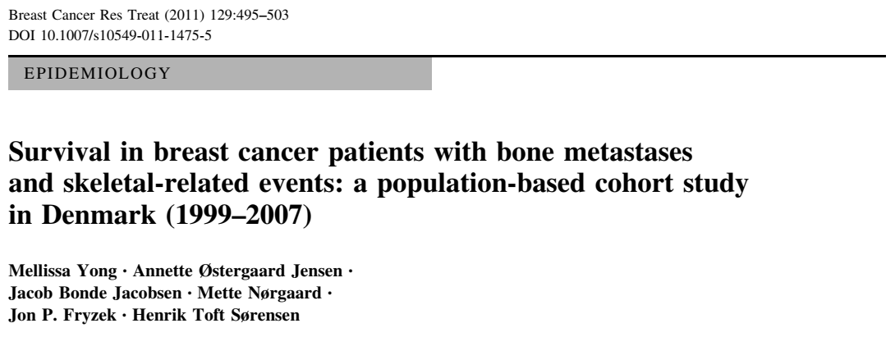
Rachana Shenoy
19/12/2018

Slide 4
Background
Breast cancer is the most common cancer in women in the world.
Bone is the most common site of metastasis.
Bisphosphonates are used to reduce skeletal-related events like pathological fractures in malignant bone disease.
How does presence of skeletal metastasis affect survival in patients with breast cancer?

Slide 5
Study question
What are the estimates of survival in breast cancer patients who develop bone metastases and SREs?
(SRE- Pathological fractures, spinal cord compression, bone pain requiring palliative radiotherapy, and orthopedic surgery)

Slide 6
Nationwide population-based cohort study in Denmark
Population- all the patients with a recorded first primary
diagnosis of breast cancer
Exposure- Skeletal metastasis in patients with breast cancer
Outcome- Survival
Time period- 1999 and 2007

Slide 7
Methods
Electronic data on all inpatient, outpatient, and emergency room visit from the Danish National Patient Registry (DNPR).
Breast cancer patients were identified using ICD-10 code C50.x.
Information on the diagnosis of bone metastases was obtained through ICD-10 code: C79.5.

Slide 8
For each patient, the following were recorded-
radiation to the bone given within 90 days after a bone metastasis diagnosis
(2) pathological or osteoporotic fractures in relation with a bone metastasis diagnosis
(3) surgery to the bone
(4) hypercalcaemia
(5) spinal cord compression in conjunction with a bone metastasis diagnosis

Slide 9
Linking of DNPR with Danish Cancer Registry to obtain data on treatment at diagnosis- endocrine therapy or chemotherapy.
Receptor status was obtained from the Danish Pathology Registry.
Addressing comorbidities- defined by the Charlson Index
  0—‘‘low’’ or no recorded underlying disease
  1–2—‘‘medium’’
  and >2—‘‘high’’

Slide 10
Statistical analysis
Follow-up began at date of breast cancer diagnosis with patients contributing time-at-risk within each cohort.
If patients developed a bone metastasis or an SRE, then they stopped contributing time-at-risk for their respective cohort.
1- and 5-year survival rates for each cohort and computed crude mortality rates (deaths per 1,000 person-years were calculated.

Slide 11
A Cox’s proportional regression analysis was used to compute mortality rate ratios (MRRs) and associated 95% confidence intervals (CIs), comparing mortality rates between patients by the presence of bone metastases with and
without SREs as time-varying covariates, adjusting for age and level of comorbidity.
Stratification according to stage, therapy received, receptor status and corresponding subset analysis was also done.

Slide 12
How serious is the risk of bias?
Were the sample of patients representative?
Yes

Slide 13
Cohort (n) | Median age (range) in years
All patients with breast cancer (n=35,912) | 62 (18–104)
Breast cancer with bone metastasis(n=1,494 ) | 61 (25–95)
Breast cancer with bone metastasis and SRE(n=722) | 62 (25–95)

Slide 14
Were patients classified into prognostically homogeneous groups?
Yes, they were stratified according to age, comorbid condition, therapy received, receptor status and stage.

Slide 15
Was follow-up sufficiently complete?
Yes

Slide 16
Were outcome criteria objective and unbiased?
Yes, defined clearly.

Slide 17
What are the results?
Both 1- and 5-year survivals were low for breast cancer patients with both bone metastases and SREs [1-year survival = 40.2 (32.8–47.4%); 5-year survival = 2.5 (95% CI 1.8–3.5%)].
The median survival for breast cancer patients
with bone metastases was 16 months, and the median survival for breast cancer patients with bone metastases and a subsequent SRE was 7 months.

Slide 18
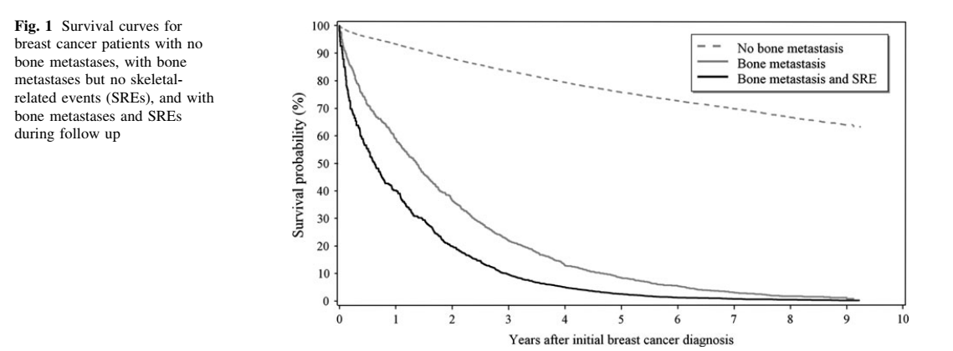
How likely are the outcomes over time?

Slide 19
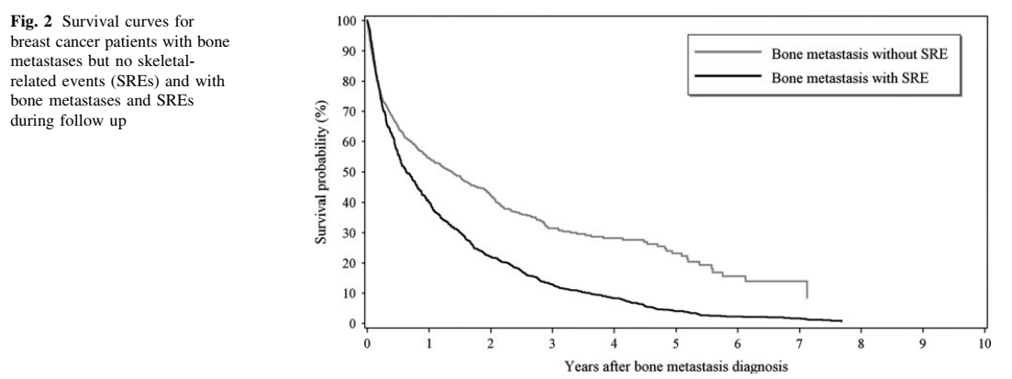

Slide 20
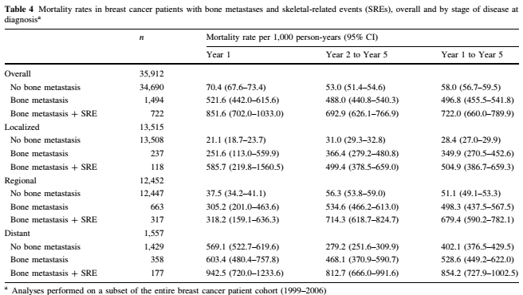
How precise are the estimates of likelihood?

Slide 21
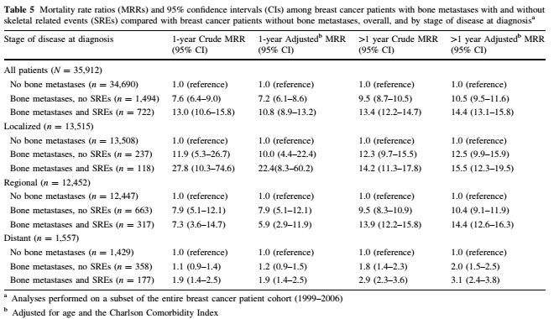
Did the presence of comorbidities affect survival?

Slide 22
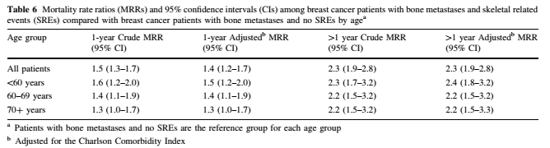
Did age affect survival?

Slide 23
Did receptor status affect survival?
HER 2 positivity increased mortality- data not shown.

Slide 24
Conclusion
Patients with Breast cancer and skeletal metastasis had a poorer prognosis compared to those with no bone disease.
Among these patients, presence of SRE was associated with higher mortality.
So is there a role for aggressive interventions to prevent SRE?

Slide 25
Limitations
Role of bisphosphonate use not assessed.
Potential for under-coding, especially in very sick patients with multiple other problems.
Assessment of comorbidity based on an index and not clinical.
? Role of other metastasis in addition to skeletal metastasis
No comment on response to therapy.

Slide 26
How can I apply the results to patient care?
Were the study patients and their management similar to those in my practice?
Yes

Slide 27
Was the follow-up sufficiently long?
Yes

Slide 28
Can I use the results in the management patients in my practice?
Yes, it is a nation-wide study including the entire population of breast cancer patients, followed up for a long period and all patients received standard of care, free NHS-based treatment.

