Slide 1
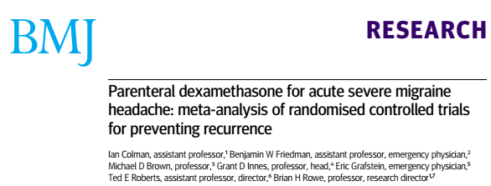

Slide 2
INTRODUCTION
Migraine is a common and disabling health problem among adults.
Surveys from around the world suggest that 6% of men and 15-17% of women experience migraine headaches.
These headaches cause major disability.
49% of people treated for migraine headache in the emergency department had a recurrent headache within 24 hours.

Slide 3
CLINICAL QUESTION
To assess the effectiveness and tolerability of parenteral corticosteroids for the relief of acute migraine headache in adults and the prevention of recurrence.

Slide 4
PICOT
P= Patients >/= 18 years of age with acute severe migraine
I= Parenteral corticosteroids (IM or IV ) + standared migraine abortive care
C= Placebo + standared migraine abortive care
O=
  Primary- Recurrence of migraine headache within 24 to 72 hours of treatment.
  Secoondary-
    Reduction in headache pain after treatment on a 10 cm visual analogue scale.
    Adverse events associated with the treatment
Design- RCT

Slide 5
Are the results valid?
Did the review explicitly address a sensible question?
  Role of steroids in migraine.
    Similar treatment effects across range of population.
    Focussed question.

Slide 6
Was the search for relevant studies detailed and exhaustive?
Searched Cochrane Central Register of Controlled Trials, Medline, Embase, LILACS, and CINAHL
Searched conference proceedings from major meetings on neurology, headache, and emergency medicine for the past 10 years
Reviewed clinical practice guidelines for the management of acute migraine
Searched websites housing clinical trial details, theses, or dissertations; and contacted pharmaceutical companies, authors of previously identified studies, and experts in headache
Searched the reference lists of potentially relevant studies to identify additional studies.
Language of publication and non-publication were not reasons for exclusion.

Slide 7
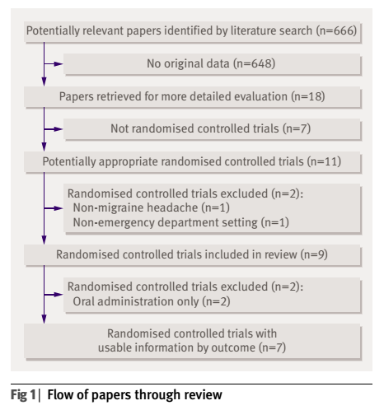
2 independent reviewers reviewed the full manuscripts for possible inclusion.
Unpublished studies- included
2 RCTs were abstracts whose study data were acquired through correspondence with the main author.

Slide 8
Were the primary studies of high methodologic quality?
Internal validity of individual trials assessed using Jadad’s scale.
Evaluates the reported randomisation, blinding, and withdrawals in a clinical
trial
Assigns a score from 0 to 5, with higher scores indicating higher quality in the conduct or reporting of the trial.

Slide 9
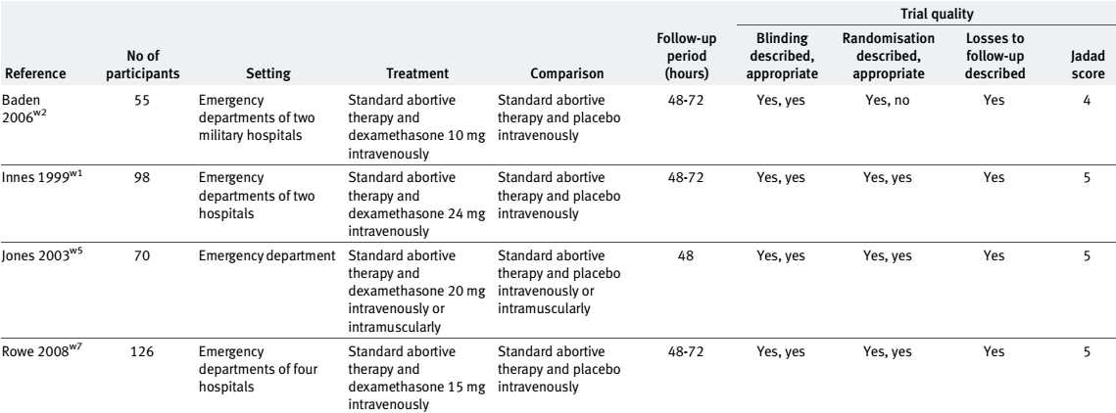

Slide 10
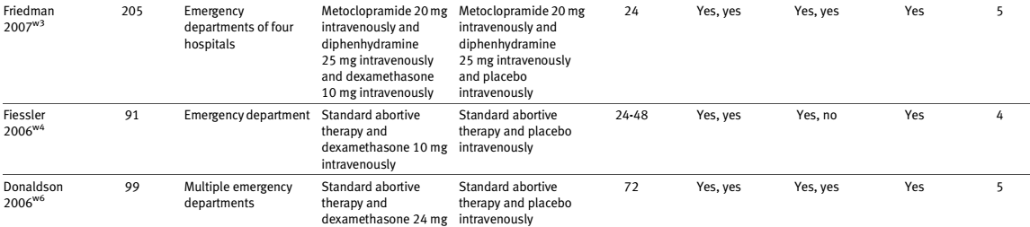

Slide 11
Were the assessments of the included studies reproducible?
2 independent reviewers screened the titles and abstracts of eligible studies.
Atleast 2 independent reviewers reviewed the full manuscripts for possible inclusion.
Disagreements were resolved through discussion.

Slide 12
Credibility of the systematic review process
Did the review explicitly address a sensible clinical question? Yes
Was the search for relevant studies exhaustive? Yes
Was the risk of bias of the primary studies assessed? Yes
Did the review address possible explanations of between-study differences in results? Yes
Did the review present results that are ready for clinical application? Yes
Were selection and assessments of studies reproducible? Yes

Slide 13
What are the results?
What are the overall results of the study?

Slide 14
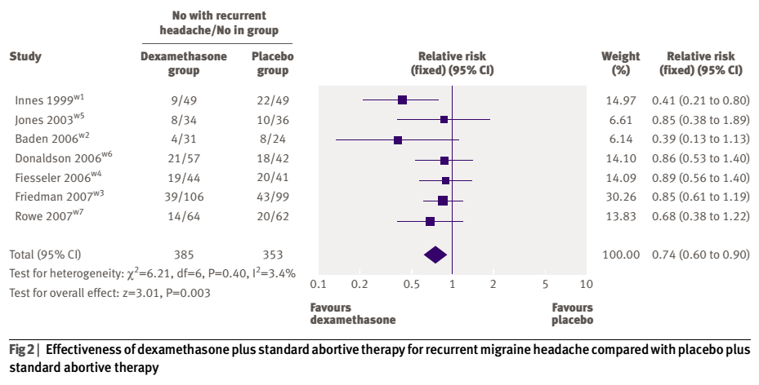
RRR= 26%

Slide 15
Dexamethasone arm
Total patients with recurrent headache- 114
Total- 385
Event rate of recurrent headache= 114/385= 0.296
  Placebo arm
  Total patients with recurrent headache- 141
  Total- 353
  Event rate of recurrent headache= 141/353= 0.399

Slide 16
ARR= 0.296- 0.399 =0.103
NNT= 1/0.103= 9.7

Slide 17
Headache
No benefit in initial pain reduction for those treatments that included dexamethasone compared with placebo
Weighted mean difference 0.37
95% confidence interval (−0.20 to 0.94)
This study pooling demonstrated moderate heterogeneity (I²=46.2%)

Slide 18
Subgroup analyses
Forty seven patients in one study received treatment intramuscularly,
Subgroup comparison
  IM versus IV
  47 versus 592
  No significant differences were found between
    Intramuscular administration (relative risk 0.59, 0.19 to 1.81)
    Intravenous administration (relative risk 0.75, 0.61 to 0.91).

Slide 19
Sensitivity analysis
Primary results were not influenced by the use of fixed effect models compared with random effect models, high quality studies compared with low quality studies, or odds ratios compared with relative risks.

Slide 20
How precise are the results?
  Narrow confidence interval.
Were the results similar from study to study?
  Yes.
  I² = 3.4%

Slide 21
Adverse events

Slide 22
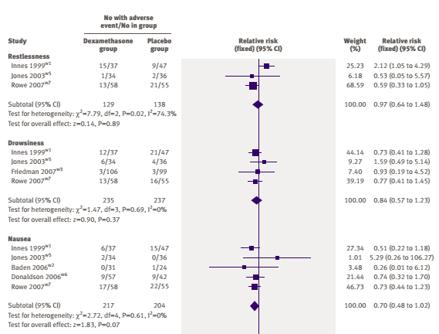

Slide 23
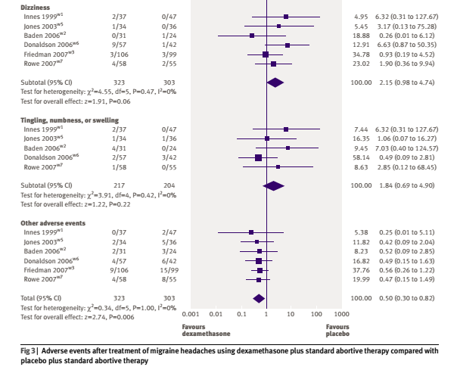

Slide 24
Will the results help me in caring for my patients?
How can I best interpret the results to apply them to the care of my patients?
  Study was done in ED.
  Majority of headache and migraine patients come to OPD.
Were all patient important outcomes considered?
  Yes
  Looked at adverse events.
Are the benefits worth the costs and potential risks?
  Yes
  NNT= 9

Slide 25
Conclusion
When added to standard abortive migraine therapy, single dose parenteral dexamethasone is associated with
  26% relative reduction in recurrent headache
  NNT=9 occurring within 72 hours

