Slide 1
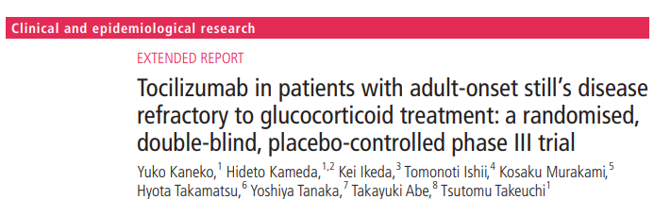
Critical Appraisal of an RCT
Jasper Rathinam J

Slide 2
Background
AOSD – Systemic Inflammatory disorder of unknown etiology.
Steroid therapy – current standard – frequent poor response and complications
Upcoming biological therapies
Very good response in similar syndromes.
Lack of RCT in Still’s Disease

Slide 3
PICOT STATEMENT
P – Patients > 20 yrs of age with Stills Disease with inadequate response to steroids for 2 weeks
I –receive intravenous tocilizumab at a dose of 8 mg/kg
C – Placebo in phase 1,2 and Tocilizumab in phase 3
O – ACR 50 at 4 weeks and 12 weeks
T – Upto 52 weeks
Site : Multicentric study in Japan

Slide 4
STUDY DESIGN
This multicentre, randomised, double-blind, placebo-controlled phase III trial was conducted at eight centres in Japan as an investigator-initiated phase III trial and consisted of three parts:
part 1, a randomised, double-blind, placebo-controlled 4-week phase with a fixed dose of glucocorticoids
part 2, continued double-blind, placebo-controlled, 8-week phase with a conditional decrease in glucocorticoid dose
part 3, a single, openlabel, 40-week phase.

Slide 5
Was the study population clearly defined?
INCLUSION CRITERIA
Eligible patients were 20 years or older with disease onset at more than 15 years old who had been diagnosed with adultonset Still’s disease with Yamaguchi criteria
And had shown inadequate response to more than 2 weeks of glucocorticoids equivalent to at least 0.5 mg/kg/day of prednisolone, with a stable dose of current glucocorticoids equivalent to 10 mg/day of prednisolone for at least 2 weeks.

Slide 6
Was the study population clearly defined?
INCLUSION CRITERIA
They had atleast 2 swollen joints and atleast one systemic feature score.
Patients’ blood tests showed erythrocyte sedimentation rate of at least 20 mm/hour or C reactive protein of at least 1.0 mg/dL.

Slide 7
Was the study population clearly defined?
EXCLUSION CRITERIA:
Received any other immunotherapy in the last 2 weeks
Received any biological therapy in the last 12 weeks.
Patients were excluded if they had important concurrent medical or surgical disorders, including leucocytopaenia (5 times of an upper limit of each site), elevated total bilirubin (>3 times of an upper limit of each site), serious disease assessed by investigators as inappropriate and a history of malignancy within 5 years.
All patients were examined for active infections, especially viral hepatitis and tuberculosis

Slide 8
Were the outcome measures clearly defined?
The Co primary outcome was ACR 50 at 4 weeks, 12 weeks
Secondary Outcomes – ACR 20 , ACR 70 , Safety and individual systemic features scores
Safety Outcomes – Monitored for 1 year

Slide 9
Did the intervention and control groups start with the same prognosis?
Differences in baseline characters
Randomisation did not achieve well matched characters

Slide 10
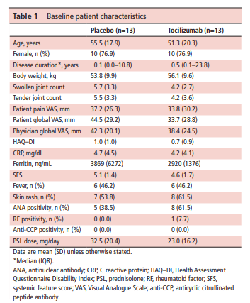

Slide 11
Were the patients randomized?
Yes
Randomization was 1:1 and was performed with the use Central Automatic System

Slide 12
Was the randomisation concealed ?
Yes
Allocation was concealed

Slide 13
Were the patients in the study groups similar in known prognostic variables?
Yes , all prognostic variables

Slide 14
Was the effect of the standard treatment preserved?
Steroids were continued
No other immunotherapy was allowed during the study

Slide 15
To what extent was the study blinded
Investigators: Yes
Treating Physicians: Yes
Patients: Yes
Monitors( committee analyzing outcomes): No
Data analysis: No

Slide 16
Were the groups prognostically balanced at the study completion?
Mostly unchanged through the study

Slide 17
Was the follow up complete?
Yes the follow up was complete

Slide 18
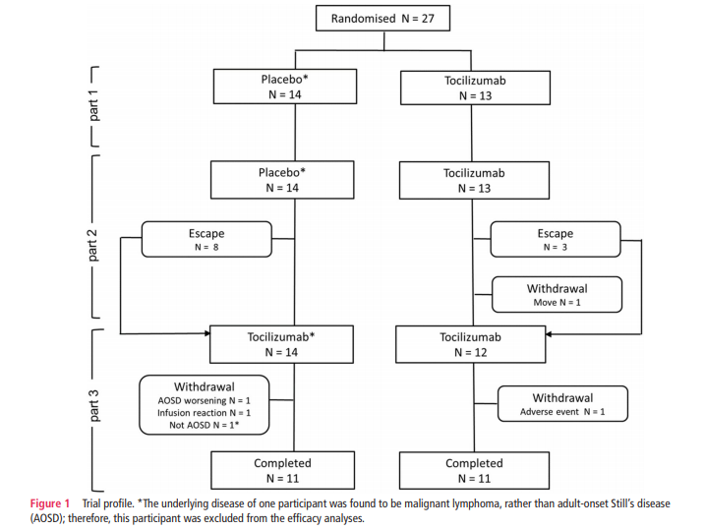

Slide 19
Were the patients analysed in the groups to which they were randomized?
Yes
Very Few numbers in both sides lost to follow up
Intention to treat Analysis was done

Slide 20
Was the study stopped prematurely?
Yes
Targets not achieved – sample size
Sample size calculation recently changed

Slide 21
Were adequate number of people included in the study?
In the protocol, sample size calculation was based on the first of the coprimary endpoints, the proportion of patients who achieved ACR50 at week 4. The ACR50 response rate was assumed to be 65% in the tocilizumab group and 15% in the placebo group, in reference to the trials in patients with juvenile idiopathic arthritis. Under these assumptions, 17 patients were needed in each group to have power of 80% with a two-tailed significance level of 5%.
As study was going slowly ACR 50 was changed to 80% and SS was reduced To 12 in each groups

Slide 22
Validity of the study
Study population: well defined
Outcomes: clearly defined
Randomization: adequate
Blinding: Adequate
Sample size calculation: appropriate but changed
Intention treat analysis: done
Baseline characteristics: not well matched

Slide 23
RESULTS
At week 4, 61.5%(8 of 13, 95% CI 31.6 to 86.1) of patients who received tocilizumab had an ACR50 response, compared with 30.8% (4of 13, 9.1–61.4) of patients who received placebo (p=0.238,
two-tailed Fisher’s exact test
12 week outcomes were similar

Slide 24
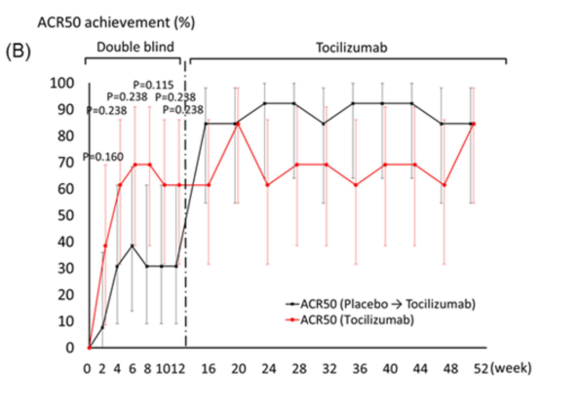
ACR 50 response rates

Slide 25
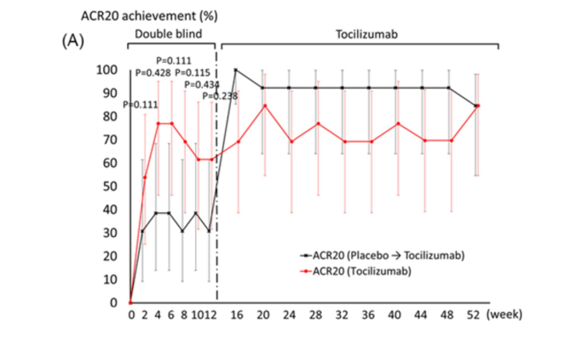
ACR 20 response

Slide 26
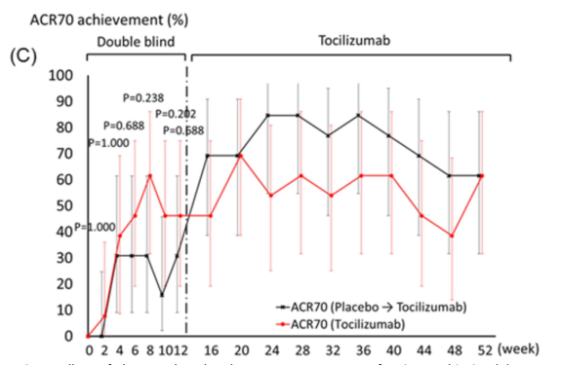
ACR70 Response Rates

Slide 27
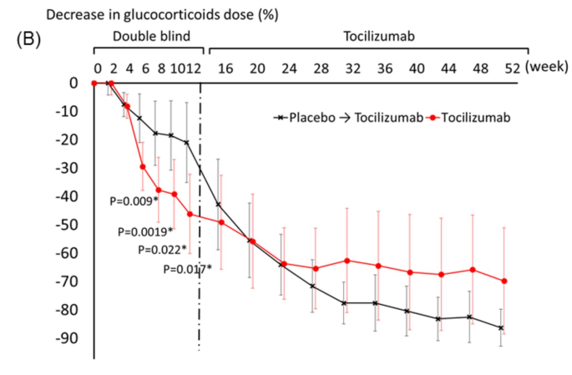

Slide 28
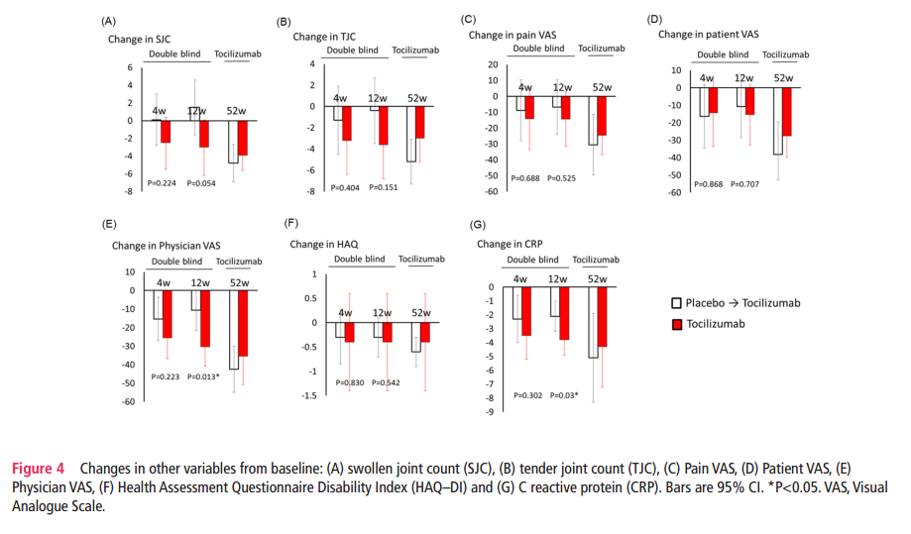

Slide 29
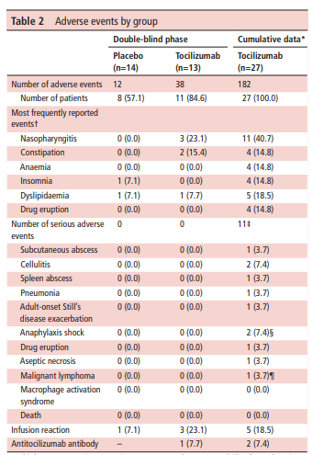
Adverse Events

Slide 30
Were the Study Patients similar to my patients in practice?
Predominantly similar
Difference in Race
Frequent Financial Constraints in our setting

Slide 31
Were all patient-important outcomes considered?
Yes
No mortality associated with AOSD during the disease

Slide 32
Are the likely advantages of the novel treatment worth the potential harms and costs?
CER – 30.8%
EER - 61.5%
ARR- 30.7%
NNT – 100/30.7 – 3.3
Cost – 32K for 400 mg( 2 weekly dose)
Cost 1 year : 7.68Lakhs
In our setting - ?? Cost effective

Slide 33
THANK YOU

