Slide 1
Critical Appraisal of a Case Control Study
Anil Mathew Philip

Slide 2
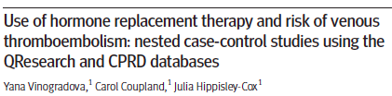

Slide 3
Background
Venous thromboembolism (VTE) is a rare but serious risk associated with hormone replacement therapy (HRT)
HRT is used to prevent a range of symptoms experienced by many women during the menopause, such as hot flushes and night sweats
Previous Cochrane meta analysis, have not shown consistent results to show increased risk of VTE with HRT

Slide 4
Aim
To assess the associations between VTE risk and all available types of HRT in the general female population in UK between 1998 and 2017

Slide 5
PICOT
Population: open cohorts of women aged 40-79 years and registered with study practices(CPRD/Qresearch)
Cases: we identified cases of incident VTE recorded
Controls: matched each case to up to five controls from the same practice and by year of birth
Outcome: To see what was incidence of the VTE patients had exposure to HRT
Timeline: between Jan 1998 and Feb 2017

Slide 6
Study Design
Nested case- control study, using the 2 UK primary care research data bases: Qresearch and Clinical Practice research Datalink(CPRD), between January 1998 and February 2017

Slide 7
Inclusion Criteria:
Age of 47 -79 years
Female
Exclusion criteria:
Women with a history of previous VTE
Less than one year of medical records

Slide 8
Statistical Analysis
We used conditional logistic regression adjusted for the confounders to estimate odds ratios and to assess associations between HRT exposure and VTE risk
To account for multiple comparisons, we chose a 1% significance level and calculated 95% confidence intervals

Slide 9
Are the Results Valid?
Did the cases and control group have the same risk (chance) for being exposed in the past?

Slide 10
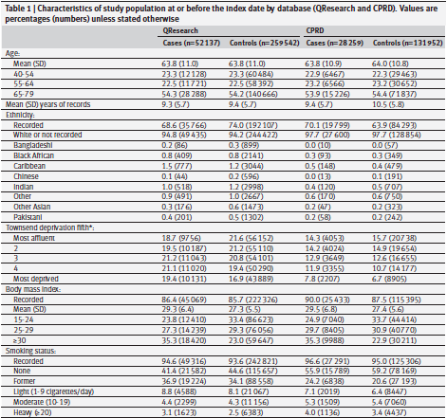

Slide 11
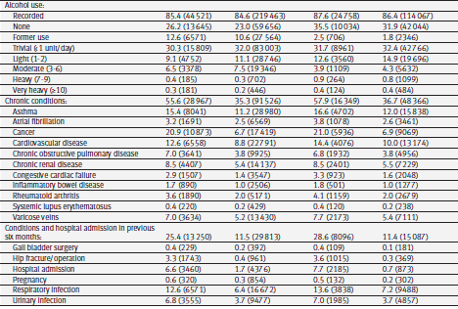
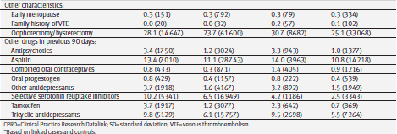

Slide 12
What are the Results?

Slide 13
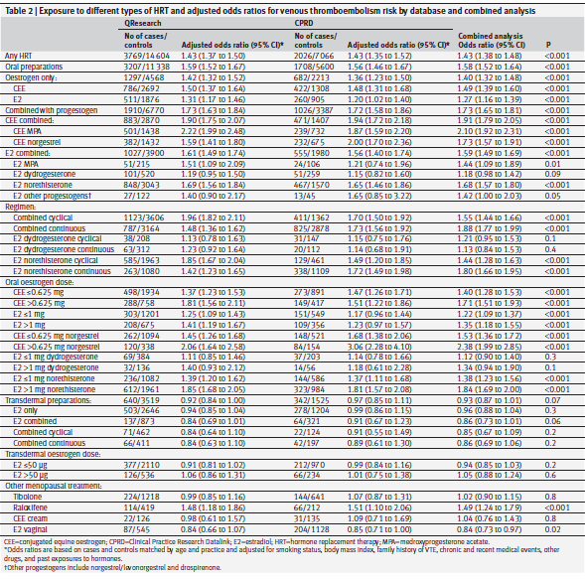

Slide 14
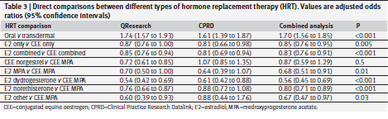

Slide 15
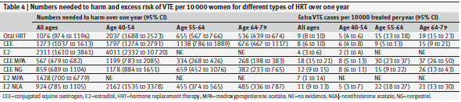

Slide 16
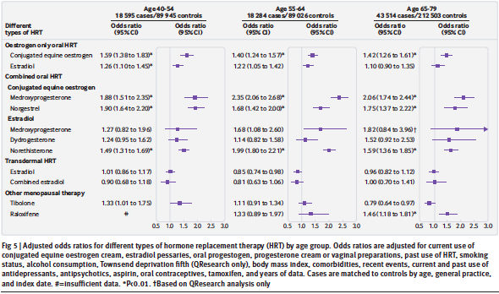

Slide 17
How strong is the association between exposure and outcome?
Odd Ratio of 1.70
How precise is the estimate of risk?
Confidence Interval was 1.56- 1.85

Slide 18
How can I apply the results to my patient care?
Were the study patients similar to patients in my practice?
This was a study done in UK
The highest number of patients included was ages between 65-79

Slide 19
Was the duration of follow up adequate?
Have not mentioned a specific follow up period. But have said a minimum of 1 year follow up in records

Slide 20
Is the exposure similar to what might occur in my patient?
No, HRT is till not being widely prescribed to patients with PMS.

Slide 21
Are the benefits that offset the risks of the exposure?

Slide 22
Conclusion
In our patient population HRT is still not being used routinely.
In patients who are receiving therapy there is an association of VTE with HRT, more with Conjugated Equine Estrogen. Which was much less with Transdermal HRT, hence would prescribe the later if needed.

