Slide 1
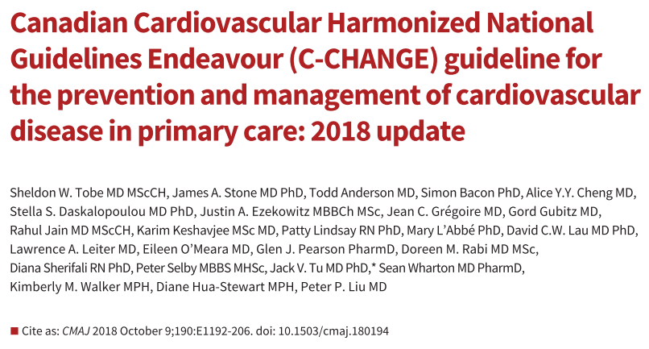
Jemin J Webster
CEU 31-1-2019

Slide 2
Introduction
The C-CHANGE guideline is a composite of nine of Canada’s cardiovascular-focused clinical practice guidelines
To meet primary care need
Managing patients with multiple comorbidities.
Notes:
The Canadian Cardiovascular Harmonized National
Guideline Endeavour (C-CHANGE) is a nationally
endorsed guideline process, targeting primary care
health care practitioners. The C-CHANGE guideline is a composite
of nine of Canada’s cardiovascular-focused clinical practice
guidelines (Table 1),

Slide 3
AGREE II

Slide 4
Domain 1. Scope and Purpose
Are the overall objectives of the guideline are specifically described?
  Chosen to meet primary care needs, managing patients with multiple comorbidities.
Health intent- Diagnosis and management of multiple commorbidity primary care setting.
Targets
  Audience- Primary health care providers
  Population- Canadian adults who have or are at risk of developing chronic cardiovascular diseases
Score- 6
Notes:
caring for Canadian adults who have or are at risk of developing chronic cardiovascular diseases, including hypertension, diabetes, dyslipidemia, heart failure and stroke, and the risk factors for these conditions, including smoking, obesity and physical inactivity.

Slide 5
Are the health questions covered by the guideline specifically described?
  Yes
Target population- mentioned
Intervention- mentioned.
Health care setting or context- mentioned
Score- 6

Slide 6
Are the population (patients, public, etc.) to whom the guideline is meant to apply specifically described?
  Yes
Target population- Mentioned
Gender and age- Mentioned
Clinical condition- mentioned
Severity/stage of disease- Mentioned
Excluded population- Not mentioned
Score- 7

Slide 7
Domain 2. Stakeholder Involvement
Does the guideline development group include individuals from all relevant professional groups? Yes
Name- Mentioned
Discipline/content expertise- Mentioned
Description of the member’s role in the guideline development group- Mentioned
Score-6

Slide 8
Have the views and preferences of the target population (patients, public, etc.) been sought?
  No
Score- 2

Slide 9
Are the target users of the guideline clearly defined?
  Yes
Clear description of intended guideline audience- Yes
Description of how the guideline may be used by its target audience- Yes
Score- 7

Slide 10
Domain 3. Rigour of Development
Were systematic methods used to search for evidence?
  Yes, AGREE II tool for all the guidelines included.
Not included other languages
Not reviewed conference proceedings
Time period searched- Upto 2017
Search terms- Not specified.
Full search strategy- not mentioned
Not mentioned regarding conflict resolution.
Score- 5

Slide 11
Were the criteria for selecting the evidence clearly described ?
  Yes.
The relevant population, management startegies were described in general but not in specific for each question.
Not compared one treatment strategy with the other
Score- 3.
Notes:
Every effort is made to reduce the number of recommendations that are based on consensus opinion only, but these are still considered strong recommendations, as most people would follow the expert opinion where sufficient evidence does not exist
For drug and device recommendations, the highest level of evidence is required from randomized controlled trials of hard outcomes with adequate power and appropriate internal and external validity
7
Health behavior change and diagnostic recommendations can have evidence with surrogate outcomes

Slide 12
Were the strengths and limitations of the body of evidence clearly described ?
  Not mentioned
Study design- Not mentioned -
Study methodology limitations (sampling, blinding, allocation concealment, analytical methods)- Not mentioned
Consistency of results across studies- Not mentioned
Direction of results across studies- Not mentioned
Magnitude of benefit versus magnitude of harm- Not mentioned
Score- 2

Slide 13
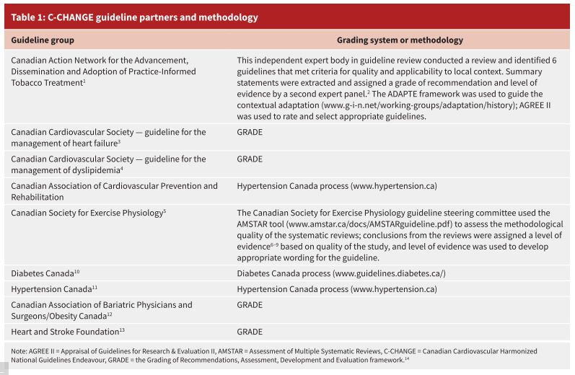

Slide 14
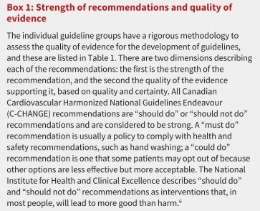
Were the methods for formulating the recommendations clearly
described?
  No
Quality of evidence for each have been mentioned.
Score- 4

Slide 15
Have the health benefits, side effects, and risks been considered in formulating the recommendations?
  No
Adverse effects not mentioned
Comparison between various treatment options are mentioned- not mentioned
Score- 4.

Slide 16
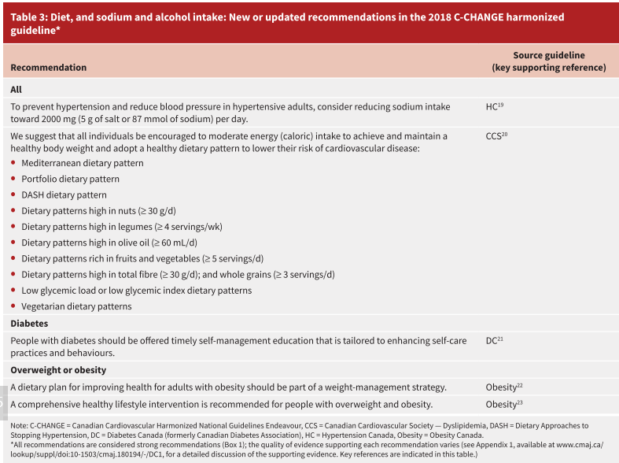

Slide 17
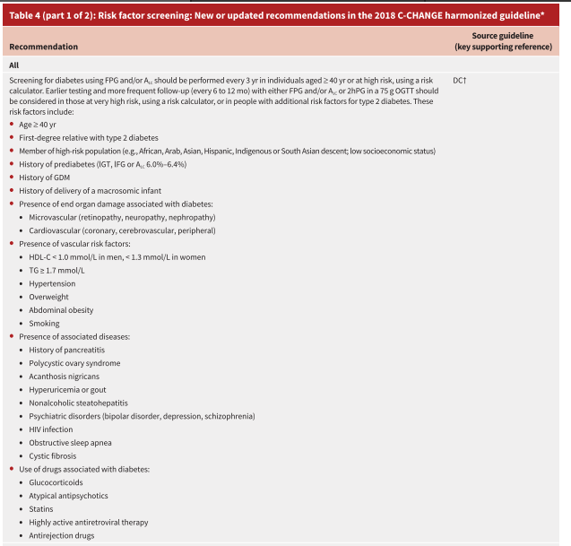
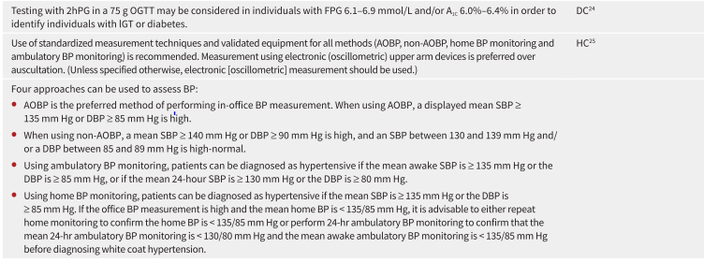

Slide 18
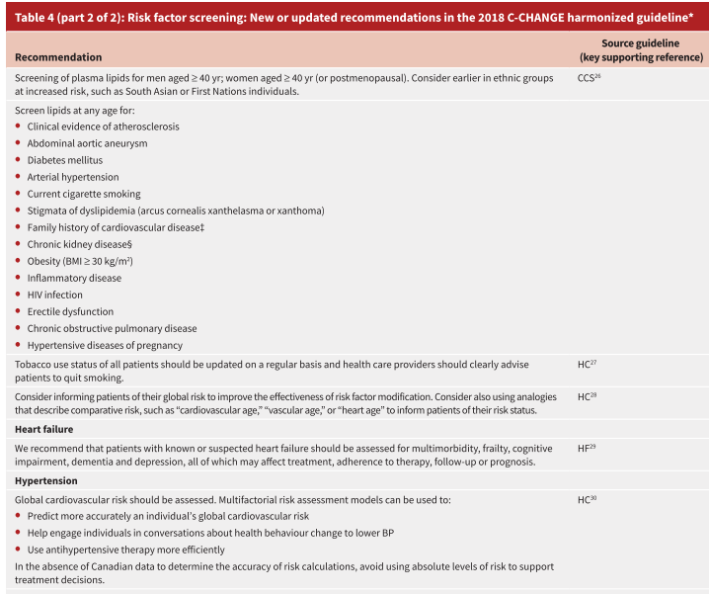
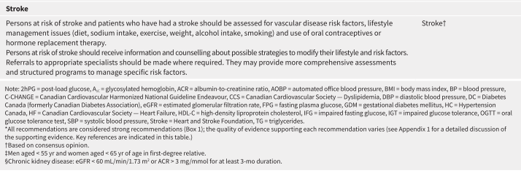

Slide 19
Is there an explicit link between the recommendations and the
supporting evidence?
  References for supporting evidence for each recommendation are not mentioned and easily identifiable for the user.
Score- 5.

Slide 20
Has the guideline been externally reviewed by experts prior to its
publication?
  Not mentioned.
Score- 1

Slide 21
Is there a provision for updating the guideline?
  Yes, current one is an update
  The next update of the C-CHANGE guideline is projected to be 2021,
Score- 7

Slide 22
Domain 4. Clarity of Presentation
Are the recommendations specific and unambiguous?
Yes
Score- 6

Slide 23
Are the different options for management of the condition or health issue clearly presented?
  Yes
Score- 6

Slide 24
Were the key recommendations easily identifiable?
  Yes
  Summary given.
Score- 7

Slide 25
Domain 5. Applicability
Does the guideline describes facilitators and barriers to its application ?
  Not mentioned
Score-2
Notes:
• identification of the types of facilitators and barriers that were considered
• methods by which information regarding the facilitators and barriers to implementing recommendations were
sought (e.g., feedback from key stakeholders, pilot testing of guidelines before widespread implementation)
• information/description of the types of facilitators and barriers that emerged from the inquiry (e.g.,
practitioners have the skills to deliver the recommended care, sufficient equipment is not available to ensure all
eligible members of the population receive mammography)
• description of how the information influenced the guideline development process and/or formation of the
recommendations

Slide 26
Does the guideline provide advice and/or tools on how the
recommendations can be put into practice?
  Guidelines summary mentioned.
  Flow diagram not given.
  No pilot test done.
Score- 5.

Slide 27
Have the potential resource implications of applying the recommendations have been considered?
  Not mentioned
Score- 3
Notes:
• identification of the types of cost information that were considered (e.g., economic evaluations, drug
acquisition costs)
• methods by which the cost information was sought (e.g., a health economist was part of the guideline
development panel, use of health technology assessments for specific drugs, etc.)
• information/description of the cost information that emerged from the inquiry (e.g., specific drug acquisition
costs per treatment course)
• description of how the information gathered was used to inform the guideline development process and/or
formation of the recommendation

Slide 28
Does the guideline present monitoring and/or auditing criteria?
  Not mentioned
Score- 2
Notes:
dentification of criteria to assess guideline implementation or adherence to recommendations
• criteria for assessing impact of implementing the recommendations
• advice on the frequency and interval of measurement
• descriptions or operational definitions of how the criteria should be measured

Slide 29
Domain 6. Editorial Independence
Has the views of the funding body influenced the content of the guideline?
  The C-CHANGE implementation tools and activities were funded by the Public Health Agency of Canada.
  Other guideline recommendation funding not mentioned.
Score- 3

Slide 30
Has competing interests of guideline development group members been recorded and addressed?
  Yes.
Score- 6

Slide 31
RATE THE OVERALL QUALITY OF THE GUIDELINE
4
I would recommend the guidelines with modifications.

