Slide 1
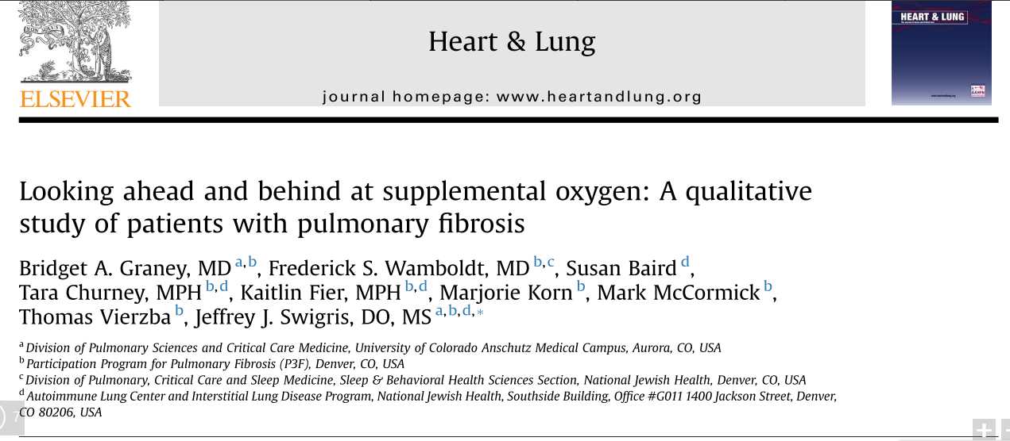

Slide 2
Background
Pulmonary fibrosis (PF) -progressive, debilitating shortness of breath, fatigue and poor quality of life (QOL)
O2 is ubiquitously prescribed for PF patients, little is known about how well these intended goals are met.
Notes:
Patients with pulmonary fibrosis (PF) face myriad challenges
including progressive, debilitating shortness of breath, fatigue and poor quality of life (QOL)
Although O2 is ubiquitously prescribed for PF patients, little is known about how well these intended goals are met.

Slide 3
P- Patients with PF of any etiology, greater than 18 years of age, not using O2 and able to speak and read English.
I- Structured telephone interviews
O- Understand the perceptions and experiences of patients
T- 9-12 months.

Slide 4
Validity Criteria
Was the choice of participants explicit and comprehensive?
No
Only patients were interviewed.
Care taker/family member, clinician were not included.
Pulmonary rehabilitation representative, oxygen suppliers.
Notes:
interviewed 40 participants at enrollment. Five of these 40 ended up being prescribed O2 and were interviewed at the three other timepoints.
40 patient were followed with PF, only 5 needed O2 supplementation for whom the qualitative data are available.

Slide 5
Validity Criteria
Was data collection sufficiently comprehensive and detailed?
No.
Collected data at four time point.
1) enrollment; 2) 7-10 days prior to initiation of 3) one month after initiation of O2; and 4) 9-12 months after initiation ofO2
University of California San Diego Shortness of Breath Questionnaire (UCSD); Version 1 of the Medical Outcomes Study Short-Form 36-item instrument (SF-36) and the Fatigue Severity Scale (FSS).
Notes:
For the longitudinal study, data were collected at four time
points: 1) enrollment;
2) 7e10 days prior to initiation of O2 (participants informed us when O2 was prescribed by their treating physicians, and data were conducted before use of O2 began); 3) one month after initiation of O2; and 4) 9e12 months after initiation ofO2. Since we did not know which participants would end up being prescribed O2, we interviewed 40 participants at enrollment. Five of these 40 ended up being prescribed O2 and were interviewed at the three other timepoints. In each case, the decision to prescribe O2 was made solely by the participant’s treating physician who was not a member of the research team.
The UCSD is a 24-item questionnaire with 21 items asking respondents to rate dyspnea while performing physical activities across a range ofenergy demands and 3 additional items that assess the impact of dyspnea.6 UCSD scores range from 0 to 120; higher scores indicate greater dyspnea. The UCSD has been shown to possess adequate reliability, validity and responsiveness in PF.7
The SF-36 is a generic health-related QOL (HRQL) questionnaire with eight domain and two component summary scores (physical and mental or PCS and MCS). Here, we report results for the component summaries. Each domain and component score was transformed to a scale in which respondents from the 1998 U.S. general population had a mean of50 and a standard deviation of10. Higher scores indicate greater HRQL.8 The SF-36 has been shown to possess validity in patients with PF.9
The FSS is a 9-item questionnaire, scored from 9 to 63, with higher scores indicating more severe fatigue. There are no published data on the psychometric properties of the FSS in PF.

Slide 6
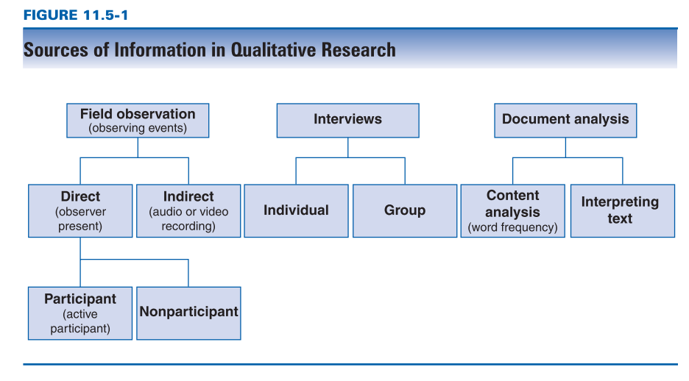

Slide 7
Validity Criteria
Were the data analyzed appropriately and the findings corroborated adequately?
Yes.
Thematic analysis- Interviews were Grouped timepoints and read by two analyst.
They created categories and themes to describe the related codes.
Frameworks- Looking ahead-anticipation / looking behind- reflection.
Notes:
For the thematic analysis, interviews were initially grouped by
time point and then read several times by the two analysts (B.A.G., J.J.S.) to become familiar with the data, achieve immersion and formulate initial impressions.
we focused on creating categories and ultimately themes to describe clusters ofrelated codes.We developed a
framework for describing how patients with pulmonary fibrosis look at O2, either in anticipation (“looking ahead”)orreflection (“looking behind”).

Slide 8
Study Results
What are the results of the study?

Slide 9
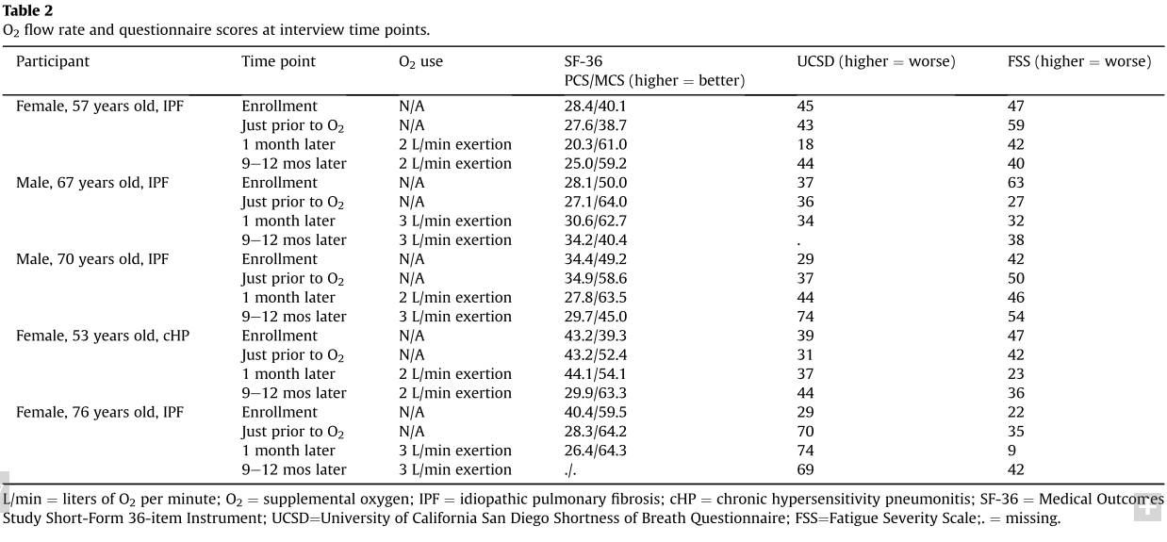

Slide 10
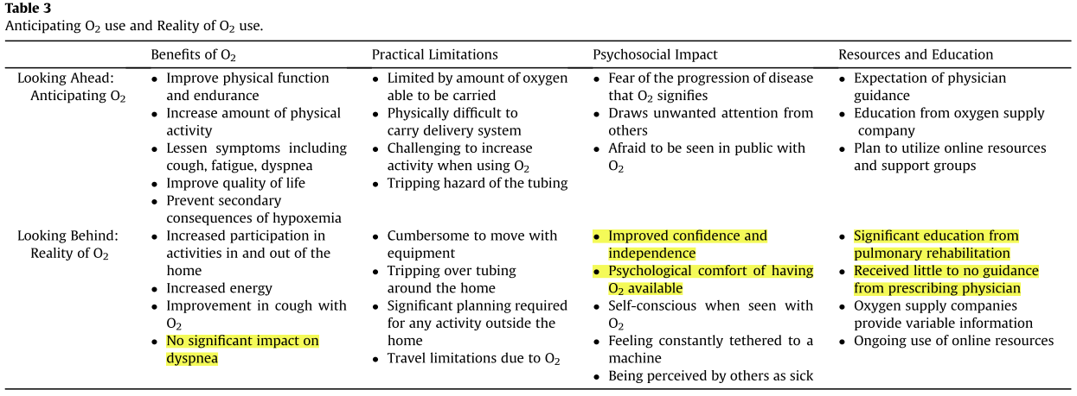

Slide 11
Applicability to Patient Care
Does the study offer helpful theoretical conclusions?
Yes.
Notes:
The process could be improved by providing them with clearer expectations and trustworthy educational resources. Oxygen case managers could help patients incorporate supplemental oxygen more seamlessly into their lives.
The findings of qualitative research are concepts (often referred to as categories) and relationships.

Slide 12
Applicability to Patient Care
Does the study help me understand the context of my practice?
Yes.

Slide 13
Applicability to Patient Care
Does this study help me understand my relationships with patients and their families?
No, only patient perspective was obtained.
Notes:
For patients with pulmonary fibrosis, starting and using supplemental oxygen on an everyday basis confers benefits
There are also a significant number of challenges.
This could be improved by providing them with clearer expectations and trustworthy educational resources.

