Slide 1
Critical Appraisal of an Economic Study
Jacob

Slide 2
Background
Despite the development of NOACs, warfarin remains an integral option in anti-coagulation management strategies.
Warfarin is a well-established medication with a relatively low cost.
However, it has significant expenses associated with the monitoring and management stage of the therapy.

Slide 3
Patient self-testing (PST) of warfarin therapy - concept of management at a primary care level.
The PST model involves the patient measuring their international normalized ratio (INR) levels using a portable point-of-care (POC) device.
Evidence ranging from randomized controlled trials (RCT), meta-analysis and full systematic reviews indicates that PST is associated with improved outcomes.
Notes:
Patient self-testing (PST) of warfarin therapy - concept which allows the management of warfarin therapy to move away from already overburdened hospital-based clinics to management at a primary care level.

Slide 4
Aim
Primary aim of this study was to determine the incremental cost-effectiveness of PST in comparison with usual care , patients with oral anticoagulations

Slide 5
PICOT
Population: Not mentioned
Intervention: Patient self testing of INR and adjustment by a research pharmacist
Control: Usual care (lab testing) with dose adjustment by Clinic doctor or nurse
Outcomes: Primary
The difference in the time in therapeutic range (TTR) between the two arms.
Study design: Prospective, randomized controlled crossover study.

Slide 6
Patients were initially assigned to either 6 months of routine care or 6 months of PST, crossover after 6 months
The primary outcome was the difference in the time in therapeutic range (TTR) between the two arms.
For the purposes of this trial, TTR was defined as the time spent within 0.5 units of the targeted INR value.

Slide 7
Are the results valid?

Slide 8
1. Did the recommendations consider all relevant patient groups, management options, and possible outcomes?
Did the investigators adopt a sufficiently broad viewpoint?
The cost analysis was done based on a health care provider perspective
Social perspective (direct and indirect)

Slide 9
b. Are results reported separately for relevant patient subgroups?
No sub groups in the study
Age/ Distance from the clinic/ Education/ physical impairment could have been the subgroups

Slide 10
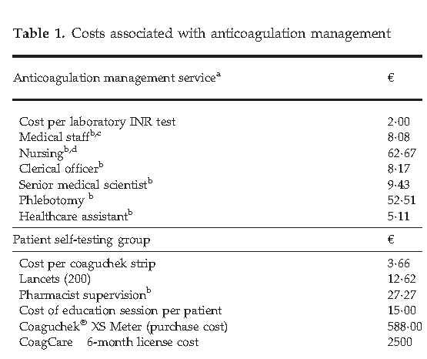
2. Is there a systematic review and summary of evidence linking options to outcomes for each relevant question?
Were costs measured accurately?
Yes
Pre published cost were used
Only direct was used in main
cost analysis
Societal perspective with added
Indirect costs were Shown
separately using local Validated
standards

Slide 11
b. Did investigators consider the timing of
costs and outcomes?
Study was done for 1 year

Slide 12
What are the results?

Slide 13
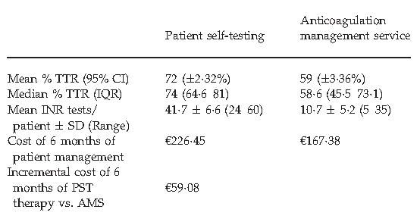
a. What were the incremental costs and effects of each strategy

Slide 14
b. Do incremental costs and effects differ between subgroups?
No sub groups in the study

Slide 15
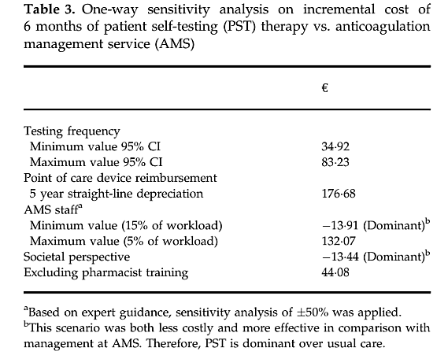
c. How much does allowance for uncertainty change the results?

Slide 16
How can I apply the results to patient care?

Slide 17
a. Are the treatment benefits worth the harms and the costs?
The current study showed a difference of 13% between
the means of both groups and a 15.4% difference between the two median values.
The Stroke Prevention Using Oral thrombin Inhibitor in Atrial Fibrillation (SPORTIF) III and SPORTIF V studies suggest that the incidence of death, major bleeding and stroke may be halved by a 15% improvement in TTR
Ultimately good control translates to benefit

Slide 18
Cost
Difference in the cost- 59.08 euro x 81= 4986 ₹ for 6 months

Slide 19
b. Can I expect similar costs in my setting?
Cost of manpower may be lower, but cost of the instruments and machine will be the same
POC will be relatively more costly in our setting compared with usual care

Slide 20
Conclusion
Cost- paid by patients
Complex procedure to do at at home for a illiterate, and verbal communication will be difficult
Not recommended in our setting

