Slide 1
CRITICAL ANALYSIS OF A DECISION ANALYTIC MODEL
Jasper Rathinam J

Slide 2
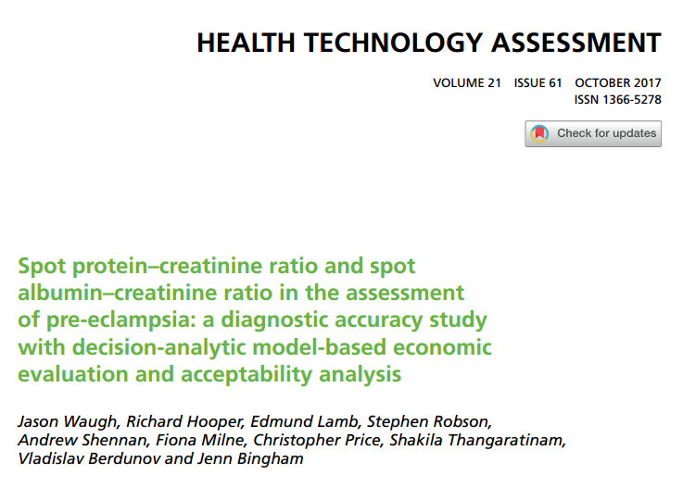

Slide 3
Background
Pre-eclampsia (PE) is a multisystem disorder of pregnancy associated with new raised blood pressure (BP) and proteinuria.
It remains the second leading cause of direct maternal deaths in the UK and causes 20% of all stillbirths
Lack of evidence relating both to the diagnosis of significant proteinuria in pregnant women and the prognostic value of various urinary protein thresholds
Guideline for the management of hypertensive disorders of pregnancy differentiates PE from gestational hypertension is by the presence of new significant proteinuria and it is critical in terms of monitoring and management, cost and outcomes.

Slide 4
Study Design
Patients : pregnant women aged ≥ 16 years, who were at > 20 weeks’ gestation with new hypertension (systolic BP of ≥ 140 mmHg and/or diastolic BP of ≥ 90 mmHg) and a trace or more proteinuria on an automated dipstick urinalysis
Investiation : SPCR , SACR
Gold Standard : 24 hour urine protein
Outcome : Diagnostic Accuracy , Economic Analysis , Decision Analysis
Time : 6 weeks

Slide 5
STUDY DESIGN – PRIMARY OBJECTIVE
The primary objective of the study was to evaluate the accuracy of quantitative assessments of spot protein–creatinine ratio (SPCR) and spot albumin–creatinine ratio (SACR) at different thresholds in predicting severe PE compared with 24-hour urine protein measurement in pregnant women with hypertension and suspected proteinuria

Slide 6
STUDY DESIGN – SECONDARY OBJECTIVES
Investigate differences between laboratory assay methods for 24-hour proteinuria estimation
Evaluate the accuracy of quantitative assessments of SPCR and SACR at different thresholds in predicting adverse perinatal outcomes
Estimate the diagnostic utility of SPCR or SACR tests as a potential replacement for 24-hour protein estimation by developing a decision-analytic model
Assess the cost-effectiveness using incremental cost per quality-adjusted life-year (QALY) gained by the mother and baby in each test compared with standard practice.

Slide 7
INCLUSION CRITERIA
Pregnant women aged ≥ 16 years
Who were at > 20 weeks’ gestation with new hypertension (systolic BP of ≥ 140 mmHg and/or diastolic BP of ≥ 90 mmHg)
Had a trace or more proteinuria on an automated dipstick urinalysis
Who were able to give written informed consent.
Exclusion Criteria : Women with pre-existing renal disease (proteinuria before 20 weeks), pre-gestational diabetes or chronic hypertension

Slide 8
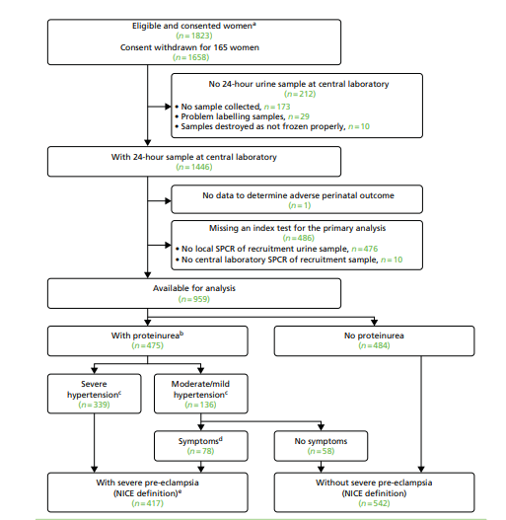

Slide 9
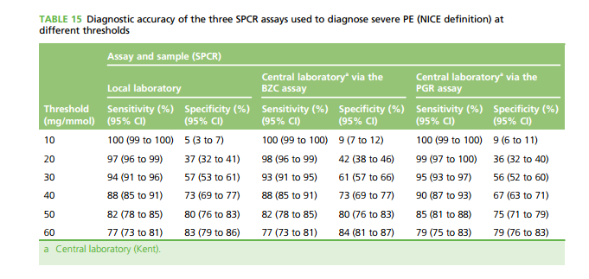
DIAGNOSTIC ACCURACY - RESULTS

Slide 10
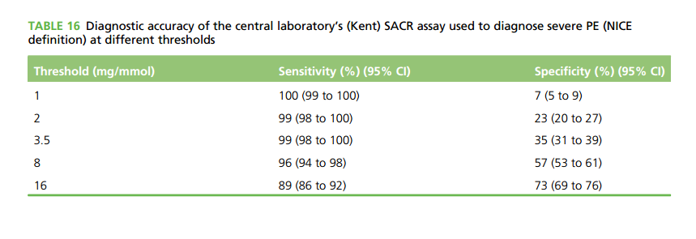
DIAGNOSTIC ACCURACY - RESULTS

Slide 11
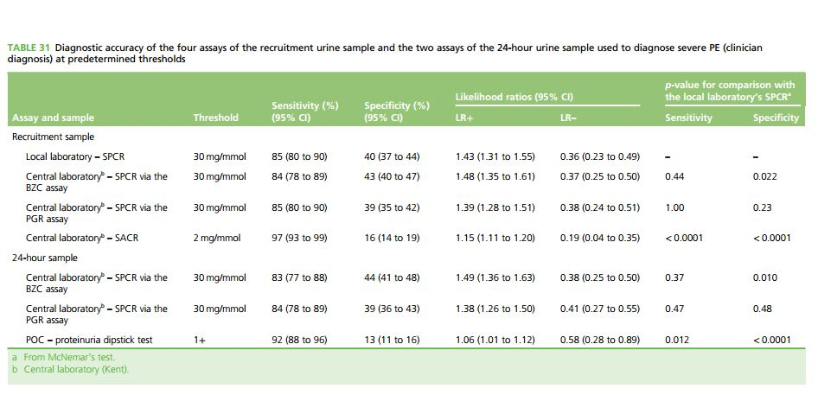

Slide 12
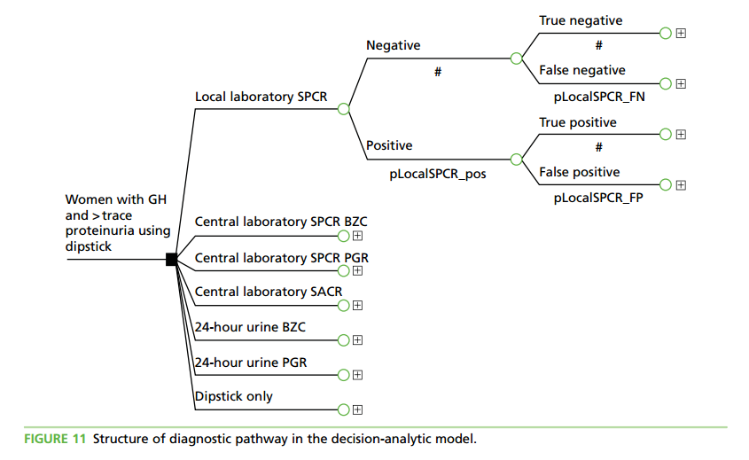
DECISION ANALYTIC MODEL

Slide 13
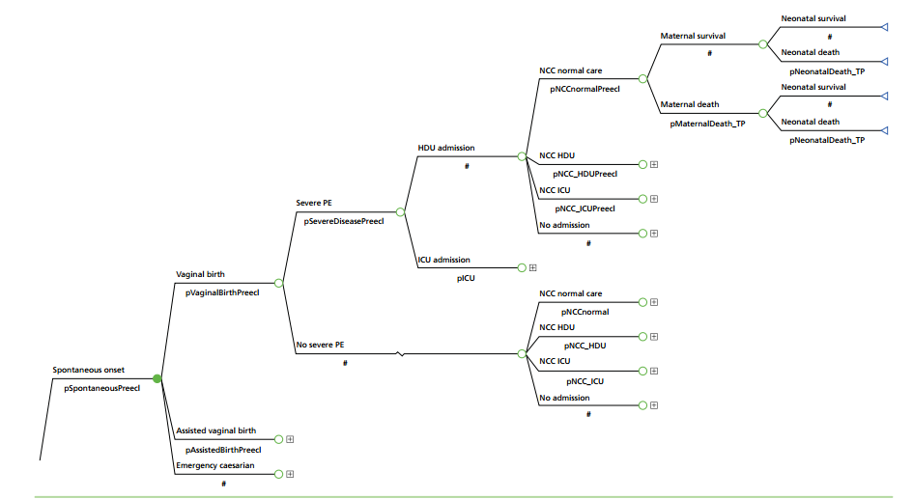

Slide 14
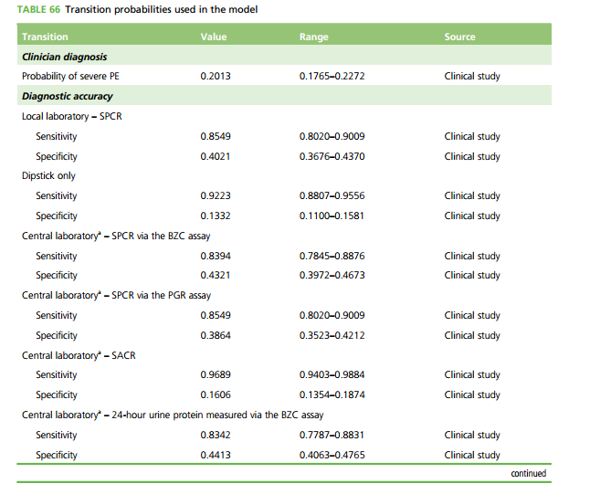

Slide 15
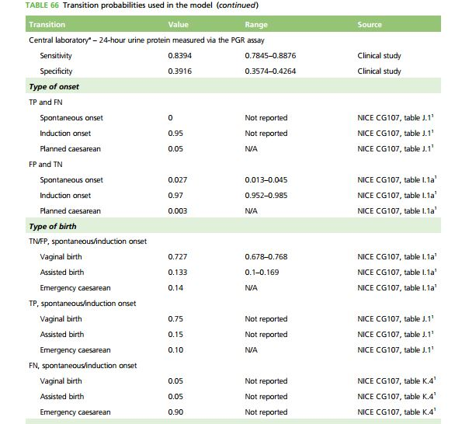
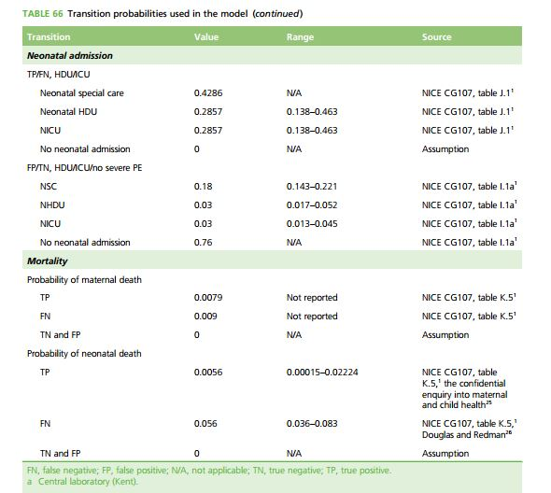

Slide 16
MODEL DESIGN
All patients begin at the initial node (pregnant with hypertension and trace/dipstick +1 urine protein). The model then assigns patients to one of the comparator tests. The presence or absence of severe PE will determine the subsequent progression of patients to the therapeutic pathway . Differences in pathways will be determined by the diagnostic accuracy (sensitivity and specificity) collected in the clinical study
All patients begin at the initial node, according to the consequences of tests - (severe PE, moderate PE or gestational hypertension).
Subsequent progression determines the type of birth, maternal HDU/ICU admission as a
result of PE and neonatal HDU/ICU.
Transition probabilities are derived from the NICE hypertension in pregnancy guideline model Patients accumulate cost of treatment up to the end of the pathway (discharge from maternal ward/HDU/ICU/death).
The mean cost per patient is added to the intervention cost and QALYs estimated based on maternal and neonatal mortality rates in PE or gestational hypertension

Slide 17
Are the recommendations valid?
Did the recommendations consider all relevant patient groups, management options, and possible outcomes?
All relevant patients were included
Outcomes including cost analysis was considered
Management options were based on latest NICE guidelines

Slide 18
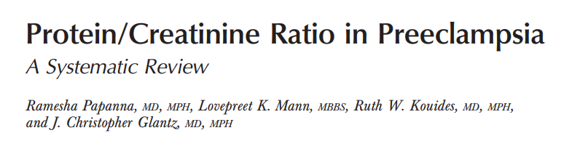
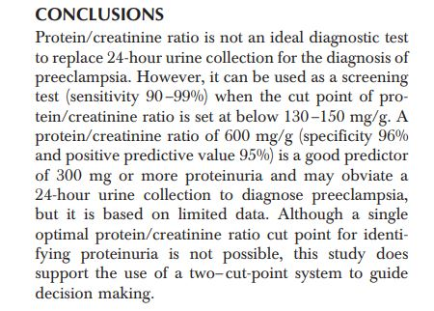
Are there systematic reviews of evidence that estimate the relative impact of management options on relevant outcomes?

Slide 19
Is there an appropriate specification of values and preferences associated with each of the outcomes?
Decision analysis model had objective protocols to follow
Costs were taken from average expenditure data
Do the authors indicate the strength of their recommendations?
No

Slide 20
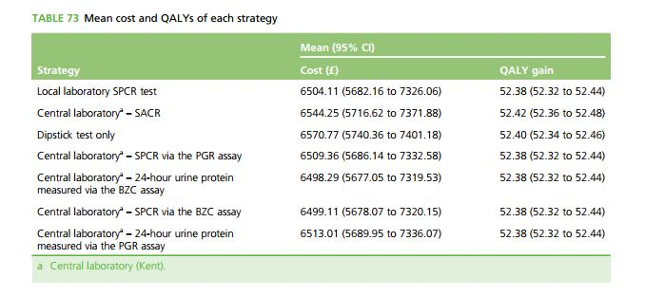
What are the results?

Slide 21
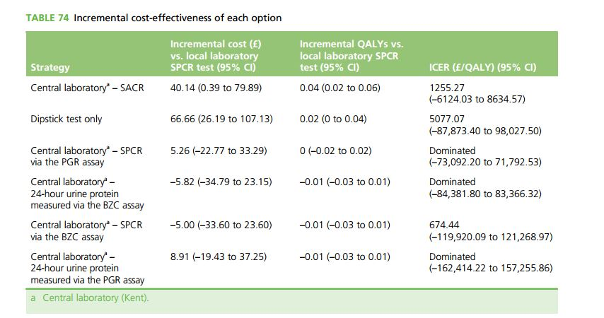
Results - ICER

Slide 22
What are the key recommendations?
Evidence would suggest that all proteinuria assessments should be performed by an initial dipstick screening test read on an automated dipstick reader, and for all non-negative tests a SACR test should be considered. In the absence of SACR being available, SPCR could be used as an alternative.
Given the intermethod/laboratory variability of protein assays demonstrated, all ‘protein’ tests should be viewed with extreme caution and consideration should be given to a urine albumin assay being employed for future definitions.
Clinically significant proteinuria should remain defined at a level of 8 mg/mmol measured by the SACR test or 30 mg/mmol measured by the SPCR test.
The evidence from this clinical study does not support the recommendation of 24-hour urine sample collection in hypertensive pregnant women.

Slide 23
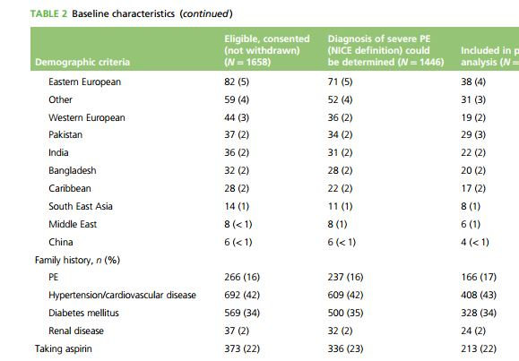
Will the recommendations help you in caring for your patients?
Do the recommendations
make sense in your
practice setting?
Yes
Except for Racial differences
Age – not given

Slide 24
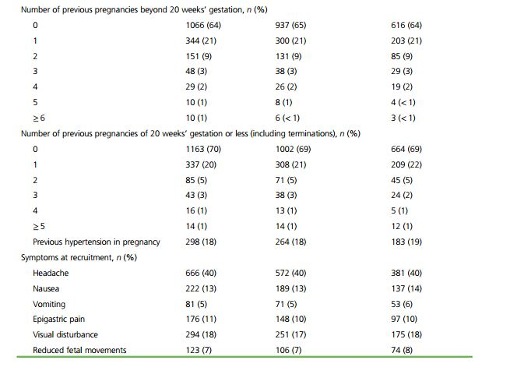

Slide 25
Thank You

