Slide 1
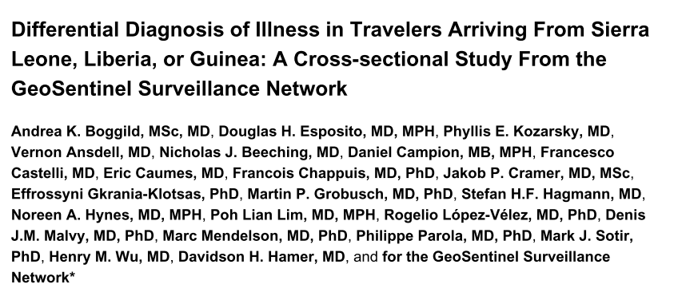
Ann Intern Med. Author manuscript; available in PMC 2016 June 02
CEU- 21-Jan 2019

Slide 2
Background
The largest-ever outbreak of Ebola virus disease (EVD), ongoing in West Africa since late 2013, has led to export of cases to Europe and North America.
Clinicians encountering ill travelers arriving from countries with widespread Ebola virus transmission must be aware of alternate diagnoses associated with fever and other nonspecific symptoms.
Notes:
Background—The largest-ever outbreak of Ebola virus disease (EVD), ongoing in West Africa since late 2013, has led to export of cases to Europe and North America. Clinicians encountering ill travelers arriving from countries with widespread Ebola virus transmission must be aware of alternate diagnoses associated with fever and other nonspecific symptoms.

Slide 3
Patients- Ill returned travelers and new immigrants from Sierra Leone, Liberia, or Guinea.
Cross sectional design- To define the spectrum of illness observed in persons returning from areas of West Africa where EVD transmission has been widespread; from GeoSentinel epidemiologic surveillance system .
September 2009 and August 2014.

Slide 4
Did the study patients represent the full spectrum of those with this clinical problem?

Slide 5
Were study patients recruited consecutively from the clinical settings?
No, only the patient with a probable and confirmed diagnosis was included in the analysis.
Did the study patients exhibit the full clinical spectrum of this presenting problem?
No

Slide 6
Did the investigators define the clinical problem clearly?
No.
No specific symptoms mentioned, a generalized term Illness was used and only patient with diagnosis/probable diagnosis was included.
Notes:
We included only patients with a probable or confirmed final diagnosis (specific etiologic or syndromic diagnosis as described earlier) and a presenting chief symptom other than asymptomatic screening (Figure).
GeoSentinel is an epidemiologic surveillance system that is not designed to capture
comprehensive and objective clinical and laboratory details

Slide 7
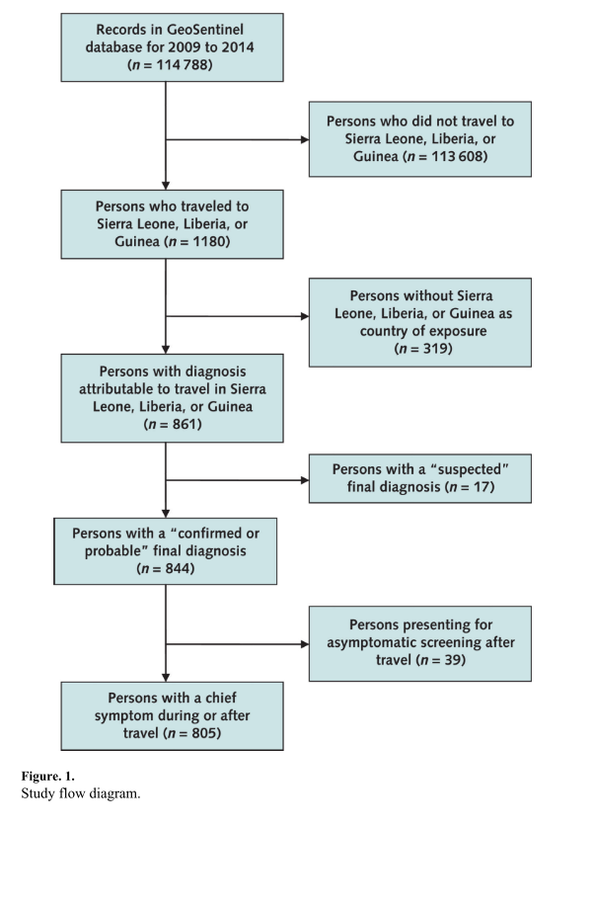

Slide 8
Were study patients collected from all relevant clinical settings?
NO
57 travel or tropical medicine clinics in 25 countries
Data collected by specialist clinics may not be representative of all ill returned travelers

Slide 9
Was the diagnostic evaluation definitive?
NO data on the same.

Slide 10
Was the diagnostic evaluation sufficiently comprehensive?
No data available.

Slide 11
Was the diagnostic evaluation consistently applied to all patients?
Not mentioned

Slide 12
Were the diagnostic labels assigned reproducibly?
Yes
Physicians at the sites determine the final diagnoses and diagnostic codes, which are selected from a standardized list of 522 diagnostic entities
Notes:
Physicians at the sites determine the final diagnoses and diagnostic codes, which are selected from a standardized list of 522 diagnostic entities, some of which are etiologic (such as Streptococcus pneumoniae) and others of which are syndromic (such as cough).

Slide 13
Were there few patients left undiagnosed?
Only probable and definite diagnosis were considered, undiagnosed were not included.

Slide 14
For undiagnosed patients, was follow-up sufficiently long and complete?
Only probable and definite diagnosis were considered, undiagnosed were not included.

Slide 15
Results
What were the diagnoses and their probabilities?

Slide 16
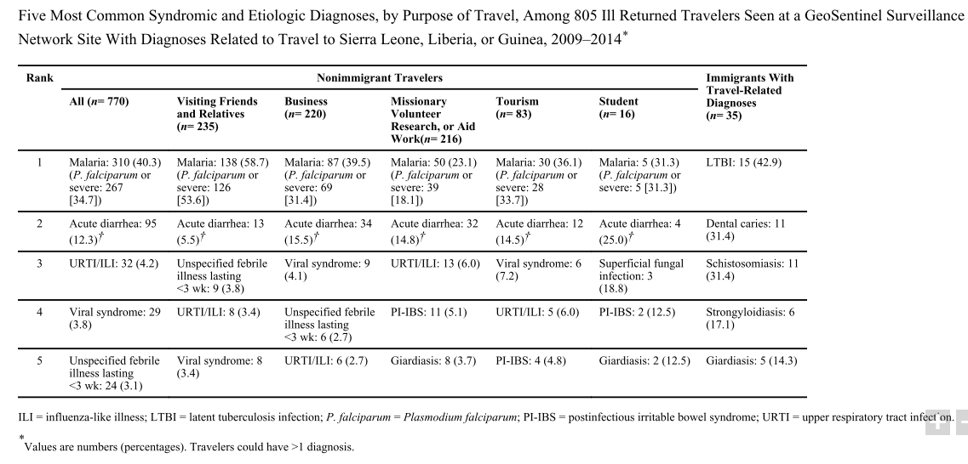

Slide 17
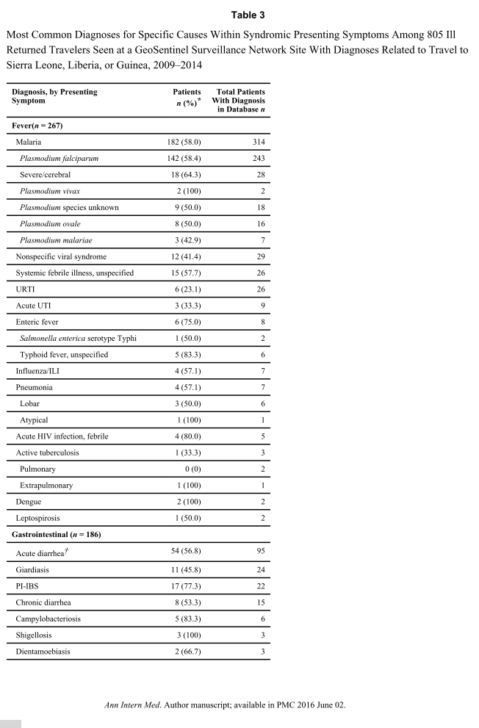

Slide 18
How Precise Are the Estimates of Disease Probability?
Mal CI: 36.85% to 43.76%
CI: 10.2% to 14.85%
. CI: 3% to 5.9%
. CI: 2.6% to 5.3%
. CI: 2.1% to 4.8%

Slide 19
How can I apply the results to patient care?
Are the study patients and clinical setting similar to mine?

Slide 20
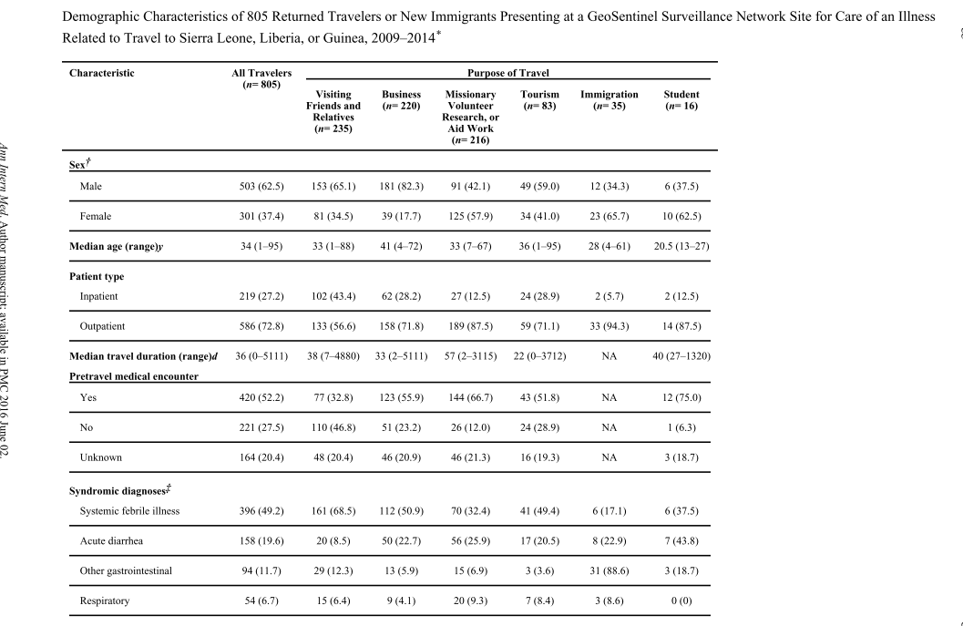

Slide 21
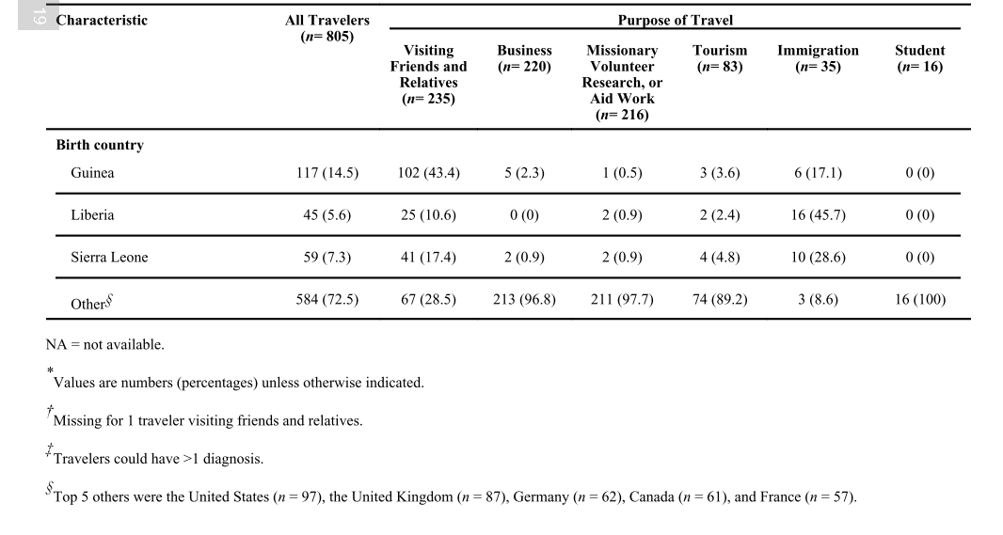

Slide 22
Is it unlikely that the disease possibilities or probabilities have changed since this evidence was gathered?
They have included upto August 2014
The epidemic of Ebola lasted 2014-2016.

