Slide 1
Critical Appraisal of a Diagnostic Study
Jasper Rathinam J

Slide 2
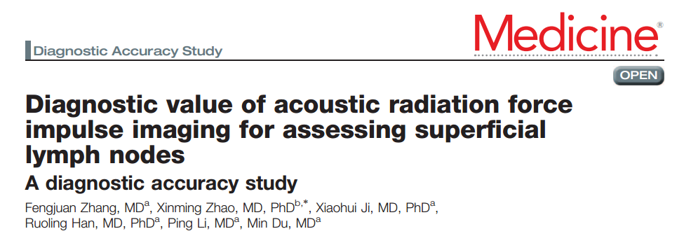

Slide 3
Background
The conventional sonographic criteria for metastatic lymph nodes are still controversial
Non invasive diagnosis of nature of neck nodes may be vital
Elasticity score and strain ratio are used for the interpretation of conventional elastography – but are interobserver variable
Acoustic radiation force impulse (ARFI) imaging is a relatively new elastography technique that reduces operator dependency and improves reproducibility because of the addition of automated acoustic stress
Virtual touch tissue imaging (VTI) and shear wave velocity (SWV) have been shown to be of some use in previous data and other settings

Slide 4
PICOT
P : Patients with suspicious superficial lymph nodes who were detected by conventional sonography were recruited
I : ARFI Imaging findings of VTI and SWV
G : USG Guided Core biopsy of the same node studies
O: Comparison with the gold standard
T : Prospective, consecutive study

Slide 5
Methodology
Hebei Medical University.
From October 2015 to March 2016, 108 consecutive patients with suspicious superficial lymph nodes who were detected by conventional sonography were
recruited for ARFI imaging
42 had surgical lymph node biopsy later
Rest had USG guided core needle biopsy
Definite Histological diagnosis was established in all
virtual touch tissue quantification (VTQ) , Virtual touch tissue imaging (VTI) and shear wave velocity (SWV) were done in ARFI

Slide 6
Inclusion Criteria
The cortical thickness of lymph nodes were at least 0.5cm; the minimum diameter of lymph nodes was greater than or equal to 0.6cm to ensure that the peripheral tissue was not included in the sample frame of VTQ
The maximum diameter was less than or equal to 2cm to ensure that there was enough peripheral tissue in VTI whose maximal region of interest of 2 x 3
cm
Neither clinical treatment nor fine needle aspiration (FNA) biopsy nor core needle biopsy of the nodules was performed before ultrasound examination.
Patients who had SWV error values were excluded

Slide 7
How serious is the risk of bias?
Did participating patients constitute a representative sample of those presenting with a diagnostic dilemma?
They recruited consecutively, all patients
Error in SWV patients were excluded from analysis – 10 patients

Slide 8
Did investigators compare the test to an appropriate, independent reference standard?
Yes
Ref Standard was Histopathology
All pathological diagnoses were made by a pathologist experienced in lymphatic system disorders pathological examination.

Slide 9
Were those interpreting the test and reference standard blind to the other results?
Pathologist were not aware of the ARFI Findings
ARFI findings were machine generated values

Slide 10
Did all patients receive the same reference standard irrespective of the results of the test results?
Yes , All of them underwent a biopsy irrespective of the results

Slide 11
Results
The histopathological results revealed
23 chronic nonspecific reactive lymph nodes (CLNs)
36 malignant blood and lymphatic system diseases lymph nodes (BLLNs, 2 chronic granulocyticleukemia, 1 chronic lymphocytic leukemia, 15 Hodgkin’s
lymphoma, 18 non-Hodgkin’s lymphoma)
38 metastatic lymph nodes (MLNs). ( 3 adenocarcinoma of the lung, 3 squamous cell carcinoma of the lung, 3 small cell carcinoma of the lung, 5 squamous cell carcinoma of the esophagus, 1 kidney cancer, 1 small bowel cancer, 3 papillary
thyroid cancer, and 19 breast carcinoma. )

Slide 12
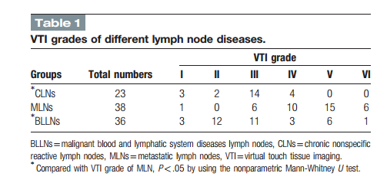
Results – VTI Grades

Slide 13
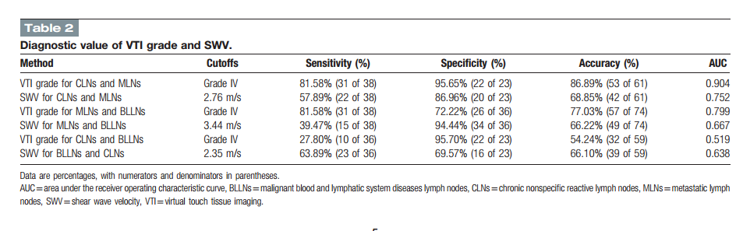

Slide 14
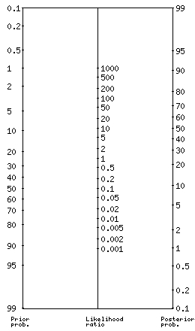
What are the results?
What likelihood ratios were associated with the range
of possible test results?
If the pretest probability of a patient having
Metastatic Lypmh Node is 40% - post test probability of 90%
If positive and 10 % if negative ( VTI > Grade 4)

Slide 15
LR+
18.5
4.4
2.9
7.03
6.47
2.09
LR-
0.19
0.49
0.26
0.64
0.75
0.52

Slide 16
How can I apply the results to patient care?
Will the reproducibility of the test results and its interpretation be satisfactory in my clinical setting?
ARFI is a cheap investigation, with machine generated values
Easy to train radiologists to do the same

Slide 17
Are the study results applicable to patients in my practice?
May be used as a screening tool , but histopathology is needed to confirm diagnosis
No single best factor could differentiate benign vs malignant
No TB Lymphadenitis in this study

Slide 18
Will the test results change my management strategy?
May not change - due to the values of Benign diseases lying between BLN and MLN
Will patients be better off as a result of the test?
May not

Slide 19
Thank You

