Slide 1
Critical appraisal of a screening test
Jacob

Slide 2
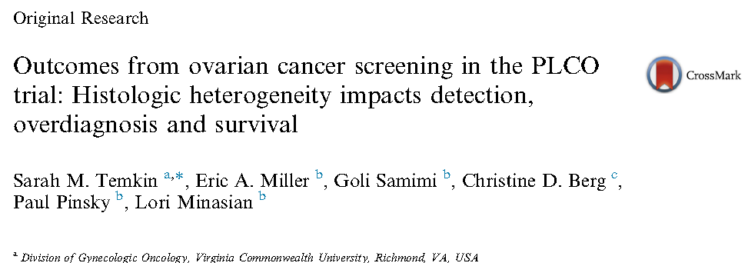

Slide 3
Introduction
The majority of women with ovarian cancer present with advanced stage disease where long-term survival is rare
Early-stage ovarian cancer has significantly higher survival rates
Despite several large prospective trials, a mortality benefit of screening was not identified.
Significant harms from ovarian cancer screening included the high rate of false positive screens, 9.6%, of which 33% were followed by surgery

Slide 4
In the last decade, the emergence of robust clinicopathologic, molecular, and genetic data have enabled a more accurate, modern characterization of ovarian cancer subtypes.
The majority of epithelial ovarian cancers, which can be further subdivided into two main histological categories: Type I and type II tumors
Type II ovarian cancers are defined by TP53 mutations and are the most common and most aggressive of the ovarian cancers

Slide 5
This study used data from the PLCO trial to examine screening outcomes by tumor type.
This study to determine how screening impacts the detection and
overdiagnosis of type II ovarian tumors differentially from other types of ovarian cancers

Slide 6
AIM
The aim of this study was to evaluate the screening outcomes for different histologic subtypes of ovarian cancers

Slide 7
PICOT
Population:
Intervention: CA-125 and transvaginal ultrasound annually for 3e5
Years
Control: Usual care
Outcome: screening outcomes for different histologic subtypes of ovarian cancers

Slide 8
How serious is the risk of bias?
Is there randomized control trial evidence addressing the impact of the intervention in asymptomatic people?
Yes, the RCT shows there is a significant number of over diagnosed patients

Slide 9
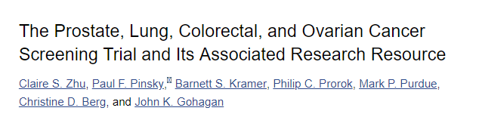
What are the recommendations, and will they help you in caring for patients?
Were the data identified, selected, and combined in an unbiased fashion?
Yes, the RCT from which the guideline was done was done well and was unbiased
Large sample size, generalizable, blinded study

Slide 10
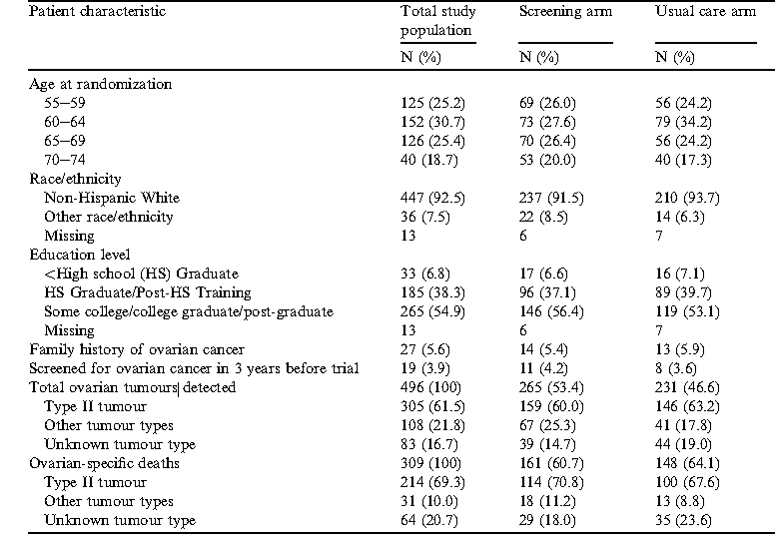
What are the benefits?

Slide 11
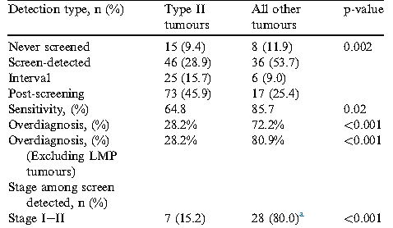
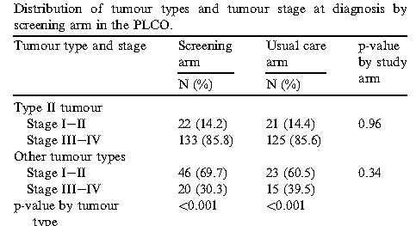
Notes:
Among patients randomized to the screening arm, 28.9% of type II tumors were screen-detected compared to 53.7% of other tumors
The remaining type II tumors were diagnosed post screening (45.9%)
The majority of screen-detected type II tumors (84.8%) were diagnosed at advanced stages (III/IV)
Between the two study arms, ovarian-specific survival did not significantly differ by arm for type II tumours (p Z 0.74) or for the other tumours (p Z 0.32)

Slide 12
What are the harms?
Overdiagnosis is a potential harm of screening when disease is diagnosed that will never cause symptoms or death during a patient’s lifetime
As expected, substantially higher overdiagnosis of the slower growing tumors were diagnosed.
15-year follow-up from the PLCO trial demonstrated no mortality difference between participants randomized to the screened arm compared to those in the usual care arm.

Slide 13
How do benefits and harms compare in different people and with different screening strategies?
Screening for ovarian cancer has no benefit in any subset or group of people and with any screening strategy

Slide 14
What is the effect of individuals’ values and preferences?
Individuals in our practice would not prefer screening as it does not have survival benefit and the screening cost has to be borne by the patient

Slide 15
What is the cost effectiveness??
Not calculated as there is no benefit

Slide 16
Thank you

