Slide 1
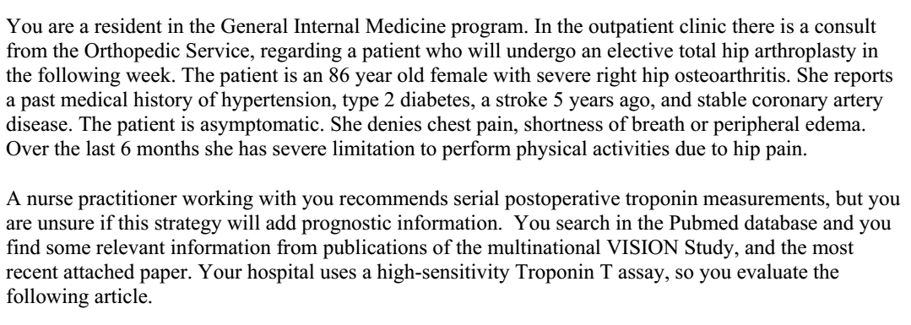

Slide 2
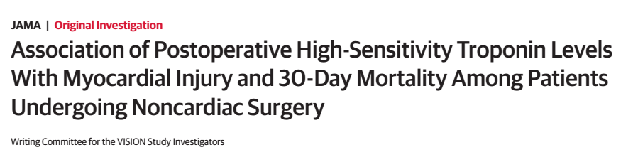
19/12/2018

Slide 3
Background
Large observational studies suggest that in patients above 45 years of age, undergoing non cardiac surgery, 1% die in hospital or within 30 days of surgery.
Defined as myocardial injury caused by ischemia that occurs during or within 30 days after surgery and is independently associated with mortality.
Diagnostic criteria based on non high sensitivity troponin T assay has been identified, but high sensitivity troponin T has recently been approved for use.

Slide 4
Prospective cohort of adults who underwent non cardiac surgery.
  First 15000 patients non-hsTnT was measured
  Second 21000 patients hsTnT was measured
23 centres in 13 countries
  North America, Africa, South America, Asia , Australia and Europe

Slide 5
P: Patients above 45 years of age, undergoing major non cardiac surgery
T: October 2008 to November 2013

Slide 6
Primary Outcome:
  Association between perioperative hsTnT measurements and 30 day morality
  And potential diagnostic criteria for MINS based on hsTnT
Secondary outcomes:
  Determine if there was an interaction between the lowest prognostically important post operative hsTnT threshold and estimated eGFR or sex
  Describe characteristics of patients experiencing MINS an their outcomes
  Determine the proportion od MINS that might go undetected without troponin monitoring

Slide 7
Inclusion criteria:
  Age >45 years
  Major non cardiac surgery : general or regional anaesthesia
  Hospitalisation for at least 24 hours post surgery
Exclusion:
  Previously enrolled in VISION
  Did not give informed consent

Slide 8
Statistical Analysis
For the primary outcome, a Cox proportional hazards model was undertaken.
  Dependant variable: mortality up to 30 days post surgery
  Independent variable: preoperative and surgical variables previously associated with 30 day mortality
Modified Mazumdar approach : used to determine if there were prognostically important post operative hsTnT thresholds that were associated with risk of 30 day mortality

Slide 9
How serious was the risk of bias?
Was the sample of patients representative?
  Yes, had patients across the globe, included numerous types of surgeries.

Slide 10
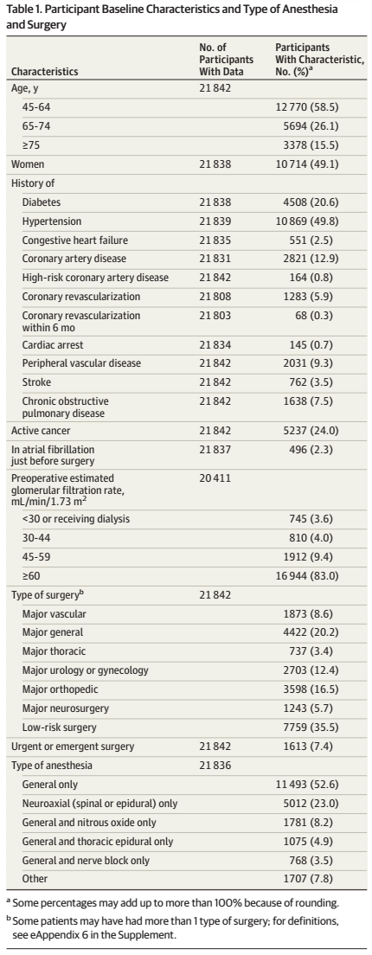
Were patients classified into prognostically similar group?

Slide 11
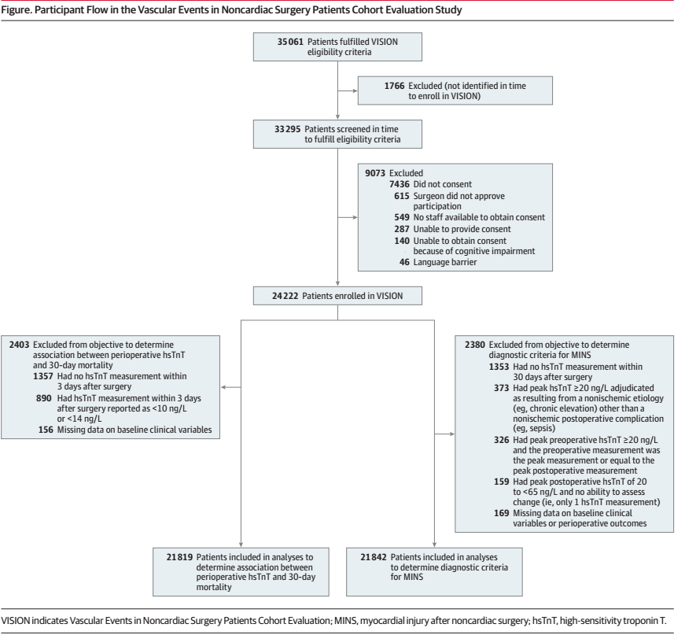
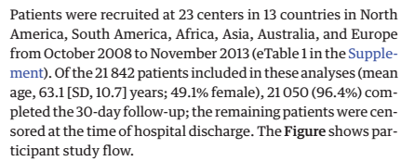
Was follow up sufficiently complete?
Yes
96.4% completed follow up
Remaining patients were
Censored at the time of
discharge

Slide 12
Were outcome criteria objective and unbiased?
yes

Slide 13
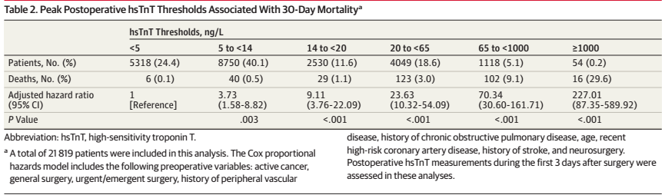
What are the results?
How likely are the results over time?
Death within 30 days after surgery occurred in 266 patients:
  1.2%, 95% CI , 1.1% -1.4%

Slide 14
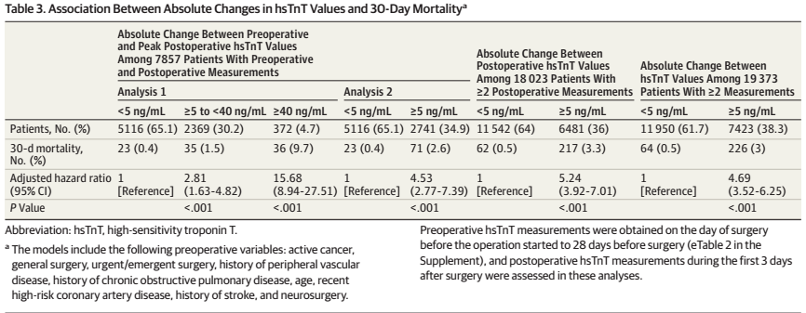

Slide 15
How precise are the estimates of likelihood?

Slide 16
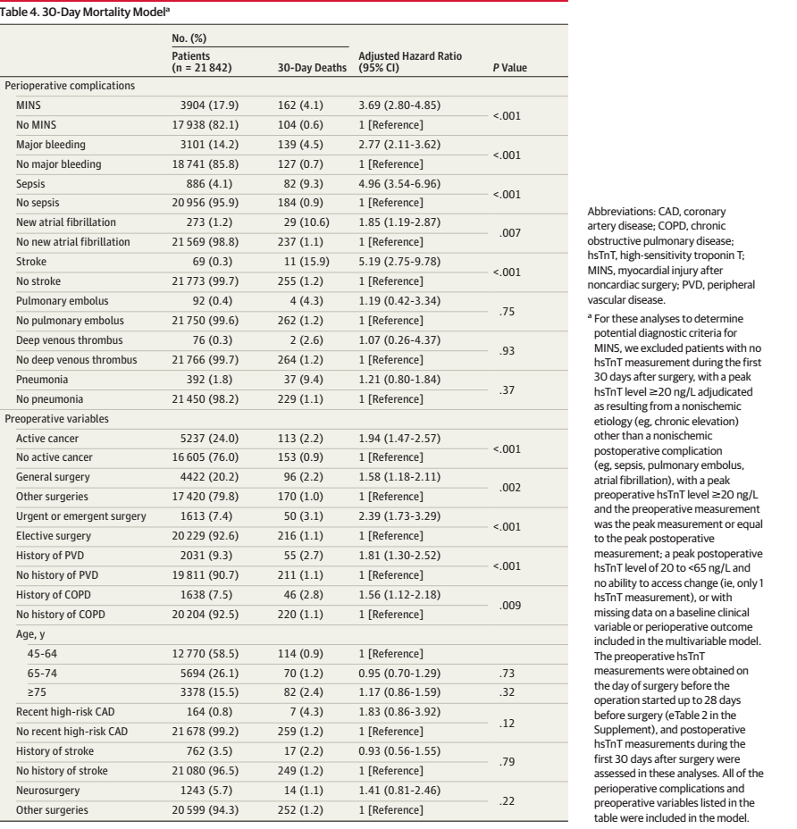

Slide 17
How can I apply the results to patient care?
Were the study patients and their management similar to those in my practice?
  Yes
Was follow up sufficiently long?
  yes

Slide 18
In patients undergoing major non cardiac surgery, peak post operative hsTnT was associated with increased risk of cardiac mortality.
Elevated post operative hsTnT without ischemic features was also associated with 30 day mortality
Limited by the arbitrary criteria for prognostically important hsTnT elevation
Adjusted CI for peak post operative hsTnT were wide

Slide 19
Can I use the results in management of patients in management of patients in my practice?
Yes

