Slide 1
Critical Appraisal of a Systematic Review
Anil Mathew

Slide 2
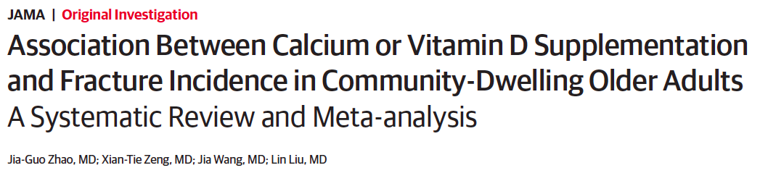

Slide 3
Background
Approximately 40% of 50-year-old women will have major osteoporotic fractures during the remainder of their life times
More than one fifth of patients died within 1 year after hip fracture
The increased social and economic burdens associated with osteoporosis related fractures worldwide make their prevention a major public health goal

Slide 4
Meta-analyses published to date have not reached consistent conclusions regarding the association between calcium, vitamin D, or combined calcium and vitamin D supplements and fracture risk
Older people living in institutions such as nursing homes and residential care facilities have a higher risk of fracture compared with people living in the community

Slide 5
Aim
To separately compare calcium, vitamin D, and combined calcium and vitamin D supplements with a placebo or no treatment for fracture incidence in community dwelling older adults

Slide 6
PICOT
Population: Adults over 50 years of age, living in their communities
Intervention: Vitamin D and Calcium supplements/ Combined supplements
Control: Placebo
Outome: Primary Outcome- Hip fracture, Secondary outcome-non vertebral fracture, vertebral fracture and total fractures
Timeline: 10 years data, from 24 Dec 2006 to 24 Dec 2016

Slide 7
Inclusion Criteria:
RCTs comparing calcium, vitamin D, or combined calcium and vitamin D supplements with a placebo or no treatment group
Trials enrolling adults older than 50 years and living in their communities
Trials providing fracture data

Slide 8
Exclusion Criteria:
Randomized trials without a placebo or no treatment group
Corticosteroid-induced secondary osteoporosis
Use of other treatments(eg. an anti osteoporotic drug)
Vitamin D analogues (eg. calcitriol) or hydroxylated vitamin D use
Dietary intake of calcium or vitamin D (eg. from milk) was evaluation studies

Slide 9
Assessing the Credibility of the Systematic Review Process
Did the review explicitly address a sensible clinical question?
Yes, previous studies have been done in patients in nursing homes and in patients, this is a community based study, looking at fracture incidence in these patients

Slide 10
2. Was the search for relevant studies exhaustive?
They have gone through PubMed, Cochrane Library and EMBASE databases looking at trials from Systematic Reviews and individual RCT’s

Slide 11
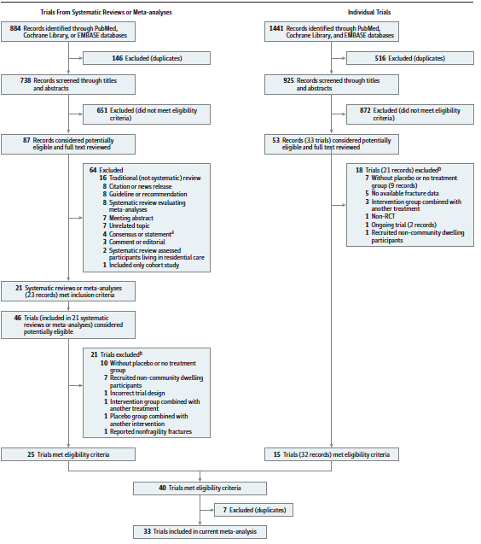

Slide 12
3. Were selection and assessment of studies reproducible?
Two researchers independently extracted information from each study and have included studies which have met the inclusion criteria and have pooled the data from other meta analysis and individual studies.
Disagreements were reviewed by a third reviewer.

Slide 13
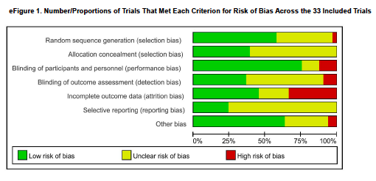
Rating the Quality of Evidence (the confidence in the estimates)
What is the risk of bias across all the studies ?

Slide 14
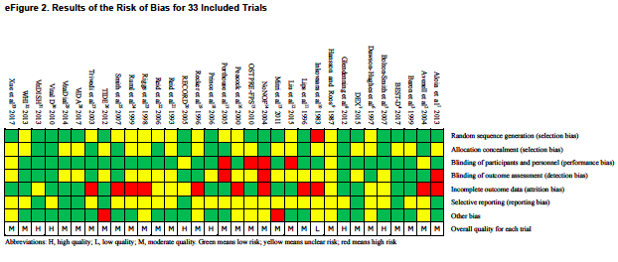
26 – Medium Risk, 6- High Risk, 1- Low Risk

Slide 15
Do the systematic review population, intervention, comparison, and outcomes fit the patient at hand (i.e., indirectness)
Baseline characteristics compared shows similar Age groups: 59-81, mean 62, all studies had Vit D less than 30,
There is a mixed population, studies taken from around the world, but mostly European studies included.
They have looked at clinically relevant outcomes.

Slide 16
What are the results?
Did the review present results that are ready for publication?
Yes
Did the review provide a rating for confidence in effect estimates or provide information I need to evaluate confidence(risk of bias in included studies)?
Yes

Slide 17
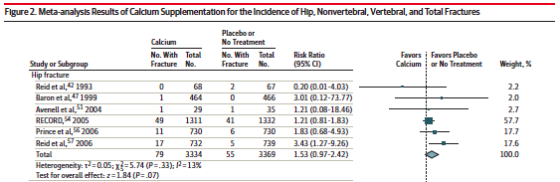
Are the results inconsistent across studies (i.e., inconsistency)?

Slide 18
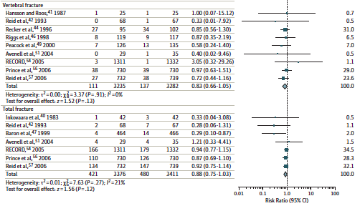

Slide 19
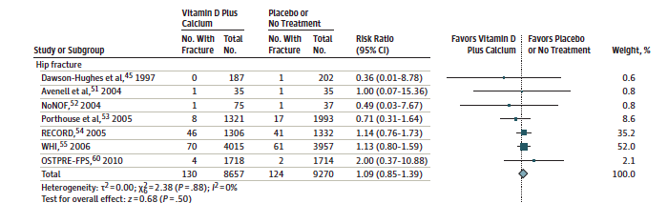
Do you consider the magnitude of treatment effect large (e.g. RR> 2.0 or <0.5)?
EER= 1.5% CER=1.3%
ARR= 1.5 -1.3 = 0.2
NNT= 500

Slide 20
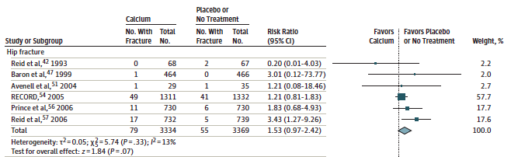
EER=2.3% CER=1.63%
ARR=0.67
NNT= 149

Slide 21
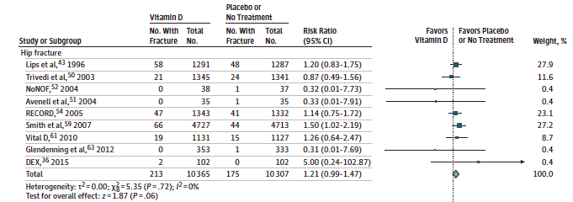
EER=2.05% CER= 1.69%
ARR= 0.36%
NNT= 277

Slide 22
Overall confidence in the estimates?

Slide 23
Is there a high likelihood of publication bias?
They have taken both negative an positive studies, hence likelihood of publication bias is low.

Slide 24
Would I use the results of this study for my patients?
From this meta analysis, we can conclude that there is no benefit from supplementation to patients in community without increased risk of fracture.
Hence for this select group I would not prescribe supplement calcium/Vit D

