Slide 1
Critical Appraisal of a RCT
Anil Mathew Philip

Slide 2
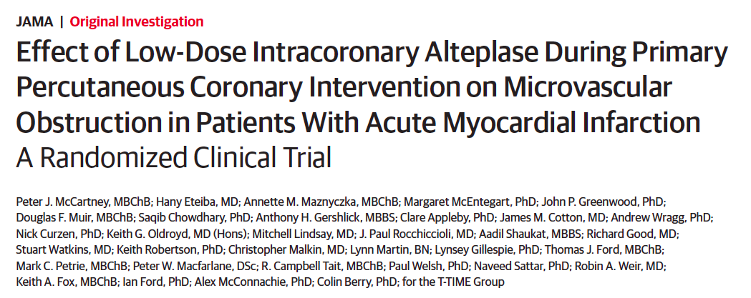

Slide 3
Background
IHD is the leading cause of disability and death worldwide
Primary PCI to emergently reopen the occluded coronary artery and secure vessel patency with a stent is the standard of care for a STEMI
Normalized coronary blood flow is typically achieved in 91%of patients, however, failed microvascular reperfusion has been estimated to occur in 45% of all treated patients→ microvascular obstruction
This is independently predictive of an unfavorable cardiac prognosis

Slide 4
During Primary PCI there is distal embolization of thrombus → microvascular thrombosis with fibrin-rich microthrombi, contribute to microvascular obstruction
Addition of a fibrinolytic agent prior to PCI showed improvement in coronary flow acutely, but causes paradoxical activation of thrombin, clot formation and bleeding
This study is to see if there is reduction of microvascular obstruction with low-dose intracoronary fibrinolytic therapy with alteplase infused early after coronary reperfusion

Slide 5
Hypothesis
In patients undergoing primary PCI for acute STEMI, adjunctive fibrinolytic therapy with low-dose intracoronary alteplase given after reperfusion and before stent implant reduce microvascular obstruction

Slide 6
Population: Patients with a clinical diagnosis of acute STEMI with a symptom onset to reperfusion time of 6 hours or less
Intervention: after successful reperfusion patients received either 10mg or 20mg of intracoronary alteplase
Control: placebo

Slide 7
Outcomes:
Primary: amount of microvascular obstruction demonstrated by contrast enhanced MRI from days 2-7
Secondary: MRI outcomes were: -presence of microvascular obstruction
–amount of myocardial hge
–infarct size
–myocardial salvage index
-LVEF obtained on days 2-7, and 3 months
Angiographic measures of reperfusion
Health status
Adverse events: - MACE
- Acute CVA and systemic bleeds

Slide 8
Timeline: Planned for 2 year study, enrollment starting on 17 March 2016, planned for 12 month follow up.
But on recommendation of data and saftey monitoring committee recruitment was dicontinued on December 21, 2017 due to futility criterion for efficacy

Slide 9
Study design
Multicenter done in 11 hospitals across UK
Randomized, double-blind, parallel-group phase 2 clinical trial

Slide 10
Inclusion criteria
Adults aged >18 years
STEMI with symptom onset <6 hours
Radial artery access

Slide 11
Exclusion Criteria
Shock
Normal coronary flow
Contraindication to MRI
Implantable defibrillator
eGFR <30
Significant bleeding problem
Patients on concomitant anticoagulation
Severe hypertension uncontrolled
Major surgery/blunt trauma within the last 2 months
Known case of CVA within the ast 6 months
Pregnancy and lactation

Slide 12
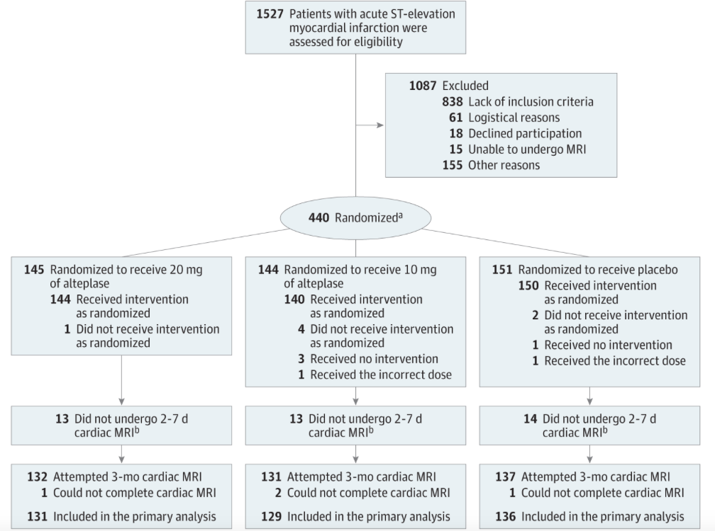
Consort figure

Slide 13
Sample size
The target sample size was 618, based on obtaining 186 per group who had undergone an MRI within days 2 through 7 after enrollment, allowing for approximately 10% missing data. This was designed to give90%power at a 5%significance level, to detect a difference between 2 groups of 1.72%, assuming a mean (SD) of 3.2% (5.1%) for the extent of microvascular obstruction in the comparator group.

Slide 14
I. How serious was the risk of bias?

Slide 15
1.Did the intervention and control groups begin the study with similar prognosis?
a. Were patients randomised?
Participants were randomized by staff in the catheter laboratory using an interactive voice response–based randomization system. The randomization sequence was computer generated
The allocation sequence was on a 1:1:1 basis between the placebo and alteplase (10mg, 20 mg) groups and the sequence was concealed electronically
The participants, staff, and researchers were blinded to the treatment group allocation

Slide 16
b. Was the randomisation concealed?
Not mentioned

Slide 17
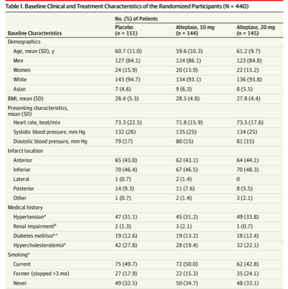
c. Were patients at baseline with respect to known prognostic factors?

Slide 18
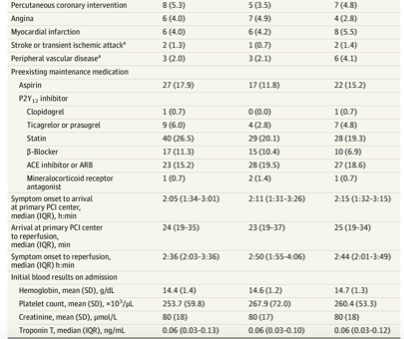

Slide 19
2. Was prognostic balance maintained as the study progressed?
a. Were patients, caregivers, collectors of outcome data, adjudicators of outcome, and data analysts aware of group allocation?
The participants, staff, and researchers were blinded to the treatment group allocation

Slide 20
3. Were the groups prognostically balanced at the conculsion of study?
a. Was the follow- up complete?
The follow up planned was a 12 month follow up which was not completed as the study was prematurely stopped

Slide 21
b. Was the trial stopped early for benefit?
On the recommendation of the data and safety monitoring committee, recruitment was discontinued on December 21, 2017, because a pre specified futility criterion for efficacy was met.
Specifically, the conditional power for an analysis on the primary efficacy outcome based on 40% of the randomized population (n = 267) with follow-up to 3 months was less than 30% in both treatment groups.

Slide 22
c. Were the patients analyzed to the group that they were randomized to?
Yes

Slide 23
Validity of the study
Study population: well defined
Outcomes: clearly defined
Randomization: adequate
Allocation concealement: not mentioned
Blinding: Blinded
Sample size calculation: adequate
Baseline characteristics: well matched

Slide 24
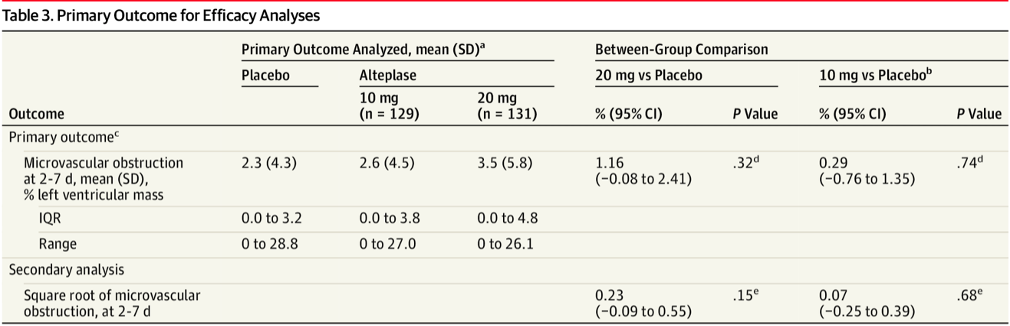
Results

Slide 25
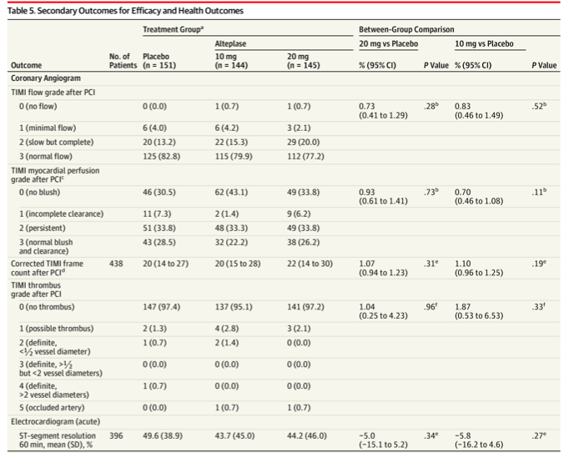

Slide 26
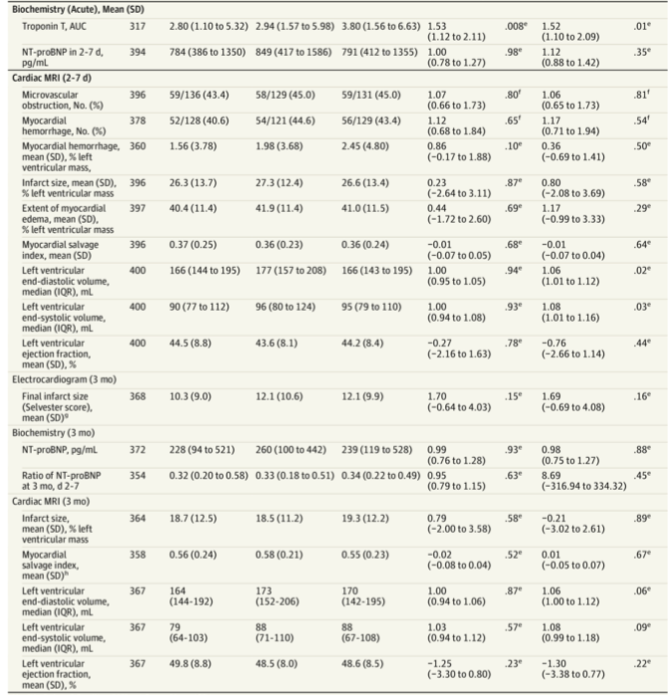

Slide 28
III. How can I apply these results to my patients

Slide 29
Were the patients similar to my patients?
The study was done in a predominantly white population. The % of diabetes is much higher in this population and is a major risk factor for MI’s.

Slide 30
b. Were all patient- important outcomes considered?
Yes

Slide 31
c. Are the likely advantages of the novel treatment worth the potential harms and costs?
This study was prematurely stopped and looking.

