Slide 1
Critical Appraisal of a Case Control Study
Jasper Rathinam J

Slide 2
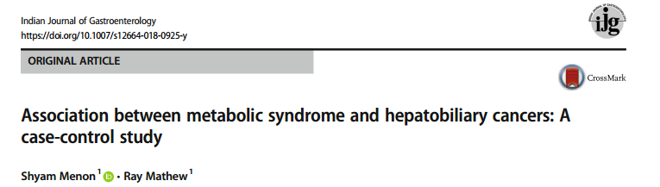

Slide 3
Background
Increasing trend of in incidence of hepatobiliary cancers , GB and cancers.
IS this an association to increasing noncommunicable diseases? DM, HTN, Obesity
Previous data showed association of metabolic syndrome with Liver Cancer

Slide 4
OBJECTIVE
To assess the association between metabolic syndrome and HPB cancers using a case control design

Slide 5
Study Design
P : Patients from the THIN Database (the Health Improvement Network (THIN) ) in UK
Cases : Those who developed HPB Cancers
Controls : Age and Sex matched controls from the THIN Database
Outcome : Association of HPB malignancy and Metabolic Syndrome
Time Period : Database data from 1980 - 2015

Slide 6
Sample Size Calculation
Assuming a population prevalence of hepatobiliary cancer
of 8 per 100,000 and a relative risk of mortality of 1.52 (95%
CI 1.13–2.05) in men and 1.62 (1.40–1.87) in women with
increasing BMI levels
Sample size was determined as atleast 10,023 patients would provide sufficient power at type I (α) error rate of 0.05 and a type II (β) error rate of 0.1 to
examine the association between hepatobiliary cancer and metabolic syndrome

Slide 7
Cases – Inclusion Criteria
Age > 20
With the diagnosis of Liver ,Biliary , Gall Bladder Cancers
Minimun follow up data available for atleast 1 year.( or death)
Type 1 Diabetics were excluded

Slide 8
Control Selection
These cases were matched with controls in a 1:2 fashion, by age, practice (e.g. general practitioner [GP]), and gender, with at least 1 year of follow up on the database
Data on co-morbidities, drug history (medication for diabetes, aspirin and statin use), anthropometric data (weight, body mass index [BMI]), and data on smoking and alcohol consumption were extracted from the database

Slide 9
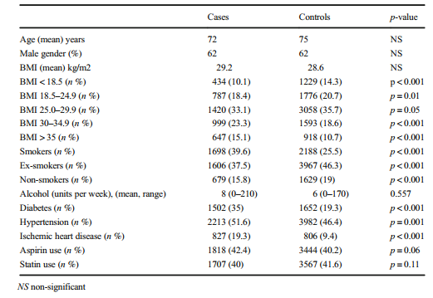
Are the results valid?
Did the cases and control group have the same risk (chance) for being exposed in
the past?

Slide 10
Were cases and controls similar with respect to the indication or circumstances that would lead to exposure?
Yes ,Similar baseline characters
Were the circumstances and methods for determining exposure similar for cases and controls?
Similar retrospective data which were recorded was used.
Minor variations of Weight, Height scales possible

Slide 11
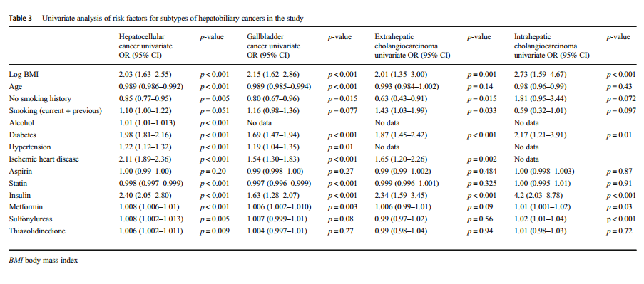
What are the Results?

Slide 12
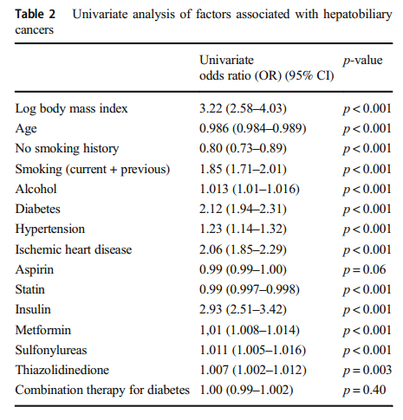
What are the Results?

Slide 13
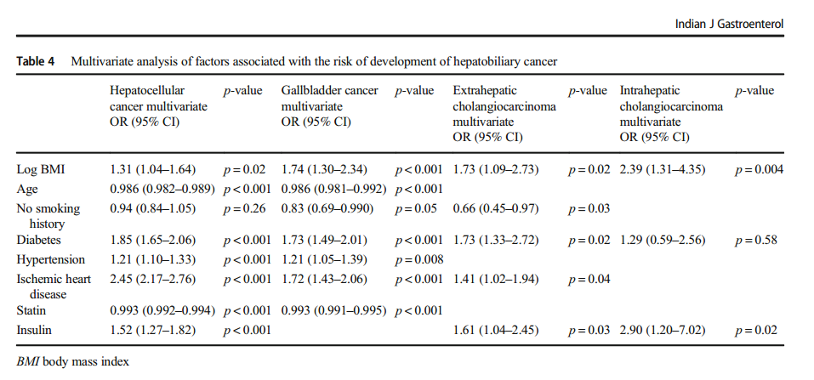
What are the Results?

Slide 14
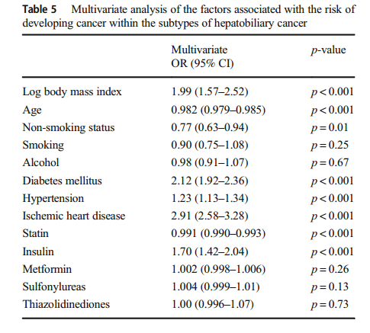
What are the Results?

Slide 15
How strong is the association between exposure and outcome?
Odds Ratio of 2 ( 1.99) for BMI
How precise is the estimate of risk?
Confidence Interval was 1.57 – 2.52

Slide 16
How can I apply the results to my patient care?
Were the study patients similar to patients in my practice?
UK population included
Epidemiological variations would be there
Mean Age was 75 among study participants.

Slide 17
Was the duration of follow-up adequate?
It was a case control , restrospective study
Minimum follow up of 1 year
Exact follow up details and duration – not mentioned.

Slide 18
Is the exposure similar to what might occur in my patient?
Yes
Increasing incidence of Obesity ,DM ,HTN in our community as well

Slide 19
What is the magnitude of the risk?
prevalence of hepatobiliary cancer of 8 per 100,000 – Risk of general Public
CER – 8/100000 – 0.008%
EER – 0.016%
ARR – 0.008%
NN cause one extra case of HPB Malignancy – 12,500

Slide 20
Are there benefits that offset the risks of the exposure?
Dietary modification and lifestyle modification have been shown to have multiple other benefits and no risks
No other loss of benefit identified.

Slide 21
Thanks

