Slide 1
Critical appraisal of a qualitative study
Jacob

Slide 2
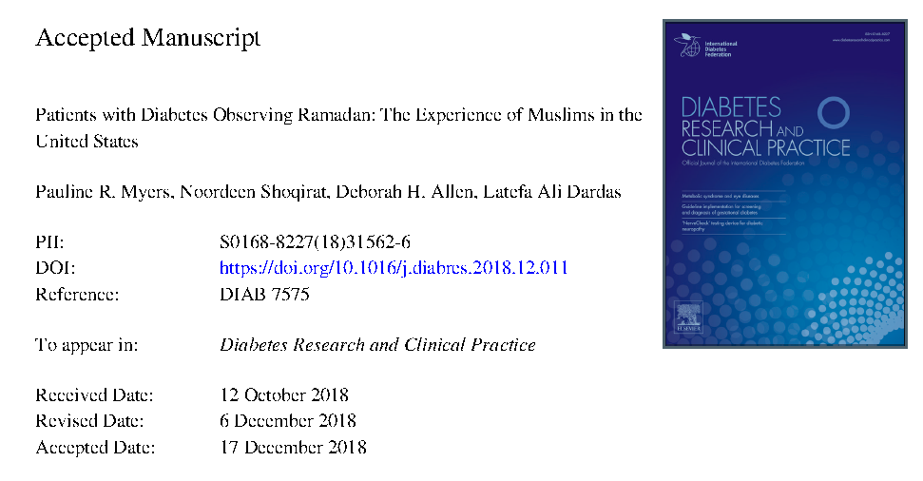

Slide 3
Aims of this study
Explore the beliefs which influence the experience and practices of diabetes management among Muslims in the United States during Ramadan
Explore perspectives of Muslims with diabetes on their experience with healthcare providers providing support during their fasting experience.

Slide 4
Population: A purposive sample of 14 Muslim patients with diabetes were recruited from 10 local mosques in North Carolina.
Study design: Exploratory design, semi-structured interviews were conducted for qualitative analyses.

Slide 5
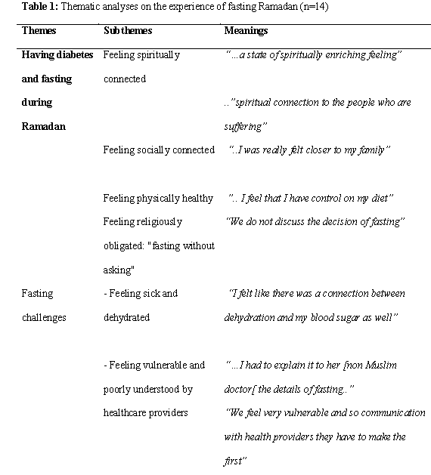
Outcome

Slide 6
Inclusion and exclusion criteria
The participants were recruited from 10 local mosques in North Carolina.
Muslim faith, aged 18 years or older, diagnosed with diabetes mellitus, and able to speak and read English
Those with cognitive impairment were excluded due to informed consent requirements

Slide 7
Validity Criteria
Was the choice of participants explicit and comprehensive?
No,
Even though Muslim fasting patients were chosen
Subjects were chosen with invitation from mosques
They were only from 10 mosques in north carolina

Slide 8
Was data collection sufficiently comprehensive and detailed?
Yes
The interviews centered on personal perspectives and beliefs, experiences and practices about fasting and managing diabetes during Ramadan
The interview specifically sought participant feelings about fasting during Ramadan, missing fasting days, decision-making about fasting, changes to their normal routine, barriers to managing diabetes during Ramadan, and the support received during Ramadan from healthcare providers

Slide 9
Were the data analyzed appropriately and the findings corroborated adequately?
Yes
All interviews were digitally recorded, transcribed verbatim and thematically analyzed
Transcripts were read initially several times by the full research team to develop a sense of the experience
Two researchers (NS & LD) examined each transcript and coded separately to extract significant statements and concepts for each specific experience and perception.
All related codes were grouped together to create themes and subthemes.
Trustworthiness of data was established using a variety of processes

Slide 10
Study Results
What are the results of the study?
Fasting during Ramadan was found to be a positive experience for Muslims with diabetes.
Fasting provided opportunities to feel compassion for those who are underprivileged; build a sense of self-control and will-power; improve their ability to resist temptations for over-eating; and develop a greater sense of humility, spirituality, and social involvement
However, “fasting without asking” raises some concerns

Slide 11
Participants felt religiously obligated to fast regardless of their health status and risk for experiencing potential diabetic complications
These findings suggest that this choice was based on misunderstanding Quran and Islamic teachings, which clearly exempt unwell Muslims from fasting
Many participants currently prefer making the decision to fast and change their medical routines without the input of healthcare providers.
This perception relates to healthcare provider’s lack of knowledge about Ramadan or from previous frustrating relationships with providers not supporting their religious practices

Slide 12
Applicability to Patient Care
Does the study offer helpful theoretical conclusions?
Yes
Fasting during Ramadan is an individual choice which should be supported by healthcare providers to ensure safe fasting
Allowing Muslim patients to make their own decision regarding fasting is crucial for self-empowerment, however, they need to be provided the tools to make healthy decisions

Slide 13
Does the study help me understand the context of my practice?
Yes

Slide 14
Does this study help me understand my relationships with patients and their families?
Yes

Slide 15
Thank you

