Slide 1
Critical Appraisal of an Economic Study
Anil Mathew Philip

Slide 2
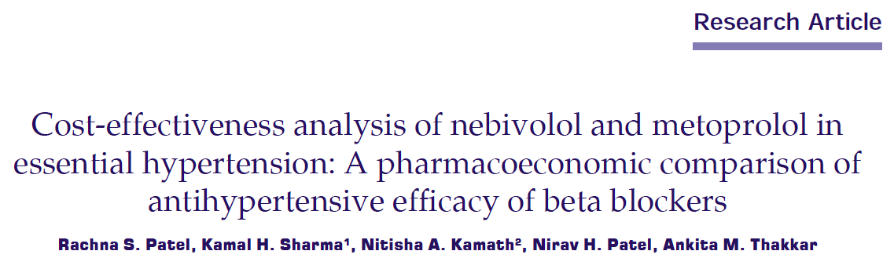

Slide 3
Background
Hypertension is an increasingly prevalent chronic condition that is associated with serious morbidity and mortality
Important risk factor for the development and progression of CVD
In India, 23.10% men and 22.60% women over the age of 25 years suffer from hypertension
BP reductions of 10 mmHg systolic or 5 mmHg diastolic are associated with a 33-48% reduction in stroke and a 17-27% reduction in CHD events

Slide 4
Previous research has shown that systematic control of blood pressure can result in considerable cost savings
Meta-analysis of efficacy and tolerability of nebivolol compared to other anti-hypertensive drugs his meta-analysis suggests that nebivolol 5 mg is likely to have advantages over existing antihypertensive drugs and may have a role in the treatment of hypertension

Slide 5
Hypothesis
Nebivolol is the more cost effective and efficacious drug compared to Metoprolol sustained release

Slide 6
PICOT
Population: Treatment naïve adult patients (aged> 18 years) with a BP of >140/90mmHg
Intervention: Nebivolol 2.5mg/5mg/10mg
Control: Metoprolol 25mg/50mg/100mg

Slide 7
Outcomes:
Primary- To look at the cost effectiveness of standard doses of both drugs in terms of mmHg reduction of BP/day
Secondary- Overall efficacy and saftey of the two drugs
Timeline: Patients would be followed up for 8 weeks

Slide 8
Study design
This was a prospective, randomized, controlled (RCT), open label, observational study
Comparison groups were nebivolol (2.5 mg, 5 mg, 10 mg) and sustained released metoprolol succinate (25 mg, 50 mg, 100 mg) in drug naïve newly diagnosed hypertensive patients

Slide 9
60 patients were divided into 6 groups 10 patients each
Patients in groups I, II, and III were given nebivolol in doses of 2.5 mg, 5 mg, and 10 mg, respectively and those in groups IV, V, and VI were given sustained released metoprolol succinate in doses of 25 mg, 50 mg, and 100 mg
The patients were called for follow-up visits, V2(28 days) and V3(56 days)

Slide 10
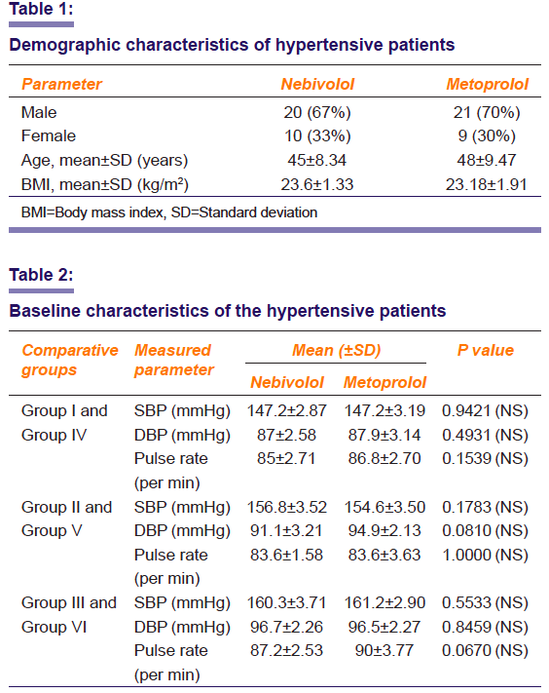

Slide 11
Are the results valid?

Slide 12
1. Did the recommendations consider all relevant patient groups, management options, and possible outcomes?
Did the investigators adopt a sufficiently broad viewpoint?
Yes, they have looked at cost effectiveness of mmHg of BP/day fall comparing two drugs.
They have also looked at HR/adverse events.

Slide 13
b. Are results reported separately for relevant patient subgroups?
Yes, the patients have been grouped into subgroups and results analyzed separately.
Small sample size of only 60 patients. Methods of stratification and randomization have not been mentioned.

Slide 14
2. Is there a systematic review and summary of evidence linking options to outcomes for each relevant question?
Were costs measured accurately?
Yes
Nebivolol 2.5 mg daily dose per tablet was 4.80 INR
sustained released metoprolol succinate 25mg daily dose per tablet was 4.50 INR

Slide 15
b. Did investigators consider the timing of
costs and outcomes?
Yes, they have followed up patients at 4 weeks and 8 weeks and have looked at the blood pressure and heart rate at these intervals, looking for cost effectiveness per mmHg drop in BP.

Slide 16
What are the results?

Slide 17
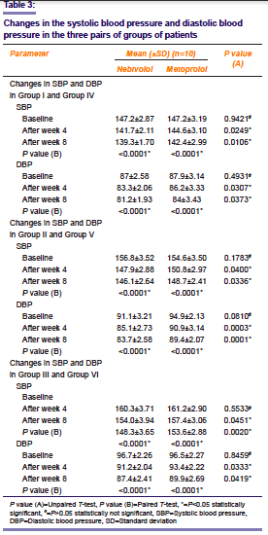

Slide 18
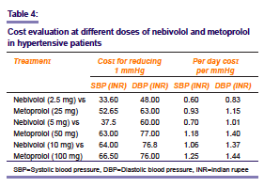
a. What were the incremental costs and effects of each strategy?
b. Do incremental costs and effects differ between subgroups?

Slide 19
c. How much does allowance for uncertainty change the results?
They have included treatment naïve patients who did not have other comorbidities.

Slide 20
Exclusion criteria:
Patients with pregnancy and/or lactation
patients with anuria, progressive and severe oliguria
hepatic coma
hypernatremia (sodium <135 mEq/ml), hypokalemia (K+<3.5 mEq/ml), hyperuricemia (uric acid >6 mEq/ml)
systemic lupus erythematosus
bronchial asthma
diabetes
thyrotoxicosis
peripheral vascular disease
bradycardia (heart rate <60 bpm), heart block greater than first degree, cardiogenic shock, decompensated cardiac failure or sick sinus syndrome
hepatic and/or renal dysfunction
any other serious concurrent illness or malignancy, continuing history of alcohol and/or drug abuse

Slide 21
How can I apply the results to patient care?

Slide 22
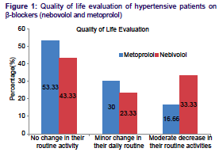
a. Are the treatment benefits worth the harms and the costs?
The authors have mentioned A total of 10% (n = 30) of the metoprolol users suffered such adverse effects, whereas only 3.33% of the nebivolol users(n=30) suffered adverse effects( p= 0.3006), but not evident from graph
Nebivolol 2.5mg OD x 8 weeks = Rs. 268.8/-
Metoprolol XL 25mg OD x 8 weeks = Rs. 252/-
If we compare per day/mmHg cost 0.6/- vs 0.83, for a 5mmHg drop difference in cost per day would be 3/- and 4.15/-

Slide 23
b. Can I expect similar costs in my setting?
Yes, this study has been done in India, hence there is no cost difference.

