Slide 1
Critical Appraisal of Clinical Decision Analysis
Anil Mathew Philip

Slide 2
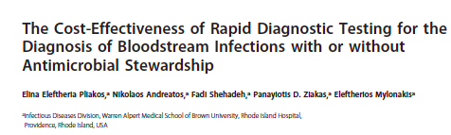

Slide 3
Background
Blood stream infections are the leading cause of mortality due to infection, and is associated with prolonged hospital stay and expenses
Timely administration of antibiotics can reduce mortality as well as resistance
Use of molecular rapid diagnostic tests require <24 hours to identify the organism, hence we can transition from broad spectrum AB, according to sensitivity
Combined with ASP have the potential to improve outcomes
Recommended by IDSA, but yet to be widely implemented

Slide 4
Aim
The aim of this study is to determine the cost-effectiveness of mRDT alone or combine with an ASP by looking at:
the length of stay and the effect of mRDTs +/- ASP on mortality
And the cost effectiveness of the different models

Slide 5
Study Design
Population: Patients from meta analysis- with survival of patients with blood stream infections who underwent species identification with mRDT or CLM, with or without ASP
Investigation: Different methods of identification of blood stream infection mRDT
Gold Standard investigation: Conventional laboratory methods
Outcome: to look at the base-case analysis

Slide 6
Primary Outcome
The outcome for the base-case analysis was the ICER, defined as the excess cost of a strategy over the cost of the baseline strategy

Slide 7
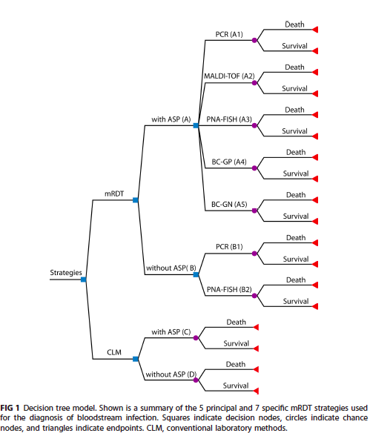

Slide 8
Are the recommendations valid?
Did the recommendations consider all relevant patient groups, management options, and possible outcomes?
Yes, here they have looked extensively at the different methods of mRDT and CLM, and have looked at appropriate outcomes with hospital stay and cost. Effectiveness of strategy was assed by 30 day mortality.

Slide 9
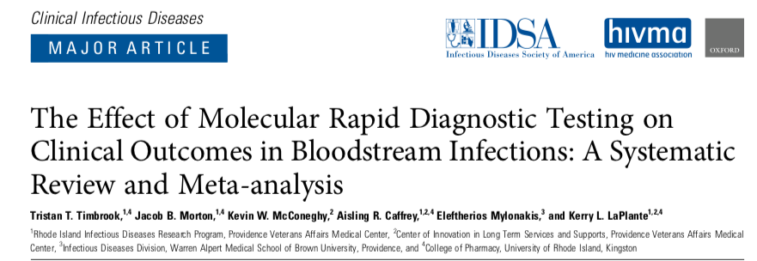
Are there systematic reviews of evidence that estimate the relative impact of management options on relevant outcomes?
This SR, had concluded that mRDT with ASP, had the best clinical outcomes in terms of LOS, and showed a decreased mortality risk.

Slide 10
Is there an appropriate specification of values and preferences associated with each of the outcomes?
The decision analysis model was clear and had 5 principal strategies
The base-case cost values used were cost adjusted based on costs that were used in John Hopkins hospital. For the cost of ASPs, we used the cost estimate provided by Scheetz et al., namely, $125 ($179.29 adjusted) per patient

Slide 11
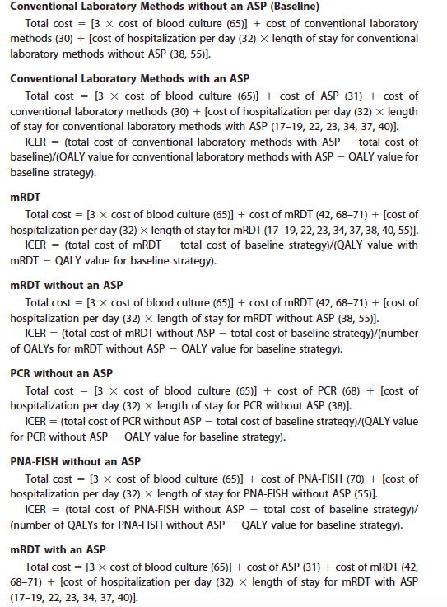

Slide 12
Do the authors indicate the strength of their recommendations?
No mention of the strength of recommendation has been mentioned.

Slide 13
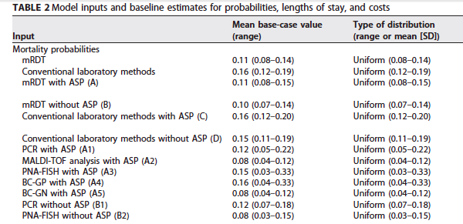
What are the results?

Slide 14
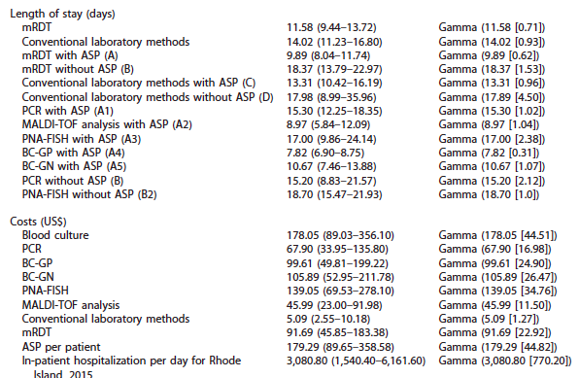

Slide 15
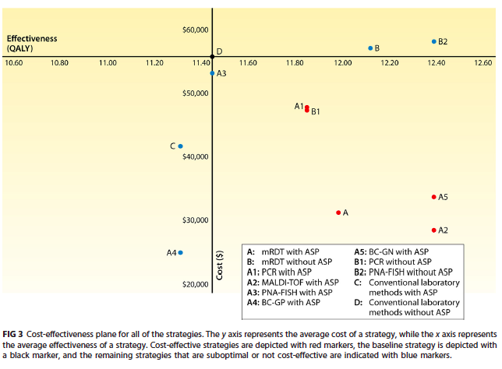

Slide 16
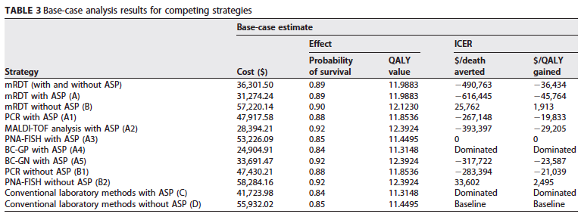

Slide 17
Will the recommendations help you in caring for your patients?
Do the recommendations make sense in your practice setting
Yes, here the use of MALDI-TOF with ASP, has shown improved outcomes in terms of mortality and costs(most cost effective model).
Initial investment may be a problem for most institutes

