Slide 1
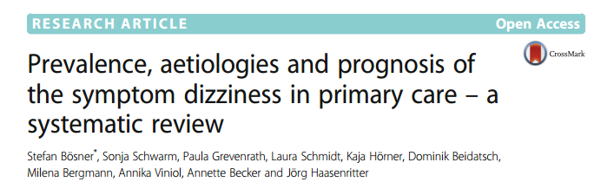
Critical appraisal of study on differential diagnosis
Jasper rathinam j

Slide 2
background
Dizziness is a common complaint and frequent reason for consultation in primary care virtually affecting every person once in his or her lifetime
Dizziness is a more subjective and vague symptom referring to a
sense of spatial disorientation, motion of the environment, or light headedness
Vertigo (as a subcategory of dizziness) is described as an illusion of movement, either of the external world revolving around the individual or of the individual revolving in space.
Both symptoms can be caused by a broad spectrum of diseases ranging from
benign and self-limiting (e.g. neuritis vestibularis) to severe and potentially life-threatening causes (e.g. cardiac arrhythmias or acute cerebral-vascular events)
most patients with dizziness the general practitioner (GP) is the first contact person within the official healthcare system.

Slide 3
PICOT
P : Patients presenting to primary clinic with the complaints of Giddiness and Vertigo
E : Evaluation for cause of the same
O : Final Diagnosis and Outcome for the patients
T: Cross sectional , Some studies – 3 month follow up

Slide 4
Study design – systematic review
computer-based search of the PUBMED and EMBASE databases
Studies published in English, German, Dutch, Italian, Russian, Swedish, French and Spanish were included.
Studies selection process : 2 sets of authors , reviewed and choose. Third author in case of disagreement.
3 types of Data were extracted : Bibliographic data , diagnostic categories and their absolute and relative frequencies , All forms of reported outcomes

Slide 5
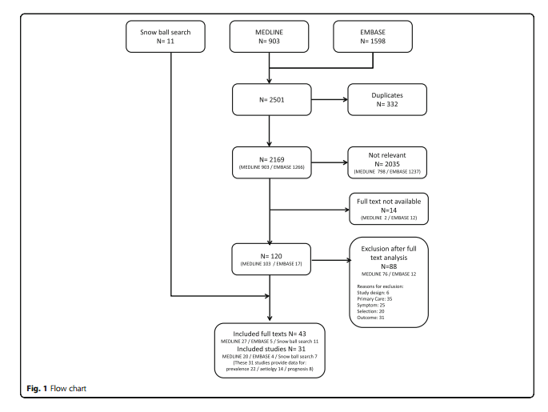

Slide 6
Did the study patients represent the full spectrum of those with this clinical problem?
Did the investigators define the clinical problem clearly ?
As it was a systematic review , broad definition included.
Were the study patients collected from all relevant clinical settings?
Data collected by only primary clinics may not be representative of all patients
Critical patients may present to tertiary centre

Slide 7
Were study patients recruited consecutively from the clinical settings ?
Probably , not mentioned
Did the study patients exhibit, the full clinical spectrum of this presenting complaints?
Details – not available

Slide 8
Data accrue mainly from Europe (21 studies) and USA (five studies) and 5 studies from Australia and Asia
Time of publications varied between 1972 and 2014.
Twenty three studies took place in general practice, five in primary health care
centres and the remaining three in hospital based primary care centres

Slide 9
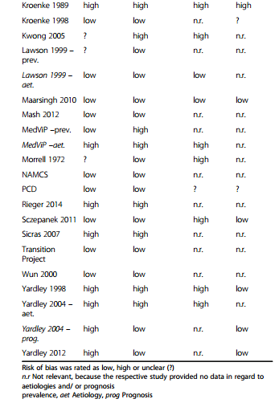
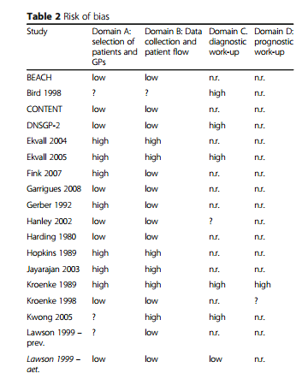

Slide 10
Was the diagnostic evaluation definitive?
Was the diagnostic evaluation sufficiently comprehensive?
No data available in most studies

Slide 11
Was the diagnostic evaluation consistently applied to all patients?
Not mentioned , but probably different as studies were done in various countries over varied time zones( ranging 40 years)

Slide 12
Were the diagnostic labels assigned reproducibly?
Yes
Final Diagnostic labels were created and data from studies were allotted to such labels.
No diagnosis identified was mentioned in 80% of studies
No definite criteria were applied to choose diagnosis
Notes:
Physicians at the sites determine the final diagnoses and diagnostic codes, which are selected from a standardized list of 522 diagnostic entities, some of which are etiologic (such as Streptococcus pneumoniae) and others of which are syndromic (such as cough).

Slide 13
Were there few patients left undiagnosed?
Many patients were left undiagnosed

Slide 14
For undiagnosed patients, was follow-up sufficiently long and complete?
Most studies were cross sectional .
Detailed evaluation for etiology not done in man studies as they looked at data from primary care

Slide 15
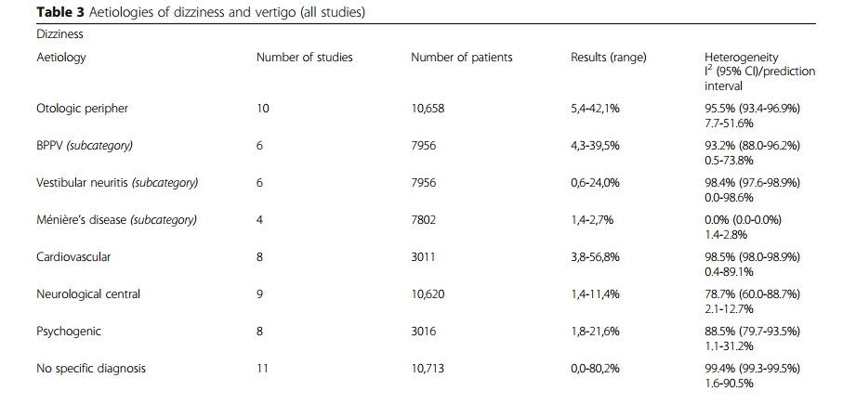
What were the results?
What were the diagnoses and their probabilities?

Slide 16
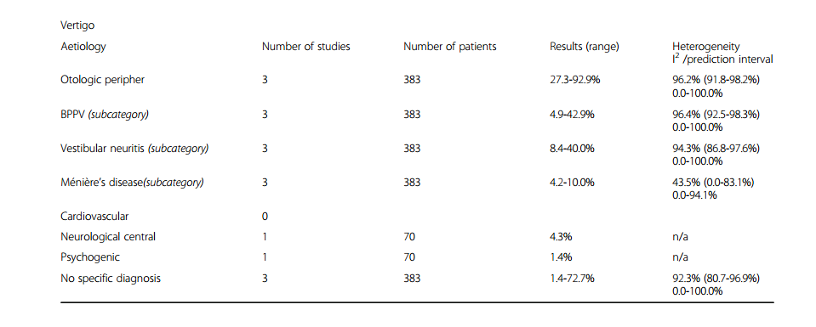

Slide 17
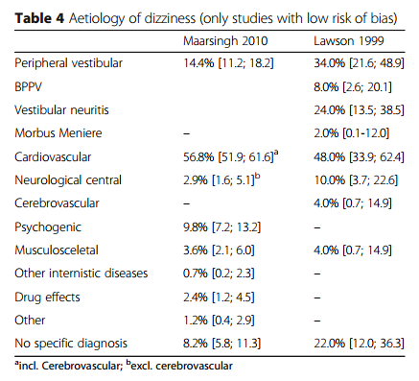

Slide 18
Prognosis/Outcome
Five studies measured subjective patient assessment. Patients reported subjective improvement in al studies ranging from 37% to 77%

Slide 19
How precise are the estimates of disease probability?
All studies showed significant heterogeneity except for the estimate for Meniere’s Disease
And wide 95 % Confidence Intervals

Slide 20
Are the study patients and clinical setting similar to mine?
The study group was those presenting to Primary care
Over 40 years
Over many countries
May not be directly applicable

Slide 21
Is it unlikely that the disease possibilities or probabilities have changed since this evidence was gathered?
Currently advances in diagnostic methods may reduce the not diagnosed causes

Slide 22
Thank you

