Slide 1
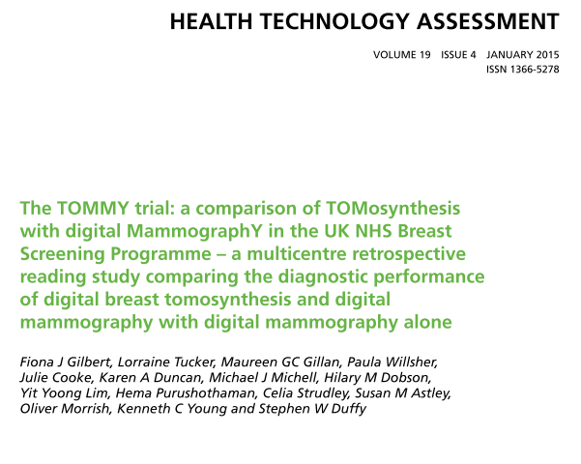

Slide 2
Breast screening with mammography is recognised as the most effective method of detecting early-stage breast cancer and reducing breast cancer mortality.
A recent meta-analysis of 11 randomised trials concluded that there was a 20% relative risk reduction in breast cancer mortality in women invited to screening.
15–30% of cancers are not detected- in two-dimensional (2D) mammography
Digital breast tomosynthesis (DBT) is a newly developed three-dimensional (3D) imaging technique that has the potential to improve the accuracy of mammography by reducing overlapping shadows from breast tissue that degrade the image quality in standard 2D projection imaging.
Notes:
that overlapping dense fibroglandular tissue within the breast can decrease the visibility of malignant abnormalities or simulate the appearance of an abnormality. This reduces the sensitivity of screening and increases the number of false-positive recalls.2 by standard screening,3
and this percentage is higher in women aged under 50 years4
dense breasts.

Slide 3
P-Women aged 40–73 years attending routine breast screening
Index test-Standard two-view DBT imaging
Standard test-Two-view 2D mammography of both breasts
Diagnostic accuracy.
Notes:
Digital breast tomosynthesis (DBT) is a newly developed three-dimensional (3D) imaging technique that has the potential to improve the accuracy of mammography by reducing interference from breast tissue overlap

Slide 4
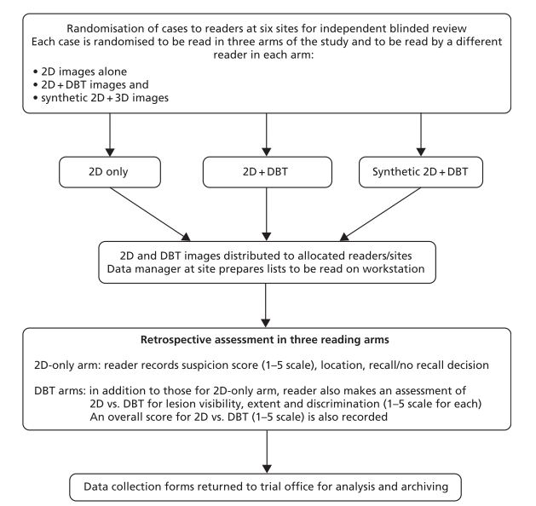

Slide 5
Statistical analysis
In any given subgroup, we postulated a sensitivity for 2D mammography of 85% and for 2D + DBT of 95%.
With a 5% significance level and two-sided testing
This implies a total study size of 7000 assessment cases. A study population of this size would have at least 90% power for any subgroup that is at least 15% of the total study and 80% for any subgroup that is at least 11%.
Notes:
In any given subgroup, we postulated a sensitivity for 2D mammography of 85% and for 2D + DBT of 95%.
subgroup was likely to be approximately 15% of the total; therefore, a total of 1267 cancer cases was required.
Approximately 18% of cases recalled for assessment are ultimately found to have breast cancer.
This implies a total study size of 7000 assessment cases. A study population of this size would have at least 90% power for any subgroup that is at least 15% of the total study and 80% for any subgroup that is at least 11%.
It might be reasonable to anticipate that the specificity of 2D would be 93% and that the addition of DBT might improve this to 97%. Assuming 90% agreement between the two imaging modalities, negative assessment outcomes would be as shown in Table 4.
For 90% power to detect this as significant, we required 62 discordant negative cases in any given subgroup, that is 620 negative cases in total in any given subgroup. Since the subgroups of interest were all expected to be at least 15% of the total study size, we expected 1050 (15% of 7000) subjects in each subgroup, of whom 861 (82%) would be negative. Thus, there will be >90% power for the postulated difference in specificity

Slide 6
Anticipate the specificity of 2D would be 93% and that the addition of DBT might improve this to 97%
For 90% power to detect this as significant, we required 62 discordant negative cases in any given subgroup, that is 620 negative cases in total in any given subgroup. Since the subgroups of interest were all expected to be at least 15% of the total study size, we expected 1050 (15% of 7000) subjects in each subgroup, of whom 861 (82%) would be negative. Thus, there will be >90% power for the postulated difference in specificity
Notes:
It might be reasonable to anticipate that the specificity of 2D would be 93% and that the addition of DBT might improve this to 97%. Assuming 90% agreement between the two imaging modalities, negative assessment outcomes would be as shown in Table 4.
For 90% power to detect this as significant, we required 62 discordant negative cases in any given subgroup, that is 620 negative cases in total in any given subgroup. Since the subgroups of interest were all expected to be at least 15% of the total study size, we expected 1050 (15% of 7000) subjects in each subgroup, of whom 861 (82%) would be negative. Thus, there will be >90% power for the postulated difference in specificity

Slide 7
How serious is the risk of bias?
Did participating patients constitute a representative sample of those presenting with a diagnostic dilemma?
Yes

Slide 8
Did investigators compare the test to an appropriate, independent reference standard?
Yes 2D mammography.

Slide 9
Were those interpreting the test and reference standard blind to the other results?
Readers reviewed (1) 2D images or (2) 2D + DBT or (3) synthetic 2D + DBT images for any one case and did not review any cases from their own centre.
Notes:
Readers reviewed (1) 2D images or (2) 2D + DBT or (3) synthetic 2D + DBT images for any one case and did not review any cases from their own centre. Cases were read on a workstation without access to the original screening mammograms or prior examinations. Readers were blinded to the outcome status of each case and read cases independently of all other readers.
For the 2D-only arm, the location of any suspicious abnormality in the breast was recorded on a nine-square grid on the data collection proforma (see Appendix 11). Suspicion was scored on a five-point scale85
and a decision to recall or not was recorded.

Slide 10
Did all patients receive the same reference standard irrespective of the results of the test results?
Yes
readers reviewed (1) 2D, (2) 2D+ DBT or (3) synthetic 2D + DBT images

Slide 11
What are the results?
What likelihood ratios were associated with the range of possible test results?

Slide 12
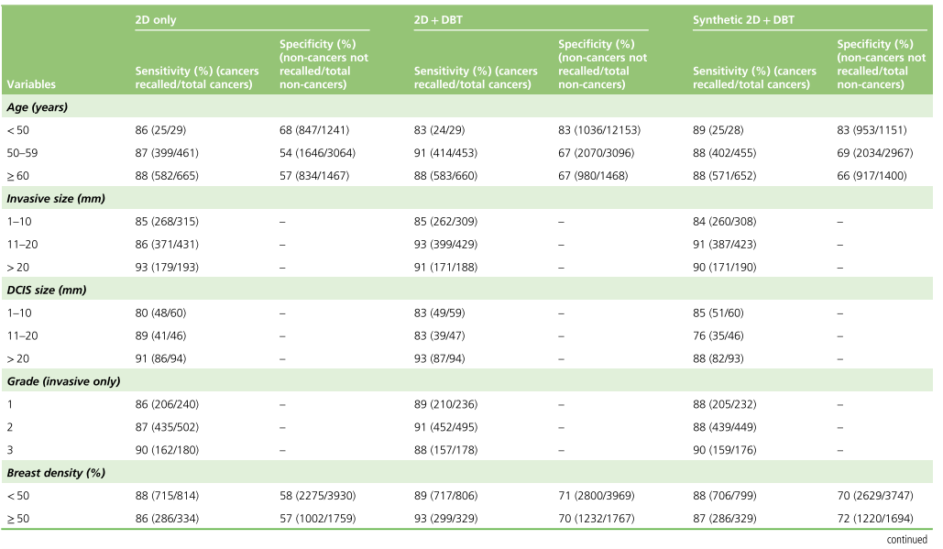

Slide 13
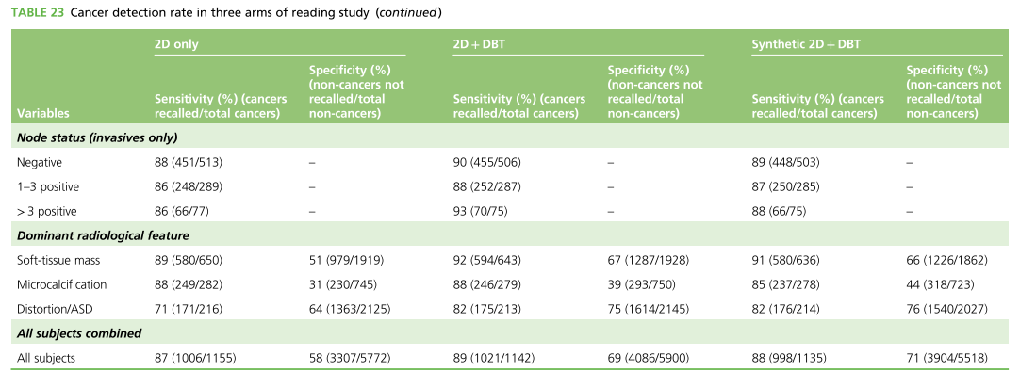
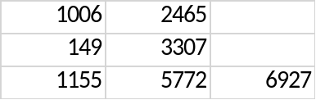
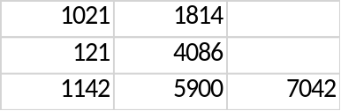
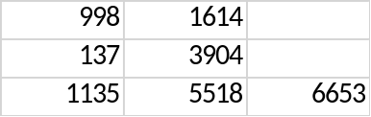
Positive LR 2.07 2.87 3.03

Slide 14
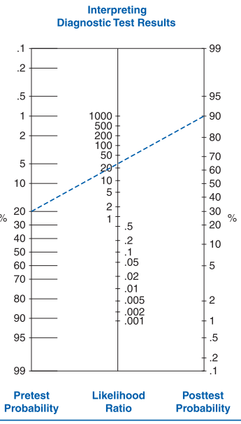

Slide 15
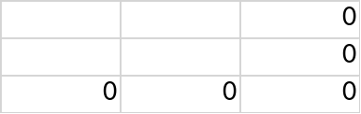

Slide 16
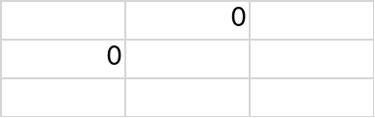

Slide 17
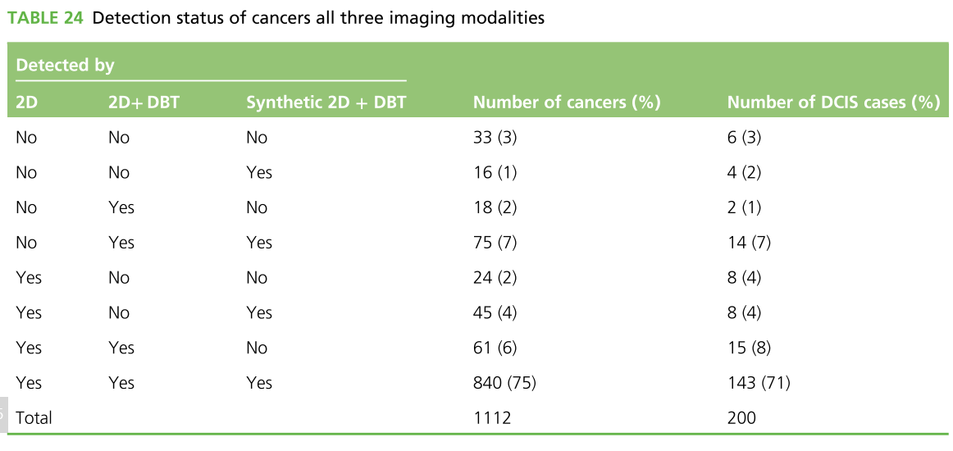

Slide 18
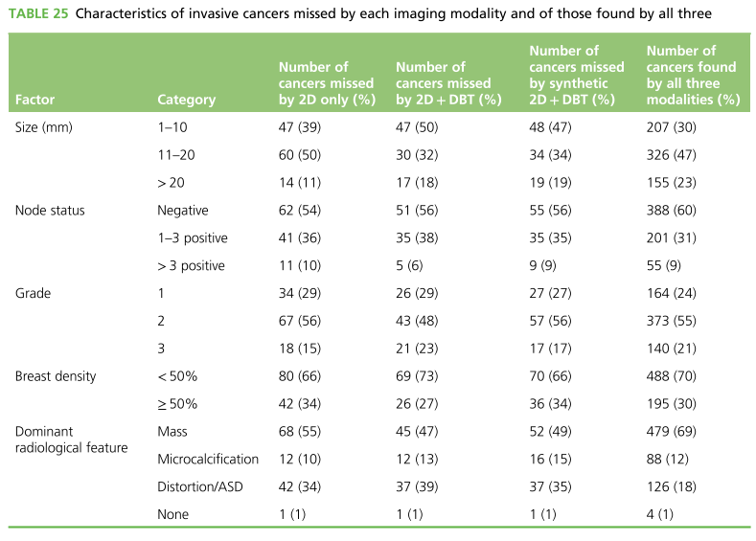

Slide 19
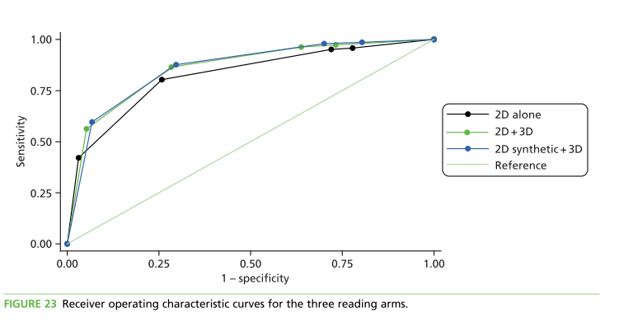
Notes:
For 2D alone, the AUC was 0.84 (95% CI 0.83 to 0.86), for 2D+ DBT the AUC was 0.89 (95% CI 0.87 to 0.90) and for synthetic 2D + DBT the AUC was 0.87 (95% CI 0.86 to 0.89). Both 2D + DBT and synthetic 2D + DBT had significantly greater AUCs than 2D alone (p < 0.001 in both cases).

Slide 20
How can I apply the results to patient care?
Will the reproducibility of the test results and its interpretation be satisfactory in my clinical setting?
Two observers have scored the same images show that in 70% of cases there was good agreement. In 8% of cases there was, however, a disagreement of more than 20%, which is a result that has been noted elsewhere.

Slide 21
Are the study results applicable to patients in my practice?
Yes

Slide 22
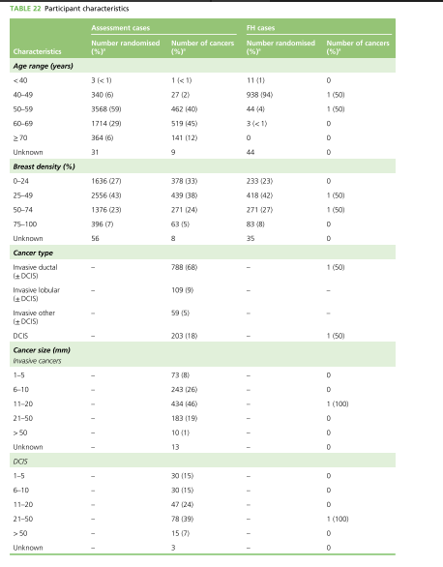

Slide 23
Will the test results change my management strategy?
No difference in sensitivity. No added benefit.

Slide 24
Will patients be better off as a result of the test?
Would need to do a cost and prognosis study to find the result.

