Slide 1
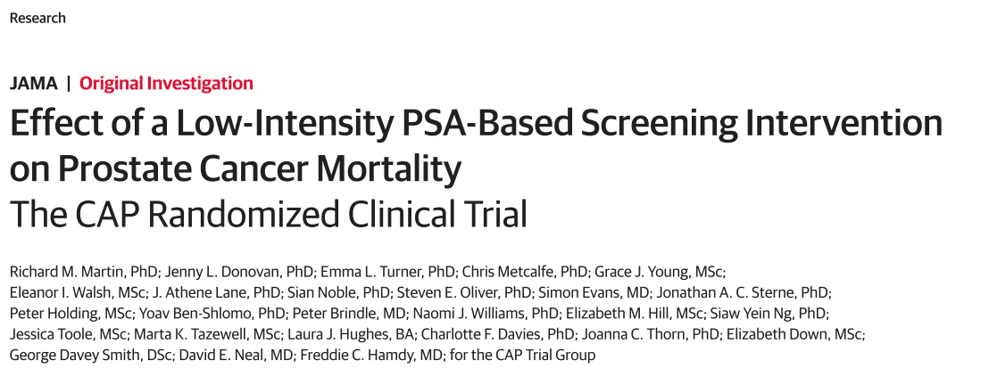

Slide 2
Background
Prostate cancer screening remains controversial
To evaluate the effect of a single prostate-specific antigen (PSA) screening intervention and standardized diagnostic pathway on prostate cancer–specific mortality.
Notes:
Prostate cancer screening remains controversial because potential mortality or quality-of-life benefits may be outweighed by harms from overdetection and overtreatment.
OBJECTIVE To evaluate the effect of a single prostate-specific antigen (PSA) screening intervention and standardized diagnostic pathway on prostate cancer–specific mortality.

Slide 3
P-Men aged 50 to 69 years attending primary care practices across the United Kingdom.
I- PSA testing
C- Standard (unscreened) practice
O- Prostate cancer–specific mortality
T- Median follow-up of 10 years.

Slide 4
The inclusion criteria
All men aged 50 to 69 years in each of the randomized primary care practices.
The exclusion criteria
History of prostate cancer on or before the randomization date
Notes:
The inclusion criterion was all men aged 50 to 69 years in each of the randomized primary care practices. The exclusion criteria were a history of prostate cancer on or before the randomization date and patient registration with the practice on a temporary or emergency basis. Follow-up was completed on March 31, 2016.

Slide 5
Cluster Randomized Trial of PSA Testing for Prostate Cancer (CAP)
Included 419 582 men aged 50 to 69 years
573 primary care practices across the United Kingdom.
Randomization and recruitment of the practices occurred between 2001 and 2009; patient follow-up ended on March 31, 2016.
Randomization was stratified within geographical groups and block sizes of10 to 12 neighboring practices using a computerized random-number generator.
Notes:
The Cluster Randomized Trial of PSA Testing for Prostate Cancer (CAP) included 419 582 men aged 50 to 69 years and was conducted at 573 primary care practices across the United Kingdom. Randomization and recruitment of the practices occurred between 2001 and 2009; patient follow-up ended on March 31, 2016.
Randomization was stratified within geographical groups and block sizes of10 to 12 neighboring practices using a computerized random-number generator.
The assignment of groups (eg, schools, clinics) rather than individuals to intervention and control groups. This approach is often used when assignment by individuals is likely to result in contamination (eg, if adolescents within a school are assigned to receive or not receive a new sex education program, it is likely that they will share the information they learn with one another; instead, if the unit of assignment is schools, entire schools are assigned to receive or not receive the new sex education program). Cluster assignment is typically randomized, but it is possible (though not advisable) to assign clusters to treatment or control by other methods.

Slide 6
Outcome
The primary outcome was definite, probable, or intervention-related prostate cancer mortality at a median follow-up of 10 years.
Determined by an independent cause of death evaluation committee that was blinded to trial group assignment
Notes:
The primary outcome was definite, probable, or intervention-related prostate cancer mortality at a median follow-up of 10 years and was determined by an independent cause of death evaluation committee that was blinded to trial group assignment

Slide 7
Concealment not possible.
Notes:
Because randomization preceded practices being invited to take part in the study and because the invitation was tailored to the group (intervention or control) to which the practice had been randomized, it was not possible to conceal randomization while practices decided whether to participate.

Slide 8
Sample size
209000 men in each group would yield 1720 prostate cancer deaths during a median follow-up of10 years, and allow a prostate cancer mortality RR of 0.87 to be detected with 80% power at a significance level of .05.
Notes:
Calculations predicted that 209000 men in each group would yield 1720 prostate cancer deaths during a median follow-up of10 years, and allow a prostate cancer mortality RR of 0.87 to be detected with 80% power at a significance level of .05. Assuming an uptake in PSA testing of between 35% and 50%
this corresponds to RRs between 0.62 and 0.73 among men actually undergoing PSA testing.

Slide 9
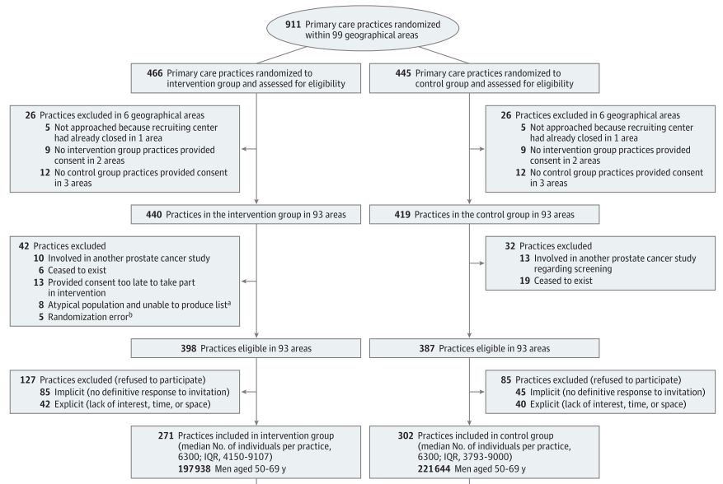

Slide 10
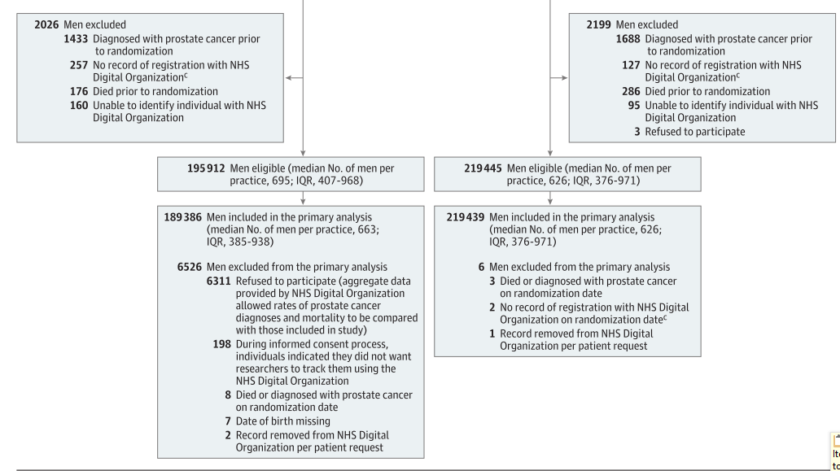

Slide 11
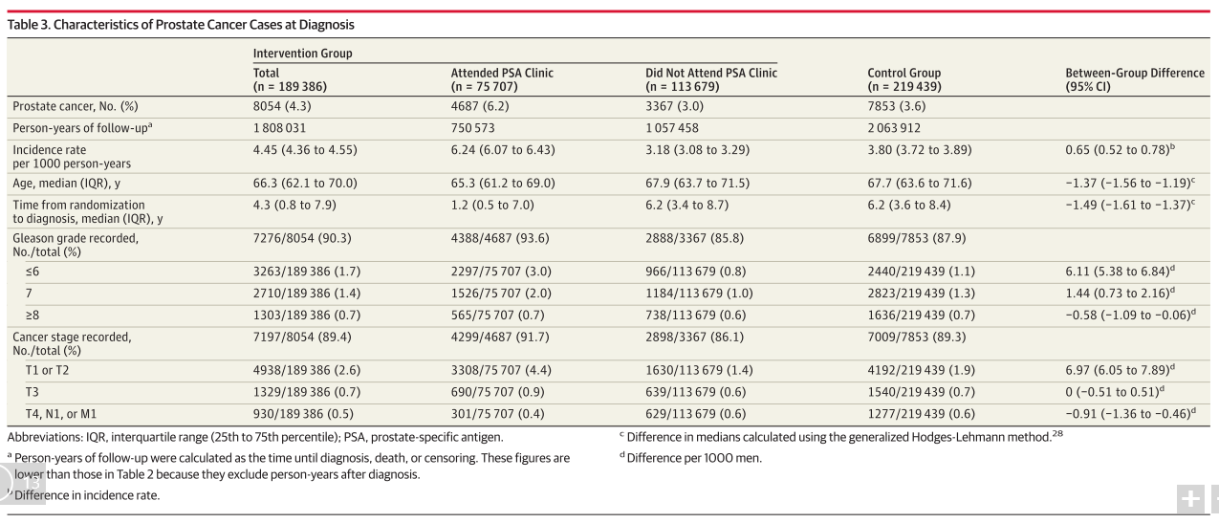

Slide 12
Were the data identified, selected, and combined in an unbiased fashion?

Slide 13
Validity of the study
Study population: well defined
Outcomes: clearly defined
Randomization: Adequate
Allocation concealment: Not done.
Blinding: Out come assesors were blinded.
Sample size calculation:
Intention to screen analysis: Done
Baseline characteristics: well matched

Slide 14
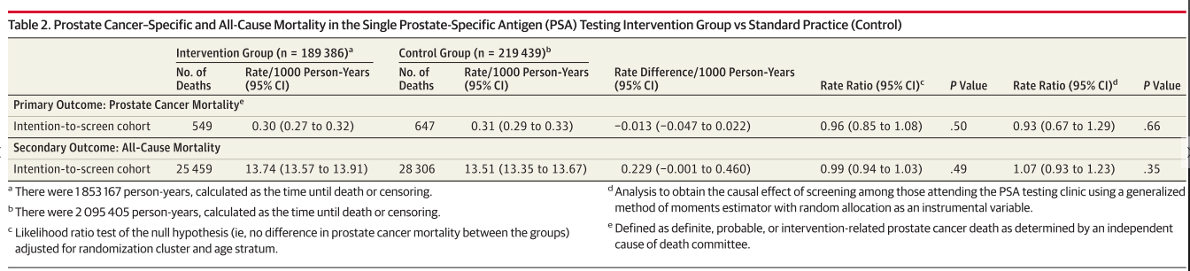
What are the benefits?

Slide 15
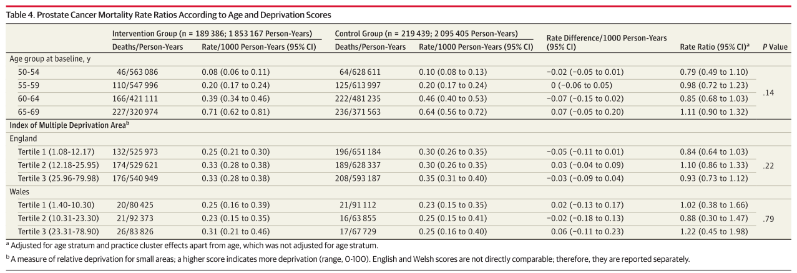

Slide 16
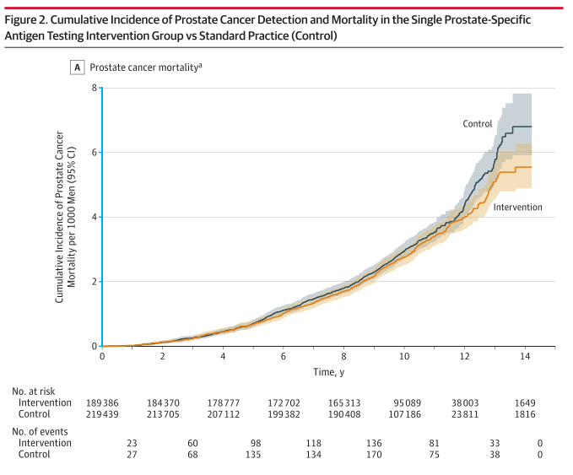
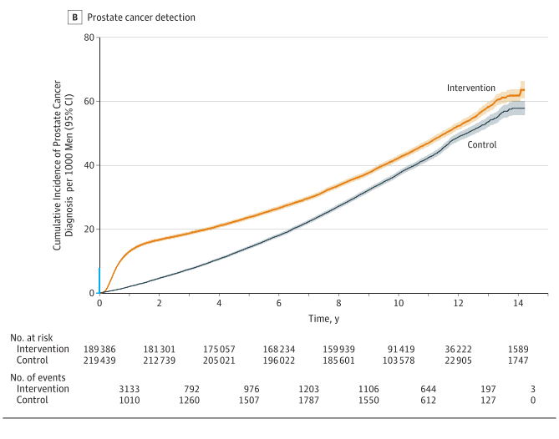

Slide 17
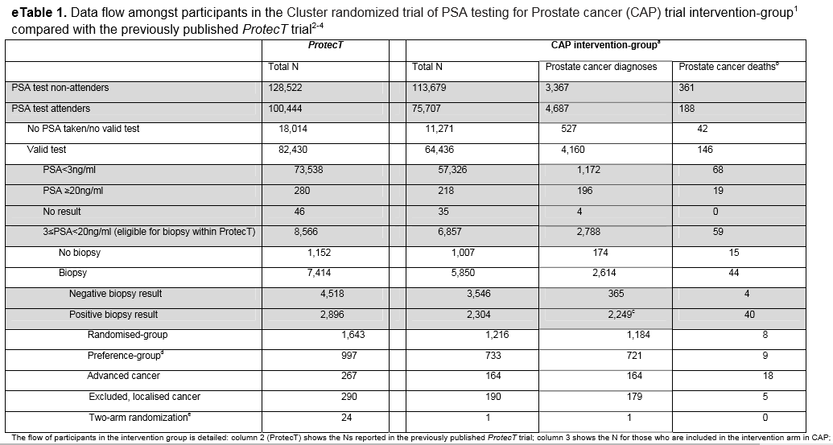
What are the harms?
Notes:
What Are the Harms?
Among those who test positive, adverse consequences may include • complications arising from investigation (screening test); • adverse effects of treatment; • unnecessary (over-)treatment of persons having true-positive results (clinically irrelevant disease, overdetection);
• adverse effects of labeling and early diagnosis; • anxiety generated by the investigations and treatment; and • costs and inconvenience incurred during investigations and treatment

Slide 18
What are the harms?
False negatives were in lethal cancer group reported-
Single PSA test screening did not identify (n = 129/188; 69%).
68 had a PSA level of less than 3.0 ng/mL at screening.
Did not mention
  • unnecessary (over-)treatment of persons having true-positive results (clinically irrelevant disease, overdetection)
  Adverse effects of labeling and early diagnosis;
  anxiety generated by the investigations and treatment;
  costs and inconvenience incurred during investigations and treatment
Notes:
Lethal cancer had not been identified by the single PSA test screening in the majority (n = 129/188; 69%).
Of these 129 men, 42 had not undergone PSA testing at all, 15 eligible men had not received a prostate biopsy,
68 had a PSA level of less than 3.0 ng/mL at screening (and therefore were below the threshold for recommending biopsy), and
4 had a benign prostate biopsy result
What Are the Harms?
Among those who test positive, adverse consequences may include • complications arising from investigation (screening test); • adverse effects of treatment; • unnecessary (over-)treatment of persons having true-positive results (clinically irrelevant disease, overdetection);
• adverse effects of labeling and early diagnosis; • anxiety generated by the investigations and treatment; and • costs and inconvenience incurred during investigations and treatment

Slide 19
How do benefits and harms compare in different people and with different screening strategies?
Only Single screening strategy done here.
Other studies has looked at multiple screening
Notes:
First, the single PSA screening may fail to reflect the long-term effect ofmultiple PSA testing rounds seen in the ERSPC and PLCO trials. Nevertheless, we observed both a Gleason grade and cancer stage shift, and a reduction in long-term prostate cancer incidence following a single screening round. In PLCO35 and ERSPC centers,36,37 tumors identified during second and subsequent screening rounds were more likely to be localized, small volume, and with favorable histological grading compared with those found during the first round of screening, supporting model-based estimates that suggest over detection increases with repeated screening.37
This study look at a since PSA screening, where as other previous studies screening stratergy have looked in to multiple PSA testing.

Slide 20
What is the effect of individuals’ values and preferences?
No details given.

Slide 21
What is the effect of uncertainty associated with the evidence?
The sample size were large.
False negative among lethal groups were present.

Slide 22
What is the cost-effectiveness?
Not done.

Slide 23
Thank you.

