Slide 1


Slide 2
Background
Approximately 15% of ischaemic strokes are preceded by a transient ischaemic attack (TIA).
“Warning” event provides an opportunity to prevent stroke, and guidelines highlight the need for rapid access clinics.

Slide 3
PICOT
P- patients who had a TIA (n = 87) or minor stroke (n = 87) during the study period.
O- Risk of recurrent stroke at seven days, one month, and three months after TIAs and minor strokes.
T- 3 months after the TIA or minor stroke
Design- Population based prospective cohort study of patients with TIA or stroke.

Slide 4
Inclusion criteria
Patients who presented with a first or recurrent TIA or minor stroke, diagnosed according to standard criteria, during the study period.
Minor stroke was defined as ≤ 3 on the National Institutes of Health stroke scale at the time of initial assessment.

Slide 5
EXCLUSION CRITERIA
If informed consent or if assent from the nearest relative
was unavailable

Slide 6
Are the results valid?
Was the sample of patients representative?
  Population based study
  Covered a population of 90 542 who were registered with 63 general practioners.
  GPs had to inform the study physician.
  Biweekly visits by study research nurse .
  Daily review of hospital admission registers, emergency department records, radiology requests for brain and carotid imaging.
  Patients not needing hospital admission were seen as soon as possible in the next OPD by the study physician.

Slide 7
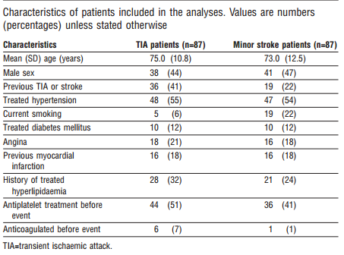
Baseline characteristics

Slide 8
Were patients sufficiently homogeneous with respect to prognostic risk?
  Excluded patients with major stroke.
  Included patients with previous TIA or minor stroke.

Slide 9
Was follow-up sufficiently complete?
  Yes
Were objective and unbiased outcome criteria used?
  MRS- subjective score
  NIHS score- Objective.

Slide 10
What are the results?
How likely are the outcomes over time?
How precise are the estimates of likelihood?
 | 7 days | 1 month | 3 months
TIA | 8% (2.3%- 13.7%) | 11.5% (4.8% – 18.2% | 17.3% (9.3%- 25.3%)
Excluding recurrent TIA/ minor stroke | 7.2% (1.7% to 12.8%) | 8.4% (2.4% to 14.4%) | 13.3% (6.0% to 20.6%)
Minor stroke | 11.5% (4.8%-11.2%) | 15% (7.5%- 22.5%) | 18.5% (10.3%-26.7%)
Excluding recurrent TIA/ minor stroke | 7.2% (1.7% to 12.8%) | 10.9% (4.2% to 17.6%) | 14.6% (7.0% to 22.2%)

Slide 11
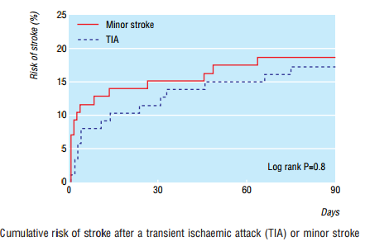

Slide 12
How can I apply the results to patient care?
Were the study patients and their management similar to my own?
  Racial differences
  Only 12% of study population are diabetics.
  Management- same.
Was the follow-up sufficiently long?
  3 months follow up not long enough.
Can I use the results in managing patients in my practice?
  Yes.

