Slide 1
Appraisal of a systematic review
Dr Jacob

Slide 2
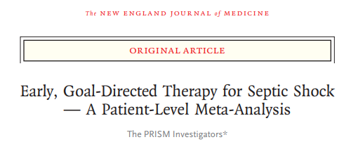

Slide 3
In 2001, Rivers and colleagues reported on a 263-patient, single-center, randomized, controlled trial of early, goal-directed therapy (EGDT) versus usual care in patients presenting with septic shock
Three subsequent, government-funded, multicenter, randomized, controlled trials from the United States failed to show lower mortality with EGDT than with usual care

Slide 4
AIM
The goals of the current study were to use pooled data from the three trials to determine the effect of EGDT versus usual care on 90-day mortality and secondary clinical and economic outcomes and to compare the effects of EGDT across prespecified patient and care-delivery subgroups

Slide 5
Intervention: EGTD
Control: Usual care
Three multicenter trials (ProCESS, ARISE, and ProMISe)

Slide 6
Assessing the credibility of the systematic process

Slide 7
Did the review explicitly address a sensible clinical question?
Yes
The effect of EGDT versus usual care on 90-day mortality was evaluated

Slide 8
Was search for the relevant studies exhaustive?
No web search was done, only 3 major studies were taken

Slide 9
Were selection and assessment of studies reproducible?
Decision making was not discussed

Slide 10
Did the review address possible explanations of between study differences in results?
All three studies were negative studies showing likely results

Slide 11
Did the review present results that are ready for clinical application?
Yes, this was a negative study
EGDT was not beneficial

Slide 12
Rating the quality of study

Slide 13
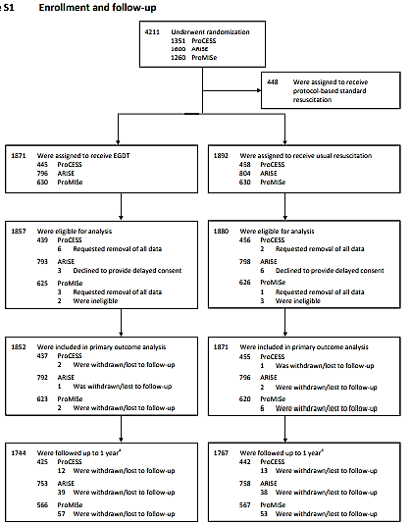
What is the risk of bias across all the studies?

Slide 14
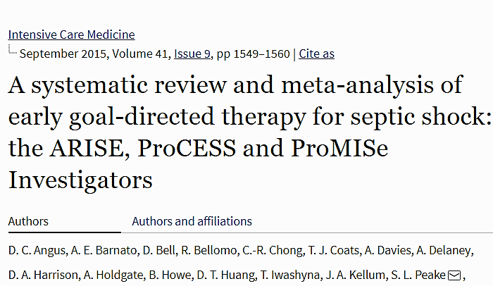
Bias was looked in the prior systematic review
The Cochrane Collaboration tool was used to assess the risk of bias in the prior study
This study does not give risk of bias
All of the 3 studies were RCT’s.

Slide 15
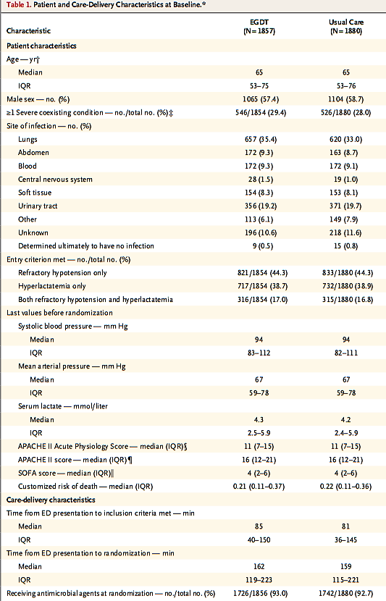
Do the systematic review population, intervention, comparison, and outcomes fit the patient at hand

Slide 16
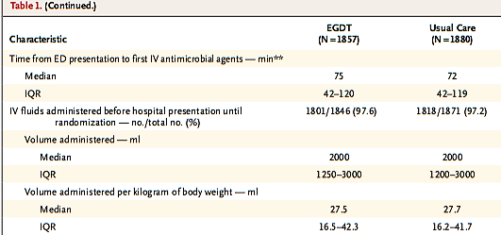
Do the systematic review population, intervention, comparison, and outcomes fit the patient at hand
Yes, we would expect the same population, the result comparison was optimal

Slide 17
Are the results inconsistent across studies?
No, all three studies were similar, but individual studies have not been evaluated in this analysis.

Slide 18
Is there a high likelihood of publication bias?
Was not done

Slide 19
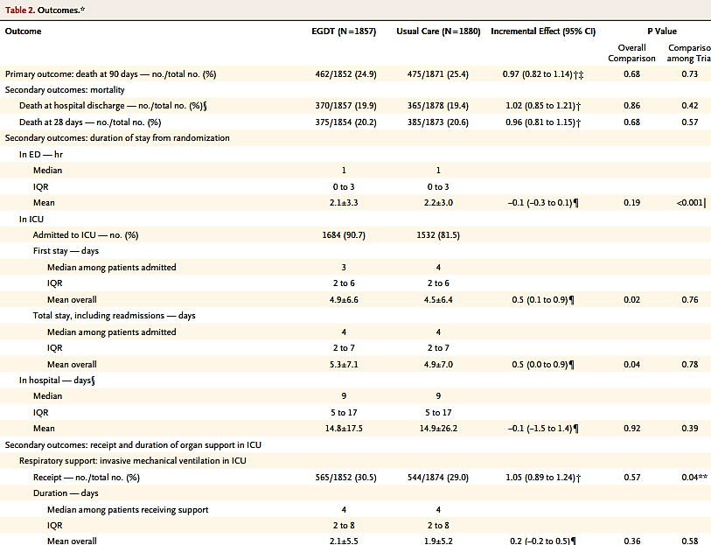
Do you consider the magnitude of treatment effect large (e.g. RR> 2.0 or
<0.5)?

Slide 20
Overall confidence in the estimates

Slide 21
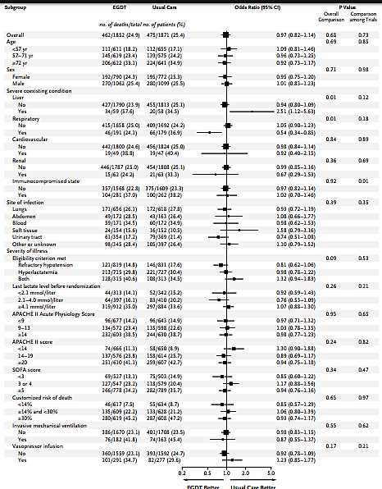

Slide 22
Individual studies were not compared and so the overall effect was not done

Slide 23
Analysis
Selection bias- 3 studies
Metanalysis of three negative studies were done
No dilemma at the start of the study
Result was negative as expected
No new inference from his study

Slide 24
Thank you

