Slide 1
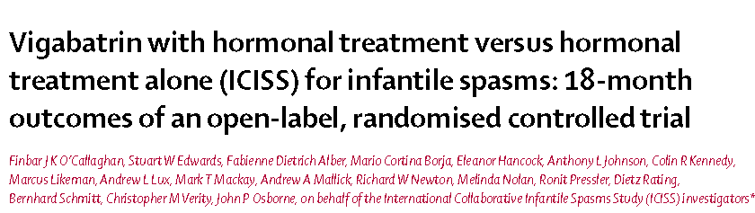
RCT critical appraisal
Jacob

Slide 2
Background
Infantile spasms are a severe form of epilepsy
They were the first described form of epileptic encephalopathy
Affects approximately one in 2500 infants
Notes:
Infantile spasms are a severe form of epilepsy often associated with a poor outcome both with respect to development and future epilepsy control.

Slide 3
Background
The International Collaborative Infantile Spasms (ICISS) study is the first study to assess a combination of therapies (hormonal therapies plus vigabatrin)
Between days 14 and 42 of treatment.
This study shows combination treatment with vigabatrin and hormonal therapy is more effective than hormonal therapy alone
Notes:
Provides evidence for their effectiveness at stopping spasms between days 14 and 42 of treatment
This study shows combination treatment with vigabatrin and hormonal therapy is more effective than hormonal therapy alone at both stopping spasms (between days 14 and 42 of treatment) and achieving an electroclinical response.

Slide 4
Question?
Does a combination treatment of hormonal therapy plus vigabatrin show any difference in developmental or epilepsy outcomes at 18 months ?

Slide 5
Population: Infants with clinical diagnosis of infantile spasms by the local investigator
Intervention: Prednisolone tablets or tetracosactide depot and vigabatrin
Control: Hormonal therapy alone
Outcome: Cessation of spasms, which was defined as no witnessed spasms on and between day 14 and day 42 inclusive from trial entry

Slide 6
Timeline: Recruitment commenced on March 7, 2007 till May 22, 2014
Study design: pragmatic, multicenter, parallel-group, open-label, randomized controlled trial
From 102 hospitals (three in Australia, 11 in Germany, two in New Zealand, three in Switzerland, and 83 in the UK).
The sponsor and funding sources of the study had no role in study design, data collection, data analysis, data interpretation, or writing of the report.

Slide 7
Was the study population clearly defined
Inclusion criteria
Clinical diagnosis of infantile spasms by the local investigator
And an electroencephalogram (EEG) that was judged by local neurophysiologists to be hypsarrhythmic or similar, compatible with the diagnosis of infantile spasms

Slide 8
Exclusion criteria
Age younger than 2 months or older than 14 months;
Delay of more than 7 days since diagnosis
Diagnosis of tuberous sclerosis
Previous treatment for infantile spasms or previous use of hormonal treatments or vigabatrin
co-incidence of another condition likely to be lethal before outcome assessment
Difficulty with language used for assessment or participation in a concurrent trial.

Slide 9
Were the outcome measures clearly defined?
Primary early outcome
Cessation of spasms, which was defined as no witnessed spasms on and between day 14 and day 42 inclusive from trial entry, as recorded by parents or carers in a seizure diary.
Primary late outcome
Development at 18 months of age, as measured by the VABS composite score

Slide 10
Secondary outcomes at 18 months
Presence or absence of infantile spasms in the preceding 28 days
Presence or absence of any form of epileptic seizure in the previous 28 days
Use of any anti-epileptic treatment (including ketogenic diet) in the previous 28 days

Slide 11
Were the patients randomized?
Randomized by interactive computer system by the recruiting clinicians via the trial website.
Patients were allocated in a 1:1 ratio to receive combination therapy or hormonal therapy alone.
Randomization was stratified on two variables:
presence or absence chromosomal abnormality or clinical syndrome, neonatal encephalopathy with seizures, and cerebral palsy or developmental impairment diagnosed before onset of spasms

Slide 12
Was the randomisation concealed?
Yes it was concealed

Slide 13
Was the follow up complete?
Yes follow up was complete

Slide 14
Were the patients analysed in the groups to which they were randomized?
Yes, there were no cross overs

Slide 15
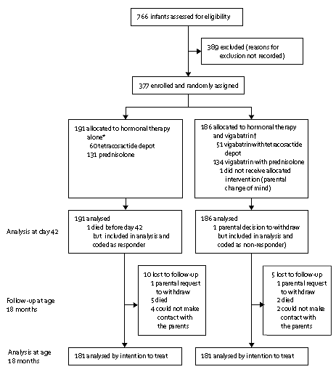
Consort figure

Slide 16
Were adequate number of people included in the study?
Data from our previous clinical trial(UKISS) had a VABS composite score was 88 for those on hormonal treatments alone
we judged that this score would need to improve by approximately half a standard deviation (ie, 7 points) on combination therapy to be considered clinically meaningful
Number of patients required to see an improvement in mean VABS composite score from 88 to 95 in the subgroup with no identified cause, with a two-tailed significance level of 0・05 and 90% statistical power, would be 96 in each group or 72 in each group at 80% power

Slide 17
Decision was then taken to halt recruitment, given the disproportionate costs that would be required to extend the trial to recruit the number of patients needed to reach 90% power

Slide 18
Did the intervention and control groups start with the same prognosis?
Baseline characters not available and appendix is not accessible

Slide 19
Validity of the study
  Study population: well defined
  Outcomes: clearly defined
  Randomization: Adequate
  Allocation concealment: done
  Blinding: open label
  Sample size calculation: Adequate but not achieved
  Intention to treat analysis: Not done
  Baseline characteristics: -

Slide 20
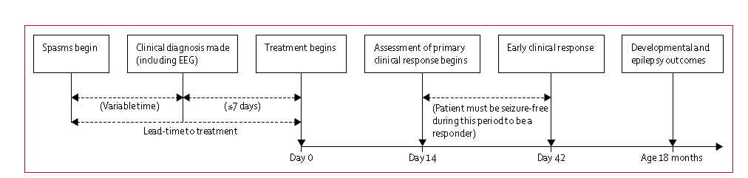
Results

Slide 21
Results
VABS mean composite scores did not differ significantly between the combination therapy group and the hormonal therapy alone group (73・9 vs 72・7, difference –1・2 [95% CI –4・9 to 2・6], p=0・55).
Treatment modality was not significantly associated with epilepsy outcome at 18 months. Seizures were seen in 54 (30・0%) of 180 infants who received combination therapy and in 52 (29・2%) of 178 who received hormonal therapy alone (difference 0・8% [95% CI –8・8 to 10・4], p=0・90).
Hence secondary outcomes were not looked

Slide 22
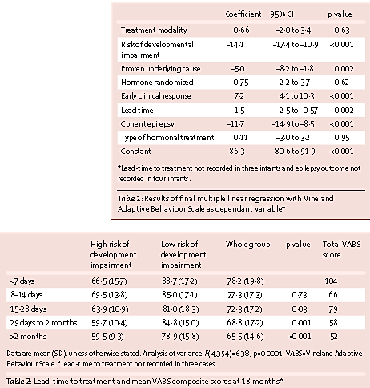

Slide 23
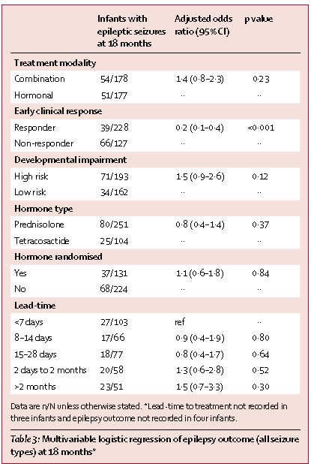

Slide 24
Were all clinically relevant outcomes considered?
Yes

Slide 25
Were the study patients similar to the patients in my practice?
Base line characters were not available
Ethnic differences exist in the prevalence . Will there be a difference in treatment benefits- probably not
Latitudinal differences on the global epidemiology of infantile spasms: systematic review and meta-analysis
Jason L. Jia†,
Shiyi Chen†,
Vishalini Sivarajah,
Derek Stephens and
Miguel A. CortezEmail authorView ORCID ID profile

Slide 26
Conclusion
Addition of vigabatrin with hormonal therapy does not improve the clinical out come of patients with infantile spasms

Slide 27
Thank you

