Slide 1
CRITICAL APPRASSAL OF A CASE CONTROL STUDY
Jacob

Slide 2
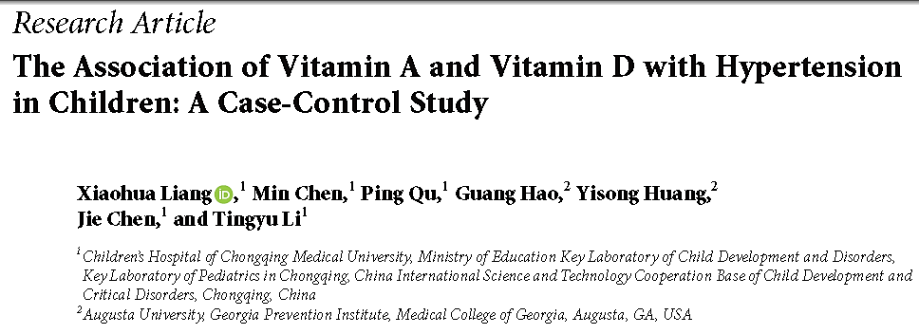

Slide 3
Hypertension is a major risk factor for cardiovascular disease and stroke.
Lifestyle interventions are recommended for children
with primary hypertension
Little nutrition intervention study has been done in children with primary hypertension

Slide 4
Aim to explore the risk factors of hypertension in children
All-transretinoic acid (atRA), a biologically active metabolite of vitamin A (VA), has been shown to regulate the gene expression of components of rennin angiotensin system
Animal studies have corroborated the strong effect of VD on the
Ang II and blood pressure level

Slide 5
Population: 164 gender and age matched subjects were selected from an established cohort of 6102 children aged 6-12 years from 6 elementary schools
Case: Children with hypertension
Control: Children without hypertension
Outcome: Association of Vitamin A and Vitamin D with Hypertension in Children

Slide 6
Inclusion and Exclusion criteria
Inclusion criteria for the hypertensive group:
Children aged 6 to 12 years diagnosed with hypertension
Who were not under treatment for VA deficiency or VD deficiency, not taking antihypertensive drugs.
Children with diseases (e.g., diabetes, cardiovascular disease, or cancer) and taking medications, which affect VA and VD absorption and secondary hypertension was excluded from this study.
The inclusion criteria for the nonhypertensive group:
Children without hypertension or any other disease that affect VA and VD absorption and metabolism

Slide 7
Are the Results Valid?

Slide 8
Did the cases and control group have the same risk (chance) for being exposed in the past?
Were cases and controls similar with respect to the indication or circumstances that would lead to exposure?

Slide 9
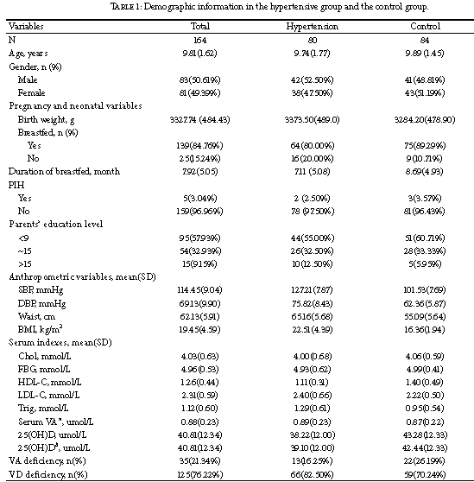

Slide 10
Were the circumstances and methods for determining exposure similar for cases and controls?
Yes
Blood pressure (BP) and heart rate (HR) were measured on three separate occasions with participant in the sit-down position by the OMRON arm type electronic sphygmomanometer using an appropriately sized BP cuff
BP measurements were taken at 11, 13, and 15 minutes during a 15-minute relaxation period, The average value of all three blood pressure measurements was used to represent resting systolic blood pressure (SBP) and diastolic blood pressure (DBP) level.

Slide 11
What are the Results?

Slide 12
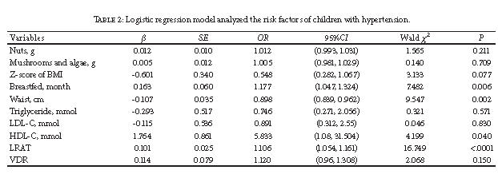
How strong is the association between exposure and outcome
How precise is the estimate of risk?

Slide 13
How can I apply the results to my patient care?

Slide 14
Were the study patients similar to patients in my practice?
Yes Indian studies show a prevalence of 0.5- 11% primary hypertension

Slide 15
Was the duration of follow-up adequate?
No follow up was done

Slide 16
Is the exposure similar to what might occur in my patient?
No, the diet found to be beneficial were nuts, mushrooms and algae which are not the stable food for the general population
Indian children are breastfed adequately

Slide 17
What is the magnitude of the risk?

Slide 18
Are there benefits that offset the risks of the exposure?
There are no adverse risks of dietary changes and so, for reducing primary hypertension in children dietary changes can be promoted

Slide 19
Thank you

