Slide 1
Critical Appraisal of a Guideline
Anil Mathew Philip

Slide 2


Slide 3
AGREE II
Domain 1. Scope and Purpose
Domain 2. Stakeholder Involvement
Domain 3. Rigour of Development
Domain 4. Clarity of Presentation
Domain 5. Applicability
Domain 6. Editorial Independence

Slide 4
Domain 1. Scope and Purpose
Are the overall objectives of the guideline are specifically described?
  Purpose of this guideline was to present the available evidence for evaluation and management of Acute Kidney Injury.
Health intent- Diagnosis and management of AKI.
Expected benefit- Approach to AKI
Targets
  Audience- All clinicians(internist, nephrologist, intensevists), caring for patients with AKI due to various eitiologies
  Population- Adults with AKI
Score- 7

Slide 5
Are the health questions covered by the guideline specifically described?
  Yes
  The guideline has gone through different aspects of eitiology, diagnosis and management comparing the various available guidelines(KDIGO, RIFLE, AKIN)
Target population- mentioned
Intervention- mentioned
Health care setting or context- mentioned
Score- 7.

Slide 6
Are the population (patients, public, etc.) to whom the guideline is meant to apply specifically described?
  Yes
Target population- Mentioned
Gender and age- Mentioned
Clinical condition- mentioned
Severity/stage of disease- Mentioned
Excluded population- Most of the literature reviewed were RCT’s/Meta Analysis/Systematic Reviews and they have mentioned which patient populations were excluded. Eg. 2 RCT’s had excluded CKD patients in assesment of AKI in non cardiac surgery.
Score- 7

Slide 7

Domain 2. Stakeholder Involvement
Does the guideline development group include individuals from all relevant professional groups?
Name- mentioned
Discipline/content expertise- mentioned
Institution- Mentioned
Geographical location- Mentioned
Description of the member’s role in the guideline development group- not mentioned
Score-6

Slide 8
Have the views and preferences of the target population (patients, public, etc.) been sought?
  No
Score- 1

Slide 9
Are the target users of the guideline clearly defined?
  Yes
  All clinicians caring for patients with AKI
Clear description of intended guideline audience- Yes
Description of how the guideline may be used by its target audience- No
Score- 5

Slide 10
Domain 3. Rigour of Development
Were systematic methods used to search for evidence?
  Studies from PubMed (1990 through July 2015), Cochrane Database of Systematic Reviews AKIN/KDIGO/RIFLE and review of there guidelines.
Not included other languages- English and Japanese
Time period searched- 1990 through July 2015
Search terms- specified
Full search strategy- not mentioned
Not mentioned regarding conflict resolution.
Score- 5

Slide 11
Were the criteria for selecting the evidence clearly described ?
  Only RCTs and systematic reviews were included. AKIN/RIFLE and KDIGO guidelines were also reviewed
  Articles published in English and Japanese were only included
The relevant population, management strategies were described in different age groups, Pediatric, adult and geriatric populations.
Have compared various methods of diagnosis.
Score- 6.

Slide 12
Were the strengths and limitations of the body of evidence clearly described ?
  Yes
Study design- mostly RCT’s and Cochrane Systematic Review
Study methodology limitations (sampling, blinding, allocation concealment, analytical methods)- Not mentioned, have given a grading of the quality of evidence.
Consistency of results across studies- Not mentioned
Direction of results across studies- Not mentioned
Magnitude of benefit versus magnitude of harm- Not mentioned
Score- 4

Slide 13
Were the methods for formulating the recommendations clearly
described?
  No
Quality of evidence for each have been mentioned.
But details of how the panellist reached the recommendations are not clear.
Score- 4

Slide 14
Have the health benefits, side effects, and risks been considered in formulating the recommendations?
  Yes, they have looked at various guidelines and have formulated a guideline which is appropriate to different settings
Adverse effects not mentioned
Comparison between various treatment options are mentioned- not clear.
Score- 4.

Slide 15
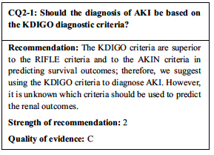
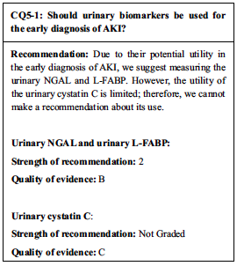
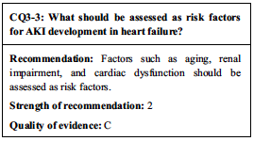

Slide 16
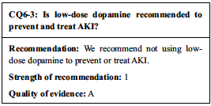
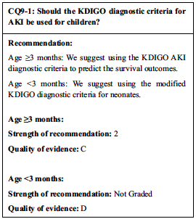

Slide 17
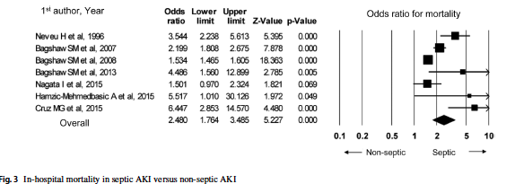
Is there an explicit link between the recommendations and the
supporting evidence?
  References for supporting evidence for each recommendation are mentioned and easily identifiable for the user.
Score- 5.

Slide 18
Has the guideline been externally reviewed by experts prior to its
publication?
  Not mentioned.
Score- 1

Slide 19
Is there a provision for updating the guideline?
  Not mentioned
Score- 1

Slide 20
Domain 4. Clarity of Presentation
Are the recommendations specific and unambiguous?
  They have extensively looked at different eitiolgies, outcomes and across age groups.
Score- 6.

Slide 21
Are the different options for management of the condition or health issue clearly presented?
  Yes
Score- 6

Slide 22
Were the key recommendations easily identifiable?
  Yes
  They have a given a summary of the recommendations throughout the guideline, after each clinical question/scenario
Score- 6

Slide 23
Domain 5. Applicability
Does the guideline describes facilitators and barriers to its application ?
  Not mentioned
Score-1
Notes:
• identification of the types of facilitators and barriers that were considered
• methods by which information regarding the facilitators and barriers to implementing recommendations were
sought (e.g., feedback from key stakeholders, pilot testing of guidelines before widespread implementation)
• information/description of the types of facilitators and barriers that emerged from the inquiry (e.g.,
practitioners have the skills to deliver the recommended care, sufficient equipment is not available to ensure all
eligible members of the population receive mammography)
• description of how the information influenced the guideline development process and/or formation of the
recommendations

Slide 24
Does the guideline provide advice and/or tools on how the
recommendations can be put into practice?
  In the guideline they have given summaries adequetly which can be used as a tool for management, have emntioned indications for RRT/ransufuions/loop diuretics and Dopamine along with the evel of evidence.
  Special situations have also been covered eg. Post surgical patients of various surgeries.
Score- 6.

Slide 25
Have the potential resource implications of applying the recommendations have been considered?
  Not mentioned.
Score- 1
Notes:
• identification of the types of cost information that were considered (e.g., economic evaluations, drug
acquisition costs)
• methods by which the cost information was sought (e.g., a health economist was part of the guideline
development panel, use of health technology assessments for specific drugs, etc.)
• information/description of the cost information that emerged from the inquiry (e.g., specific drug acquisition
costs per treatment course)
• description of how the information gathered was used to inform the guideline development process and/or
formation of the recommendation

Slide 26
Does the guideline present monitoring and/or auditing criteria?
  Not mentioned
Score- 1.
Notes:
dentification of criteria to assess guideline implementation or adherence to recommendations
• criteria for assessing impact of implementing the recommendations
• advice on the frequency and interval of measurement
• descriptions or operational definitions of how the criteria should be measured

Slide 27
Domain 6. Editorial Independence
Has the views of the funding body influenced the content of the guideline?
  Not mentioned
Score- 1

Slide 28
Has competing interests of guideline development group members been recorded and addressed?
  Not mentioned at all.
Score- 1

Slide 29
RATE THE OVERALL QUALITY OF THE GUIDELINE
4
I would recommend the guidelines with modifications.

