Slide 1
CRITICAL APPRAISAL OF A QUALITATIVE STUDY
Jasper Rathinam J

Slide 2
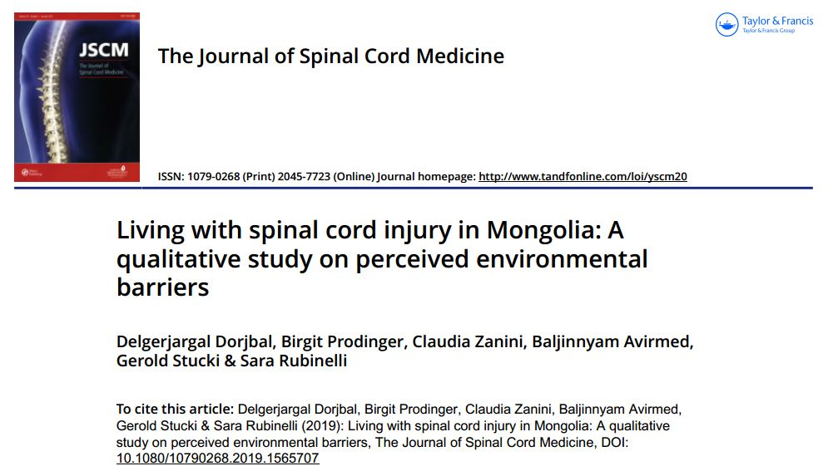

Slide 3
BACKGROUND
Environmental factors play a key role in the lives of individuals with a spinal cord injury
Environmental factors such as the built environment, societal attitudes, systems, and services can act as barriers to people’s participation in community life and autonomy
The crucial issue in many developing countries is that such environmental barriers greatly contribute to mortality within a few years of SCI
By focusing on Mongolia as a developing country the aim of this study was to identify environmental barriers and their impacts .

Slide 4
Study Design
Patients : People with Spinal Cord Injury after 2001 , between the age of 18-45
Tool: Semistructured Interview
Outcome : Impact of Environment Barriers

Slide 5
Inclusion Criteria
People aged between 18 and 45 years
Who experienced a traumatic SCI after the year 2001
Living at home and speaking Mongolian fluently.
The study excluded persons with degenerative or congenital diseases and persons over 45 years of age in order to
focus on barriers in relation to SCI and not to ageing .
After 2001 – due to change in Health care system

Slide 6
Sampling
Purposive sample - stratified by geographical
area: urban (the capital city, Ulaanbaatar) and rural
areas (provinces).
The sample size was determined by thematic saturation.
The data analysis was carried out in parallel to the data collection, and the recruitment was stopped once no new themes emerged from the analysis.

Slide 7
Was the choice of participants explicit and comprehensive?
No
Only those who volunteered to take part were included
16 Patients were included in the study
Elderly not included

Slide 8
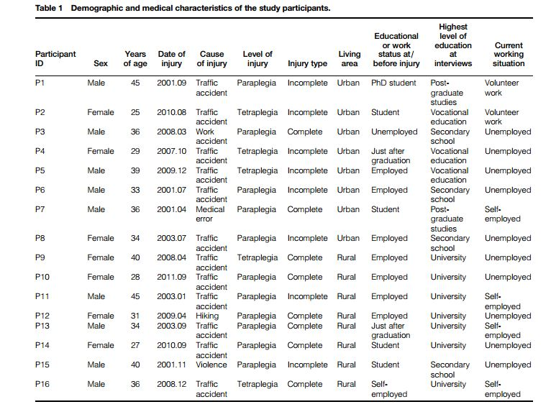

Slide 9
Was data collection sufficiently comprehensive and detailed?
Yes
Data collection was carried out from September to December 2016 by the first author.
Participants filled out a questionnaire to provide demographic and medical information
We structured the topic guide around the components of
the International Classification of Functioning, Disability, and Health (ICF)
All interviews were audiotaped and transcribed verbatim in Mongolian. Each interview lasted approximately 60–90 min

Slide 10
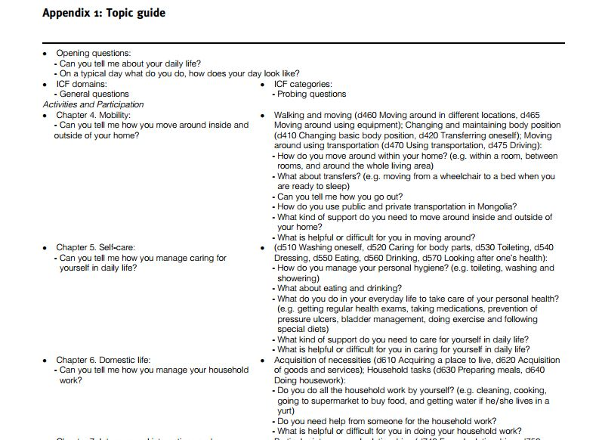

Slide 11
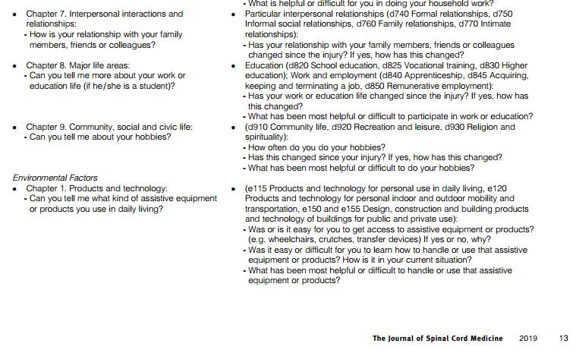

Slide 12
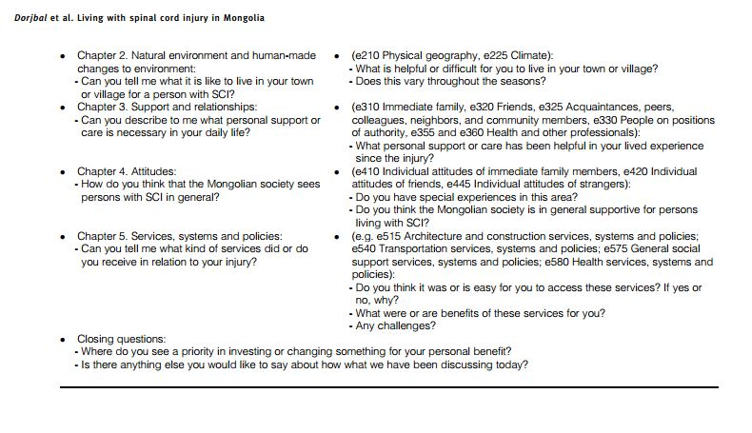

Slide 13
Were the data analyzed appropriately and the findings corroborated adequately?
Yes

Slide 14
Data Analysis
The transcripts of interviews were translated into English by a professional translation center
All instances relevant to environmental factors and their impacts in daily life were coded following the principles of thematic analysis.
Second Reviewer involved in analysis of this data
Disagreements on the coding of the translated interviews were discussed until agreement was reached, and the coding scheme was refined.

Slide 15
What are the results of the study?
Mongolia face several environmental barriers in their
daily lives.
Identification of the barriers across the two geographical areas and sex was similar.
These perceived barriers were grouped into seven categories:
(i) poor access to the physical environment
(ii) absence of wheel chair friendly transportation

Slide 16
What were the results ?
(iii) negative societal attitudes
(iv) inadequate healthcare and rehabilitation services
(v) lack of access to assistive devices and medicines
(vi) limited financial resources for healthcare
(vii) inaccurate categorization of disabilities in laws.
They have described 53 key quotes of the patients

Slide 17
Does the study offer helpful theoretical conclusions?
Yes
Failure of support systems evident
Similarity with other developing countries
Many areas of need identified

Slide 18
Does the study help me understand the context of my practice?
Yes
Struggles of SCI patients portrayed
May widen our perspective of management

Slide 19
Does this study help me understand my relationships with patients and their families?
Yes.
More relevant information for policy makers and Public Sector

Slide 20
Is this study results applicable in my setting?
Mongolia – Developing country
Variation of climate exists – Extreme cold weather there
Socio-economic variations exist

Slide 21
Thank You

