Slide 1
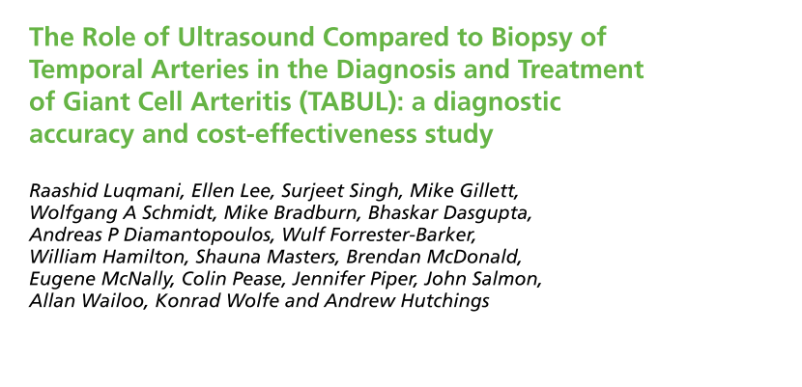

Slide 2
P-Patients had to be at least 18 years of age suspected GCA.
Index test- an ultrasound of both temporal and both axillary arteries.
Reference- composite outcome
Outcome- Diagnostic performance of the US for GCA and cost analysis
Notes:
Which combined elements of a clinician’s final diagnosis, the ACR classification criteria (incorporating the biopsy result), the emergence of complications consistent with GCA during follow-up, the emergence of alternative vasculitis diagnoses during follow-up and expert review to determine the reference diagnosis.

Slide 3
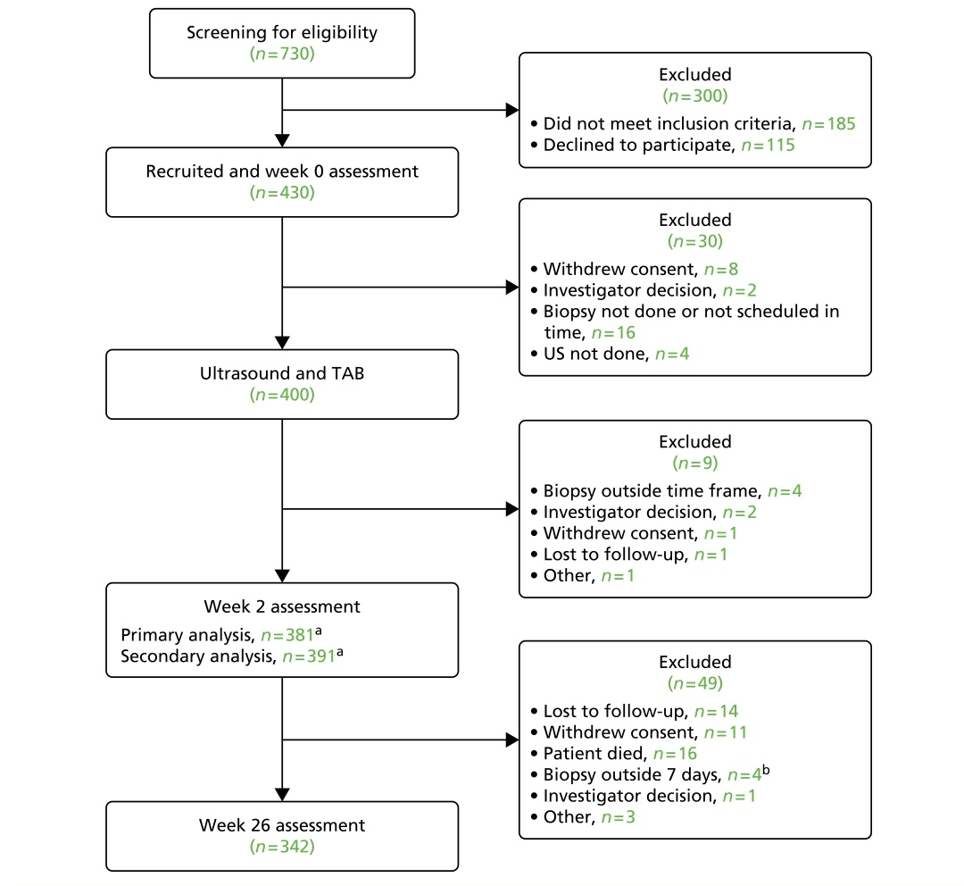

Slide 4
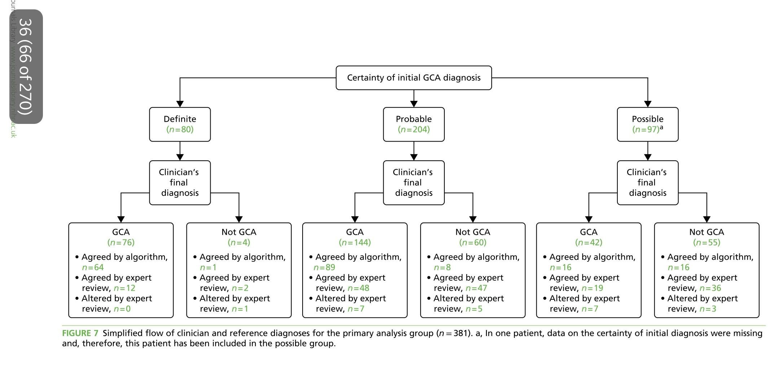

Slide 5
Objective
The primary objective of the economic analysis is to estimate the cost-effectiveness of ultrasound instead of biopsy for the diagnosis of GCA.

Slide 6
Sample size
The sample size of 402 patients was calculated to provide 90% power at a 5% type I error rate to test the joint hypotheses that:
1. ultrasound has greater sensitivity than TAB (based on an assumed sensitivity of 76% for TAB and 87% for ultrasound)
2. the specificity of ultrasound is no less than 83% using the reference diagnosis.
Notes:
The sample size of 402 patients was calculated to provide 90% power at a 5% type I error rate to test the joint hypotheses that:1. ultrasound has greater sensitivity than TAB (based on an assumed sensitivity of 76% for TAB and 87% for ultrasound)2. the specificity of ultrasound is no less than 83% using the reference diagnosis.The postulated sensitivity and specificity figures were based on a previous meta-analysis.16 The sample size would allow estimation of a one-sided rectangular confidence region for ultrasound false- and true-positive
assuming 80% prevalence of GCA in patients having a biopsy for suspected GCA, with the sample size inflated (gamma 0.1) because of uncertainty in the ratio of cases to controls in a cohort design.64In order to allow for losses to follow-up (failure to have either test done, lack of a follow-up assessment or patient withdrawal) the plan was to recruit 430 participants to the study. After monitoring actual recruitment and withdrawals during the course of the study, the target recruitment was increased to the range 435–445.

Slide 7
Did the recommendations consider all relevant patient groups, management options, and possible outcomes?
Did the investigators adopt a sufficiently broad viewpoint?
Yes
The performance of the diagnostic testing strategies; risks of GCA-related complications and glucocorticoid-related AEs; and associated costs and health-related quality-of-life effects.
The costs of the tests and medications are also covered
Notes:
However, economic evaluation is usually directed at informing policy from a broader societal perspective
The different costs of the tests or strategies. l The different proportions of false negatives and false positives. l The cost and health-related quality-of-life impact of a false negative, that is, when a patient remains undetected with GCA for up to around 2 months, with the attendant risk of developing complications such as vision loss.
l The cost and health-related quality-of-life impact of a false positive, that is, initiating or continuing treatment with high-dose steroids in a patient without GCA for many months and the impact that any unnecessary treatment has on the risk of AEs such as fractures, diabetes mellitus and weight gain.

Slide 8
Are results reported separately for relevant patient subgroups?
No
Notes:
The differences in the cost-effectiveness ratios were driven primarily by the patient’s risk of developing chronic renal disease
Biopsy alone
ultrasound alone
biopsy in combination with clinical judgement (current routine care)
ultrasound in combination with clinical judgement.

Slide 9
Is there a systematic review and summary of evidence linking options to outcomes for each relevant question?
Were costs measured accurately?
Yes
TAB £493 based on NHS Reference Costs for 2011/1283. This is assumed to include theatre cost, surgeon time, pathologist time, sample processing, camera, microscope and other pathology equipment and administration cost
US costed £57 based on the NHS Reference Costs for 2013/14
Notes:
. This is assumed to include theatre cost, surgeon time, pathologist time, sample processing, camera, microscope and other pathology equipment and administration cost. It has been pointed out that some ‘biopsy costs’ shown in NHS Reference Costs83
n the TABUL study, the typical time taken to perform ultrasound of both temporal and axillary arteries was 30 minutes, although there was considerable variation (scans took between 20 and 60 minutes, depending on the experience of the sonographer and the extent of the abnormalities to be defined). The cost of a ‘direct access’ (as opposed to outpatient) ultrasound scan taking 20 minutes or more is £57 based on the NHS Reference Costs for 2013/14

Slide 10
Did investigators consider the timing of costs and outcomes?
All costs are then adjusted for inflation to bring them to 2014/15 levels.
Notes:
Did Investigators Consider the Timing of Costs and Consequences? A final issue in the measurement and valuation of costs and consequences relates to the adjustment for differences in their timing. Generally, people prefer benefits sooner and prefer to postpone costs because of uncertainty about the future and because resources, if invested, usually yield a positive return. The accepted way of allowing for this in economic evaluations is to discount costs and consequences occurring in the future to present values by assigning a lower weight to future costs and benefits. The US Panel on Cost-Effectiveness in Health and Medicine16 proposed a 3% discount rate based on the inflation-adjusted rate of return on US government bonds, and this rate is the one most often used in studies undertaken in North America. There remain debates about whether health outcomes should be discounted at the same rate as costs.19-22 Ford et al1 did not discount because the period of the analysis was only 12 months, and making adjustments for differential timing of costs and benefits within this period would have minimally affected the results. The authors point out that there are few data on the effects of the 2 strategies on the long-term history of dyspepsia, although one study with 6-year follow-up showed that the difference in resource use at 12 months appears to continue thereafter, with no difference in the symptom status. The other longer-term issue is whether the choice of strategy has any effect on the costs of, or the rate of, survival from gastric carcinoma. In the absence of long-term clinical trials, the rates of gastric cancer would have to be estimated by the use of models. If there were such an influence, the costs and effects would need to be considered formally and, being mainly in the future, they would be discounted.

Slide 11
What are the results?
What were the incremental costs and effects of each strategy?

Slide 12
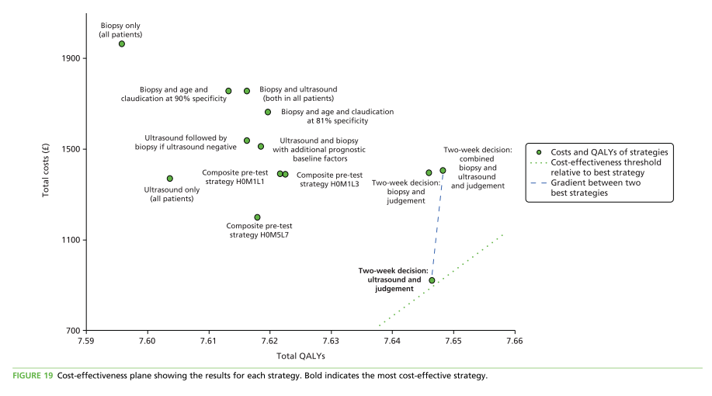

Slide 13
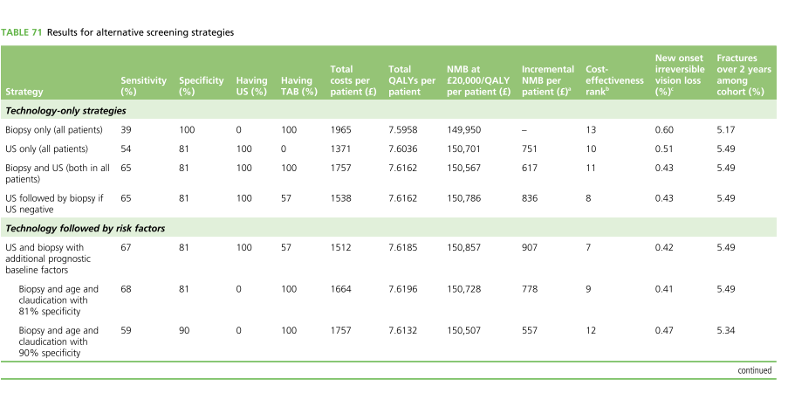
Notes:
Columns 2 and 3 show the performance of each screening strategy.
Columns 4 and 5 show the proportion of patients who would undergo each test.
Columns 6–10 are the economic outcomes.
Column 8 is the NMB measure of cost-effectiveness. The NMB figures for each strategy appear to be of roughly the same magnitude, and, although this might suggest that they are all almost the same, this would be an incorrect interpretation. The higher the incremental net benefit in column 9 of a given strategy compared with the biopsy-only strategy, the more cost-effective that strategy is. It should be remembered that these monetary differences are per patient. The budgetary impact of selected strategies is explored later. Column 10 shows the ranking of each diagnostic strategy in terms of cost-effectiveness (based on the NMB); the lower the ranking the more cost-effective the strategy. The last two columns show two clinical outcome measures.

Slide 14
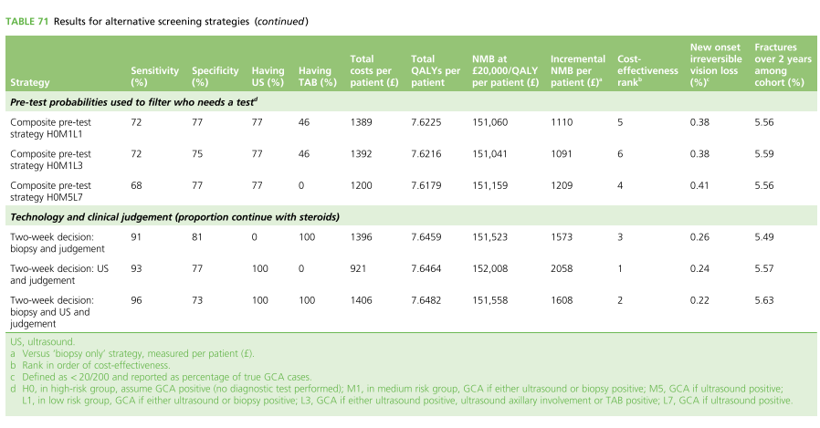

Slide 15
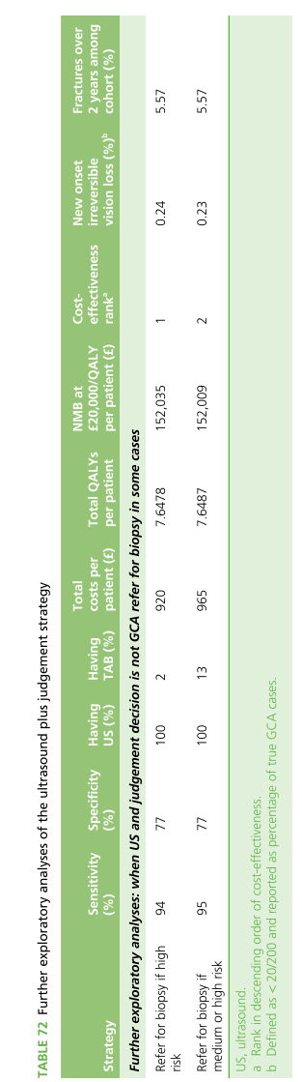

Slide 16
Do incremental costs and effects differ between subgroups?
No subgroup studied

Slide 17
How much does allowance for uncertainty change the results?
Sensitivity analysis done
Cost-effectiveness of ultrasound & judgement VS biopsy & judgement)
Notes:
The results from the sensitivity analyses indicate that the improved cost-effectiveness of ultrasound and judgement (compared with biopsy and judgement) is not sensitive to alternative assumptions, with only alternative cost or test sensitivity assumptions reducing the incremental NMB result below £400 (from £485 base-case result). This is because the difference in the cost of the tests, in particular, is a very strong driver of the cost-effectiveness. Even doubling the cost and quality-of-life burden from steroid-related AEs did not change the outcome much

Slide 18
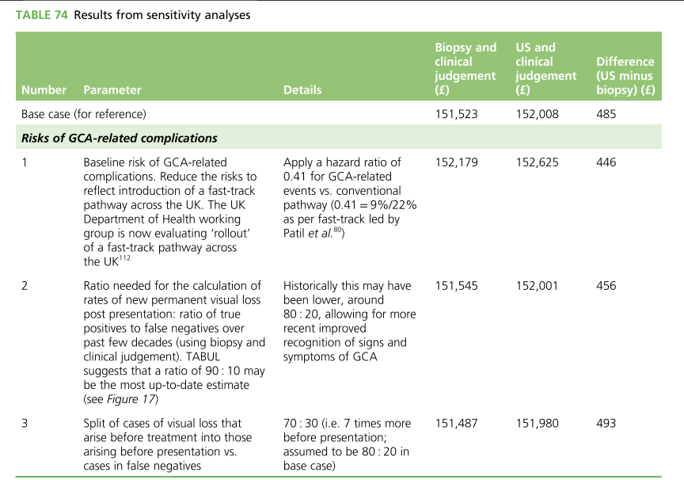

Slide 19
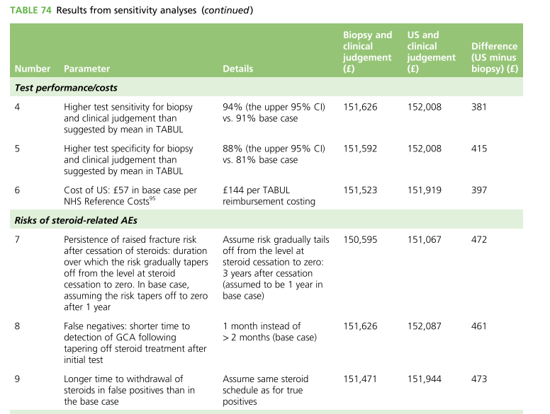

Slide 20
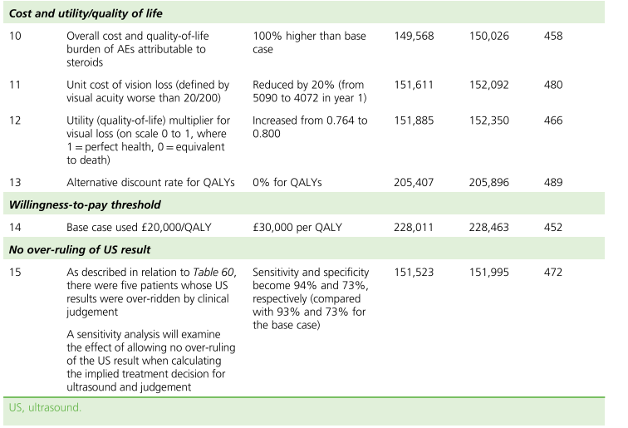

Slide 21
How can I apply the results to patient care?
Are the treatment benefits worth the harms and the costs?
Yes

Slide 22
Can I expect similar costs in my setting?

