Slide 1
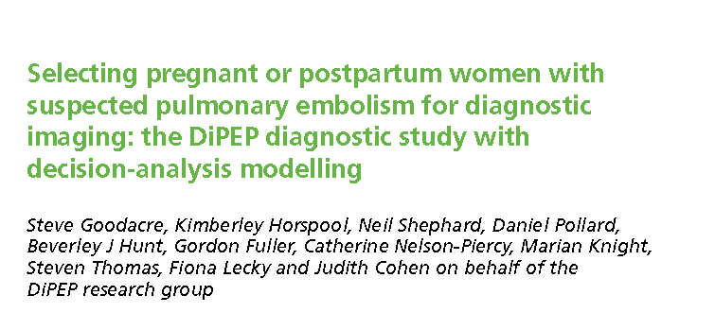
Clinical appraisal of a Decision analysis journal
Jacob

Slide 2
Pulmonary embolism (PE) is a leading cause of death in pregnancy and post partum.
Clinical decision rules use features of the patient history and examination in a structured manner to estimate the probability of disease

Slide 3
Objective
Use expert consensus to derive three new CDRs (with different trade-offs between sensitivity and specificity) for pregnant and postpartum women with a suspected PE
Estimate the diagnostic accuracy of clinical variables, our expert-derived CDRs, existing CDRs (Wells’s score, Geneva score and PERC score) and D-dimer in pregnant and postpartum women with a suspected PE
Use a statistical analysis of women with a diagnosed or suspected PE to derive a new CDR for pregnant and postpartum women with a suspected PE
Explore the potential diagnostic value of biomarkers for PE in pregnant and postpartum women
Determine the feasibility of using a prospective cohort design to validate a new CDR or biomarker
Estimate the effectiveness, in terms of adverse outcomes from VTE, bleeding and radiation exposure, and the cost-effectiveness, measured as the incremental cost per quality-adjusted life-year (QALY), of different strategies
Estimate the value of information associated with further research.

Slide 4
PICOT
P:
Any pregnant or postpartum women with a diagnosed PE who had presented with suspected PE to a hospital reporting to the UKOSS research platform
pregnant and postpartum women presenting with suspected PE to 11 prospectively recruiting sites
women with DVT diagnosed at the prospectively recruiting sites

Slide 5
I- Clinical features, decision rules and biomarkers.
setting: Emergency departments and consultant-led maternity units.
O: Multiple outcomes

Slide 6
Study Design
Expert consensus study was done to address objective 1.
case–control study to address objectives 2 and 3.
We undertook a biomarker study to address objective 4.
Objective 5 was determined by recruitment rates in the prospective study of women with a suspected PE and determining the prevalence of PE in this population.
decision-analysis model to address objectives 6 and 7.

Slide 7
Are the recommendations valid?
Did the recommendations consider all relevant patient groups, management options, and possible outcomes?
Yes
Population were patients with PE
The key events included in the decision tree were PE-related death, major bleeding events, deaths associated with major bleeding events, chronic thromboembolic pulmonary hypertension (CTEPH), recurrent VTE and deaths from recurrent VTE

Slide 8
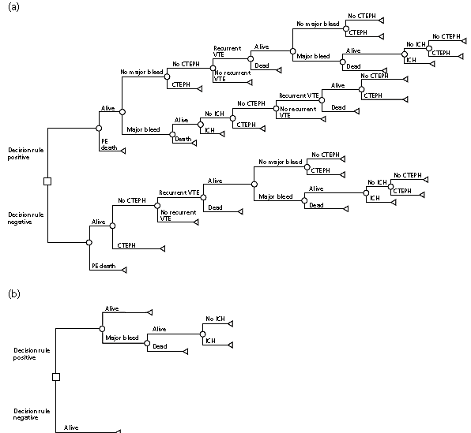
(a) true-positive scan;
(b) false-positive scan;

Slide 9
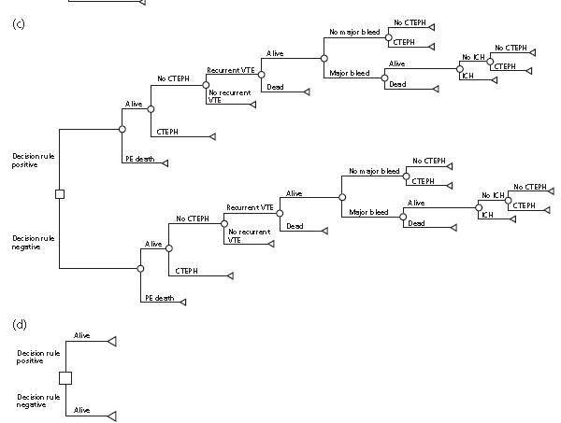
(c) false-negative scan;
(d) true-negative scan.

Slide 10
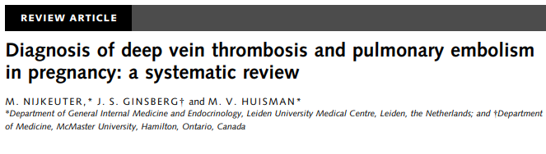
Are there systematic reviews of evidence that estimate the relative impact of management options on relevant outcomes?
Management was discussed- CT or VQ scan was recommended
Cost analysis was not done

Slide 11
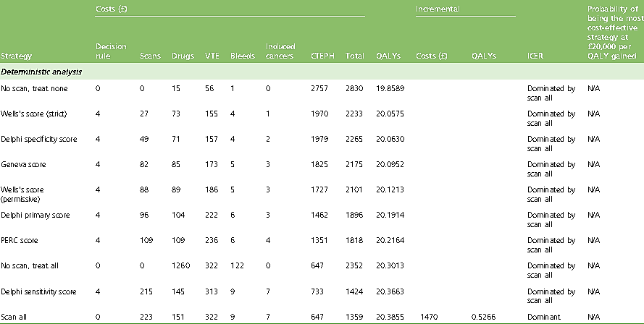
Is there an appropriate specification of values and preferences associated with each of the outcomes?
Yes

Slide 12
Do the authors indicate the strength of their recommendations?
Not given

Slide 13
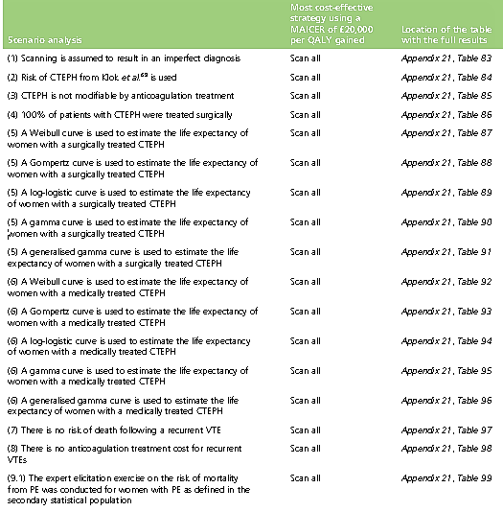
What are the results?

Slide 14
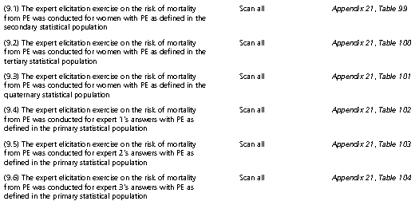

Slide 15
What are the key recommendations?
scanning all women dominated all other strategies considered for pregnant and postpartum women with a suspected PE.
In all scenario analyses , scanning all women either was the dominant strategy or had the highest incremental cost-effectiveness ratio below £20,000 per QALY gained of the 10 strategies being considered.

Slide 16
Will the recommendations help you in caring for your patients?
Do the recommendations make sense in your practice setting
Yes, this recommendation can be used in our setting for post partum patients
CT will resolve unnecessary dilemma and will lead to early management with relatively less complications
For pregnant women a case to case decision has to be made after considering the risks and benefits

Slide 17
Thank you

