Slide 1
Critical Appraisal of Differential Diagnosis
Anil Mathew Philip

Slide 2
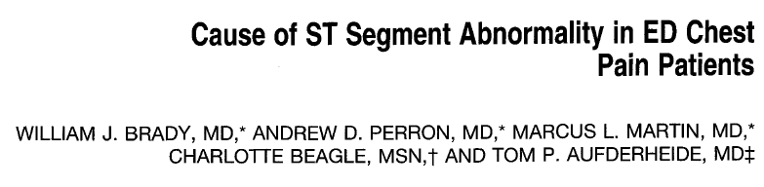

Slide 3
Background
Emergency physician must be an expert in the interpretation of the electrocardiogram (ECG)
Patients with chest pain and ST segment elevation (STE) on the 12-lead ECG who are experiencing acute myocardial infarction (AMI) may be candidates for urgent coronary reperfusion

Slide 4
Other such chest pain patients with electrocardiographic STE may be suffering from a non coronary (ie, non-AMI) chest discomfort syndrome.
The correct identification of these non-AMI patients- both clinically and electrocardiographically must be made to offer the most appropriate treatments and to avoid potentially dangerous therapies

Slide 5
Aim
To look at the various causative syndromes responsible for ECG STE in ED

Slide 6
PICOT
Population: adult patients who presented with primary/secondary complaint of atraumatic chest pain
Outcomes: to identify the different causes of STE and chest pain
Time- line: Jan 1, 1996 to March 31, 1996, retrospective analysis, no follow up

Slide 7
Study Design
Retrospective review of all the patients admitted with chest pain and STE in a Chest Pain Center over a 3 month period

Slide 8
960 patients presented with chest pain to ED (6.4%)
902 ptients with appropriate investigations
202 patients included as they had STE on ECG

Slide 9
Inclusion criteria
Adults aged >18 years
Chest pain as Primary or Secondary complaint
Atraumatic
ST segment elevation in two anatomically contiguous electrocardiographic leads with:
-(1) greater than/equal to 1 millimeter (mm) in the limb leads
-(2) greater than/equal to 2 mm in the precordial leads

Slide 10
How serious is the risk of bias?
1. Did the study patients represent the full spectrum of those with this clinical problem?
Yes, for the clinical problem being investigated they have
Here they have looked at patients who presented with chest pain and STE on ECG and initial ED ECG interpretation, final hospital ECG interpretation, and final hospital diagnosis compared
Patients were recruited from Chest Pain center and General Emergency Department
Patients were recruited retrospectively with a definitive clinical and diagnostic criteria over a 3 month period – not mentioned if recruited consecutively

Slide 11
2. Was the diagnostic evaluation definitive?
No, Here they have not mentioned how the final hospital diagnosis was made
Patients initial ECG was consistent in all patients, only patients with STE on ECG were included(which was confirmed by a Cardiologist)
There was an undefined group for ECG(17%) and Other diagnosis group for final diagnosis(15%), and there was no follow up for the undefined group, hence overall frequencies might be inaccurate

Slide 12
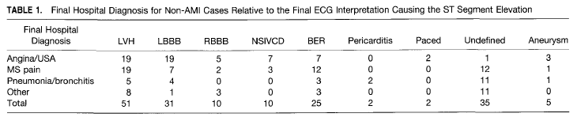
What are the results?
What were the diagnoses and their probabilities?
15% →AMI
37% →Angina/Unstable angina
33% →Musculoskeletal pain
15% →Pneumonia
15% →non specific chest pain

Slide 13
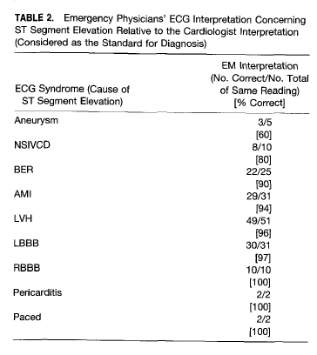
How precise are the estimates of the disease?
Aneurysm: 0.6 CI: 0.23→0.88
NSIVCD: 0.8 CI: 0.49→0.94
BER: 0.88 CI: 0.70→0.95
AMI: 0.93 CI: 0.79→0.98
LVH: 0.96 CI: 0.86→0.98
LBBB: 0.96 CI: 0.83→0.99
RBBB: 1
Pericarditis: 1
Paced: 1

Slide 14
How can I apply the results to patient care?
1.Are the study patients and clinical setting similar to mine?
Baseline characteristics of the patients has not been mentioned, hence difficult to compare, but the center mentioned seems to have a similar patient influx

Slide 15
2. Is it unlikely that the disease possibilities have changed since this evidence was gathered?
As non communicable diseases are on the rise, the numbers of AMI/USA/Angina would have changed significantly.

