Slide 1
Critical Appraisal of Diagnostic Test
Anil Mathew Philip

Slide 2
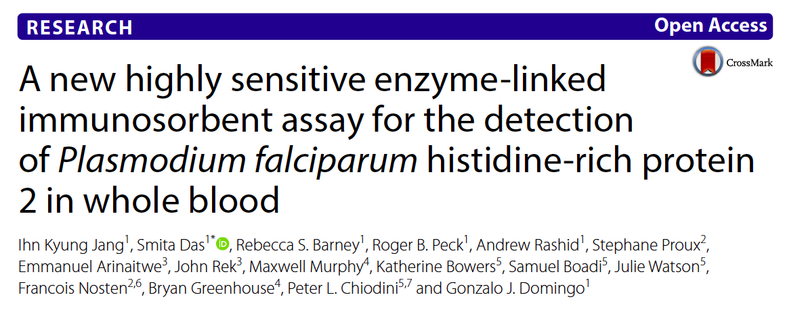

Slide 3
Background
Malaria is a vector-borne disease of major public health relevance worldwide
In 2015, the WHO reported 429,000 deaths, most of which were attributed to Plasmodium falciparum
There has been significant reduction incidence of mortality from 2010 to 2015, largely attributed to vector control and improved and accessible diagnostics and treatment
The limit of detection (LoD) for each tool, 5 parasites/μL, 20 parasites/μL more generally for blood film microscopy

Slide 4
HRP2 do not attain low enough LoDs for HRP2. New highly sensitive HRP2-based RDTs are available HS ELISA has been developed
In this study, HS ELISA performance against P. falciparum HRP2 was characterized using P. falciparum recombinant HRP2, a panel of P. falciparum native culture specimens, and clinical whole blood specimens from Myanmar and Uganda.

Slide 5
PICOT
Population:
Part 1: 300 clinical whole blood specimens from malaria endemic areas were selected for evaluating HS ELISA diagnostic performance.( 200 negative samples from Myanmar and 100 positive samples from Uganda)
Part 2: 60 specimens were tested, of which 30 specimens were positive and 30 specimens were negative.
Intervention: Testing with HS ELISA for HRP2
Control: Microscopy and qRT- PCR
Outcome: To look at the Sensitivity and specificity of HS ELISA for HRP2

Slide 6
How serious is the risk of bias?
Did participating patients constitute a representative sample of those presenting with a diagnostic dilemma?
Yes, they have included patients from malaria endemic area’s. Looking at an appropriate number of patients who have tested positive and negative with standard microscopy and qRT-PCR

Slide 7
Did investigators compare the test to an appropriate, independent reference standard?
Yes, the patients blood samples have been compared with reference test of microscopy and qRT-PCR, which is the standard for diagnosis.

Slide 8
Were those interpreting the test and reference standard blind to the other results?
Yes, Prior to receiving the specimens at reference lab, all specimens were delinked and anonymized for analysis.

Slide 9
Did all patients receive the same reference standard irrespective of the results of the test results?
Yes, all the samples have been compared with microscopy and qRT-PCR

Slide 10
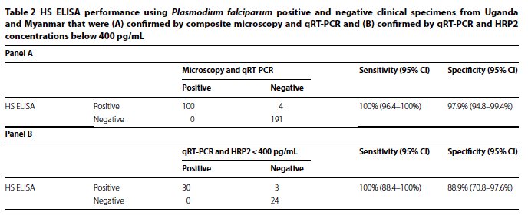
What are the results?

Slide 11


What likelihood ratios were associated with the range of possible test results?
Positive likelihood ratio is 47.62, Negative Likelyhood ratio is 0

Slide 12
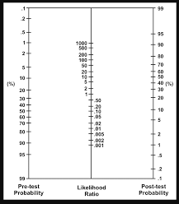

Slide 13
How can I apply the results to patient care?
Will the reproducibility of the test results and its interpretation be satisfactory in my clinical setting?
Yes

Slide 14
Are the study results applicable to patients in my practice?
Yes, in high endemic areas, the high sensitivity of the test will allow for early detection of disease, especially in the setting of screening, such as the blood bank.

Slide 15
Will the test results change my management strategy?
Yes, if we are able to detect P. falciparum infection early, we can start appropriate treatment with ACT.

Slide 16
Will patients be better off as a result of the test?
Yes

