Slide 1
Critical appraisal of a screening test
Jasper Rathinam J

Slide 2
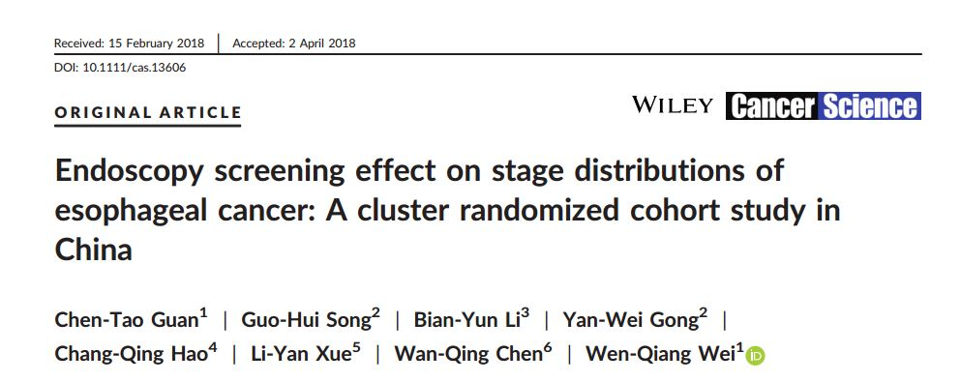

Slide 3
Background
As the eighth most common cancer and the sixth most common cause of cancer death in the world, esophageal cancer has a severe disease burden
China, which accounts for nearly 50% ofesophageal cancer cases worldwide
In China - estimation of new cases and deaths in 2013 were 277 000 and 206 000 respectively
In order to detect cancer early and improve prognosis, screening is vital.
The efficacy of endoscopy screening with iodine staining has been confirmed by a long-term follow-up cohort study
But lack of randomization meant that the conclusion was not sufficiently definitive

Slide 4
Study Design - PICO
Patients : People between the age of 40 to 69 years
Intervention : Routine Endoscopic Screening
Control : Questionnaire based screening and SOC
Outcome : Diagnosis of Esophageal Cancer and staging at diagnosis
Time Period : 2 years

Slide 5
Study Design
Multiple-center cluster randomization - ambispective cohort
After the questionnaire survey, if without contraindications for endoscopic examination (eg, history of reaction to iodine or propofol) the intervention group underwent endoscopy screening.
The entire endoscopic procedure was carried out under general anesthesia (20 mL of 1% propofol) with i.v. injection.
Local annual cancer registry reports, we collected all the target population esophageal cancer cases from January 2012 to June 2016 - and connected the incidence and TNM stage information to the target population baseline information by matching a unique
identity number .

Slide 6
Study Design – Outcome
Only pTNM was considered
Early – Stage I , Endoscopic intervention group
Middle – Stage II , IIIa
Advanced – Stage IIIb,IIIc,IV

Slide 7
How serious is the risk of bias?
Is there randomized control trial evidence addressing the impact of the
intervention in asymptomatic people ?
This study was an RCT – only cluster randominsation and comparison with historical cohort.
Previous studies were cohort studies

Slide 8
What are the recommendations, and will they help you in caring for patients?
Were the data identified, selected, and combined in an unbiased fashion?
Data of outcome was not direct
Only cluster Randomisation was done

Slide 9
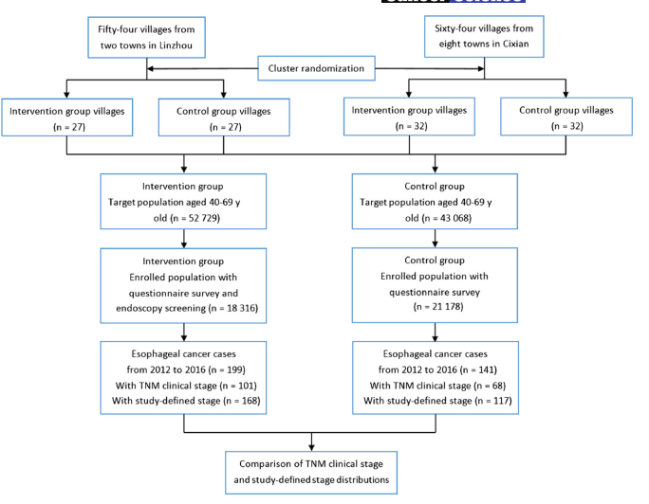

Slide 10
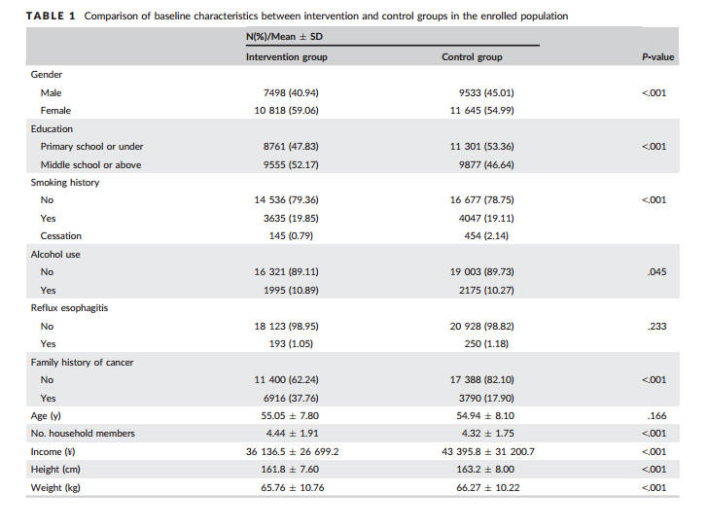

Slide 11
Validity of the study
Study population: well defined
Outcomes: clearly defined , not directly measures
Randomization: Cluster Randomisation
Blinding: Not done
Sample size calculation: Large Sample size
Intention treat analysis: done
Baseline characteristics: well matched

Slide 12
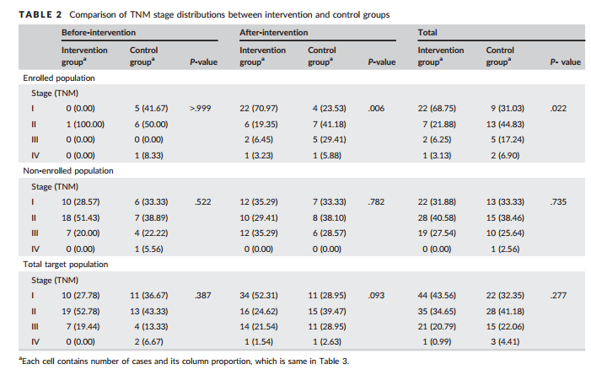
What are the benefits?

Slide 13
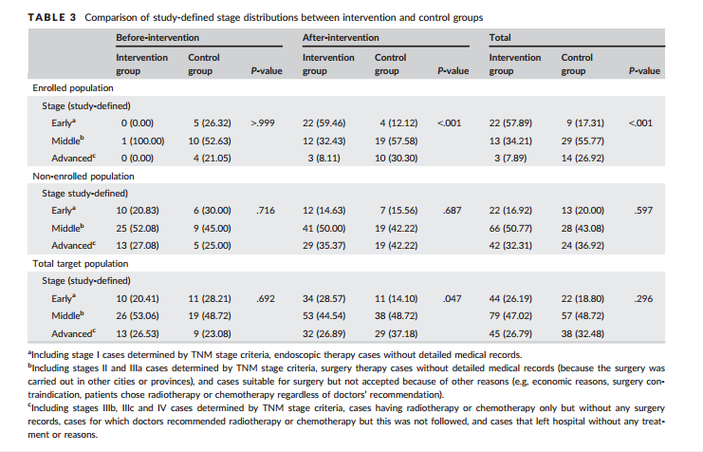

Slide 14
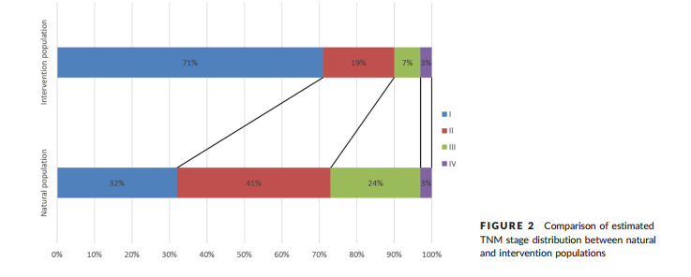
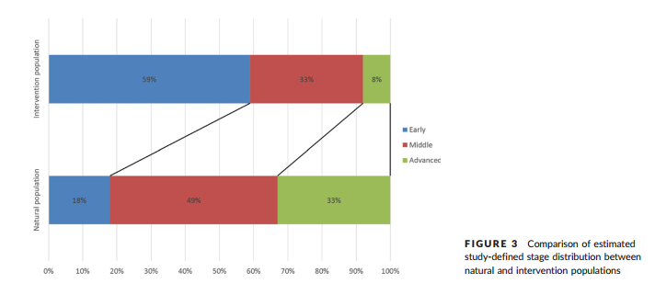

Slide 15
What are the harms?
No Complications of Endoscopy of GA mentioned
Invasive Procedures
Costly investigation
complication rate of the diagnostic Scopy was 0.13%, with an associated mortality of 0.004%
Aspiration may occur in only 0.08% of cases but the mortality rate of this complication may reach 10%
1. Stein DJ, Shaker R. Complications of upper gastrointestinal endoscopy. In: Gastrointestinal emergencies [Internet]. John Wiley & Sons, Ltd; 2016 [cited 2019 Jan 30]. p. 43–50. Available from: https://onlinelibrary.wiley.com/doi/abs/10.1002/9781118662915.ch8

Slide 16
How do benefits and harms compare in different people and with different screening strategies?
Yes , early diagnosis will have significant mortality benefit
But needs to be directly compared with complications of Endoscopy
Benefits – 13 patients had an early diagnosis of Cancer – may translate to mortality benefit
If we apply the mortality rate of UGI Scopy - 73 patients would have had harm

Slide 17
What is the effect of individuals’ values and preferences?
People may prefer a non invasive screening test if feasible

Slide 18
What is the effect of uncertainty associated with the evidence?
Significant P values - < 0.001
As large study population

Slide 19
What is the cost-effectiveness?
Cost Effectiveness Analysis not done
Next study must include a cost effectiveness model also
Maybe needed to weigh QALYs gained and to plan screening programmes

Slide 20
Thank You

