Slide 1
Critical Appraisal of Cohort Study
Anil Mathew Philip

Slide 2
Background
Obscure gastrointestinal bleeding (OGIB) is defined as recurrent or persistent bleeding with negative OGD, ileocolonoscopy, and small bowel radiography
Video capsule endoscopy (CE) is the investigation of choice in OGIB, with a high diagnostic yield compared to other modalities
A majority of OGIB cases are because benign diseases, the survival prognosis of OGIB is generally favorable. However, in patients that have comorbid conditions, prognosis may be poor

Slide 3
Aim
To look at the prognosis of OGIB in patients who underwent CE.
To studying the cause and time of death accurately

Slide 4
PICOT
Population: Patients who have undergone a CE for OGIB, in a Tertiary care hospital in Japan
Outcome: to look at the survival data or these patients
Timeline: November 2007 to March 2012, average follow up of 55.7 months(1-115)

Slide 5
Study Design
Retrospective Cohort study
  Patients had to have had CE done in the primary center in a 5 year period.
  Follow up was carried out from data from the patients follow up clinics(77 clinics and hospitals)

Slide 6
Are the results Valid?
Were the patients similar for prognostic factors that are known to be associated with the outcome(or did statistical adjustment level the playing field)?

Slide 7
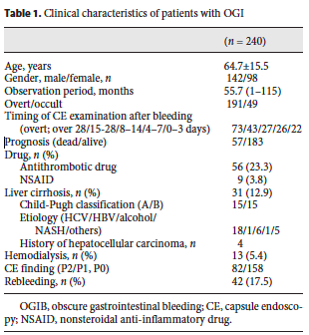
(23.7%)

Slide 8
Were the circumstances and methods for detecting the outcome similar?
Yes, the data has been extracted from data from follow up clinics and hospitals. Primary CE was done in same center.

Slide 9
Was the follow-up sufficiently complete?
Not mentioned. Mean follow up of 55.7 months.

Slide 10
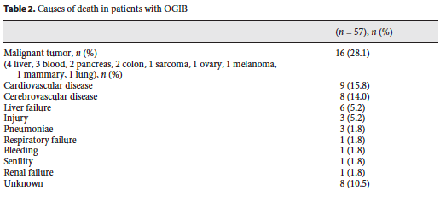
What are the results?
Death occurred in 57/240(23.37%)

Slide 11
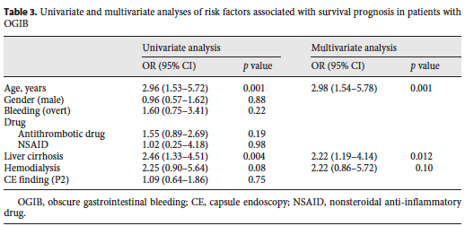

Slide 12
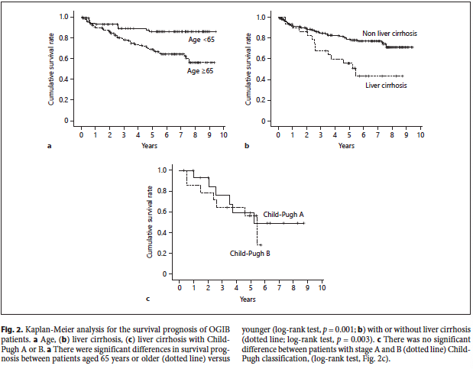
What are the results?
How likely are the outcomes over time?

Slide 13
How precise was the estimate of the risk?
Only two significant risk factors identified: Age and Liver disease
Age: OR 2.96, CI(1.53 to 5.72)
Liver Disease: OR 2.46, CI(1.33 to 4.51)

Slide 14
How can I apply the result to patient care?
Were the study patients similar to the patient in my practice?
This study was done in a Japanese community,
Ages and liver disease were similar to patients presenting with OGIB in India.

Slide 15
Was follow-up sufficiently long?
Yes, they have followed up data till 2017. Mean follow up of 55.7 months.

Slide 16
Can I use the results in my practice?
In this study they shown that the mortality increases with Age and Liver disease. The quality of the results are moderate and can help with prognostication in our setting.

