Slide 1
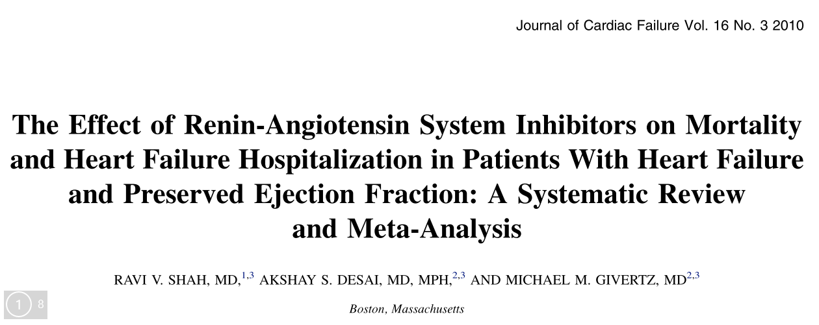
Jemin J Webster 23-Jan -2019

Slide 2
INTRODUCTION
Approximately 50% of patients with chronic HF have preserved left ventricular systolic function (so-called ‘‘diastolic HF’’ or heart failure with preserved ejection fraction, HF-PEF)
Conflicting data on no benefit is all cause mortality and heart failure hospitalization with RAS inhibitors.
Notes:
Although approximately 50% of patients with chronic HF have preserved left ventricular systolic function (so-called ‘‘diastolic HF’’ or heart failure with preserved ejection fraction, HF-PEF)

Slide 3
PICOT
P= symptomatic HF with preserved left ventricular ejection fraction (LVEF) <0.40 followed
I= ACE inhibitor (perindopril in PEP-CHF) or ARB (irbesartan in I-PRESERVE, candesartan in CHARM-Preserved)
C= Placebo
O= All-cause mortality and HF hospitalization
T- Minimum of 1 year followup

Slide 4
Are the results valid?
Did the review explicitly address a sensible question?
  Yes

Slide 5
Was the search for relevant studies detailed and exhaustive?
No
MEDLINE was searched between 1984 and 2008, with MeSH terms ‘‘heart failure,’’ ‘‘randomized controlled trials,’’ and ‘‘clinical trials,’’ and with text words ‘‘angiotensin’’ and ‘‘diastolic.’’
The EMBASE database was searched between 1990 and 2008 using OVID, with keywords ‘‘heart failure,’’ ‘‘angiotensin’’ and ‘‘diastolic,’’ and limited to human, controlled or randomized clinical trials.
Notes:
This register is compiled by systematic searches of major resources (AMED, BIOSIS, CENTRAL, CINAHL, ClinicalTrials.Gov, Embase, MEDLINE, PsycINFO, PubMed, WHO ICTRP) and their monthly updates, ProQuest Dissertations and Theses A&I and its quarterly update, Chinese databases (CBM, CNKI, and Wanfang) and their annual updates, handsearches, grey literature, and conference proceedings

Slide 6
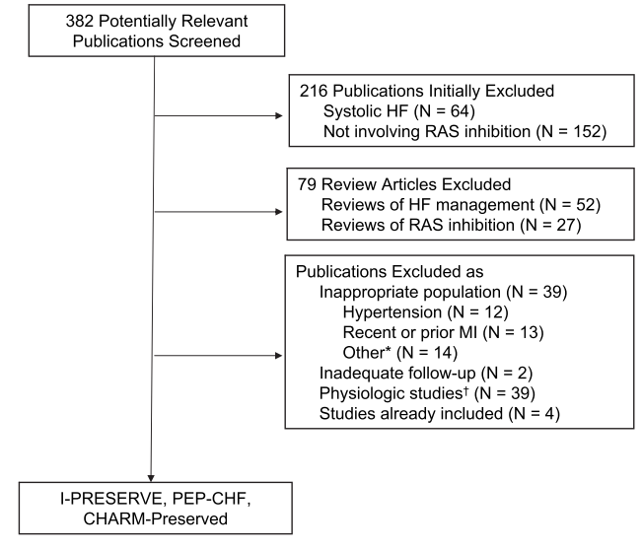

Slide 7
Were the primary studies of high methodologic quality?
No objective scale used to asses the quality of data.

Slide 8
Were the assessments of the included studies reproducible?
Data on all-cause mortality and HF hospitalization were abstracted and reviewed by all authors(3 authors).

Slide 9
What is the risk of bias across all the studies (i.e., methodological limitations)?
Do the systematic review population, intervention, comparison, and outcomes fit the patient at hand (i.e., indirectness)?
Would your decisions differ if either boundary of the confidence interval represented the truth (i.e., imprecision which occurs with a small number of events and wide confidence intervals)? Are the results inconsistent across studies (i.e., inconsistency)? Is there a high likelihood of publication bias?

Slide 10
Did the review address possible explanations of between-study differences in results?
Yes
Notes:
In PEP-CHF, there was significant attrition in the use of
perindopril (the study ACE inhibitor) in the treatment arm, and crossover to ACE inhibitor in the placebo arm (Table 2). At 1 year, 90% of patients in the study drug arm were taking perindopril. However, 6 months later, only 60% of the perindopril arm was taking study drug, and by study end, this number fell further to 35%. As well, by trial end, nearly 37% of patients initially assigned to placebo were receiving open-label ACE inhibitor. Similar to CHARM-Preserved, 11% of patients in PEP-CHF were treated with spironolactone at baseline.
Of the randomized patients in PEP-CHF, only 4 were lost to follow-up. In the I-PRESERVE study, approximately 20% of
patients in both the irbesartan and placebo arms not on an ACE inhibitor at the beginning of the study started ACE inhibitor therapy during follow-up. In addition, use of spironolactone increased from 15% to nearly 30% in both arms of the study during follow-up. An equivalent proportion of patients discontinued irbesartan or placebo over the course of the study, from 13% at 1 year to 34% at the end of the study. At study termination, mortality data was not available on 29 patients (1%) of the irbesartan arm and 44 patients (2%) in the placebo arm.

Slide 11
Did the review present results that are ready for clinical application?
Yes

Slide 12
Credibility of the systematic review process
Did the review explicitly address a sensible clinical question? Yes
Was the search for relevant studies exhaustive? Yes
Was the risk of bias of the primary studies assessed? Yes
Did the review address possible explanations of between-study differences in results? Yes
Did the review present results that are ready for clinical application? Yes
Were selection and assessments of studies reproducible? Yes

Slide 13
What are the results?
What are the overall results of the study?

Slide 14
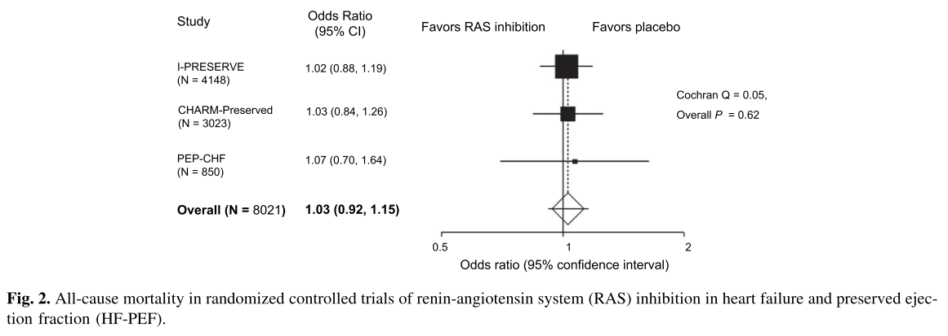

Slide 15
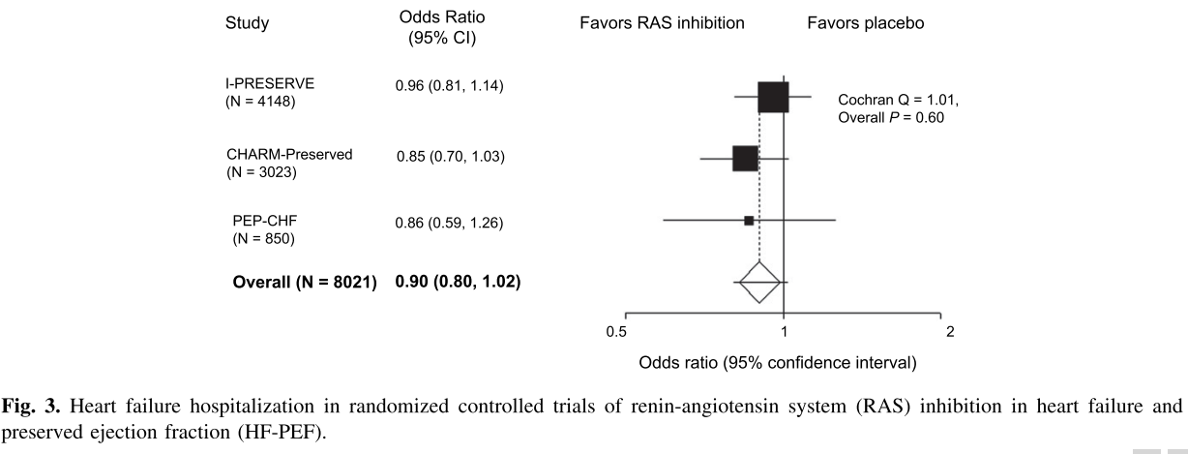

Slide 16
How precise are the results?
  Narrow confidence interval.
Do you consider the magnitude of treatment effect large?
  The results were 0.90 and 1.03.
Were the results similar from study to study?
  Pooled odds ratios were derived in fixed effects models.
  Between study heterogeneity was formally assessed via Cochran Q statistic, with P<05 considered significant.
  P=.62 AND 0.60 For all cause mortality and HF hospitalization

Slide 17
Sensitivity analysis
There were higher symptom severity of patients in I-PRESERVE,
Pooled effect estimates excluding the results of I-PRESERVE.
No effect on all-cause mortality (OR 1.04, 95% CI 0.87-1.24; P5 .69) and a nonsignificant trend toward reduced HF hospitalization (OR 0.85, 95% CI 0.72-1.00; P5 .06).
Notes:
First, given the higher symptom severity of patients in I-PRESERVE, we recalculated pooled effect estimates excluding the results of I-PRESERVE, with no effect on all-cause mortality (OR 1.04, 95% CI 0.87-1.24; P5 .69) and a nonsignificant trend toward reduced HF hospitalization (OR 0.85, 95% CI 0.72-1.00; P5 .06).

Slide 18
Sensitivity analysis
There ere marked rate of discontinuation of ACE inhibitor after the first year of follow-up in PEP-CHF,
Calculated pooled effect estimates limiting the results of PEP-CHF to 1 year (ie, before significant crossover).
No change in the pooled effect estimate for all-cause mortality (OR 1.02, 95% CI 0.91-1.15; P5 .72), inhibition on HF hospitalization (OR 0.88, 95% CI 0.78-1.00; P5 .04)
Notes:
Given the marked rate of discontinuation of ACE inhibitor after the first year of follow-up in PEP-CHF, we recalculated pooled effect estimates limiting the results of PEP-CHF to 1 year (ie, before significant crossover). There was no change in the pooled effect estimate for all-cause mortality (OR 1.02, 95% CI 0.91-1.15; P5 .72), but there was a modest significant benefit for RAS inhibition on HF hospitalization (OR 0.88, 95% CI 0.78-1.00; P5 .04)

Slide 19
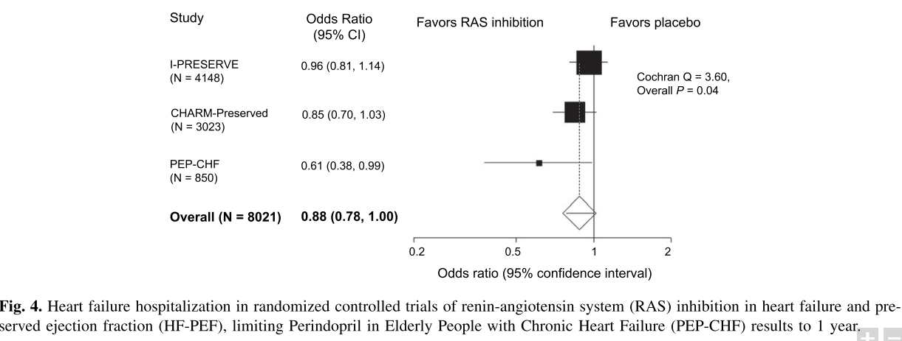

Slide 20
Sensitivity analysis
Pooled analysis of CHARM-Preserved and I-PRESERVE, the largest trials of ARB therapy in HF-PEF.
all-cause mortality (OR 1.03, 95% CI 0.91-1.15; P5 .69) or HF hospitalization (OR 0.91, 95% CI 0.80-1.03; P5 .13).
Notes:
Finally, we performed a pooled analysis of CHARM-Preserved and I-PRESERVE, the largest trials of ARB therapy in HF-PEF. The results of the pooled analysis of these two trials were no different from the overall analysis, with respect to all-cause mortality (OR 1.03, 95% CI 0.91-1.15; P5 .69) or HF hospitalization (OR 0.91, 95% CI 0.80-1.03; P5 .13).

Slide 21
Is there a high likelihood of publication bias?
Not assessed.
Notes:
The small number of studies and overall negative results in all studies found in our search.

Slide 22
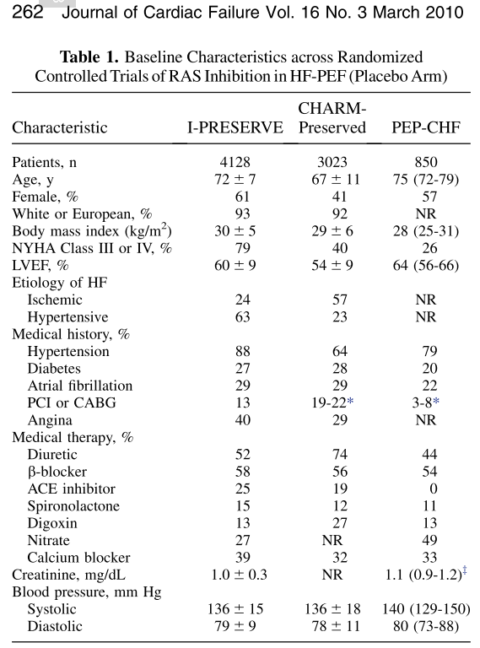
Will the results help me in caring for my patients?
How can I best interpret the results to apply them to the care of my patients?

Slide 23
Were all patient important outcomes considered?
  Adverse events not looked

Slide 24
Conclusion
RAS inhibition in HF-PEF argue against a clinically important benefit to routine prescription of RAS antagonists for reduction of mortality or HF hospitalization in this population.

