Slide 1
13/2/2019

Slide 2
Background
With the advent of better surgical techniques, the use of surgical procedures for rhythm control in atrial fibrillation is a good option
The primary objective -to assess the safety of performing SA as a concomitant or principal procedure
Outcome: mortality or major morbidity
Surgical approaches: primary atriotomy operations, primary nonatriotomy operations, and stand-alone operations.
The secondary objective –to provide a summary assessment of efficacy regarding quality of life and rhythm endpoints as measured by multiple -society monitoring standards.

Slide 3
Summary of recommendations

Slide 5
Overall objective of the guideline is specifically described?
  Yes
  The objectives of this guideline are
  (1) to present a balanced review of current knowledge in the area of surgical ablation
  (2) to provide evidence-based recommendations for clinical practice
  (3) to potentially improve and optimize future patient outcomes.
  Target audience includes : Surgeons
  Score: 5

Slide 6
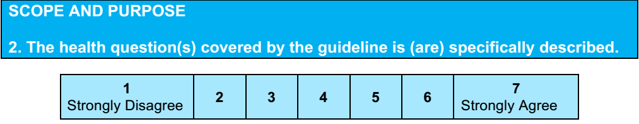
safety of performing SA as a concomitant or principal procedure- defined by mortality or major morbidity
efficacy regarding quality of life and rhythm endpoints
Score: 6

Slide 7
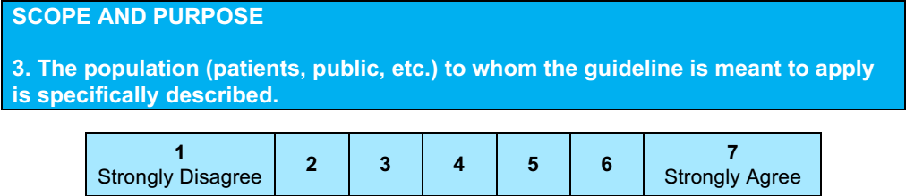
No
Score: 3
Patients with atrial fibrillation

Slide 9
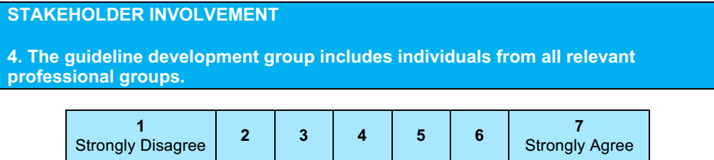
Not clearly mentioned
Score 3

Slide 10
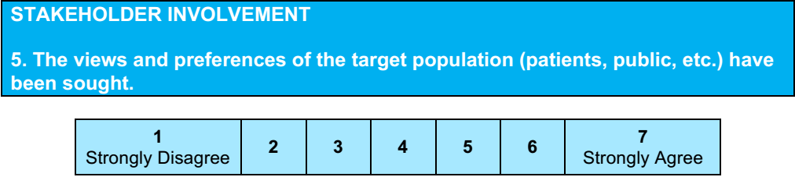
No
Score:1

Slide 11

Not mentioned explicitly
Score :3

Slide 12
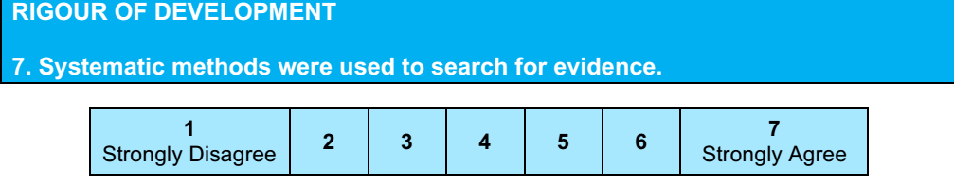
Medline and Embase databases.
Time:after January 1, 2004.
Supplemented by manual examination of the identified studies.
Abstracts were reviewed by at least three persons for relevance.
Observational studies were appraised using the Newcastle- Ottawa scale.
Appraisals of RCT and meta-analyses utilized checklists modeled after those recommended by the Center on Evidence Based Medicine
All extracted and reviewed data were compiled in the form of evidence tables by three coauthors
  Score : 5

Slide 13
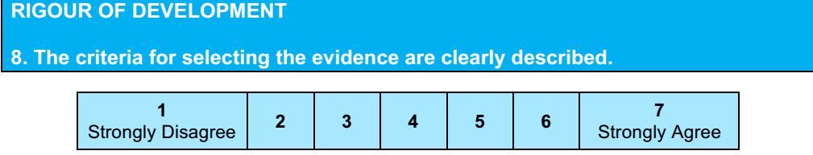
Yes
Only publications in English were used
Papers were excluded if they were case reports, were population- based studies covering incidence and risk factors for AF, had a primary focus on nonsurgical procedures, or sought to identify potential outcomes or markers not within the focus of the guideline
Score: 6

Slide 14
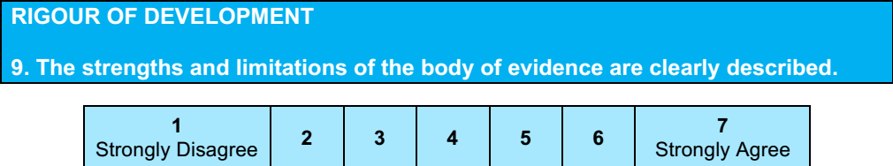
Not mentioned
Only study design mentioned
Score:2

Slide 15

all extracted and reviewed data were compiled in the form of evidence tables by three coauthors
The manuscript was presented to and approved by the Workforce on Evidence Based Surgery and the STS Executive Committee.
Score:4

Slide 16

Yes
Score: 6

Slide 17
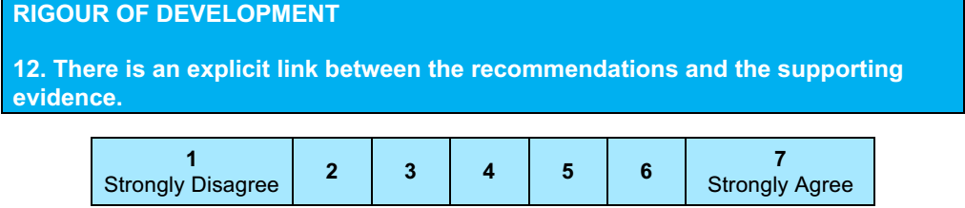
Yes
Score: 7

Slide 18
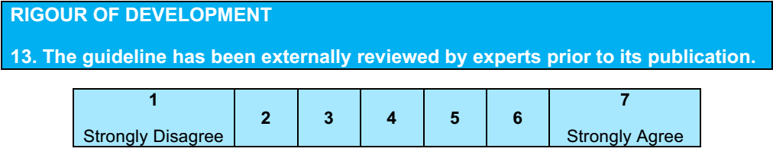
Yes
The manu- script was presented to and approved by the Workforce on Evidence Based Surgery and the STS Executive Committee.
Score: 6

Slide 19
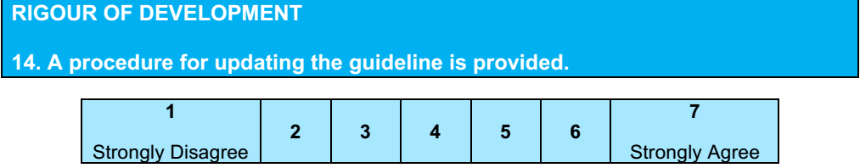
No
Score 1

Slide 21

Yes
Score: 7

Slide 22
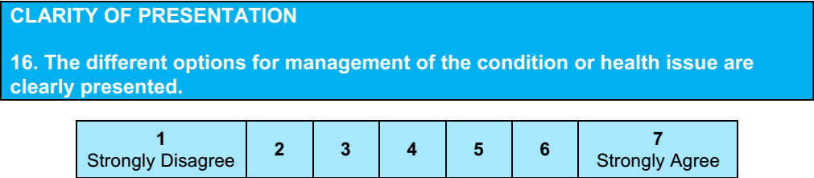
No
Score: 5

Slide 23
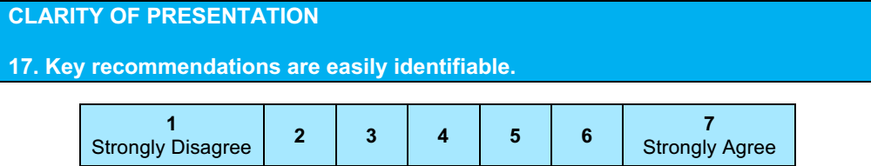
Yes
Score: 7

Slide 25
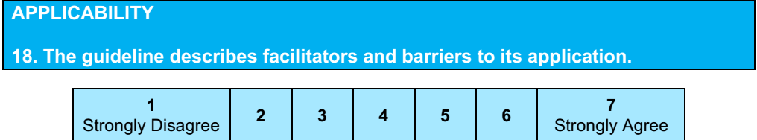
No
Score : 2
Recommendation are subject to resource availability and technical expertise

Slide 26
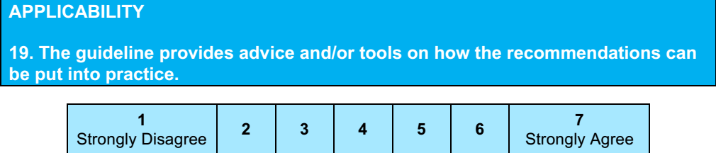
No
Score: 1

Slide 27
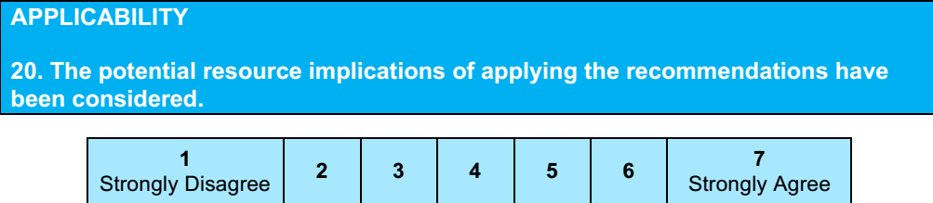
No
Score: 1

Slide 28
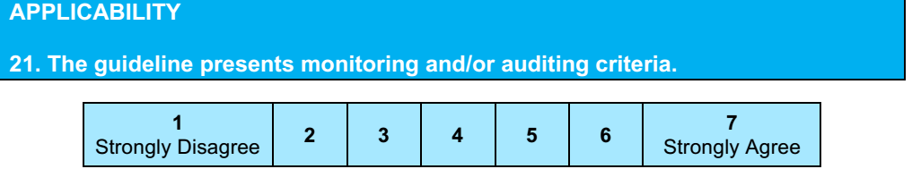
No
Score: 1

Slide 30
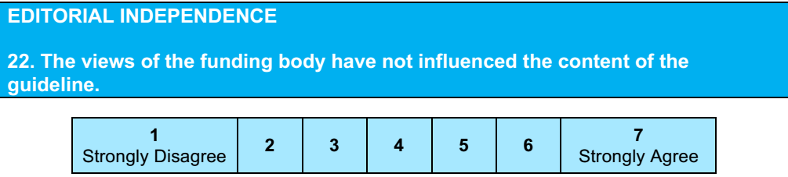
Guideline generation was sponsored by the STS without commercial support, and formulated by a volunteer member writing committee.
Efforts were made to avoid all conflicts of interest due to industry relationships, and all committee members disclosed current industry associations
Score:7

Slide 31
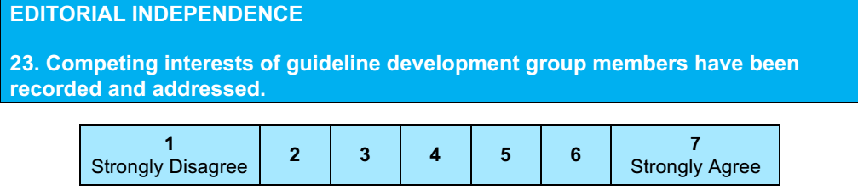
Yes
Score: 7

Slide 32

4

Slide 33

Yes , with modifications: Quality of evidence to be reviewed in detail

