Slide 1

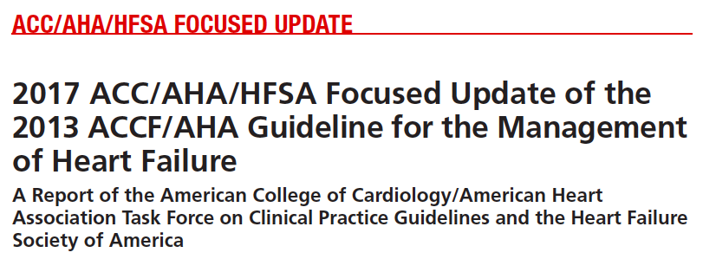

Slide 2
Background
The purpose of this focused update is to update the “2013 ACCF/AHA Guideline for the Management of Heart Failure”9 (2013 HF guideline) in areas in which new evidence has emerged since its publication.
For this update and future heart failure (HF) guidelines, the Heart Failure Society of America (HFSA) has partnered with the ACC and AHA to provide coordinated guidance on the management of HF.

Slide 3

Overall objective of the guideline is specifically described?
  Yes
  Updates in guidelines with inclusion of evidence since the last update
  Score: 5

Slide 4
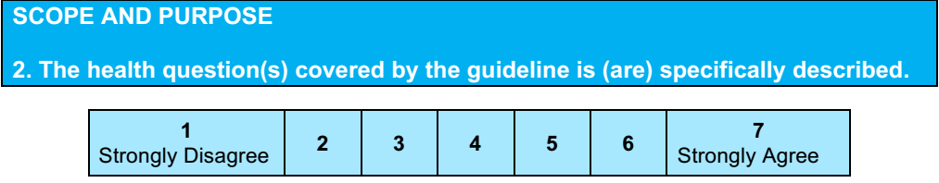
The scope of the focused update includes revision on
  biomarkers
  new therapies indicated for stage C HF with reduced ejection fraction (HFrEF)
  updates on HF with preserved ejection fraction (HFpEF)
  new data on important comorbidities, including sleep apnea, anemia, and hypertension
  new insights into the prevention of HF
Score: 6

Slide 5
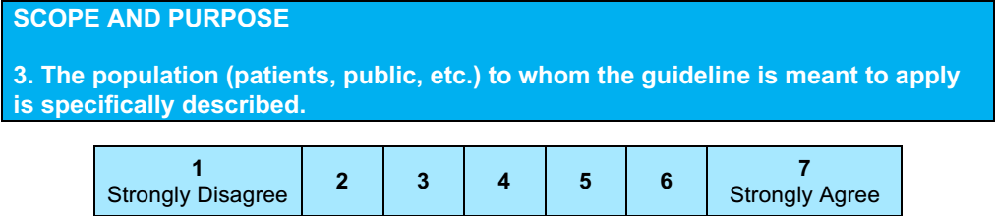
Yes
Patients with heart failure : Classes A through D
Prevention of HF in patients at risk
Score: 7

Slide 6
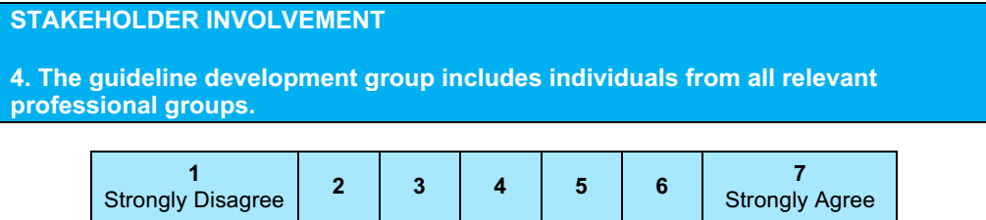
The focused update was reviewed by
  2 official reviewers each nominated by the ACC, AHA, and HFSA;
  1 reviewer each from the American Academy of Family Physicians, American College of Chest Physicians, and International Society for Heart and Lung Transplantation; and
  19 individual content reviewers.
Yes
Score 7

Slide 7
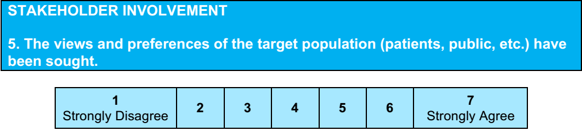
No
Score : 1
No mention of stakeholder involvement mentioned.

Slide 8
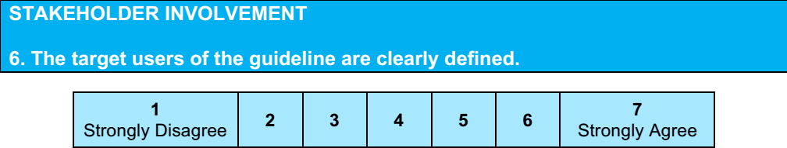
Yes
Score :7
Target users: Patients with HF
Secondary : Patients at risk of developing HF

Slide 9
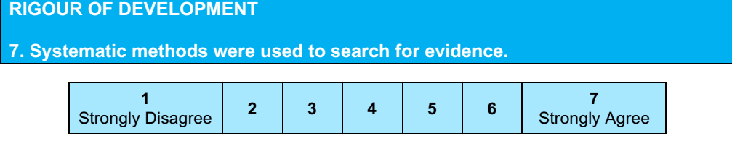
Evidence synthesis team: conducted systematic reviews.
  Literature searches focus on randomized controlled trials (RCTs) but also include registries, nonrandomized comparative and descriptive studies, case series, cohort studies, systematic reviews, and expert opinion.
  Yes: score : 6

Slide 10
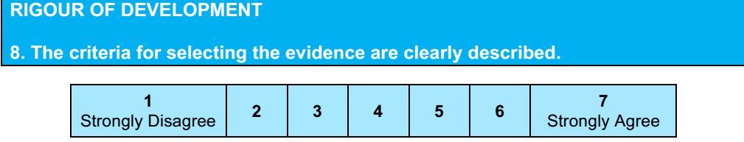
Not specifically mentioned, how many articles were assessed , and what the inclusion / exclusion criteria were.
Score: 2

Slide 11
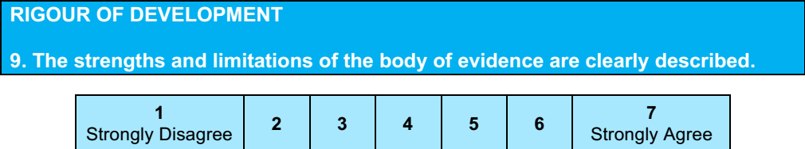
Evidence summaries – Class of Recommendation and Level of Evidence provided
Score: 6

Slide 12
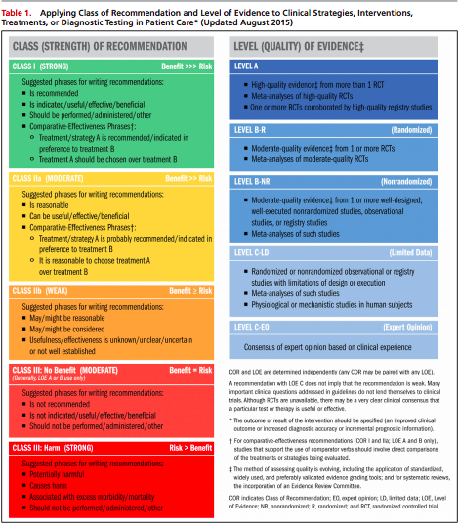

Slide 13
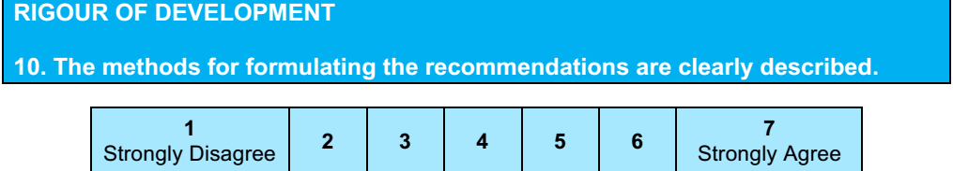
Yes
Score: 7
Recommendations from the prior guideline that remain current have been included for completeness, but the LOE reflects the COR/LOE system used when the recommendations were initially developed. New and modified recommendations in this focused update reflect the latest COR/ LOE system, in which LOE B and C are subcategorized for greater specificity

Slide 14
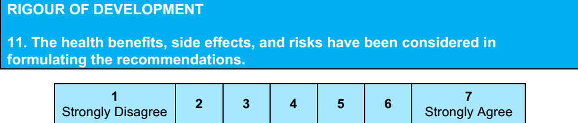
Yes
Score: 7

Slide 15
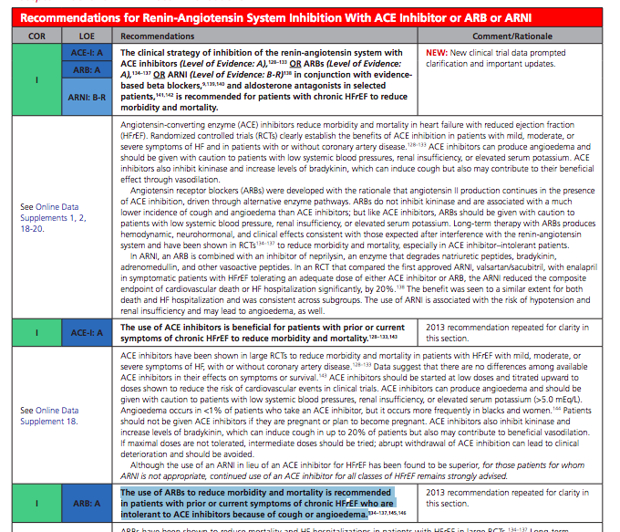

Slide 16
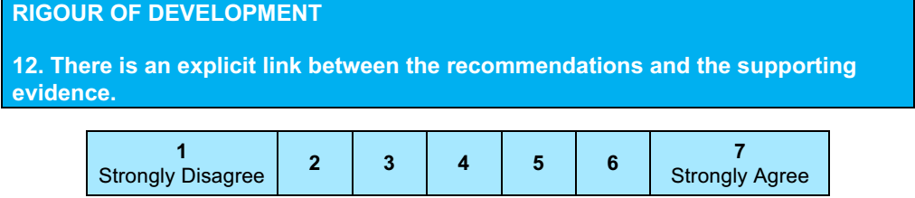
Yes
Score: 7

Slide 17
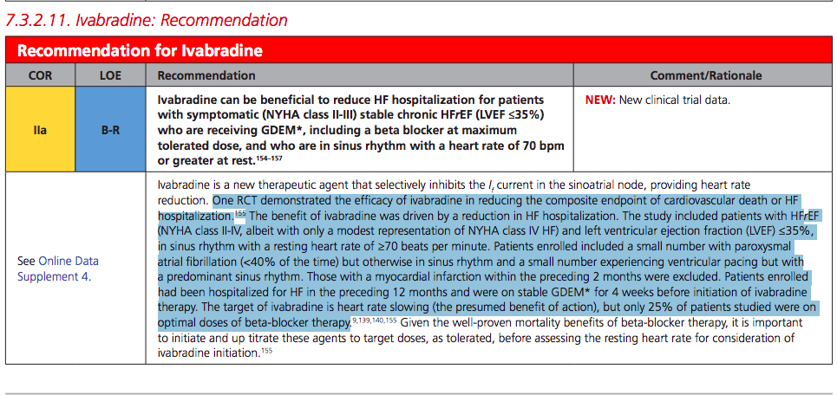

Slide 18
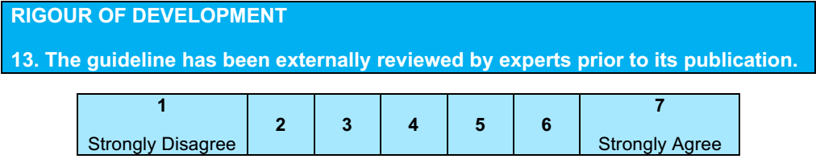
Yes
Score: 7
This document was approved for publication by the governing bodies of the ACC, AHA, and HFSA.

Slide 19
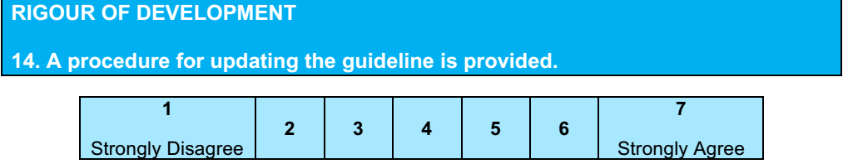
No
Score 1

Slide 20
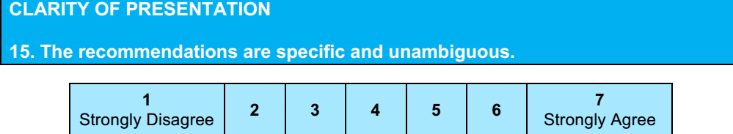
Score: 7

Slide 21
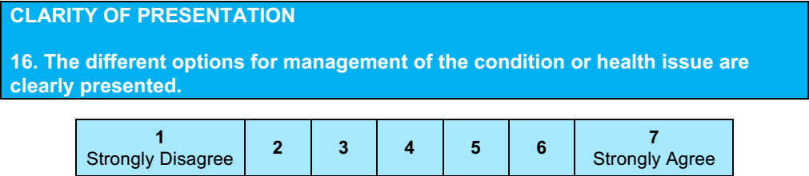
Yes
Score: 7

Slide 22
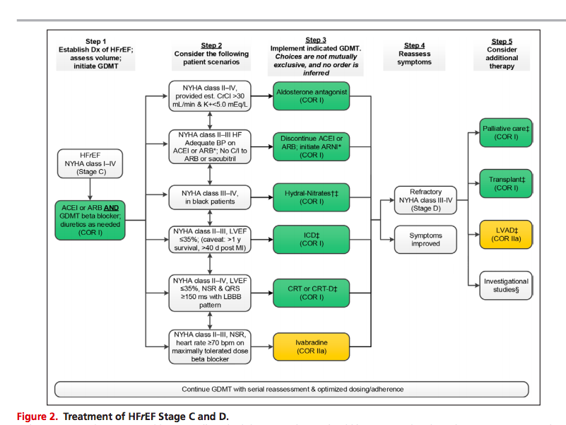

Slide 23
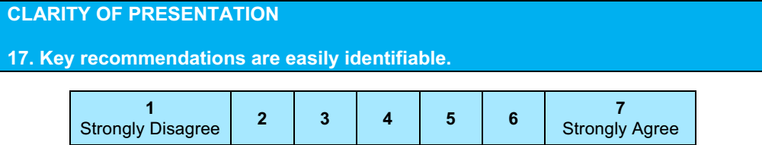
Yes
Score: 7

Slide 24
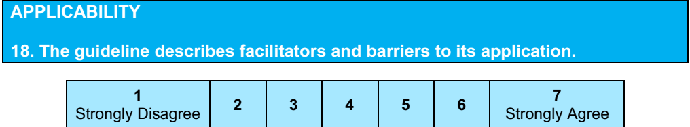
Yes
Score : 6
Recommendation are subject to resource availability.

Slide 25
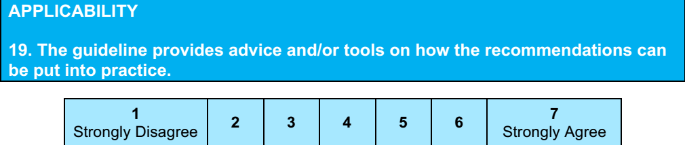
Yes
Score: 6

Slide 26
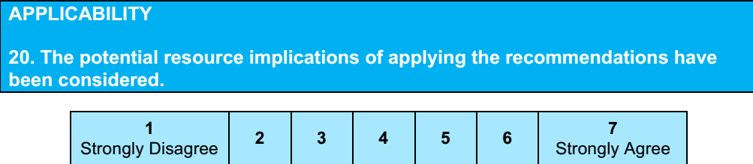
Yes
Score: 6

Slide 27
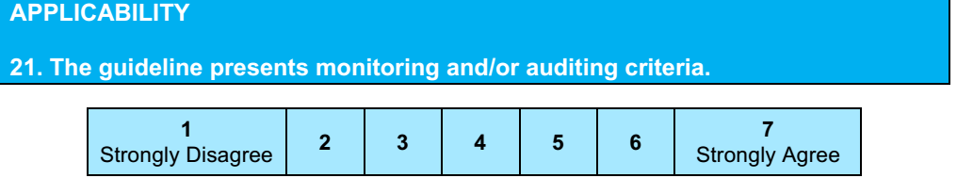
No
Score: 1

Slide 28
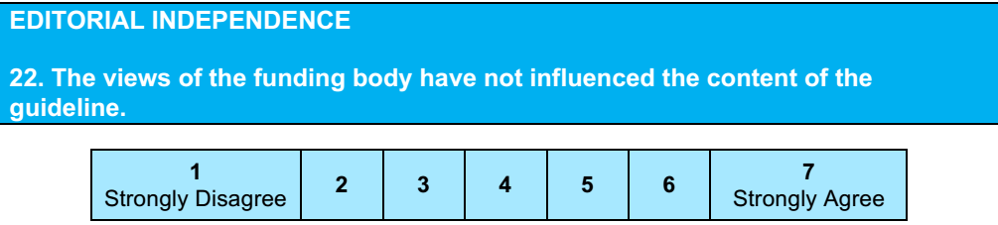
Score: 4
Source of funds – Not mentioned

Slide 29
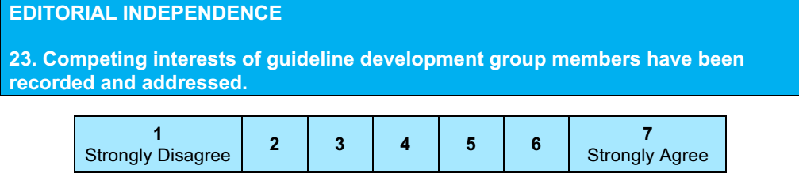
No mention made
Score: 3

Slide 30
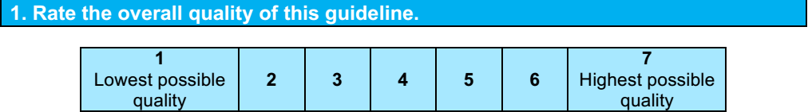
6

Slide 31
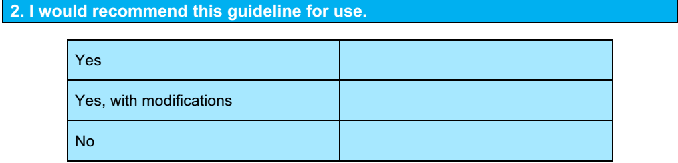
Yes

