Slide 1
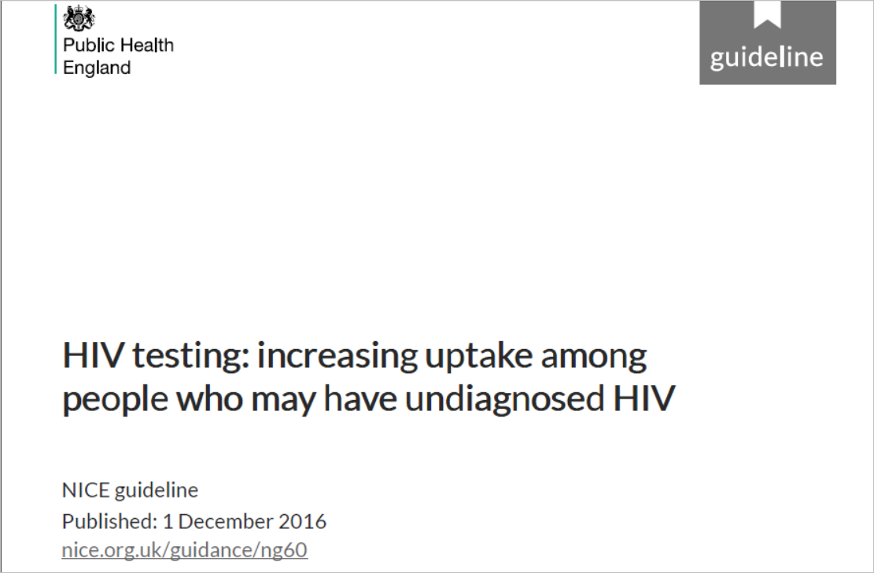
ASHA MATHAI

Slide 2
Background
Recommendations from the previous guidelines were aimed at a broader population than men who have sex with men, and black Africans.
For the more specific recommendations, it would be appropriate to broaden them to apply to any population with a high rate of HIV.
Men who have sex with men, and black Africans are still the most high-risk groups for HIV in the UK
An additional benefit of broadening the recommendations to apply to everyone with undiagnosed HIV is that it should help to normalise HIV testing so that it is not seen differently from any other blood test.

Slide 3

Overall objective of the guideline is specifically described?
  Yes
How to increase the uptake of HIV testing in primary and secondary care, specialist sexual health services and the community.
To plan and deliver services that are tailored to the local prevalence of HIV, promote awareness of HIV testing and increase opportunities to offer testing to people who may have undiagnosed HIV.
Score:7

Slide 4
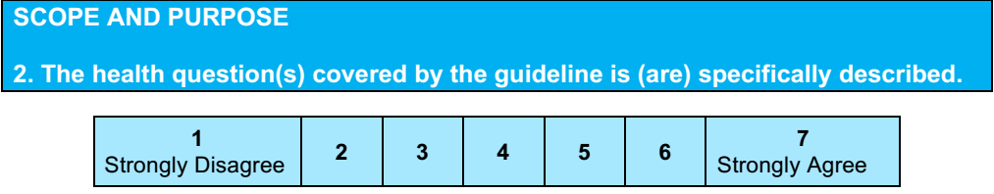
YES
Promote awareness of HIV testing and increase opportunities to offer testing to people who may have undiagnosed HIV
Health care setting or context- mentioned
Score: 7

Slide 5
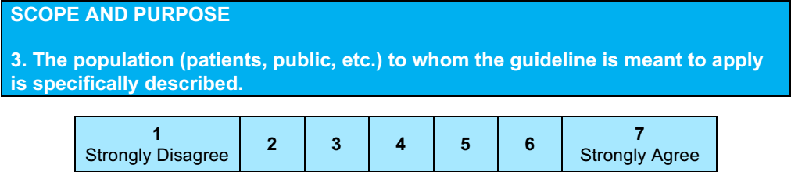
Yes
Score: 6
Target population- Mentioned
Testing everyone who has not previously been diagnosed with HIV, when they are admitted to hospital, or to people attending GP appointments.

Slide 6
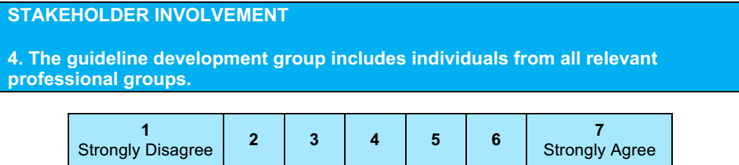
NICE worked with Public Health England
19 members
Physicians, psychologist
Public health director
Hiv survieillance members
HIV specialist nurse
Lay topic expert member
Score -4
Name- mentioned
Discipline/content expertise- mentioned
Institution- mentioned
Description of the member’s role in the guideline development group- not mentioned

Slide 7
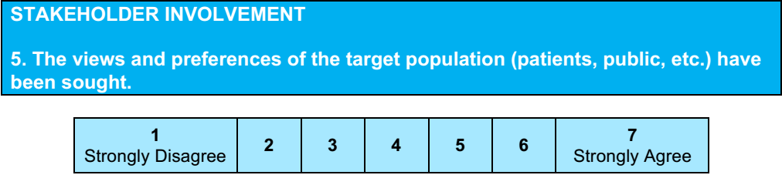
Yes
Score :6
Committee meeting to discuss the previous guidelines

Slide 8
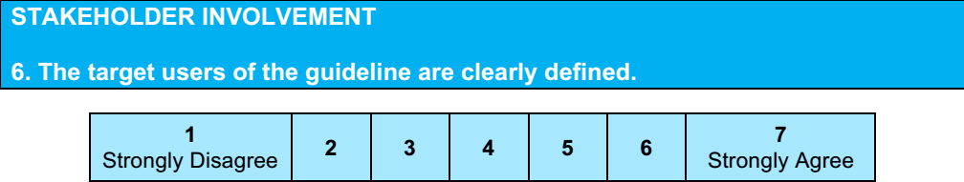
Yes
Score :7
Local authority and NHS commissioners of HIV testing services
Providers of HIV testing services
Practitioners working in services that offer HIV testing
The general public

Slide 9
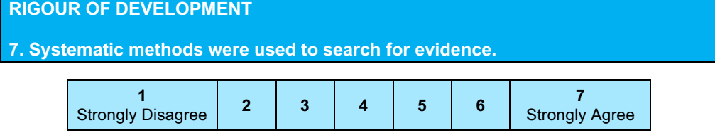
Single systematic search of relevant data bases and websites were conducted from 1996 to may 2015
Data from from Public Health England
Score - 6

Slide 10
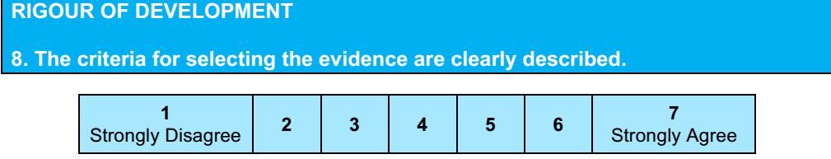
Not specifically mentioned, how many articles were assessed
Not mentioned inclusion criteria and exclusion criteria
Score: 3

Slide 11
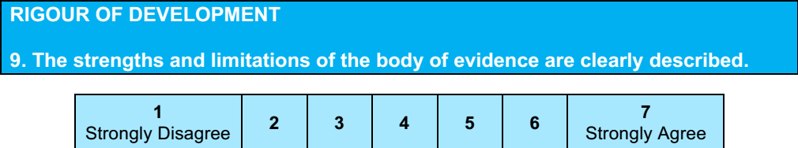
Yes
Overall, the quality of the studies was mentioned
  Evidence relating to the awareness of HIV testing was graded
  Quality of the studies relating to uptake of HIV testing was also graded
Several limitations were seen across the studies, relating particularly to study design (specifically the absence of control groups), lack of reporting of patient characteristics, lack of blinding, and use of subjective outcomes
Score - 7

Slide 12
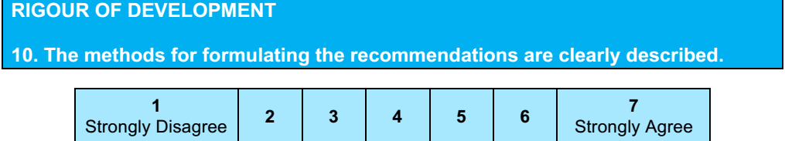
No
Details of how the panellist reached the recommendations are not clear.
Score - 3

Slide 13
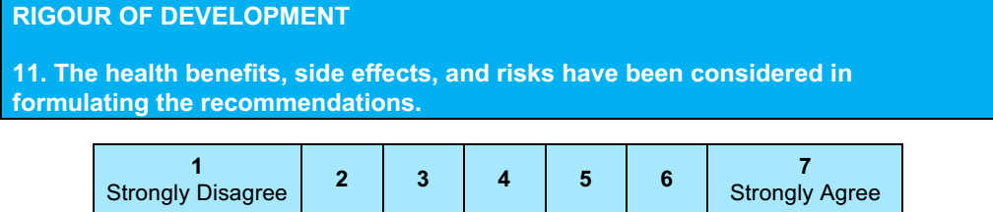
Yes- health benefits has been considered
Social stigma

Slide 14
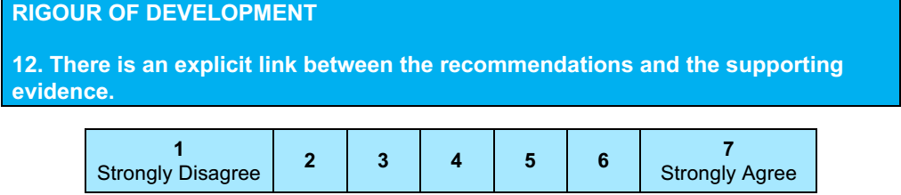
References for supporting evidence for each recommendation are mentioned
Score: 6

Slide 15
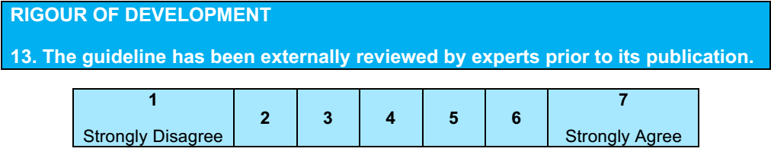
Not mentioned
Score: 2

Slide 16
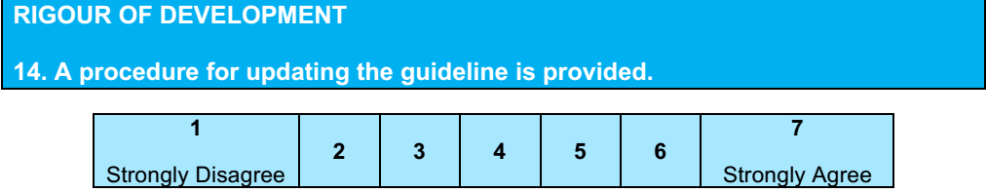
Not mentioned
Guideline committee has made the recommendations for research

Slide 17
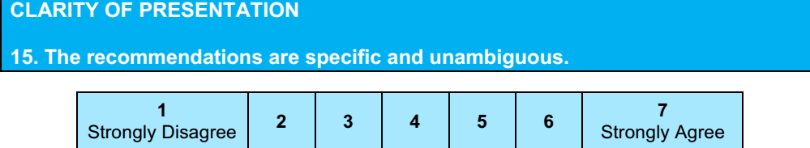
Yes
Score: 6

Slide 18
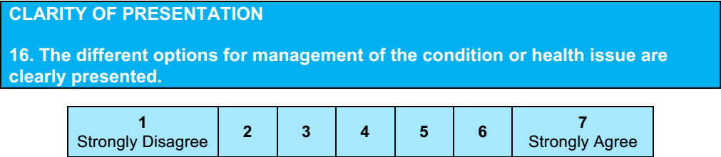
No
Score: 2

Slide 19
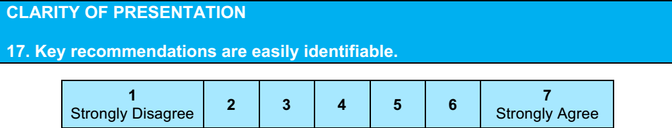
Yes
Score: 6

Slide 20
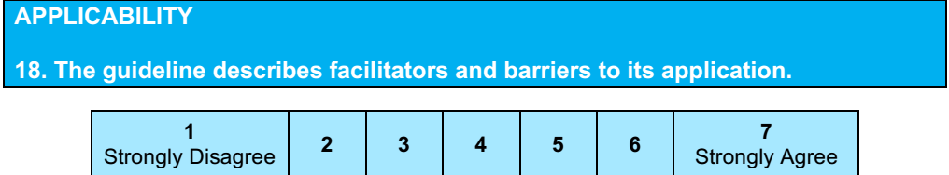
Yes
Score : 6
Recommendation are subject to patient consent and circumstances of the individual.

Slide 21
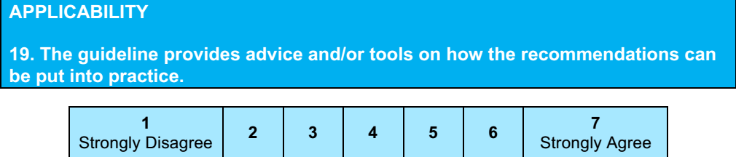
Yes
Score: 6

Slide 22
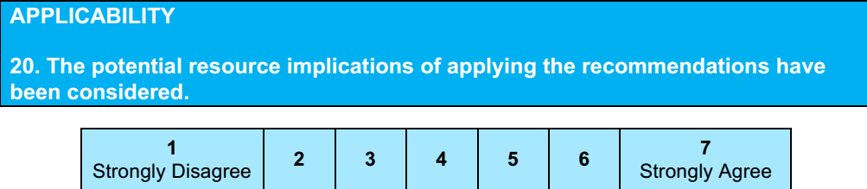
Not mentioned
Score:2

Slide 23
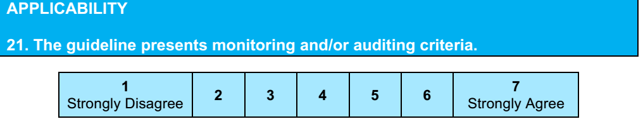
No
Score: 1

Slide 24
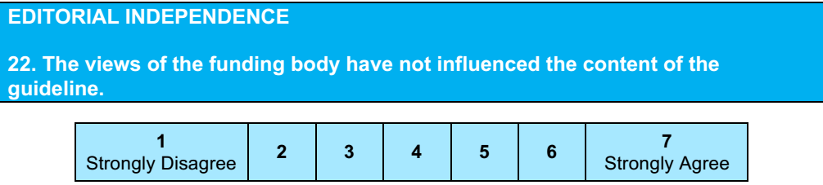
Not mentioned
Score:2

Slide 25
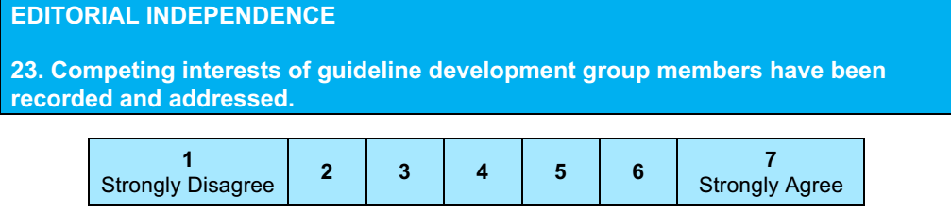
Not mentioned
Score :1

Slide 26
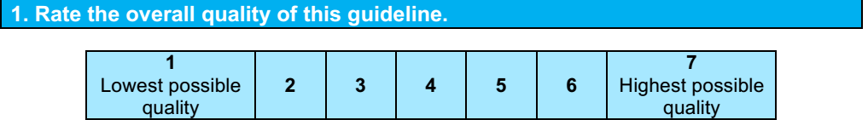
Score - 4

Slide 27
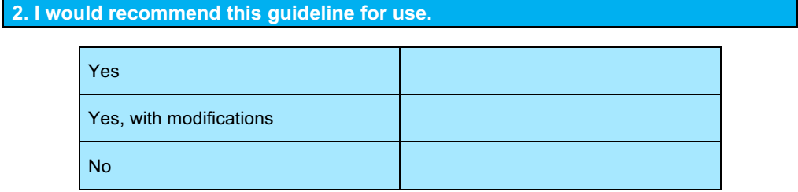
Yes , with modifications

