Slide 1
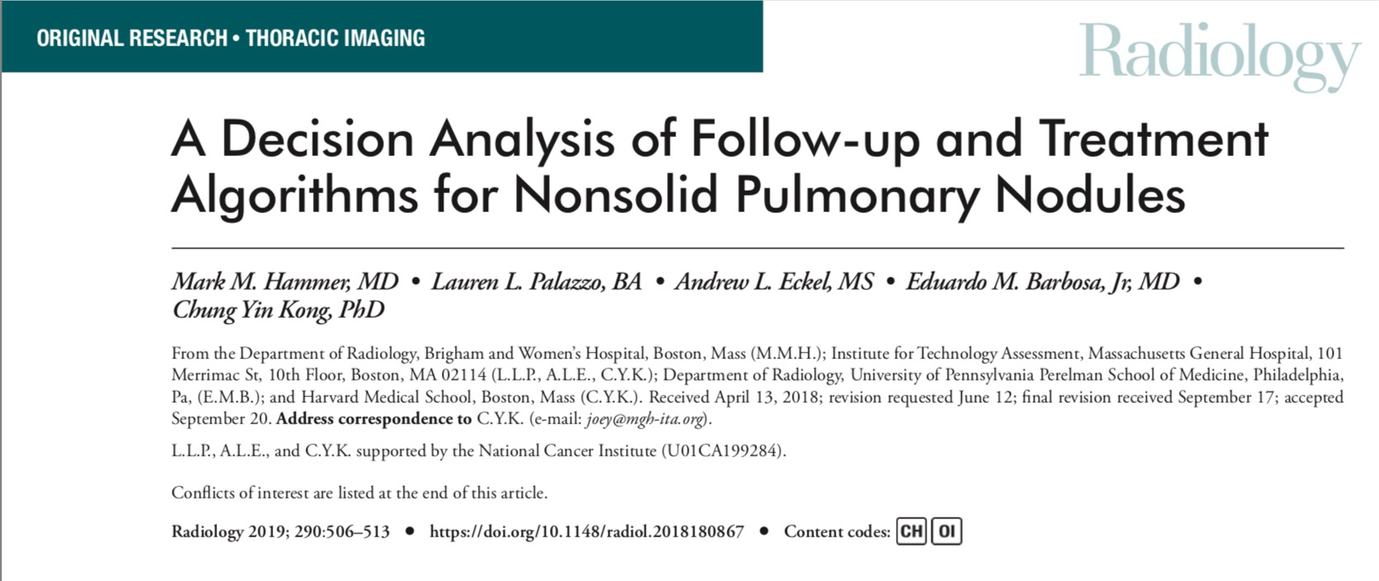
Kevin

Slide 2
Background
Non solid nodules or ground glass nodules are seen in LD CT scans
They can be inflammatory or premalignant
Questions?
-will screening, biopsy and treatment prolong survival?
-do these nodules ever manifest clinically even if they are not diagnosed?
-How often do they have to be followed up?

Slide 3
Methods
Study used pre existing data from the national lung screening trial data
Used a state transition monte carlo simulation model using C++
“clinically significant” malignancies - those that manifest clinically
Clinically significant malignancies -defined in term of nodule growth rate

Slide 4
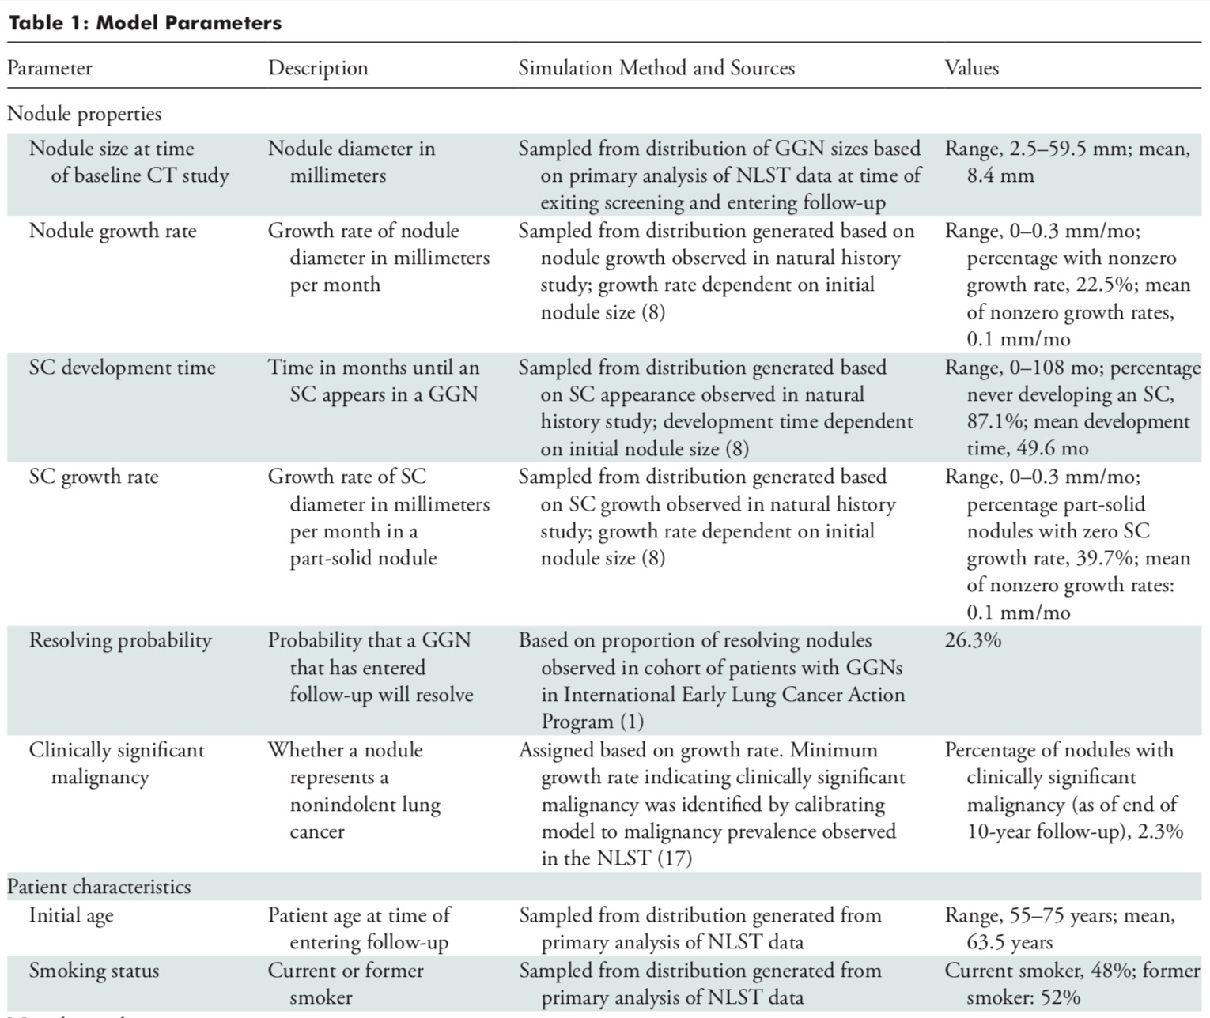

Slide 5
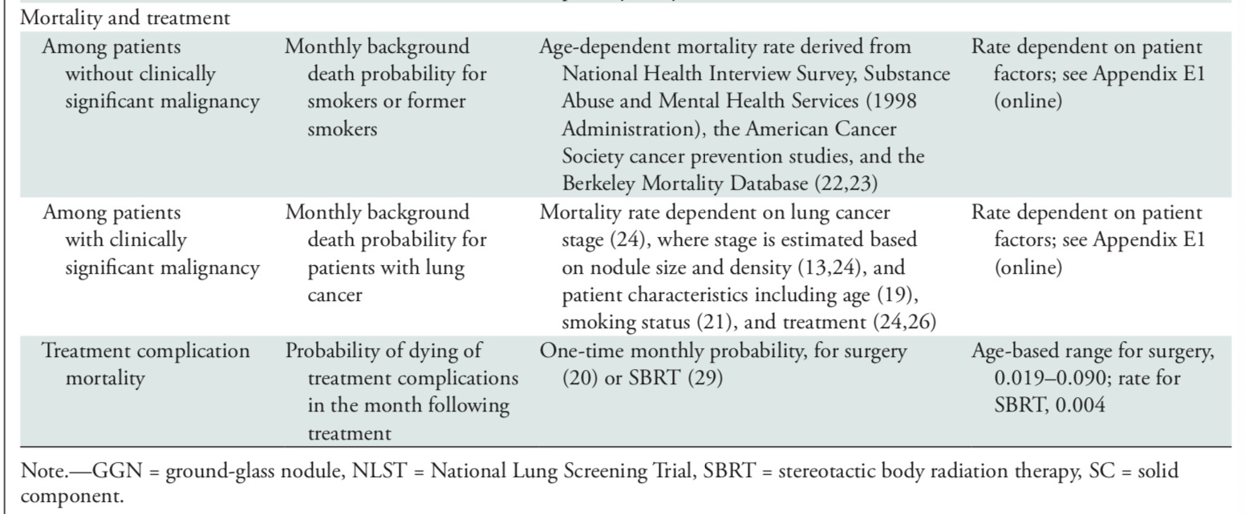

Slide 6
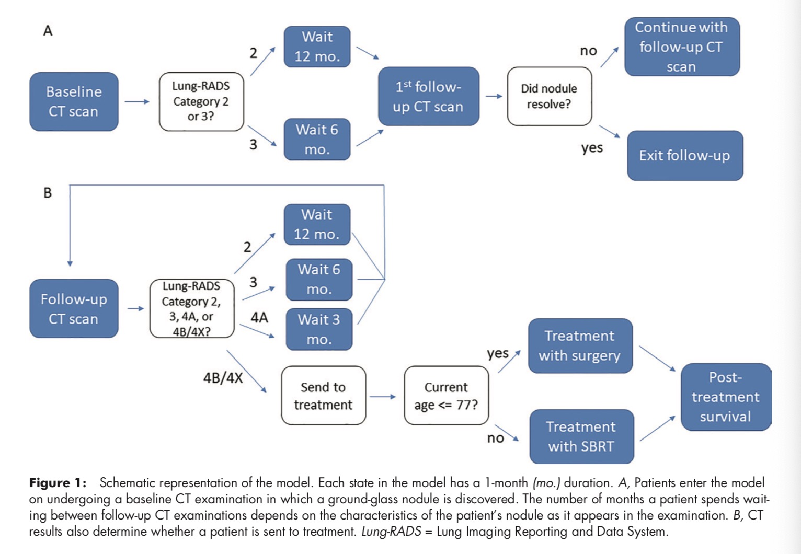

Slide 7
Patient characteristics
Patients were selected from NLST
Characteristics were set so that the cohort would be representative of real world cohort
Probability of patient death depends on age, presence and state of clinically significant lung cancer, whether the patient has received treatment.

Slide 8
Follow up schedule
Depending on the results of the baseline screening examination, the patient was assigned a 6- or 12-month waiting period until the first follow-up CT study.
Depending on the results of the follow-up study, the patient will either wait 3, 6, or 12 months for their next follow-up or exit the follow- up process and receive treatment for lung cancer.
Total follow up period - 10 years

Slide 9
Cancer treatment
Once a nodule reached category 4B or 4X - it was treated definitely
Treatment modalities - surgery: lobectomy below 77yrs, SBRT >77yrs

Slide 10
  Incidental cancer
To estimate rate of incidental cancer, the Lung Cancer Policy Model(LCPM) was used which is a well validated comprehensive microsimulation model of lung cancer development, progression, detection, treatment and survival

Slide 11
P: Patients with GGN
I: Treatment - SBRT, surgery
C: no treatment
O: overall survival
T:10 year follow up (by modelling)

Slide 12
Are the recommendations valid?
Did they consider all relevant patient groups, management options and possible outcomes?
  Only survival
  No morbidity outcomes - quality of life
  Not measured over diagnosis / unnecessary procedures

Slide 13
Sensitivity analysis
Was done
There was no difference 1 and 3 year OS
7 out of 8 sensitivity analysis scenarios showed SBRT had the highest OS
Only in the extreme scenario where the no treatment arm had minimal mortality - it was shown to have highest OS

Slide 14
Are there systematic reviews of the evidence that estimate the relative impact of management options on relevant outcomes?
  Yes
Is there an appropriate specification of values and preferences associated with each of the outcomes?
  No
Do the authors indicate the strength of their recommendations?
  Yes

Slide 15
What are the results?
2.3% (22584 of 1000000) of nodules were clinically significant malignancies
6.3% (62559 of 1000000) of nodules were treated
30% (18668 of 62559) of Lung-RADS category 4B or 4X nodules were clinically significant malignancies.
OS at 10 years
  72% ([CI]: 71%, 72%) with annual follow-up
  71% (CI: 71%, 72%) with 3-year-interval follow-up
At 10 years, OS among patients whose nodules progressed to Lung-RADS category 4B or 4X was
  80% after radiation therapy (CI: 80%, 80%)
  79% after surgery (CI: 78%, 79%)
  74% after no therapy (CI: 74%, 75%) (P , .01)

Slide 16
What are the key recommendations?
The follow up interval for GGN can be increased to 3 years
RT is better than lobectomy for the treatment of GGN

Slide 17
Will the recommendations help you in caring for your patients?
Do the recommendations make sense n your practice setting?
Yes

