Slide 1
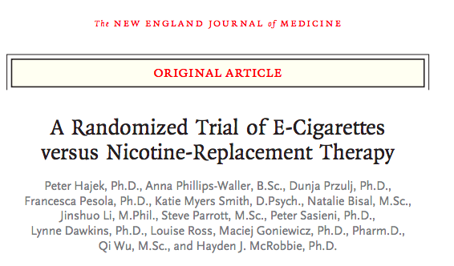

Slide 2
Background
E-cigarettes are commonly used in attempts to stop smoking, but evidence is limited regarding their effectiveness as compared with that of nicotine products approved as smoking-cessation treatments.

Slide 3
Study Design
Two-group, pragmatic, multicenter, individually randomized, controlled trial.

Slide 4
PICOT
P – Adults attending U.K National health service stop smoking services
I – E-cigarette starter pack
C – Nicotine replacement product of choice
O – Abstinence or reduction in smoking
T – 52 weeks

Slide 5
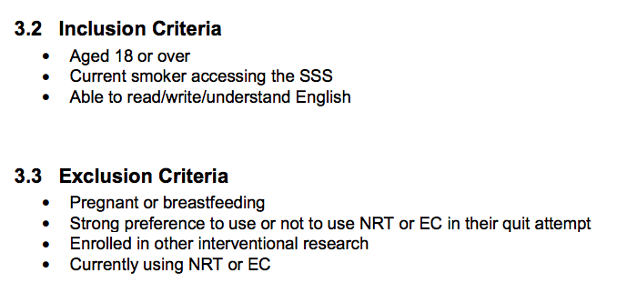
Was the Study Population Clearly Defined?

Slide 6
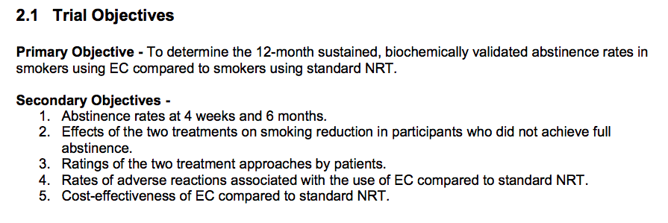
Were the outcome measures clearly defined?

Slide 7
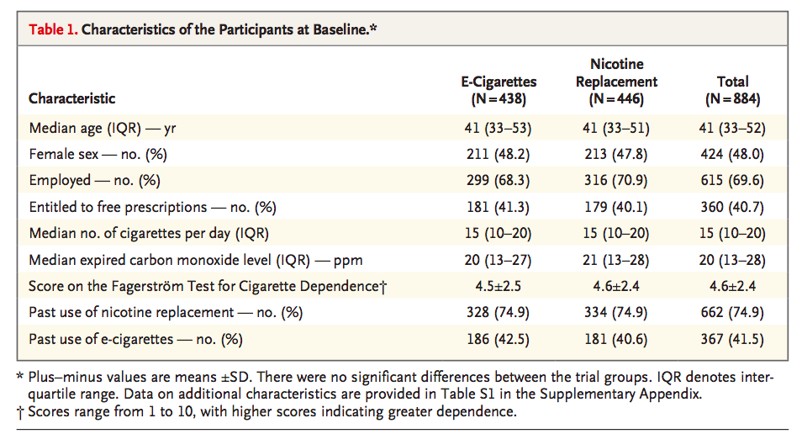
Did the intervention and control groups start with the same prognosis?

Slide 8
Were the patients randomized?
Randomization took place on the quit date to limit differential dropout.
Randomization sequences (1:1 ratio in permuted blocks of 20, stratified according to trial site) were generated with the use of a pseudorandom number generator in Stata software.

Slide 9
Was the allocation concealed ?
Assignments were embedded into an application that only revealed the next treatment assignment once a participant had been entered into the database.

Slide 10
Were the patients in the study groups similar in known prognostic variables?
Yes.
All prognostic variables were taken into consideration.

Slide 11
To what extent was the study blinded
Open label trial
Blinding was not done

Slide 12
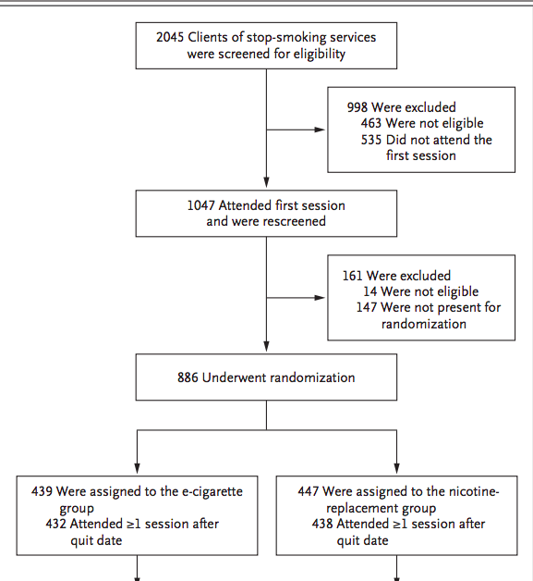
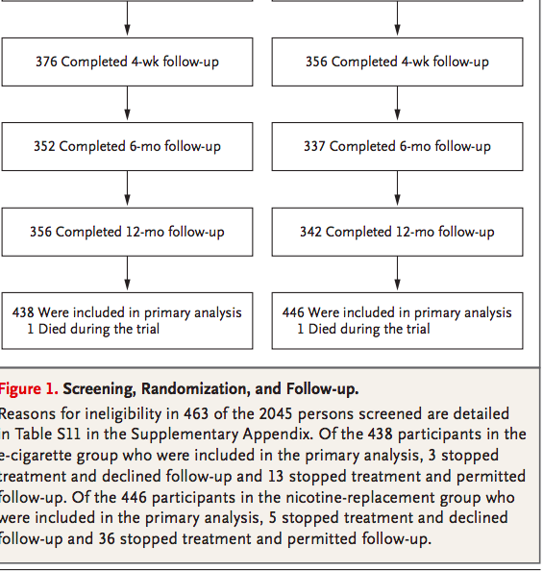
Were the groups prognostically balanced at the study completion?

Slide 13
Was the follow up complete?
Yes

Slide 14
Was the study stopped prematurely?
No

Slide 15
Were the patients analysed in the groups to which they were randomized?
Yes
There was no crossing over in the trial
ITT analysis done

Slide 16
Were adequate number of people included in the study?
It was calculated that a sample of 886 participants would provide the trial with 95% power if the true percentages of 1-year abstinence were 23.8% in the e-cigarette group and 14.0% in the nicotine replacement group (relative risk, 1.7).
Since trial setup, the abstinence rate in stop-smoking service clinics declined to 10%, but the sample of 886 participants would provide 85% power if the percentages were 17.0% and 10.0% in the respective groups.

Slide 17
Validity of the study
Study population: well defined
Outcomes: clearly defined
Randomization: Adequate
Blinding: Open Label
Sample size calculation: Adequate
Intention treat analysis: Done
Baseline characteristics: well matched

Slide 18
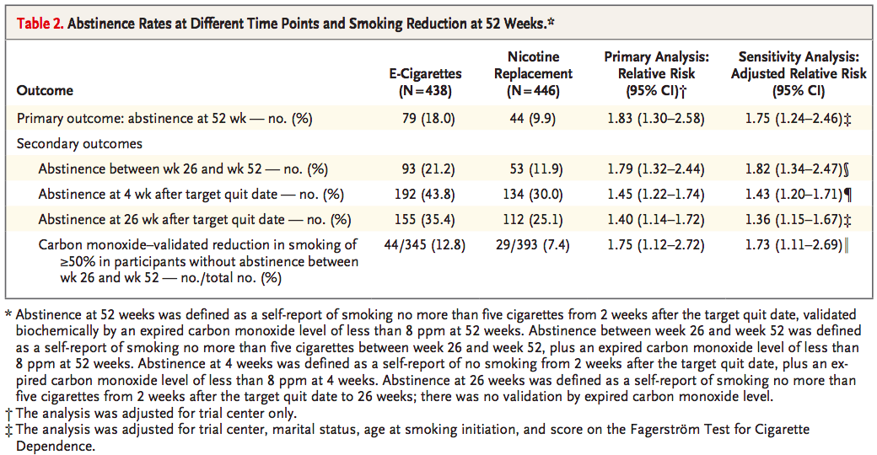
Results

Slide 19
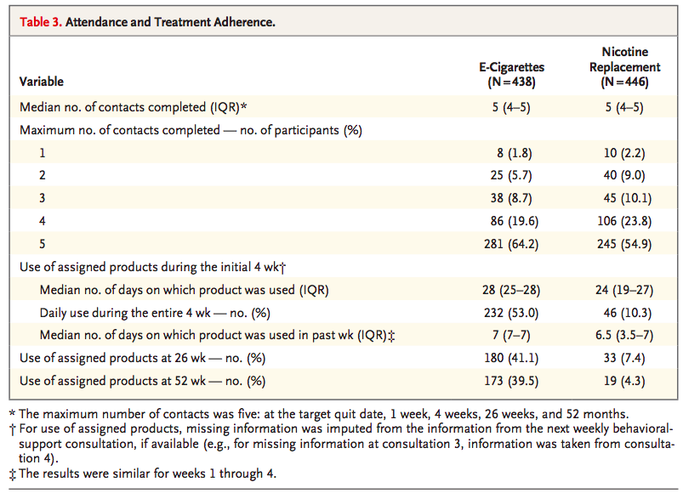

Slide 20
How can I apply the results to patient care?
ARR = (79/438) – (44/446) =18 -9.9 = 8.1
NNT = 100/8.1 = 12.34

Slide 21
Were the study patients similar to my patients in my practice?
49% of patients in the study were women
40% of the study subjects were entitled to free prescriptions.

