Slide 1
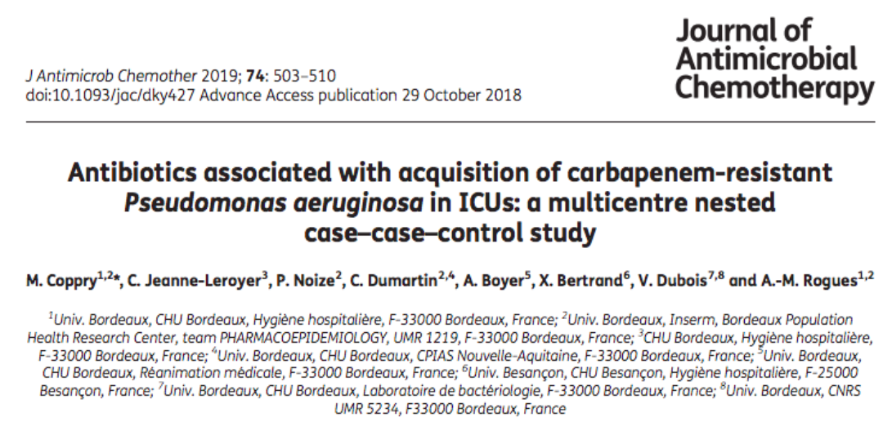

Slide 2
Background
Carbapenem-resistant Pseudomonas aeruginosa (CRPA) strains are involved in severe infections, mostly in ICUs.
Exposure to antibiotics other than carbapenems may be associated with isolation of CRPA;
This study aimed to identify those antibiotics using thecase–control study design.

Slide 3
Methods
Case-case control design
DYNAPO Cohort : Multicentre Dynamics of Acquisition of
Pseudomonas aeruginosa (DYNAPYO) cohort, which was prospectively built in 2009 in 10 ICUs from eight French hospitals
P: Patients admitted in 10 French ICUs
Cases: Patients with positive isolation of P.aeruginosa
  Cases 1: CRPA
  Cases 2: CSPA
Controls: Patients without P. aeruginosa isolation, matched with each case according to centre, length of stay and hospitalization period.
Time: 1st Jan 2009 to Dec 2009

Slide 4
Study Cohort
Inclusion:
  Patients admitted to the 10 ICUs during the cohort study period
  All patients were screened at admission with oropharyngeal and rectal swabs for P.aeruginosa colonisation. Patients included if screening was negative
  ICU stay for at least 48 hours
Exclusion:
  Positive isolation at admission screening
  Shorter ICU stay

Slide 5
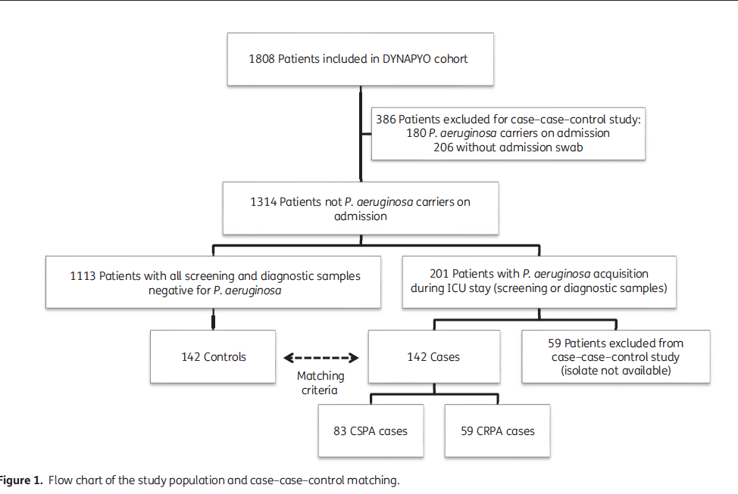

Slide 6
Exposure
Antibiotic and non antibiotic exposures for acquisition of CSPA and CRPA acquisition during or following ICU stay.

Slide 7
Statistical Analysis
Univariate and multivariable analyses were performed using logistic regression models. CRPA acquisition and CSPA acquisition were considered separate outcomes.
The exposure to each antibiotic group was assessed adjusting for non-antibiotic exposures. ORs and 95% CIs were calculated for all antibiotic groups.
Variables related to outcomes with a conservative threshold of 20%on the Wald test were maintained for multivariable models.
Goodness-of-fit assessed using the Hosmer–Lemeshow test.
Qualitative comparison between the two models was then performed to identify specific risk factors for CRPA acquisition.
Notes:
(antibiotic group, inpatient characteristics and non-antibiotic exposures)

Slide 8
Are the results valid?
Did the cases and the control group have the same risk (chance) for being exposed in the past?
  Were the cases and the control similar with respect to the indication or circumstances that would lead to the exposure?

Slide 9
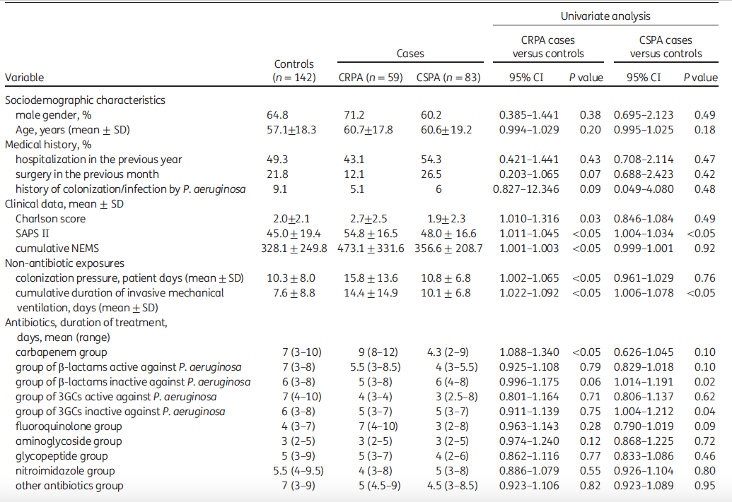
Notes:
SAPS : Simplified actue physiology score
NEMS: Nine equivalents of nursing manpower score

Slide 10
Were the circumstances and the methods for determining exposure similar for cases and controls?
  Yes

Slide 11
What are the results?
How strong is the association between exposure and outcome?

Slide 12
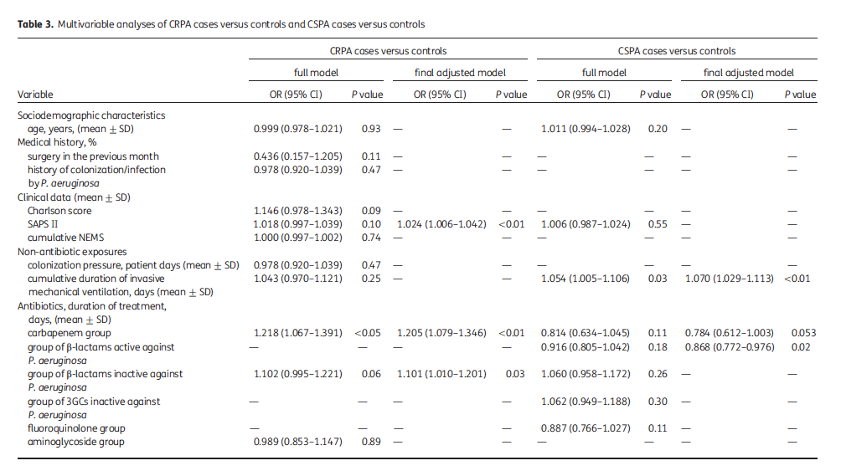

Slide 13
How precise is the estimate of risk?
Use of group of b-lactams inactive against P. aeruginosa
OR - 1.101
95% CI - (1.010–1.201)
Narrow CI. Hence, this is a precise estimate.

Slide 14
How can I apply the results to my patient care?
Were the study patients similar to patients in my practice?
  Yes
Was the duration of follow up adequate?
      Screening done at 48 hours and then weekly. However, mean duration of screening not mentioned.

Slide 15
Is the exposure similar to what might occur in my patient?
  Yes
What is the magnitude of the risk?
  Use of group of b-lactams inactive against P. aeruginosa was associated with 0.1% high risk of acquisition of CRPA following ICU stay.
Are there benefits that offset the risks of the exposure?

