Slide 1
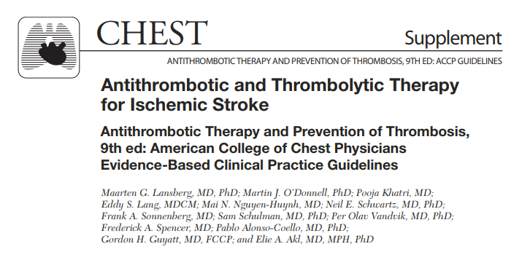
Anusha

Slide 2
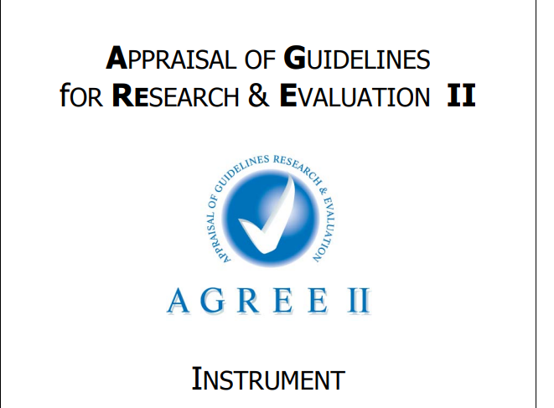

Slide 3
Objectives:
This article provides recommendations on the use of antithrombotic therapy in patients with stroke or transient ischemic attack (TIA).
3 categories of patients :
TIA
Ischemiac stroke
CVT

Slide 4
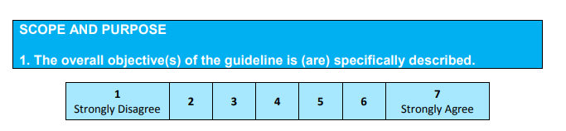
Scope and Purpose contd..

Slide 5
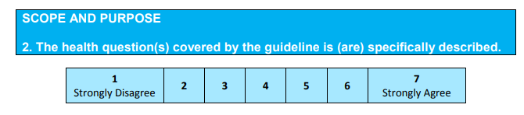
Scope and Purpose contd..

Slide 6
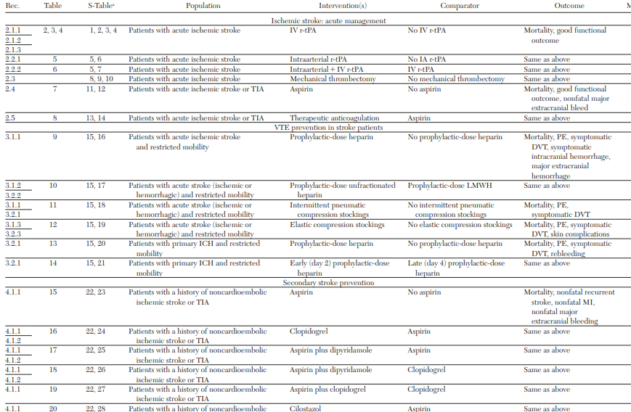

Slide 7
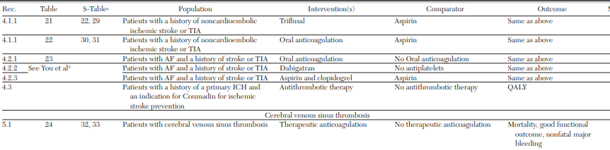

Slide 8
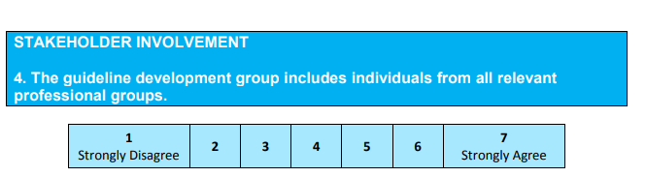
Yes, experts from neurology , internal medicine , bio statistics
No experts from ? interventional radiology
Reviewers:
Clinical areas were designated as articles, and a methodologist without important intellectual or financial conflicts of interest led a panel for each article.
Only panel members without significant conflicts of interest participated in making recommendations.

Slide 9
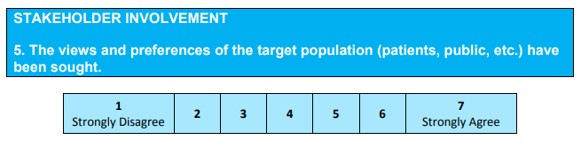
explicitly accounted for patients’ values for the different outcomes of interest.

Slide 10
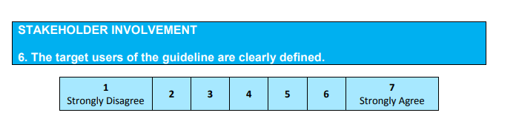
Yes , those caring for patients with TIA/stroke /CVT

Slide 11
RIGOUR OF DEVELOPMENT OF THE PG

Slide 12
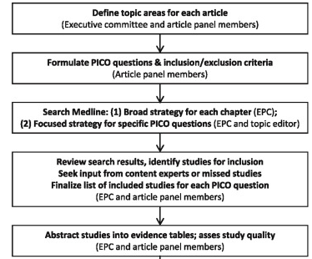
Were systematic methods used for the search of evidence?
Score : 5
Language ? Review of conflict resolution ?

Slide 14
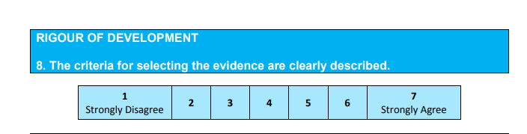
Criteria for selecting the evidence is clearly described?

Slide 15
Criteria for selecting the evidence is clearly described?

Slide 16
For each question, the topic editor and deputy editor defined the relevant population, alternative management strategies (intervention and comparator), and the outcomes (ie, population, intervention, comparator, and outcome [PICO] format).
Each clinical question provided the framework for formulating study inclusion and exclusion criteria and guided the search for relevant evidence (systematic reviews and original studies).

Slide 17
Panels typically restricted included studies to RCTs for intervention questions but included observational studies when there was a paucity of RCT data addressing an intervention and for questions of risk assessment.

Slide 18
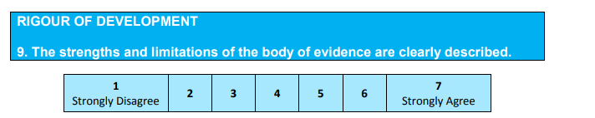
Risk of bias assesed by uniform criteria for evaluating the risk of bias associated with individual RCTs based on the criteria recommended by the Cochrane Collaboration.
Risk of bias was assesed by each induvidual reviewer
Evidence quality assessed evidence across studies on an outcome-by-outcome basis using criteria suggested by the GRADE Working Group.

Slide 19
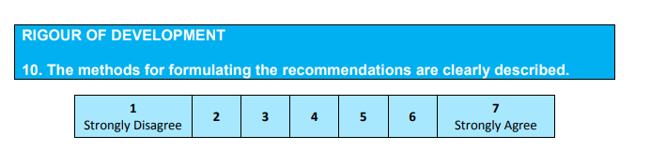
No
Though quality of evidence for each have been mention , details of how the panelist reached the recommendations are not clear

Slide 20
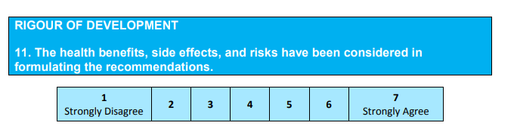
Supporting data for risks and benefits both have been described
Details of balance between trade off of risks and benefits described
Recommendations include both benefits and risks , but not in all cases has it been decribed explictly

Slide 21
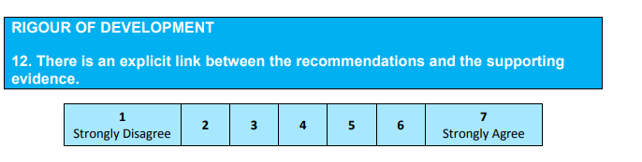
The rationale and the main evidence has been decribed in the text and the link and the references is easily indentifiable by the user .

Slide 22
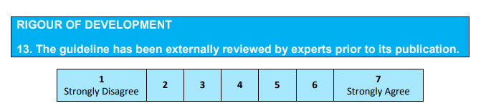
Not mentioned clearly in text or by publisher

Slide 23
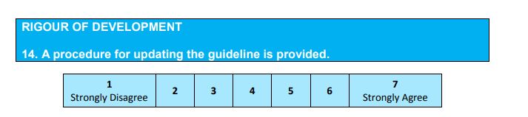
Not mentioned

Slide 24


Slide 25
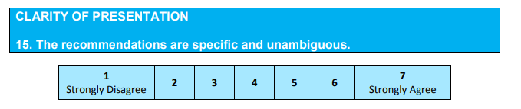
Dose of the thrombolytics ?relevance ?medical common sense
Risk stratification for TIA recommendation
?poor predictive performance of the scoring systems ?

Slide 26
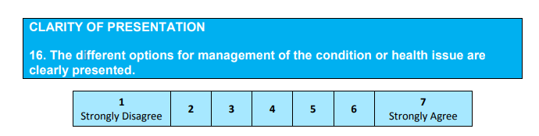
Yes

Slide 27
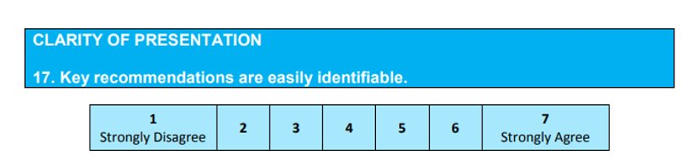
Yes ,key recommendations are summarised clearly with grade of evidence .

Slide 28
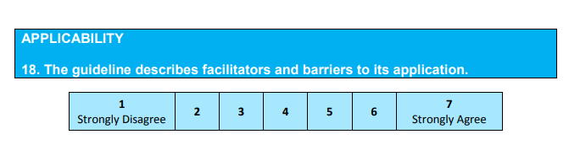
No pilot testing
No specific feedback mechanism mentioned

Slide 29
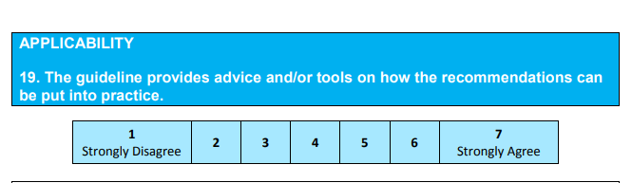
Guidelines summary is enclosed
No link to any how to manuals
No specific pilot study of guideline implementation examples
links to check lists, algorithms not enclosed fully

Slide 30
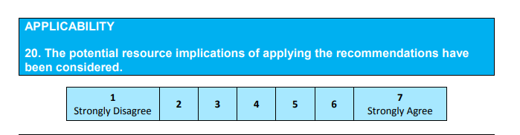
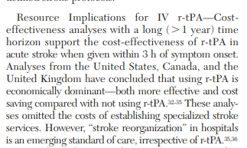
Yes , resource implications have been decribed for each iintervention including the costs that have not been accounted for .

Slide 31
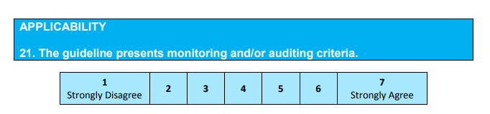
NOT MENTIONED :
• identification of criteria to assess guideline implementation or adherence to recommendations
• criteria for assessing impact of implementing the recommendations • advice on the frequency and interval of measurement
• descriptions or operational definitions of how the criteria should be measured

Slide 32
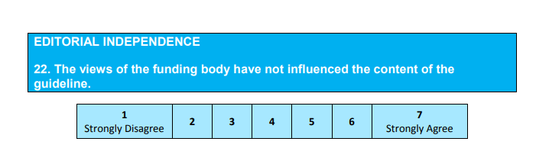

SPONSORS HAD NO ROLE

Slide 33
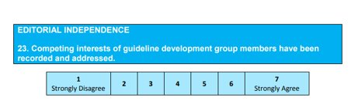
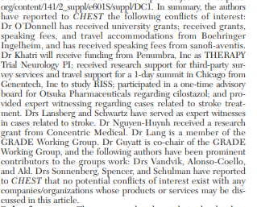
Yes reported in detail

Slide 34
