Slide 1
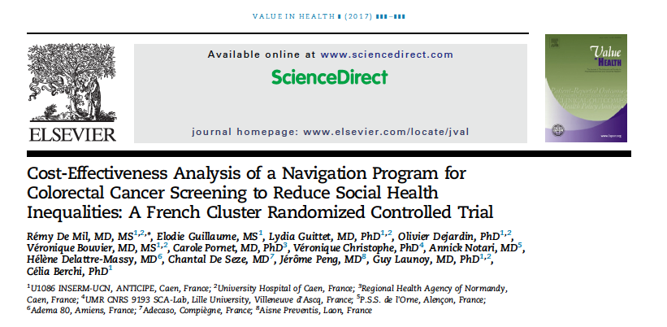

Slide 2
Background
Patient navigation programs to increase colorectal cancer (CRC) screening adherence have become widespread in recent years, especially among deprived populations.
Logistic limitations for implementation include cost and employment of personnel.
This study was done to evaluate the cost effectiveness of the first patient navigation program in France.

Slide 3
Prospective, multicenter, cluster randomized controlled trial
Study conducted in three centres, Picardy, Northern France
Clusters were categorized into four strata: urban deprived (UD), rural deprived (RD), urban affluent (UA), and rural affluent (RA).
Notes:
A total of 66 clusters were allocated to the intervention arm and 72 clusters to the control arm. The final number of participants included in the study, representing the screening population, was 14,373 in the intervention arm and 14,556 in the control arm.

Slide 4
Methods
P: Subjects in the above described area, aged 50-74 years
I: Usual care + Patient navigation system
C: Usual care
O: The primary outcome was screening adherence rate (i.e., FOBT completed or not)
  Cost Effectiveness analysis of addition of patient navigation to existing standard of care.
Time : April 2011 – March 2013

Slide 5
Usual Care ( Control Arm)
Participants in the control arm were screened using the standard screening
Participants aged 50 to 74 years are mailed invitations by the local screening structure to see their general practitioner
They are given an FOBT kit if it is indicated.
Patients can perform the FOBT at home and send it to the laboratory.
A first postal reminder is sent by the local screening structure to non participants 3 to 4 months after the initial invitation.
At 8 months’ time, the FOBT kit is mailed to each nonparticipant at home.

Slide 6
Patient Navigation (Intervention Arm)
Patient navigation was added to standard screening.
Navigation was performed by specifically trained social workers.
Participants in the two previous screening rounds, designated “attended,” were excluded a priori from the population to be contacted by screening navigators.
In addition, navigation was confined to those individuals with an available phone number who did not participate spontaneously during the first 4 months after the initial invitation for screening.

Slide 7
Finally, the population eligible for navigation comprised 8105 people:
  2259 in the Urban Deprived stratum,
  2086 in the Rural Deprived stratum,
  1599 in the Urban Affluent stratum, and
  2161 in the Rural Affluent stratum

Slide 8
Are the results valid?
Did the recommendations include all patient relevant groups, management options and possible outcomes?
  Did they adopt a sufficiently broad point of view?
    Yes
    This was a study on screening program done at the community level.
    Included all SES categories, in rural and urban locations.

Slide 9
Are the results reported separately for different patient groups?
  The results of the study allowed assessment of the effectiveness of navigation in reducing social inequalities under two scenarios:
    1) if navigation was proposed everywhere, regardless of the level of deprivation (universalism), effectiveness was assessed as the difference in screening adherence rates between deprived and affluent areas between the intervention and control groups
    2) if navigation was restricted to deprived areas (proportionate universalism), effectiveness was assessed as the difference in screening adherence rates between affluent areas in the control group and deprived areas in the intervention group, and compared with the difference in screening adherence rates between affluent and deprived areas in the control group.

Slide 10
Is there a systematic review and summary of evidence linking options to outcomes for each relevant question?
No
Were costs measured accurately?
  Yes
  Costs measured were non direct medical costs
  Program and equipment cost, Human cost

Slide 11
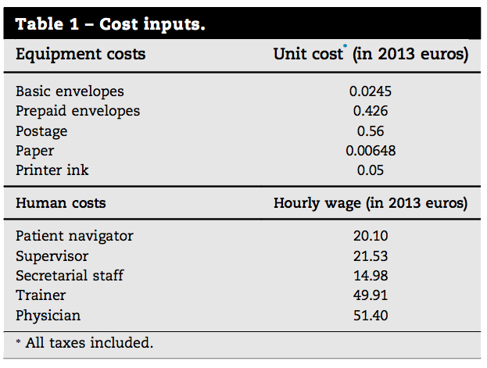

Slide 12
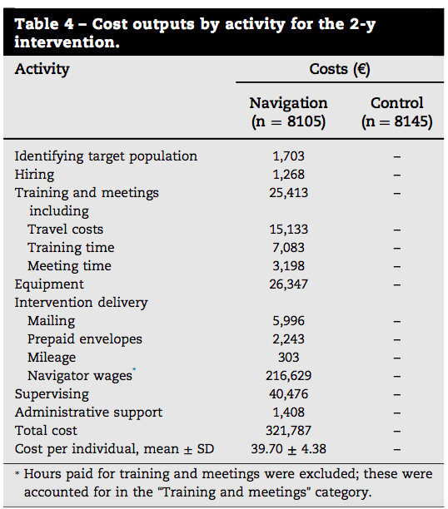

Slide 13
Did the investigators consider timing of costs and outcomes?
All costs were inflated to 2013 prices in euros using the consumer price index.
One navigator was replaced during the 2-year intervention and the costs of recruiting and training a replacement were included.

Slide 14
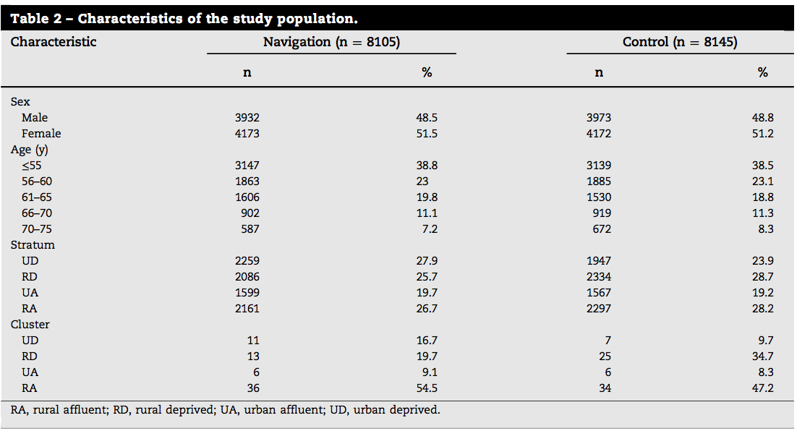

Slide 15
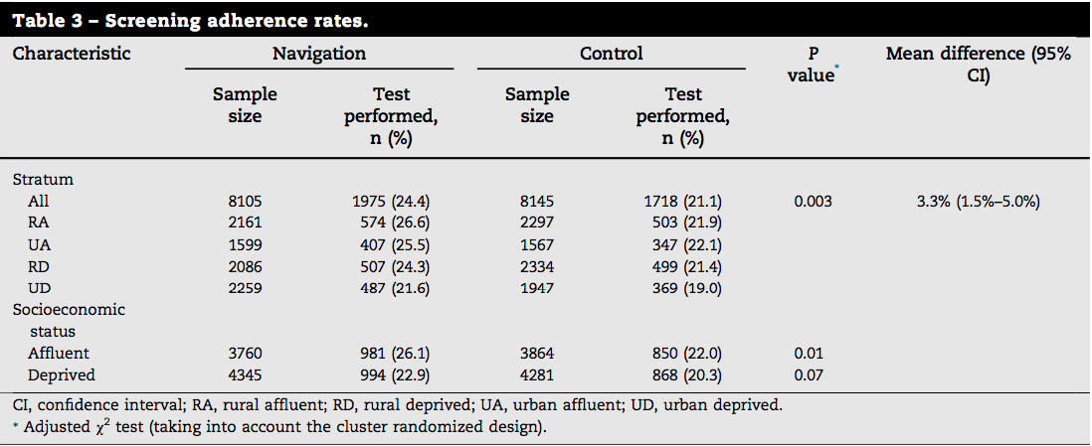
What are the results?

Slide 16
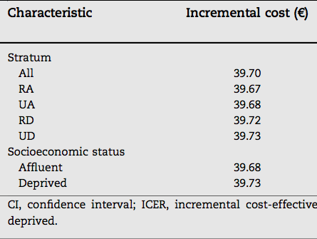
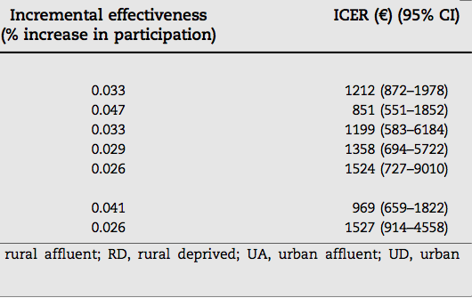
What are the results?
What are the incremental costs and effects of each strategy?

Slide 17
Do incremental costs and effects differ between sub groups?
  Yes
  ICER for the intervention compared with usual screening was €1212 per additional person screened (95% CI €872–€1978 per additional person screened).
  Navigation was less cost-effective for deprived participants than for affluent ones, with an ICER 1.6 times higher (€1527 vs. €969 per additional person screened).
  This was observed in rural areas (€1358 vs. €851 per additional person screened) as well as in urban areas (€1524 vs. €1199 per additional person screened).

Slide 18
How much does allowance for uncertainty change the results?
Sensitivity analysis done

Slide 19
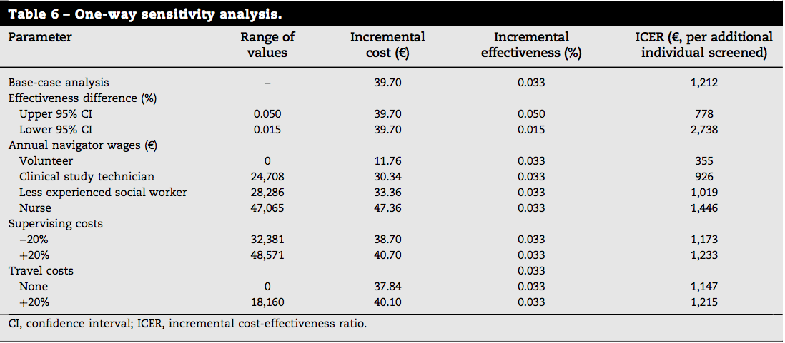
Sensitivity Analysis

Slide 20
How can I apply the results to my patient care?
Are the treatment benefits worth the harm and costs?
  No
Can I expect similar costs in my setting?

