Slide 1
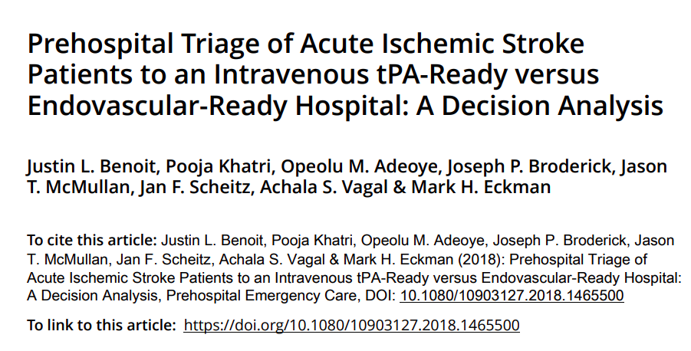

Slide 2
Background
Options in acute ischemic stroke : EVT, r-tPA
Patients are eligible for EVT only if there is LVO.
ASA guideline → EMS can bypass an IRH and take the patient to an ERH if the bypass time is not > 15-20mins
However, it is unknown when the benefit of potential endovascular therapy at an ERH outweighs the harm from delaying intravenous therapy at a closer IRH, especially since large vessel occlusion (LVO) status is initially unknown.

Slide 3
Clinical Question and Hypothesis
When should EMS bypass immediate IVT at an IRH and instead go to an ERH for possible EVT, and can pre-hospital triage tools improve that decision?
Our hypothesis was that current time recommendations for IRH bypass are too short to achieve optimal outcomes for certain patient populations.

Slide 4
Clinical Setting
The population-based Greater Cincinnati/Northern Kentucky Stroke Study’s dataset was used for the base case time from stroke onset or last seen normal time to ED arrival for ischemic stroke patients transported from the scene by EMS.
A median value of 122 min was observed.
The average transportation time to the initial hospital (generally an IRH) was 12 min in this region, making the interval between stroke onset and EMS triage decision 110 min.
Epidemiological studies suggest that most acute strokes occur within a 60-min transportation window to an ERH (which was used for ERH transportation time).

Slide 5
Methods
Model Design
  Decision tree modelling approach : IRH vs ERH

Slide 6
P: Patients with acute ischemic stroke
  Group 1: Endocascular therapy (ERH)
  Group 2: r-tPA (IRH)
  Group 3: Apply the Cincinnati Stroke Triage Assessment (CSTA) Tool and transport to the ERH if positive for LVO
Outcome : Modified Rankin Score and QALYs
T: 90 days (MRS)
Notes:
Six different mRS outcome distributions were calculated as a function of time from stroke onset to treatment:
No LVO with no reperfusion treatment
LVO with no reperfusion treatment
no LVO with IVT
LVO with IVT
LVO with successful EVT
LVO with unsuccessful EVT

Slide 7
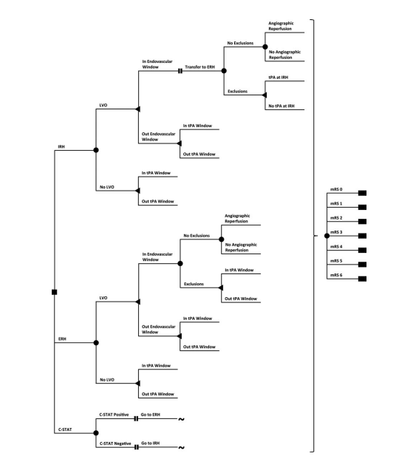

Slide 8
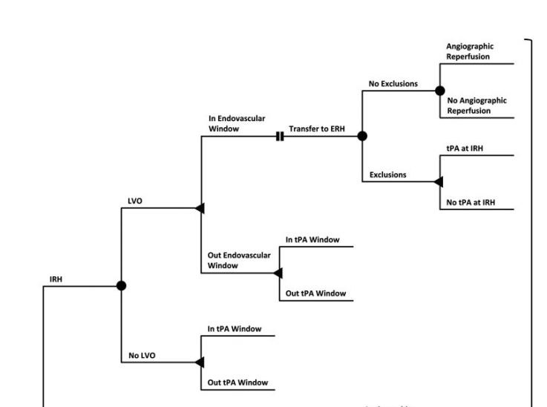

Slide 9
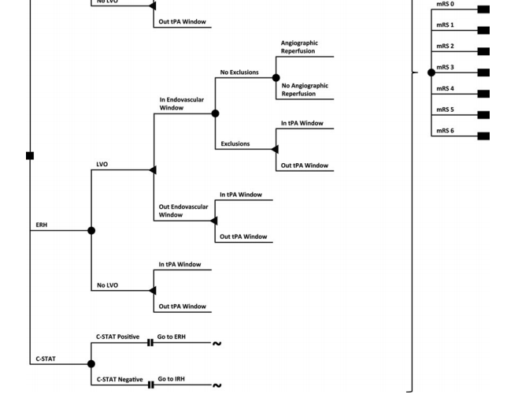

Slide 10
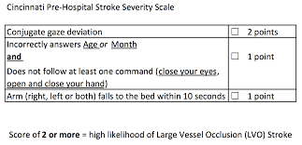

Slide 11
Are the recommendations valid?
Did they consider all relevant patient groups, management options and possible outcomes?
  Yes
  All possible outcomes have been considered

Slide 12
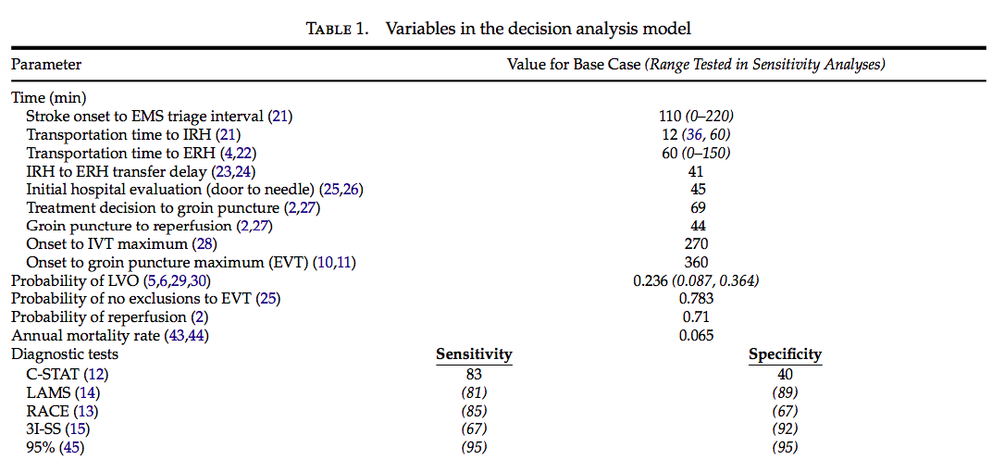

Slide 13
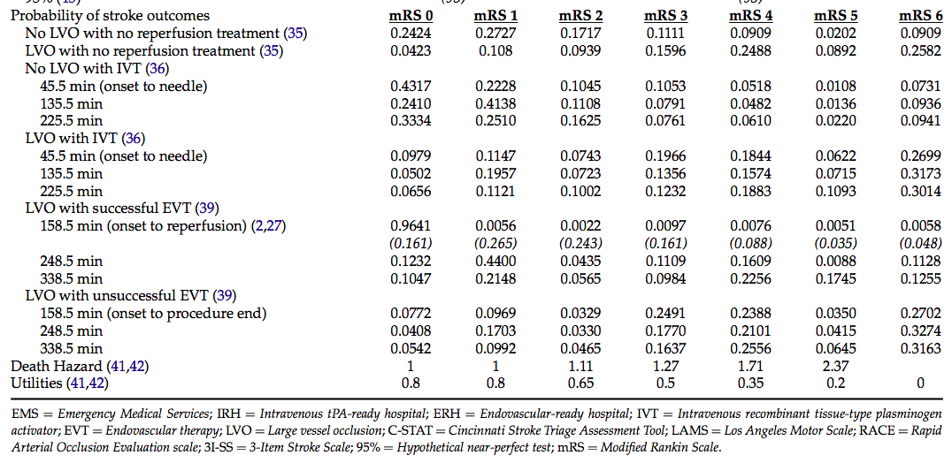

Slide 14
Are there systematic reviews of the evidence that estimate the relative impact of management options on relevant outcomes?
  SITS-ISTR is a multinational, open registry of consecutive acute ischemic stroke patients who received reperfusion therapies at 132 centers. Here they observed an LVO rate of 23%.
  NINDS trial data
Is there an appropriate specification of values and preferences associated with each of the outcomes?
  Based on previously published data or in the absence of the same, arbitrary measures were used. Time for threshold and QALY estimates were provided.
Do the authors indicate the strength of their recommendations?
  no

Slide 15
What are the results?
ERH and IRH triage strategies were compared excluding the C-STAT arm.
In the base case (12 min to IRH; 60 min to ERH), transport to the IRH is the optimal choice with an expected outcome of 8.47 QALYs.
A one-way sensitivity analysis of the ERH transportation time demonstrates that transport directly to the ERH is superior if the ERH is <56 min away, which is 44 additional minutes of transport due to IRH bypass.

Slide 16
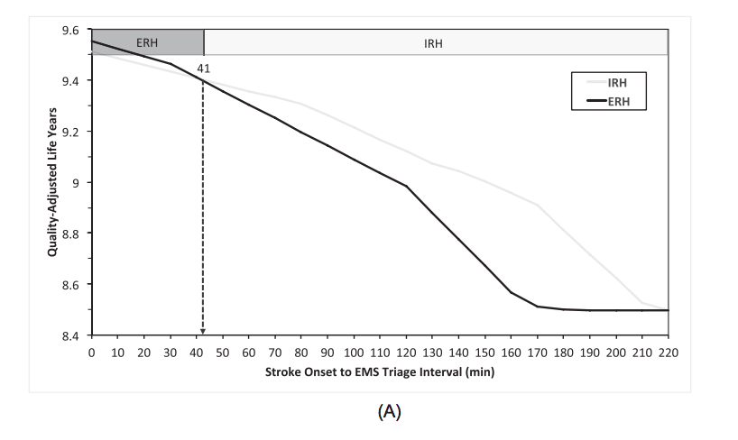
Sensitivity analysis

Slide 17
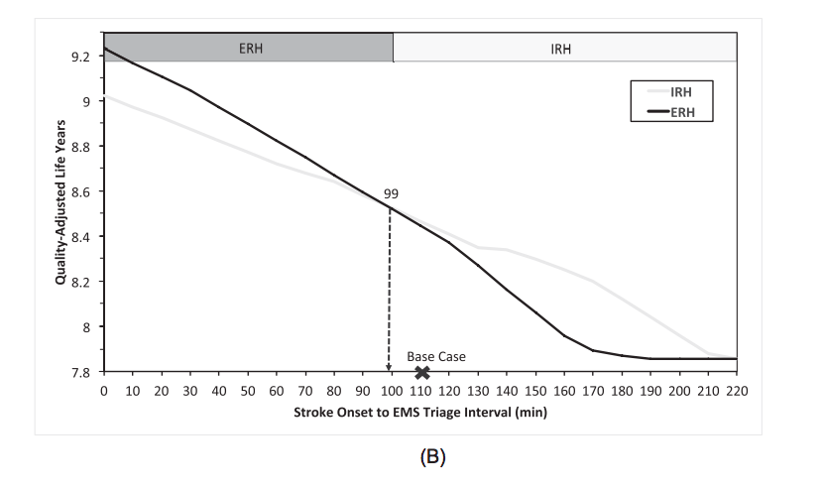

Slide 18
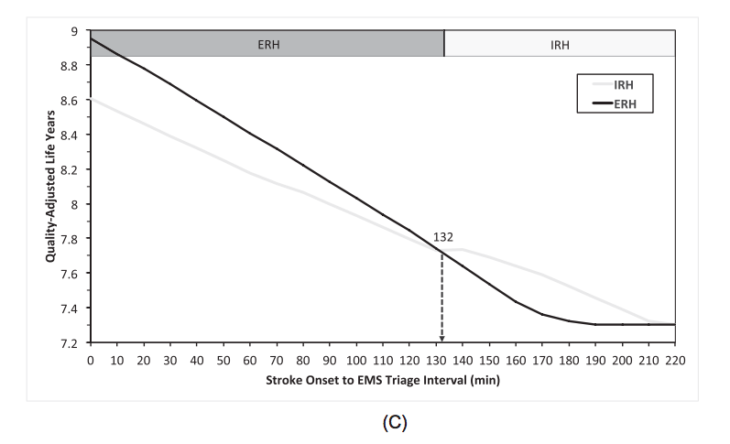

Slide 19
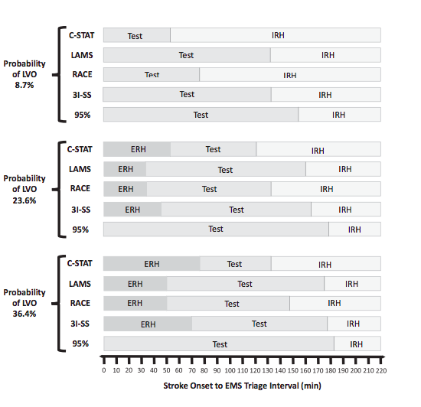
What are the results?

Slide 20
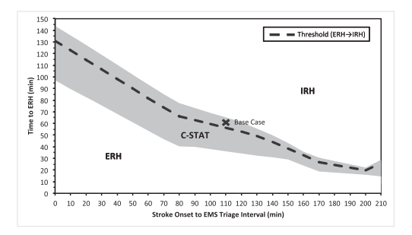
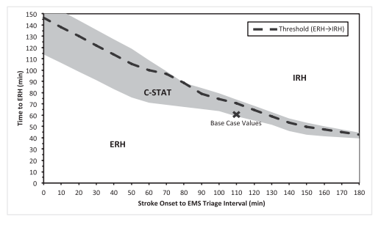
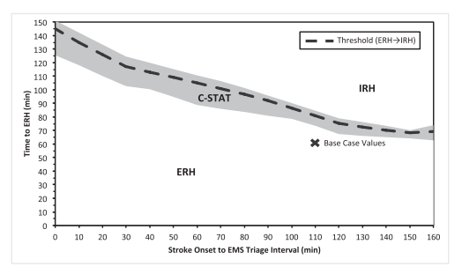
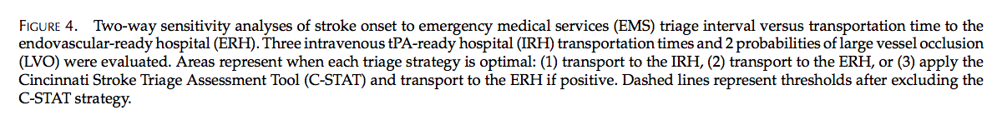

Slide 21
What are the key recommendations?
This decision analysis demonstrates that EMS stroke triage decisions regarding transport to the closest IRH versus direct transport to an ERH may have an impact on patient outcomes.
No single absolute time difference between hospitals is capable of optimizing triage for all patients.
Current American Stroke Association policy should be revisited, as the window for IRH bypass may be too narrow, and does not take into account interactions between time variables known to EMS.
The C-STAT and other prehospital stroke scales may help optimize triage further.

Slide 22
Will the recommendations help you in caring for your patients?
  NO

