Slide 1
Kevin

Slide 2
Background
A rapid test for testicular torsion in children may obviate delay for testicular ultrasound.
This study assessed testicular tissue percent saturation of oxygen (%StO2) measured by trans-scrotal near-infrared spectroscopy (NIRS) as a diagnostic test for pediatric testicular torsion.

Slide 3
Methods
P: Patients with acute scrotum >1months <18 years
Test: NIRS %St02
Standard: Standard of care (scrotal USG and surgery)
O:Diagnosis of testicular torsion
T: 2013 to 2015, Children’s Medical Center ED in Dallas, TX

Slide 4
Inclusion criteria:
  Males 1 month of age to 18 years from who presented to Children’s Medical Center ED in Dallas, TX with acute scrotum
  Defined as painful scrotum or testis with or without abdominal pain and/or waddling gait from painful scrotum
Exclusion criteria
  bilateral torsion
  previously known testicular or scrotal pathology
  chronic respiratory, hematological or vascular problems that could affect total body tissue oxygenation levels

Slide 5
Sample size calculation
sample size of 150 patients
to show the sensitivity > 0.8 with 80% power and 2-sided type 1 error of 0.05.
ROC curves were used to analyze performance of NIRS ∆%

Slide 7
Interpretation of the studies was done by staff radiologists and nuclear medicine specialists and was reviewed by the clinicians.
The physicians were not specifically blinded to the results of the other diagnostic studies, but none was aware of the pathologic end point of the presence or absence of osteomyelitis before submitting their reports.

Slide 8
Are the results valid?
Did the clinicians face a diagnostic uncertainity?
No
Was there a blind comparison with an independent gold standard?
  Not mentioned

Slide 9
Did the results of the test being evaluated influence the decision to perform the gold standard?
  No

Slide 10
What are the results?
 | Torsion +(36) | Torsion _(85)
NIRS+
NIRS-

Slide 11
The AUC was 0.66 (95% CI 0.55-0.78).
A cut-off value of ∆%StO2 ≥ 20 had a PPV of 100% and sensitivity of 22.2%
Specificity - ?100%

Slide 13
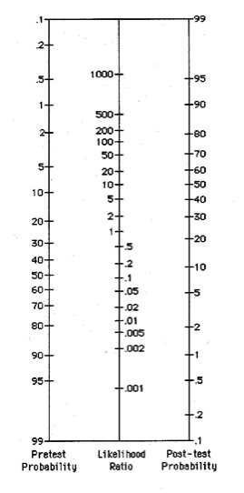
+ LR = 0.22/0.01=22
-LR=0.88/0.99=0.88

Slide 15
What likelihood ratios were associated with the range of possible test results?
Not given

Slide 16
How can I apply the results to patient care?
Will the reproducibility of the test results and its interpretation be satisfactory in my clinical setting?
  Not sure
  Effect of skin colour, scrotal odema, tanner stage etc need to be clarified
Are the study results applicable to patients in my practice?
  Not conclusively

Slide 17
Will the test results change my management strategy?
  no
Will patients be better off as a results of the test?
  Maybe

