Slide 1


Rct Critical appraisal
Jemin J Webster
17-1-2018

Slide 2
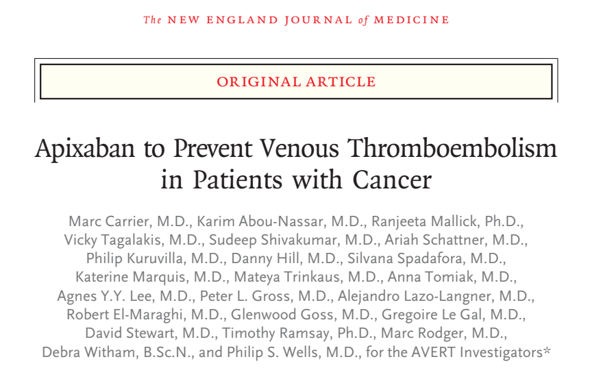

Slide 3
Background
Patients with active cancer have an increased risk of venous thromboembolism, which results in substantial morbidity and mortality.
Although parenteral thromboprophylaxis can reduce the risk of venous thromboembolism among ambulatory patients undergoing chemotherapy, it is not routinely recommended in practice guidelines because the absolute risk reduction is modest and parenteral thromboprophylaxis is associated with an increased risk of major bleeding, high cost, and the inconvenience of daily injections.
The Khorana score (range, 0 to 6, with higher scores indicating a higher risk of venous thromboembolism) has been validated to identify patients with an elevated risk of venous thromboembolism and may help select those who could benefit from prophylaxis.

Slide 4
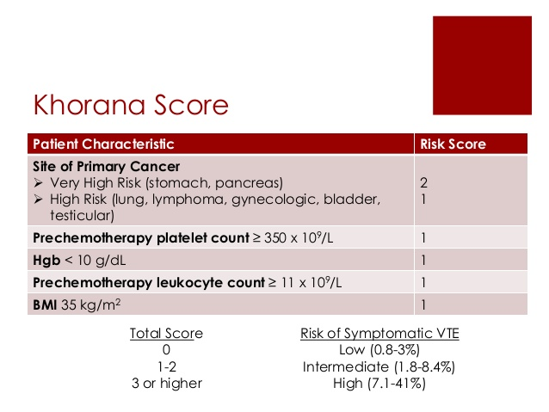


Slide 5
Patients who have a solid tumour and a Khorana score of 2 or higher have an estimated risk of symptomatic thrombosis of 9.6% during the first 6 months of chemotherapy.
The use of direct oral anticoagulants as thromboprophylactic agents in patients with cancer can offer important advantages over parenteral agents, including route of administration, convenience, and cost.
A previous small, phase 2 trial involving 125 patients suggested that the oral factor Xa inhibitor apixaban may be safe and effective.

Slide 6
Hypothesis
Apixaban for the Prevention of Venous Thromboembolism in High-Risk Ambulatory Cancer Patients (AVERT) trial to assess the efficacy of apixaban thromboprophylaxis in ambulatory patients with cancer at intermediate-to high risk for venous thromboembolism (Khorana
score, ≥2).

Slide 7
Study Design
Multicentre
Randomized
Placebo controlled
Double-blind
Clinical trial
Notes:
13 participating sites

Slide 8
PICOT
Population:
Ambulatory patients with cancer who were at intermediate-to-high risk for venous thromboembolism (Khorana score, ≥2) and were initiating chemotherapy.
Intervention:
Apixaban (2.5 mg twice daily)
Control:
Placebo
Outcome:
Documented venous thromboembolism
Timeline: 210 days

Slide 9
Was the study population clearly defined?
INCLUSION CRITERIA:
Patients who had a newly diagnosed cancer or progression of known cancer after complete or partial remission and who were initiating a new course of chemotherapy with a minimum treatment intent of 3 months were potentially eligible.
Inclusion required a Khorana score of 2 or higher, an age of 18 years or older, and the capacity to provide written informed consent.

Slide 10
EXCLUSION CRITERIA:
1.If they had conditions putting them at increased risk for clinically significant bleeding.
2. Hepatic disease associated with coagulopathy
3. Cancer diagnosis consisting solely of basal-cell or squamous-cell skin carcinoma, acute leukaemia, or myeloproliferative neoplasm.
4. Planned stem cell transplantation
5. A life expectancy of less than 6 months
6. Renal insufficiency with a glomerular filtration rate of less than 30 ml per minute per 1.73 m2 of body-surface area.
7. Platelet count of less than 50,000 per cubic millimeter.
8. Use of medications contraindicated with apixaban
9. Pregnancy or potential pregnancy, breast-feeding
10. The use of continuous anticoagulation
11. Weight of less than 40 kg.

Slide 11
Were the outcome measures clearly defined?
PRIMARY OUTCOME
The first episode of objectively documented major venous
thromboembolism (proximal deep-vein thrombosis or pulmonary embolism) within the first 180 days (with a window of ±3 days) after randomization.
SECONDARY OUTCOME:
1. The main safety outcome was major bleeding.
2. Clinically relevant nonmajor bleeding.
3. Overall survival during the trial period.
Notes:
Venous thromboembolism was defined as
any symptomatic or incidentally detected proximal
deep-vein thrombosis of the lower or upper limbs,
any nonfatal symptomatic or incidental pulmonary embolism, and pulmonary embolism–related death. Patients who presented with symptoms
of venous thromboembolism during the followup period underwent diagnostic imaging for confirmation of the primary outcome. Routine ultrasonographic testing was not performed.

Slide 12
Were the patients randomized?
Yes
Eligible patients underwent randomization by means of a centralized, Web-based randomization system to receive apixaban or placebo in a 1:1 ratio.
Randomization was stratified according to age, sex, and participating centre and occurred up to 5 days before the administration of the first chemotherapy.

Slide 13
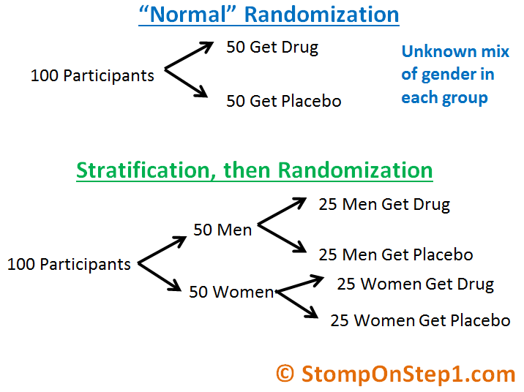

Slide 14
The experimental group received apixaban at a dose of 2.5 mg twice daily, and the control group received identical placebo tablets twice daily; the treatment period was 180 days.
The first dose of apixaban or placebo was administered within 24 hours after the initiation of chemotherapy. Patients were followed for up to 210 days or death, regardless of the duration of the treatment period.

Slide 15
Was the randomisation concealed?
Yes
Notes:
Allocation concealment - A technique used to prevent selection bias by concealing the allocation sequence from those assigning participants to intervention groups, until the moment of assignment. Allocation concealment prevents researchers from (unconsciously or otherwise) influencing which participants are assigned to a given intervention group.
Blinding (masking) - The practice of keeping the trial participants, care providers, those collecting data, and sometimes even those analyzing data unaware of which intervention is being administered to which participant. Blinding is intended to prevent bias on the part of study personnel. The most common application is "double-blinding", in which participants, caregivers and those assessing outcome are blinded to intervention assignment. The term "masking" may be used instead of blinding.
In short, in the case of Allocation concealment, both patient and researchers will know which treatment is being given. Of course, the evaluation of results may cause bias of the researchers, or even some knowledgeable patients. In the case of Single blind trial, the patients will not know whether they are in the control arm or trial arm; (some patients in control arm may be unhappy that they are not receiving the new drug!). Double blind means both patients and researchers are blind to the treatment.

Slide 16
To what extend was the study blinded?
Patients: Yes
Clincians: Yes
Data collectors: Yes
Data analysis: Yes
Notes:
\

Slide 17
Was the follow up complete?
Yes

Slide 18
Were the patients analysed in the groups to which they were randomized?
Yes

Slide 19
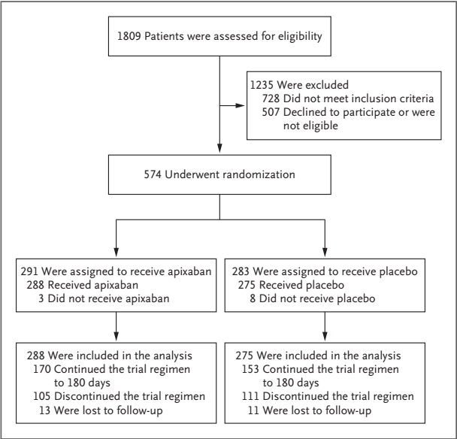
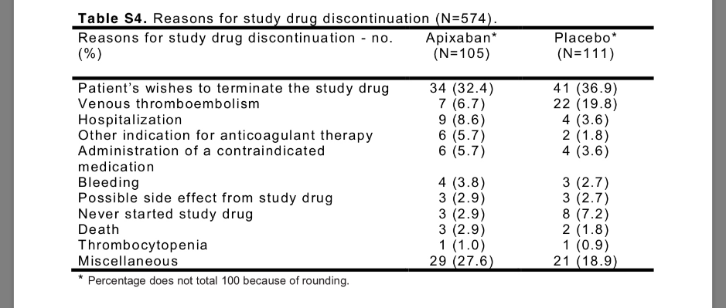
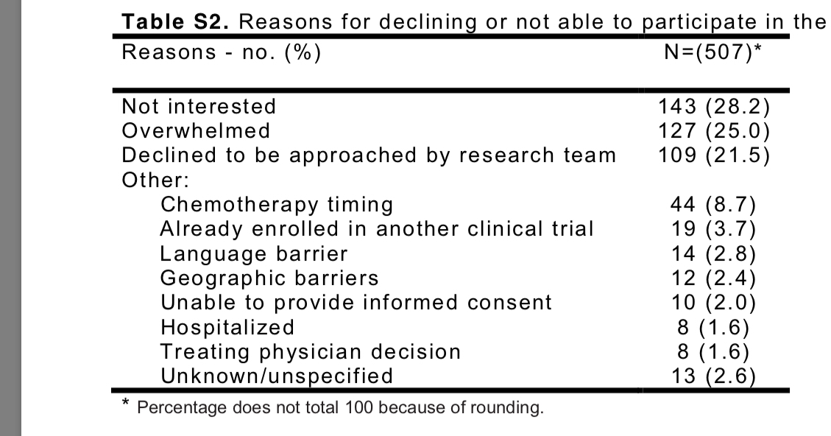
Consort figure

Slide 20
Were adequate number of people included in the study?
Based on event rates in the previous study
Prediction of venous thromboembolism in cancer patients.
Ay C¹, Dunkler D, Marosi C, Chiriac AL, Vormittag R, Simanek R, Quehenberger P, Zielinski C, Pabinger I.
Event rate (of placebo) of 10%.
Apixaban - relative difference of at least 64% in the rate
80% power, one sided alpha of 5%
Sample size = 574 patient
Notes:
The power of a study is its ability to detect a difference, if the difference in reality exists.

Slide 21
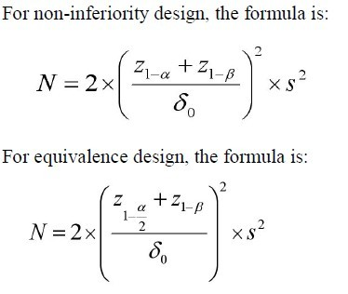

Slide 22
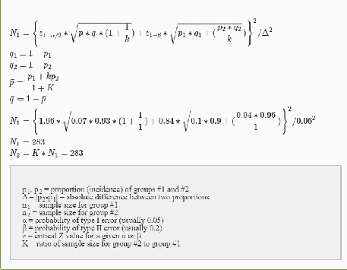

Slide 23
Did the intervention and control groups start with the same prognosis?

Slide 24
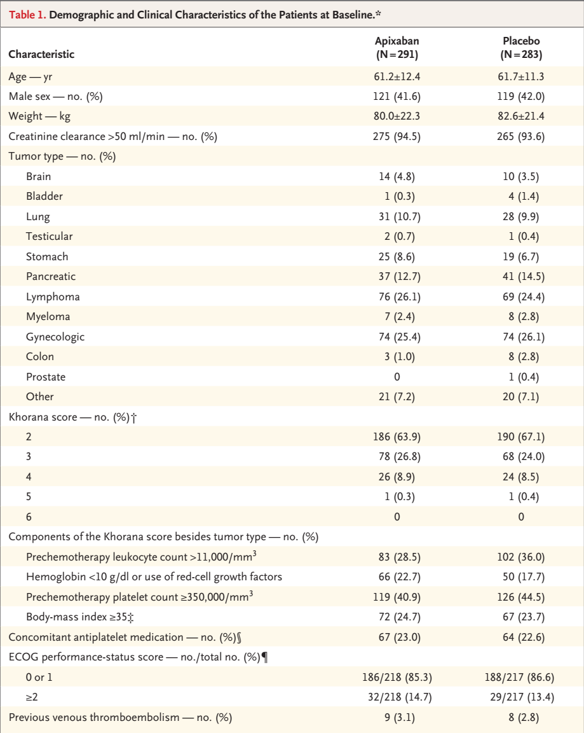

Slide 25
Validity of the study
Study population: well defined
Outcomes: clearly defined
Randomization: Adequate
Allocation concealment: done
Blinding: Double blinded
Sample size calculation:
Intention to treat analysis: Done
Baseline characteristics: well matched

Slide 26
Results
The median duration of the treatment period was 157 days (interquartile range, 78 to 168) in the apixaban group and 155 days (interquartile range, 83 to 168) in the placebo group.
The median duration of follow-up was 183 days in each
group.
The trial regimen was discontinued as per patients’ wish by 34 patients in the apixaban group and 41 patients in the placebo group.
The rate of adherence to the trial regimen was high in both groups, at 83.6% in the apixaban group and 84.1% in the placebo group.

Slide 27
Results
Efficacy and Safety Outcomes
The primary efficacy outcome occurred in 12 of 288 patients (4.2%) in the apixaban group and in 28 of 275 patients (10.2%) in the placebo group (hazard ratio, 0.41; 95% confidence interval [CI], 0.26 to 0.65; P<0.001).
The competing-risk analysis that accounted for deaths from causes other than venous thromboembolism or bleeding was consistent with the primary analysis (hazard ratio, 0.42; 95% CI, 0.27 to 0.65).

Slide 28
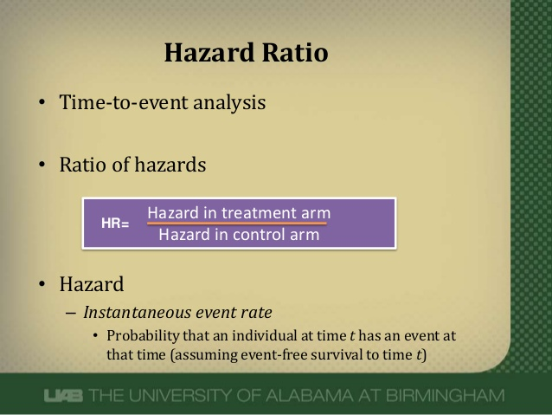

Slide 29
In the modified intention-to-treat analysis, major bleeding occurred in 10 patients (3.5%) in the apixaban group and in 5 patients (1.8%) in the placebo group (hazard ratio, 2.00; 95% CI, 1.01 to 3.95; P=0.046).
A total of 3 of the 15 major bleeding episodes were considered to be a clinical emergency, and no bleeding into critical organs was noted.
During the treatment period, major bleeding occurred in 6 of 288 patients (2.1%) in the apixaban group and in 3 of 275 patients (1.1%) in the placebo group (hazard ratio, 1.89; 95% CI, 0.39 to 9.24)

Slide 30
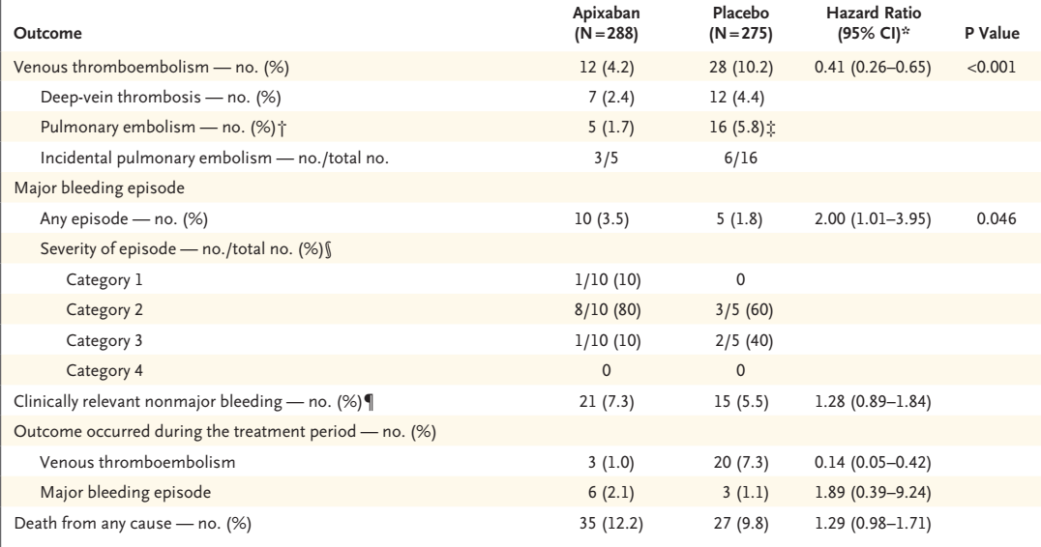
Notes:
* Confidence intervals were not adjusted for multiple comparisons.
† This includes patients who also had deep-vein thrombosis.
‡ One patient died 6 days after receiving a diagnosis of pulmonary embolism.
§ The severity of major bleeding episodes was defined as follows: category 1, the episode was not considered to be a clinical emergency; category 2, the episode led to some treatment but was not considered to be a clinical emergency; category 3, the episode was considered to be
a clinical emergency (e.g., hemodynamic instability or intracranial bleeding with neurologic symptoms); and category 4, the episode led to
death before or almost immediately after the patient presented to the hospital.13
¶Clinically relevant nonmajor bleeding was defined as overt bleeding that did not meet the criteria for major bleeding but was associated with
the use of medical intervention, contact with a physician, interruption of the assigned trial regimen, discomfort, or impairment of activities
of daily living.

Slide 31
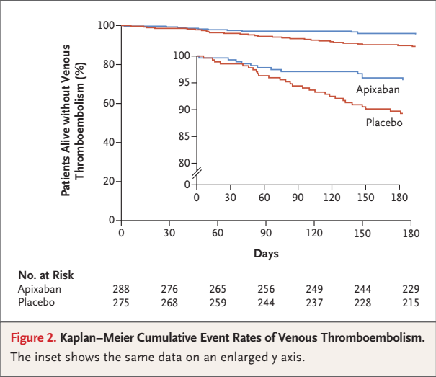

Slide 32
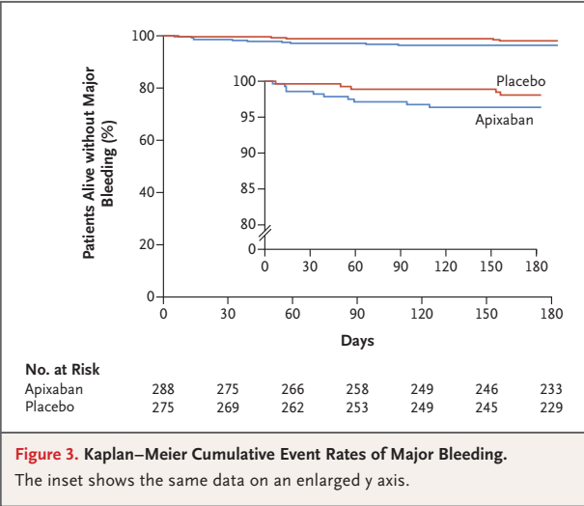

Slide 33
Were all clinically relevant outcomes considred?
Yes

Slide 34
Were the study patients similar to the patients in my practice?
Yes, except for racial differences.

Slide 35
Conclusion
Apixaban at a dose of 2.5 mg twice daily resulted in a significantly lower risk of venous thromboembolism than did placebo among ambulatory patients with cancer who were initiating chemotherapy and had an intermediate-to-high risk of venous thromboembolism.

Slide 36
Thank you

