Slide 1
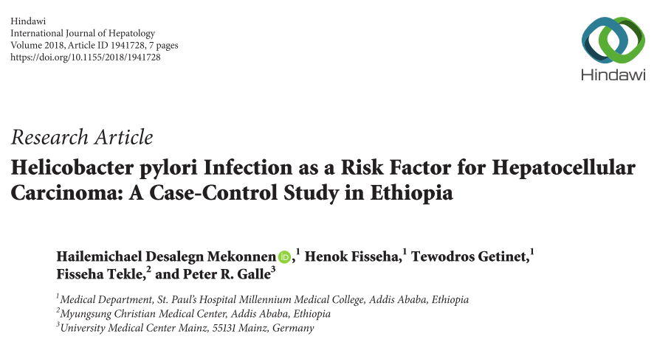

Slide 2
Cases - Patients with confirmed HCC.
Controls- Patients coming to the internal medicine outpatient department with no clinical liver disease.
Objective-Possible correlation between H. pylori infection and HCC in one of the major teaching hospitals in Ethiopia.
Timeline – Dec 30, 2016- Nov 1 2017.
Notes:
The study was conducted in St. Paul’s Hospital Millennium Medical College (SPHMMC), Gastrointestinal Unit, Addis Ababa, Ethiopia, from Dec 30, 2016, to Nov 1, 2017.

Slide 3
Sample size.
Proportions of controls exposed to H. pylori (P0= 10%) and Proportions of cases exposed to H. pylori (P1= 45%) was taken from previous study
The final sample size was defined with 95% confidence and 80% power, a 1:1 case to control ratio, and 10 % contingency and was calculated to be 66 (33 cases and 33 controls).
The final sample size considered for this study was 120, there were 5 variables considered for the regression analysis.
Notes:
The sample size was determined using the Fleiss 1981 formula with continuity correction and calculated using Epi InfoTM software version 7. The required database including proportions of controls exposed to H. pylori (P0= 10%) and proportions of cases exposed to H. pylori (P1= 45%) was taken from previous study [25]. The final sample size was defined with 95% confidence and 80% power, a 1:1 case to control ratio, and 10 % contingency and was calculated to be 66 (33 cases and 33 controls).

Slide 4
All patients were evaluated by clinical examination and laboratory tests for the presence of liver disease including viral markers and liver function tests and risk factor assessment (predesigned questionnaire) and samples were additionally tested for H. pylori infection.
alpha-fetoprotein (Cobas e411),
H. pylori stool antigen (Novatest (Cassette)),
HBsAg (Determine), and
HCV-Ab (Healegen) were determined.
Notes:
Sensitivity, specificity comparable with UBT (94% and 97%, respectively

Slide 5
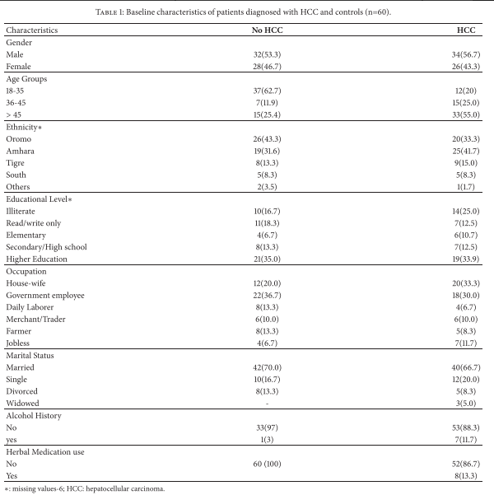
Are the Results Valid?
Did the cases and control group have the same risk (chance) for being exposed in the past?
No
Presence of Viral Hepatitis infection

Slide 6
Were cases and controls similar with respect to the indication or circumstances that would lead to exposure?
No
Young people are more in the control and more alcohol consumption in cases.

Slide 7
Were the circumstances and methods for determining exposure similar for cases and controls?
Yes

Slide 8
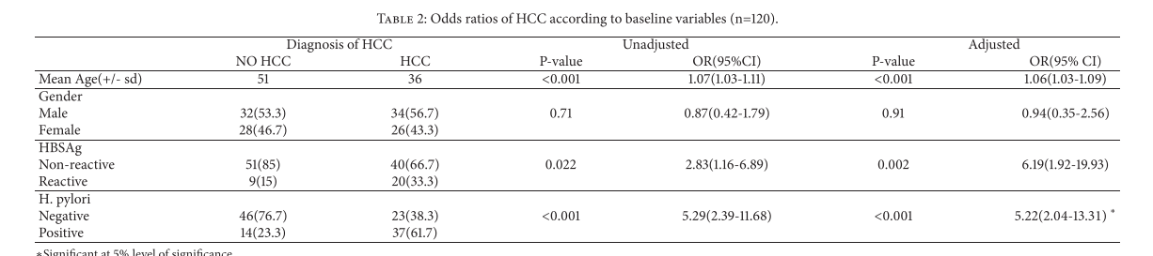
What are the Results?
How strong is the association between exposure and outcome?

Slide 9
How precise is the estimate of risk?

Slide 10
How can I apply the results to my patient care?
Were the study patients similar to patients in my practice?
Yes

Slide 11
Was the duration of follow-up adequate?
No

Slide 12
Is the exposure similar to what might occur in my patient?
Probably

Slide 13
What is the magnitude of the risk?
Odds 5.22

Slide 14
Brad Hill causality
Strength of association- OR over all 5.2
Temporality-
Consistancy- Previous studies has shown similar findings
Biological plausibility- Not very clear however, H. pylori has been isolated from HCC biopsy.
Notes:
The pathomechanism underlying the association between DPP-4 inhibitor andBPhas yet tobe elucidated.However, it is known that DPP-4 is a cell-surface plasminogen receptor that activates plasminogen, leading to the formation ofplasmin,28 which is amajor serine protease that cleaves BP-180within the immunodominant NC-16A domain and can be detected in lesional skin aswell as in blister fluid in BP.29 The inhibition of plasminbyDPP-4inhibitormaylead toalterations intheappropriatecleavageofBP-180, whichmayaffect its antigenicityand function.26 It is well established that keratinocytes and other cell types, such as endothelial and T cells, express DPP-4, inhibition of which may increase the activity of eotaxin and otherproinflammatorycytokines,leadingtocutaneouseosinophil activation and blister formation.30

Slide 15
Dose response relationship-
Experimental evidence
Specificity

