Slide 1
Critical Appraisal of Guidelines
Jasper Rathinam J
Notes:
Are your classroom colors different than what you see in this template? That’s OK! Click on Design -> Variants (the down arrow) -> Pick the color scheme that works for you!
Feel free to change any “You will…” and “I will…” statements to ensure they align with your classroom procedures and rules!

Slide 2
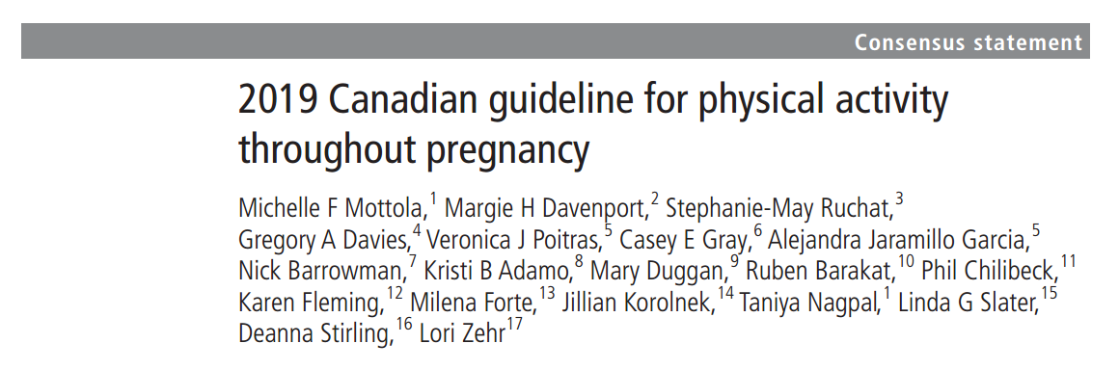

Slide 3
AGREE II
Domain 1. Scope and Purpose
Domain 2. Stakeholder Involvement
Domain 3. Rigour of Development
Domain 4. Clarity of Presentation
Domain 5. Applicability
Domain 6. Editorial Independence

Slide 4
Domain 1. Scope and Purpose
Are the overall objectives of the guideline are specifically described?
  Purpose of this guideline was to present evidence-based recommendations regarding physical activity throughout pregnancy in the promotion of maternal, fetal and neonatal health
Health intent- Promotion of good physical activity
Expected benefit- Better Outcomes in Pregnancy
Targets
  Audience- Pregnant patients and the obstetricians
  Population- Pregnant women
Score- 6

Slide 5
Are the health questions covered by the guideline specifically described?
  Yes
Target population- mentioned – Pregnant women, Details of contraindications also mentioned
Intervention- Details of physical activity mentioned
Health care setting or context- mentioned
Score- 6

Slide 6
Are the population (patients, public, etc.) to whom the guideline is meant to apply specifically described?
  Yes
Target population- Mentioned
Gender and age- Mentioned
Clinical condition- mentioned
Severity/stage of disease- Not applicable
Excluded population- Absolute and relative contraindications mentioned
Score- 7

Slide 7
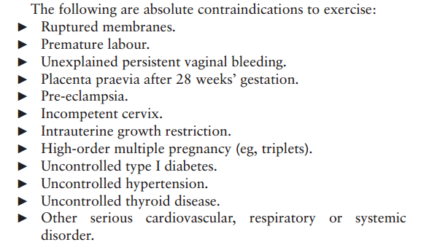
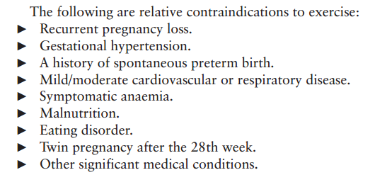

Slide 8
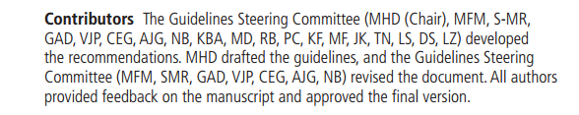

Domain 2. Stakeholder Involvement
Does the guideline development group include individuals from all relevant professional groups?
Name- mentioned
Discipline/content expertise- researchers in the field of prenatal exercise; methodological experts (AGREE II and GRADE; statistician and librarian); exercise professionals plus Obs and Sports Medicine
Institution- mentioned
Geographical location- mentioned
Description of the member’s role in the guideline development group- not mentioned
Score-6

Slide 9
Have the views and preferences of the target population (patients, public, etc.) been sought?
  Yes
  feedback from end users (obstetric care providers, exercise professionals, researchers, policy
  organisations, and pregnant and postpartum women)
Score- 5

Slide 10
Are the target users of the guideline clearly defined?
  Yes
  Obstetric care providers, Exercise professionals.
Clear description of intended guideline audience- Yes
Description of how the guideline may be used by its target audience- Not clear
Score- 6

Slide 11
Domain 3. Rigour of Development
Were systematic methods used to search for evidence?
by a research librarian on MEDLINE, EMBASE, PsycINFO, Cochrane Database of Systematic Reviews, Cochrane Central Register of Controlled Trials, Scopus and Web of Science Core Collection, CINAHL
Plus with Full Text, Child Development & Adolescent Studies, Education Resources Information Center, SPORTDiscus, ClinicalTrials.gov
Not reviewed conference proceedings
Time period searched- till date
Search terms- specified.
Full search strategy- not mentioned
Score- 6

Slide 12
Were the criteria for selecting the evidence clearly described ?
  Yes
  Exercise-only randomised controlled trials (RCT; n=104) and cohort studies (n=4).
The relevant population, management startegies were described
Score- 7

Slide 13
Were the strengths and limitations of the body of evidence clearly described ?
  No
Study design- RCTs and Cohorts
Study methodology limitations (sampling, blinding, allocation concealment, analytical methods)- GRADE system used to assess quality of evidence
Consistency of results across studies- Not mentioned
Direction of results across studies- Not mentioned
Magnitude of benefit versus magnitude of harm- Not mentioned
Score- 5

Slide 14
Were the methods for formulating the recommendations clearly
described?
  No
Quality of evidence for each have been mentioned.
Details of how the panellist reached the recommendations are clear
Score- 6

Slide 15
Have the health benefits, side effects, and risks been considered in formulating the recommendations?
  Yes
Absence of adverse effects of exercise mentioned
The high risk group was excluded
Score- 6

Slide 16
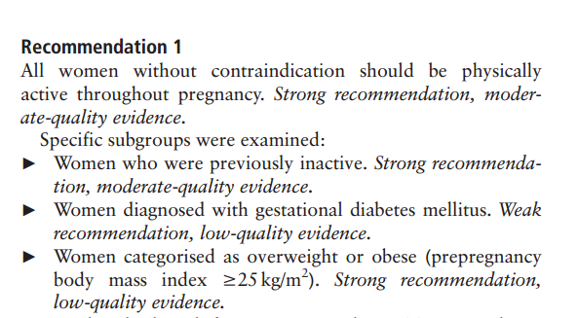
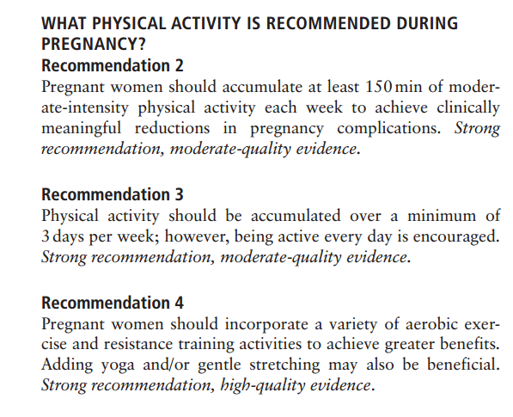

Slide 17
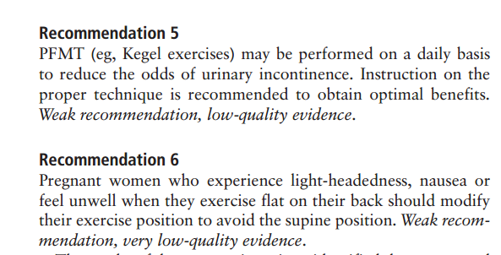

Slide 18
Is there an explicit link between the recommendations and the
supporting evidence?
  References for supporting evidence for each recommendation are mentioned and easily identifiable for the user.
Score- 6

Slide 19
Has the guideline been externally reviewed by experts prior to its
publication?
  Yes
  reviewed by the Society of Obstetricians and Gynaecologists of Canada’s (SOGC) Maternal Fetal Medicine and Guideline Management and Oversight Committees, and approved by the Board of the SOGC and the Board of Directors of the Canadian Society for Exercise Physiology (CSEP)
Score- 7

Slide 20
Is there a provision for updating the guideline?
  Planned for update every 10 years or if any significant data arises
Score- 5

Slide 21
Domain 4. Clarity of Presentation
Are the recommendations specific and unambiguous?
  Yes , its clear
  Large Exclusion Criteria – would have liked guidelines for some sub groups
  Mentioned to be decided by the local obstetrician
Score- 5

Slide 22
Are the different options for management of the condition or health issue clearly presented?
  Yes
  Descibes the types of exercise and also based on baseline physical activity
Score- 6

Slide 23
Were the key recommendations easily identifiable?
  Yes
  Summary given.
  Key message is the shifting of view of prenatal physical activity from a recommended behaviour to improve quality of life, to a specific prescription for physical activity to reduce pregnancy complications and optimise health across the lifespan of two generations
Score- 7

Slide 24
Domain 5. Applicability
Does the guideline describes facilitators and barriers to its application ?
  Not mentioned
  Implementation strategies not mentioned
Score-3
Notes:
• identification of the types of facilitators and barriers that were considered
• methods by which information regarding the facilitators and barriers to implementing recommendations were
sought (e.g., feedback from key stakeholders, pilot testing of guidelines before widespread implementation)
• information/description of the types of facilitators and barriers that emerged from the inquiry (e.g.,
practitioners have the skills to deliver the recommended care, sufficient equipment is not available to ensure all
eligible members of the population receive mammography)
• description of how the information influenced the guideline development process and/or formation of the
recommendations

Slide 25
Does the guideline provide advice and/or tools on how the recommendations can be put into practice?
  Guidelines summary mentioned.
  No Flow diagram.
  No manuals on techniques of exercise
  No pilot test done.
  Simple guidelines that can be followed
Score- 5.

Slide 26
Have the potential resource implications of applying the recommendations have been considered?
  No Costs for implementing the intervention
  Costs of implementation – not mentioned
Score- 3
Notes:
• identification of the types of cost information that were considered (e.g., economic evaluations, drug
acquisition costs)
• methods by which the cost information was sought (e.g., a health economist was part of the guideline
development panel, use of health technology assessments for specific drugs, etc.)
• information/description of the cost information that emerged from the inquiry (e.g., specific drug acquisition
costs per treatment course)
• description of how the information gathered was used to inform the guideline development process and/or
formation of the recommendation

Slide 27
Does the guideline present monitoring and/or auditing criteria?
  Not mentioned
Score- 2
Notes:
dentification of criteria to assess guideline implementation or adherence to recommendations
• criteria for assessing impact of implementing the recommendations
• advice on the frequency and interval of measurement
• descriptions or operational definitions of how the criteria should be measured

Slide 28
Domain 6. Editorial Independence
Has the views of the funding body influenced the content of the guideline?
  Funding : Knowledge Synthesis Grant from the Canadian Institutes of Health
  Research.
  MHD ( First Author) is funded by an Advancing Women’s Heart Health Initiative
Score- 7

Slide 29
Has competing interests of guideline development group members been recorded and addressed?
  Competing interests : None declared
Score- 7

Slide 30
RATE THE OVERALL QUALITY OF THE GUIDELINE
I would recommend the guidelines with modifications.
Include some recommendations for atleast some common relative contraindicatios( As subgroups)

Slide 31
Thank You

