Slide 1
Critical Appraisal of a Qualitative Study
Anil Mathew Philip

Slide 2
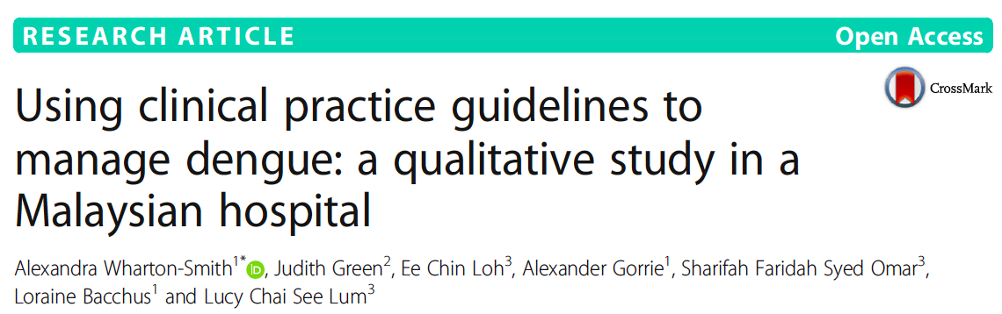

Slide 3
Background
Dengue is estimated to pose a risk to half of the world’s population
Approximately 390 million infections per year globally, incidence and severity rising sharply over the last 50 years
Key to improving dengue management is the better utilisation of evidence-based Clinical Practice Guidelines (CPGs). Developed by the World Health Organization (WHO)

Slide 4
Aim
To assess what happens in practice and if there is knowledge and adherence to CPG’s

Slide 5
Study Design
Population: Medical officers with atleast 2 years of experience in a tertiary care hospital in Malaysia – stratified by year if post- graduate training
Outcome: To identify the barriers in preventing use of CPG’s in the management of Dengue case management
Design: Qualitative study with semi structures interviews and focus group discussions

Slide 6
Validity Criteria
Was the choice of participants explicit and comprehensive?
Yes, Medical Officers were purposively sampled across the Emergency, Primary Care Clinic and Medical departments and stratified by their year of the post-graduate program(1, 2, 3 or 4)
This was the population of doctors treating Dengue patients in this hospital

Slide 7
Was data collection sufficiently comprehensive and detailed?
FGD was done in stratified groups according to maintain homogeneity.
Additional 14 medical officers were interviewed individually with a semi-structured interview.

Slide 8
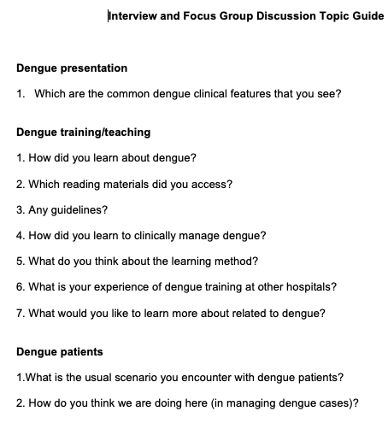

Slide 9
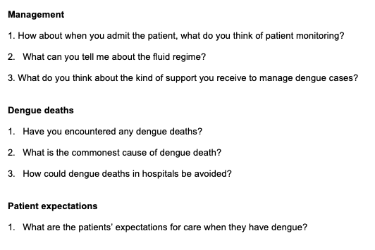
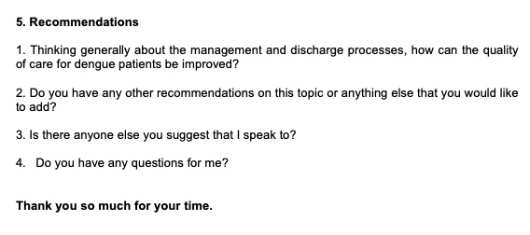

Slide 10
Were the data analyzed appropriately and the findings corroborated adequately?
Data was analysed using modified thematic content analysis using deductive analysis and inductive analysis.
Deductive analysis- initial coding frame based on the topic guide
Inductive analysis- line by line interrogation/open coding using techniques from constant comparative methods

Slide 11
Study Results
What are the results of the study?
Knowledge of Dengue Presentation and diagnosis: As the experience of the MO increased they became more confident with relevant history and of the different presentations of the disease.
Across the years experience with complications and death was present but more senior MO were more competent in addressing complications with standard protocols.

Slide 12
Familiarity with guidelines:
Two CPG were commonly used, the WHO and MOH guidelines.
Year 1 and 2 MO expressed more familiarity with WHO guidelines
Year 3 and 4 MO reported using both guidelines
Year 4 MO had a more patient to patient approach using guidelines as a basis
There was also reports of local fixed regimens for fluids in local centres

Slide 13
Barriers to effective management:
Lack of public understanding
Poor diagnosis and management at a Primary care level
Poor referral and communication pathways within the hospital

Slide 14
Applicability to Patient Care
Does the study offer helpful theoretical conclusions?
Yes, the use of WHO and MOH guidelines can improve dengue case management which is hampered by the use of local fixed regimens for fluid management.
Training programs should advocate atleast the less experienced MO’s to follow the CPG.

Slide 15
Does the study help me understand the context of my practice?
Yes, especially with less experienced MO’s, the use of CPG’s will improve detection rate and initial fluid management of these patients.
With experience using the CPG you can be more flexible with guidelines on a patient to patient basis

