Slide 1
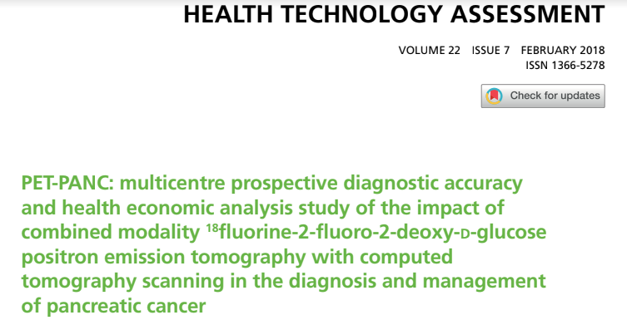
Critical Appraisal of Economic Study
Jasper Rathinam J

Slide 2
Background
Pancreatic cancer is one of the major causes of cancer death.
The 5-year survival rate for all patients with pancreatic cancer persists at 7%.
The 5-year survival rate is 10–15% following surgical resection and increases to 20–30%with adjuvant chemotherapy.
Standard Diagnostic Methods - Multidetector computed tomography (MDCT), endoluminal ultrasound (EUS) and magnetic resonance imaging (MRI) for equivocal liver lesions.
There are up to 10–20% of patients in whom an accurate diagnosis is difficult.
The use of PET/CT may add further value to the diagnosis and staging of pancreatic cancer.

Slide 3
PICOT
Patients : With suspected pancreatic malignancy
I : Addition of PET CT to Diagnostic and staging
C : Data excluding PET CT
Outcome : Impprovement of disgnostic Efficacy – Primary
Secondary : Cost effectivity of intervention
Time Period : 1 year

Slide 4
Objectives
The primary objective : to determine the incremental diagnostic accuracy and impact of PET/CT in addition to standard diagnostic work-up in patients with suspected pancreatic cancer.
Secondary objectives :
(1) to evaluate changes in diagnosis, staging and patient management through the addition of PET/CT
(2) to determine the cost-effectiveness of the addition of PET/CT in the diagnosis, staging and management of pancreatic cancer
(3) evaluate the impact of PET/CT in chronic pancreatitis
(4) identify which groups of patients would most benefit from PET/CT
(5) report the incremental diagnostic value of PET/CT for particular types of pancreatic tumour.

Slide 5
Methods – Study Design
This study was a multicentre prospective diagnostic accuracy and clinical value study of PET/CT in suspected pancreatic malignancy.
Following standard diagnosis and staging with MDCT, eligible patients underwent PET/CT within 2 weeks of informed consent. All PET/CT scans were centrally reviewed.
Setting : The study took place in 18 UK pancreatic tertiary referral centres.

Slide 6
Methods – Study Design
Diagnosis, staging and planned management were recorded
D1 - before PETCT
D2 after PET/CT.
Actual diagnosis, staging and management were then recorded (D3).
The reference standard (D4) was based on histology or clinical outcome after 12 months’ follow-up.

Slide 7
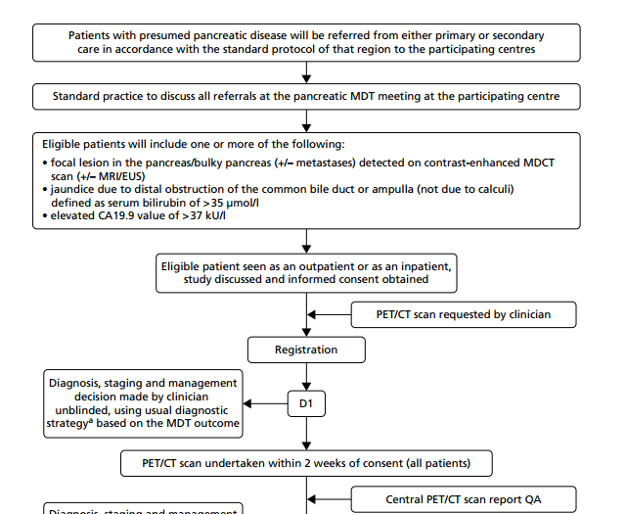

Slide 8
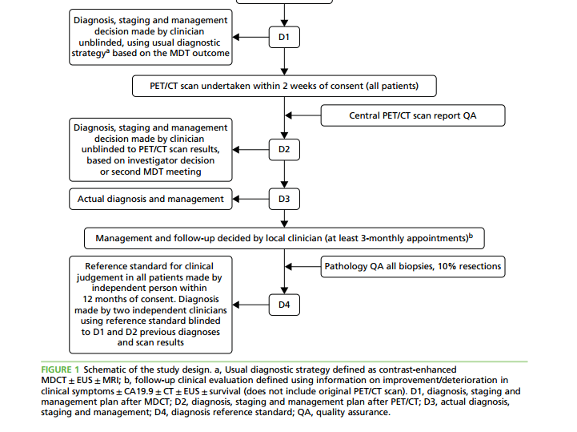

Slide 9
Participants – Inclusion Criteria
Patients with suspected pancreatic malignancy defined as one or more of
(1) focal lesion in the pancreas/ bulky pancreas/dilated pancreatic duct (± metastases) detected on MDCT scan (± MRI/EUS/ultrasound)
(2) jaundice due to distal obstruction (not due to calculi) defined as serum bilirubin > 35 μmol/l
(3) serum carbohydrate antigen 19-9 (CA19.9) > 37 kU/l.
2. Able to attend for PET/CT scan.
3. Able to undergo MDCT scan.
4. Able to attend for 12 months of follow-up.
5. Fully informed written consent given.

Slide 10
Exclusion Criteria
Patients aged < 18 years.
Pregnancy.
Patients with poorly controlled diabetes.

Slide 11
Sample Size Calculation
A previous meta-analysis reported a sensitivity of 81% and specificity of 66% for the diagnosis of pancreatic cancer with standard MDCT.
The primary objective of this study was to investigate the incremental value of PET/CT. To be of clinical value to the diagnostic work-up the addition of PET/CT should increase sensitivity from 81% to 90% and specificity from 66% to 80%.
Using methodology for a paired design, the number of diseased and non-diseased subjects required to have 80% power to detect these differences at the 5% (two-sided) significance level
To ensure adequate power, the largest of these 600 pancreatic cancer patients was the initial target for recruitment.
An interim analysis was carried out after 200 patients were recruited and the reference standard obtained.
The sample size was then revised down to 500 patients.

Slide 12
Statistical Methods
Diagnostic accuracy was investigated by comparing the baseline diagnosis (D1) and the results of the PET/CT scan(D2) with the reference diagnosis (D4)
Diagnostic impact was investigated by comparing the baseline (D1) and post (D2) PET/CT diagnoses with the reference diagnosis (D4).
The diagnostic impact of standard work-up was estimated by comparing diagnostic decisions made at D1 with the reference diagnosis made at D4 and expressing as sensitivities and specificities together with 95% confidence intervals (CI)
To evaluate the accuracy of staging by standard work-up the analysis was restricted to individuals with pancreatic malignancy diagnosed at the reference diagnosis.
The accuracy of the revised diagnoses made after PET/CT was assessed in the same way making comparisons between diagnostic and staging decisions made at D2 and the final reference diagnosis.

Slide 13
Economic Analysis
Cost-effectiveness analysis was in three parts:
Model 1, in which we calculated the marginal cost per additional correct diagnosis of pancreatic ductal adenocarcinoma (PDAC) using PET/CT and CT alone
Model 2, in which we calculated the budget impact of use of PET/CT
Model 3, in which we modelled the change in management of patients as a result of use of PET/CT in diagnosis over a 1-year time horizon.

Slide 14
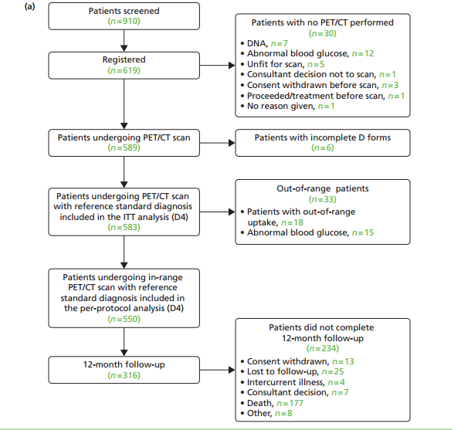
What were the results ?

Slide 15
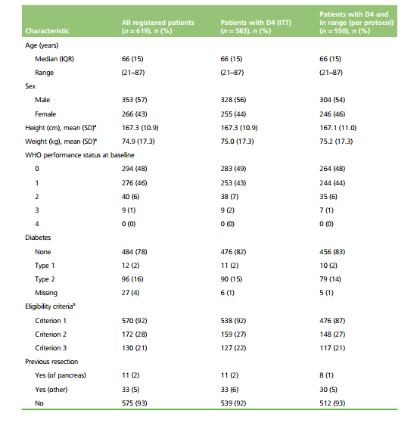
Baseline Characters

Slide 16
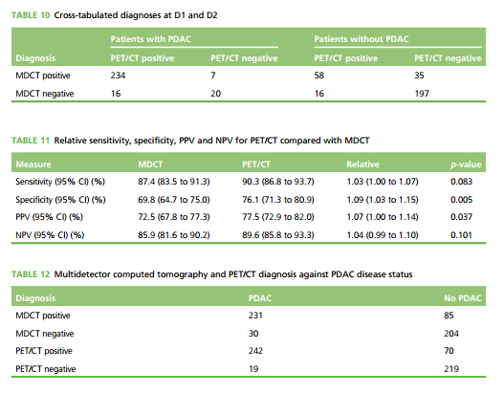

Slide 17
Economic Analysis – Model 1
The PET-PANC study has shown that CT (D1) had a sensitivity of 87.4% and a specificity of 69.8%, with a diagnostic accuracy of 78.2% for the 583 ITT patients.
PET/CT (D2) had a sensitivity of 90.3% and a specificity of 76.1%, with an overall diagnostic accuracy of 82.8%. The increased accuracy corresponds to an additional 27 correct diagnoses, corresponding to an increment of 5.9% (100 × 27/456) in accuracy rate.
The incremental cost per additional accurate diagnosis was £15,309 (95%CI £15,072 to £15,460) corresponding to £69,810 (95% CI £68,727 to £70,499) per additional percentage gained in diagnostic accuracy rate.

Slide 18
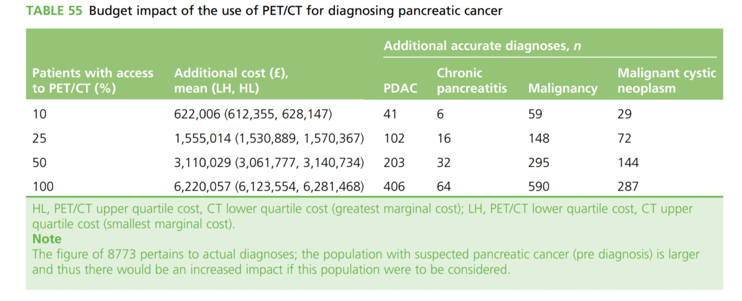
Economic Analysis- Model 2

Slide 19
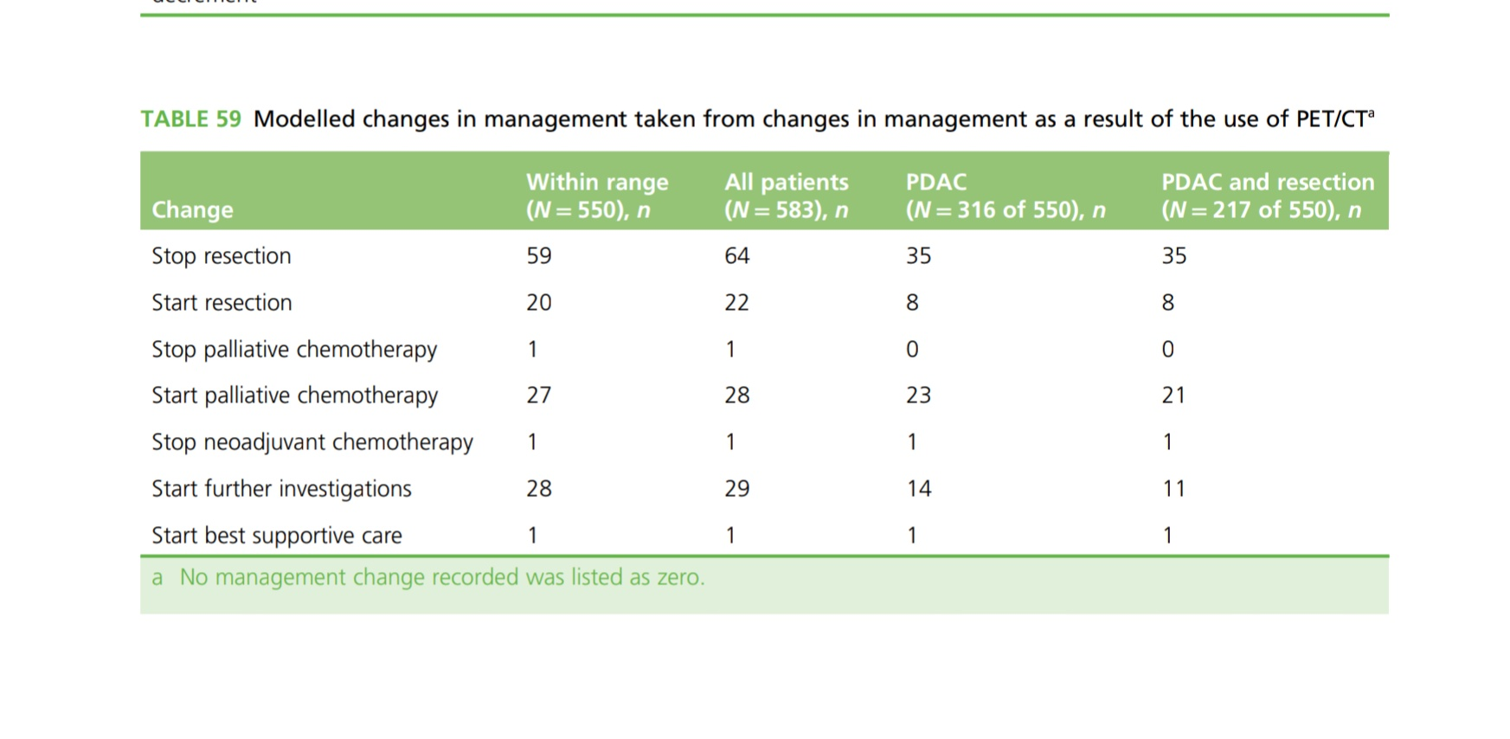
Economic Analysis

Slide 20
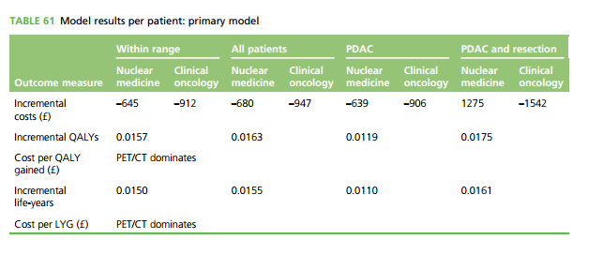
Economic Analysis – Model 3

Slide 21
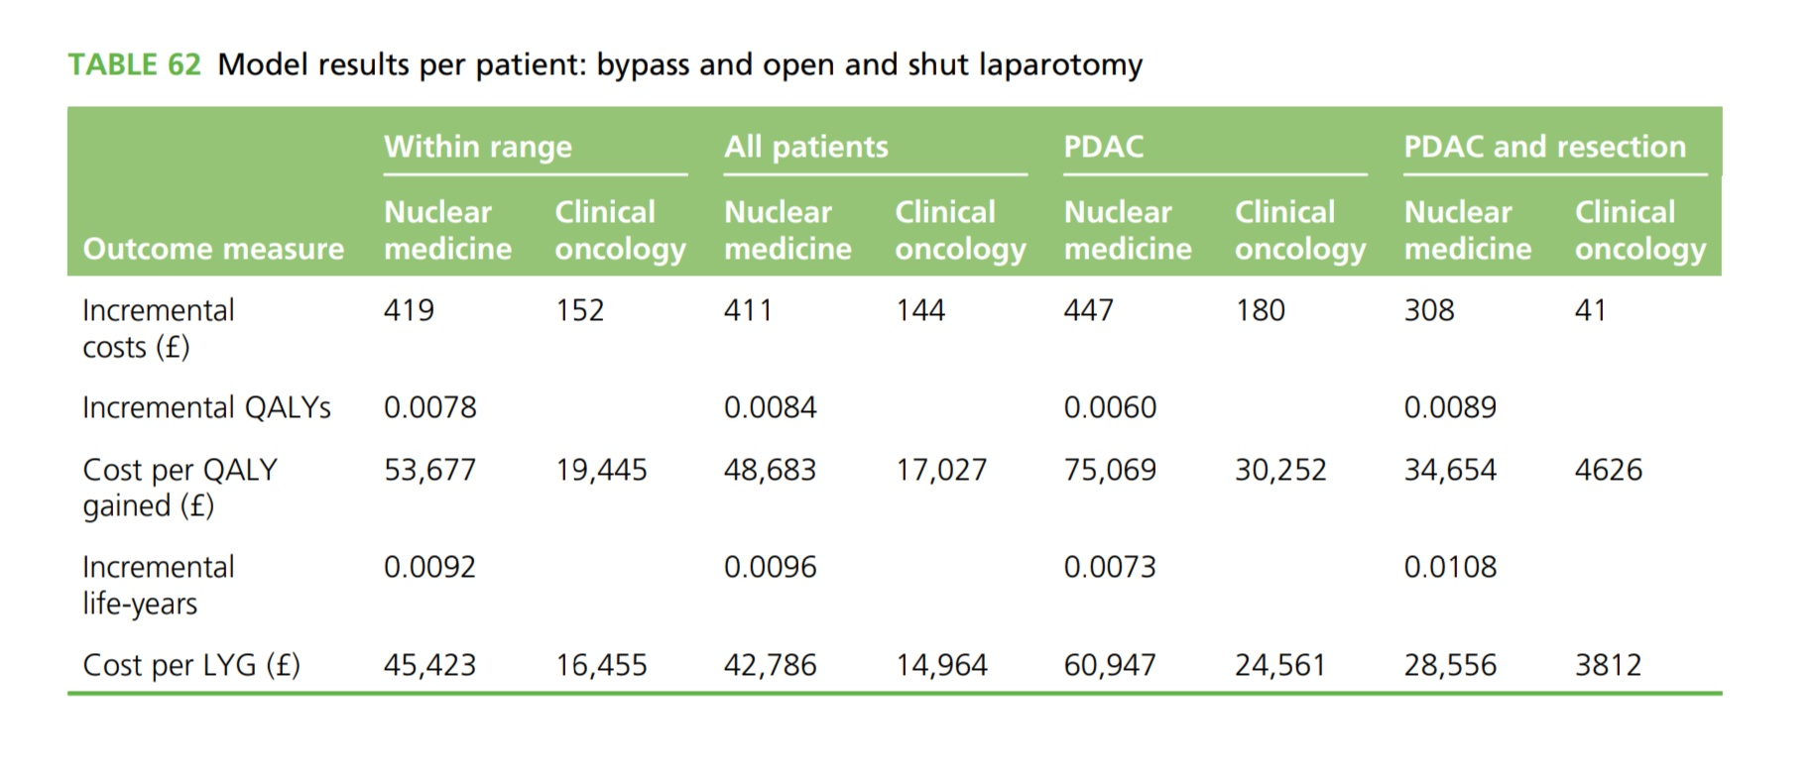
Economic Analysis – Model 3

Slide 22
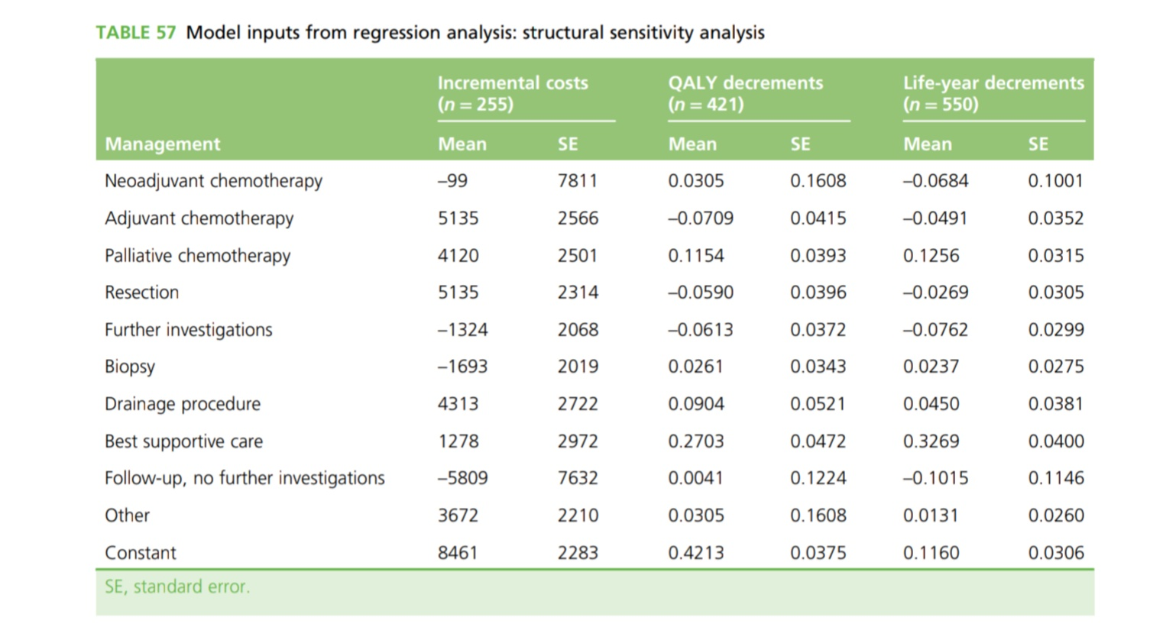
Economic Analysis

Slide 23
Are the results valid?
Did the recommendations include all patient relevant groups, management options and possible outcomes?
  Did they adopt a sufficiently broad point of view?
    Yes
    All suspected patients included
    All possible outcomes were looked at
    Multiple models of cost analysis was done

Slide 24
Are the results reported separately for different patient groups?
  Yes, specific different patient group was estimated.
  Results for those who had pancreatic cancer and those who didn’t were looked at

Slide 25
Is there a systematic review and summary of evidence linking options to outcomes for each relevant question?
Yes.

Slide 26
Were costs measured accurately?
  Yes
  Estimated costs obtained from CSRI - Client Service Receipt Inventory; - Under the NIH , and from the Department of Health
  Breakdown and detailed breakdown was given
Did investigators consider the timing of costs and consequences?
  Yes
  Patients were followed by till 1 years.
  Both costs and health were discounted at a rate of 3.5% per annum as recommend by the National Institute for Health and Care Excellence (NICE).

Slide 27
What are the results?
What are the incremental costs and effects of each strategy?
  For within-range patients the incremental cost of PET/CT was estimated as being £419 (95% CI
  –£138 to £930) for nuclear medicine and £152 (95% CI –£399 to £688) - for clinical oncology
  For nuclear medicine costs:
  the ICERs were £53,677 per QALY gained and £45,423 per LYG. Based on the upper end of the NICE
  threshold, £30,000 per QALY, these estimates suggest that PET/CT is not cost-effective.
  Using clinical oncology costs within the model, for within-range patients the ICERs were
  £19,445 per QALY and £16,455 per LYG, which are borderline cost-effective at the lower NICE threshold
  of £20,000 per QALY and cost-effective at the upper end of the NICE threshold.
  Do incremental costs and effects differ between subgroups?
  Yes and mentioned.

Slide 28
How can I apply the results to patient care?
Are the treatment benefits worth the risks and costs?
  Yes
  Cost per QALY gained= <20,000 £
  And had actually decremental costs in primary analysis
Can I expect similar costs in my setting?
  Yes.

Slide 29
Thank You

