Slide 1
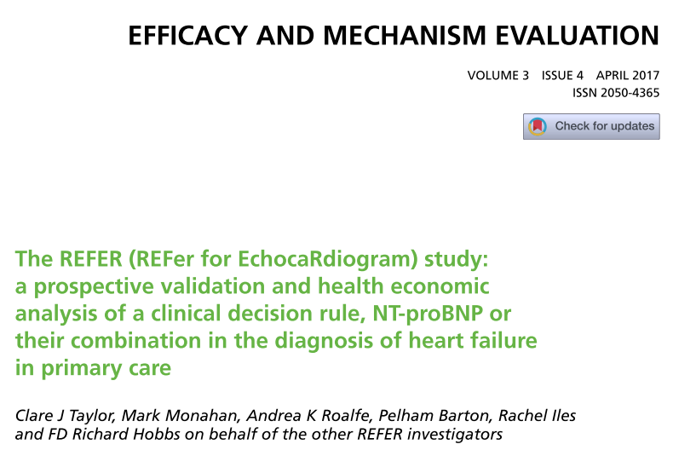

Slide 2
Objective
The REFER trial was a prospective, observational, diagnostic validation study of the MICE CDR – with natriuretic peptide testing – for diagnosing heart failure in primary care.

Slide 3
P- patients aged ≥ 55 years presenting with recent new-onset shortness of breath, lethargy or peripheral ankle edema of > 48 hours’ duration for which there was no other obvious cause.
Index test- MICE CDR – with natriuretic peptide test
Reference Standard – Expert consensus panel of three cardiology specialists, who reviewed each case blinded to the assessments by other panel members. The ESC 2012 guideline was used to define heart failure.
Diagnostic validation.
May 2011 and was completed on 31 August 2013
Notes:
The reference standard was an expert consensus panel of three cardiology specialists, who reviewed each case blinded to the assessments by other panel members. The ESC 2012 guideline was used to define heart failure.
The MICE rule comprised four clinical elements – Male, history of myocardial Infarction, Crepitations at the lung bases and oEdema – and was combined with natriuretic peptide levels to identify those likely to have heart failure and who should be referred for further diagnostic testing. The elements of the CDR are shown in Box 1.

Slide 4
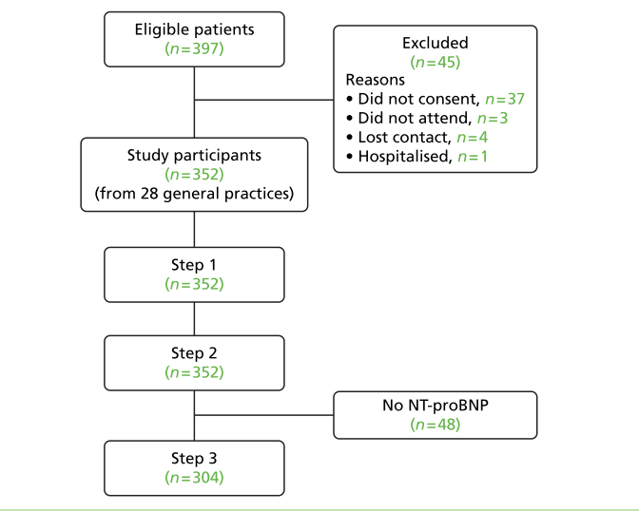
Notes:
May 2011 and was completed on 31 August 2013. Participants were recruited from a random sample of 28 general practices in central England, stratified by practice list size and deprivation quartile.
At step 1 the clinical assessment (excluding the MICE variables) and ECG and echocardiogram findings were presented.
At step 2 the CDR components (male, history of myocardial infarction, crepitations and oedema) were added and,
finally, at step 3 the NT-proBNP result was included.

Slide 5
How serious is the risk of bias?
Did participating patients constitute a representative sample of those presenting with a diagnostic dilemma?
Yes

Slide 6
Did investigators compare the test to an appropriate, independent reference standard?
NT Pro BNP was part of the consensus.

Slide 7
Were those interpreting the test and reference standard blind to the other results?
Yes
Notes:
Readers reviewed (1) 2D images or (2) 2D + DBT or (3) synthetic 2D + DBT images for any one case and did not review any cases from their own centre. Cases were read on a workstation without access to the original screening mammograms or prior examinations. Readers were blinded to the outcome status of each case and read cases independently of all other readers.
For the 2D-only arm, the location of any suspicious abnormality in the breast was recorded on a nine-square grid on the data collection proforma (see Appendix 11). Suspicion was scored on a five-point scale85
and a decision to recall or not was recorded.

Slide 8
Did all patients receive the same reference standard irrespective of the results of the test results?
Yes

Slide 9
What are the results?
What likelihood ratios were associated with the range of possible test results?

Slide 10
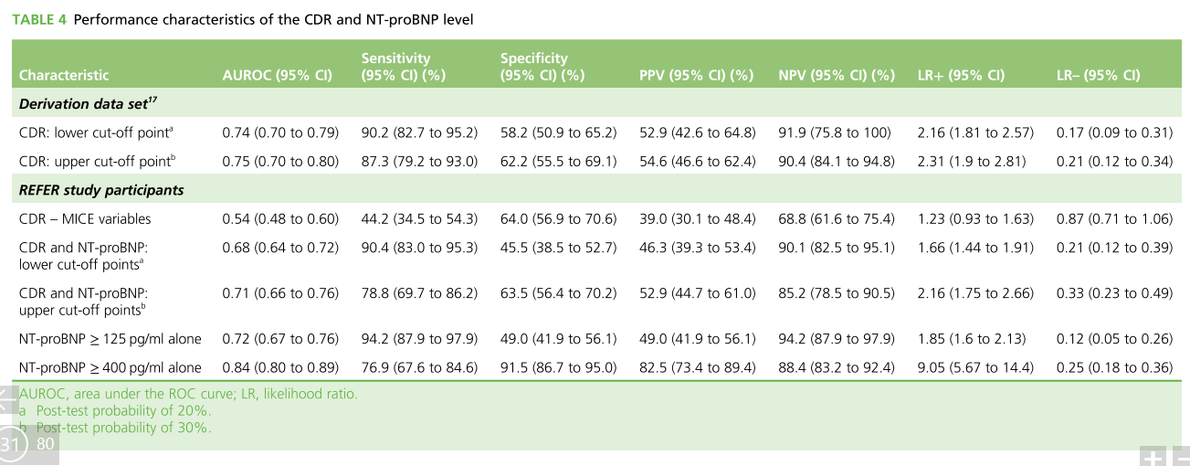

Slide 11
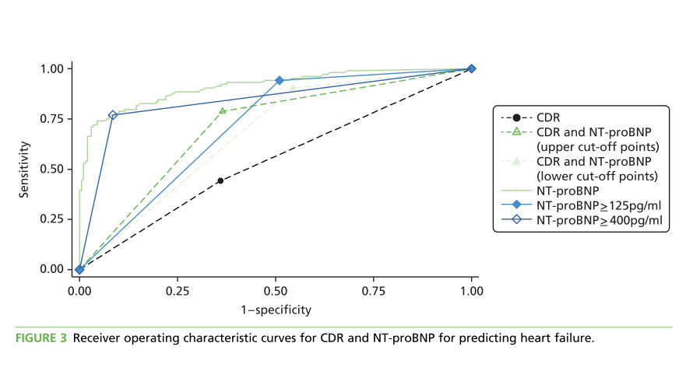

Slide 12
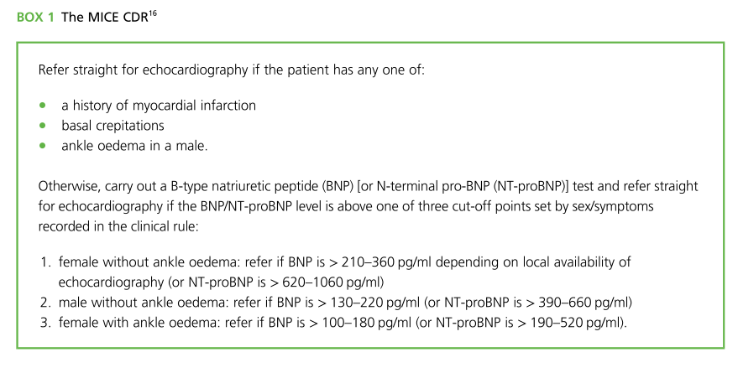

Slide 13
Are the recommendations valid?
Did the recommendations consider all relevant patient groups, management options, and possible outcomes?
Yes
Notes:
The study population was primary care patients aged ≥ 55 years presenting with recent new-onset shortness of breath, lethargy or peripheral ankle oedema of > 48 hours’ duration for which there was no other obvious cause.

Slide 14
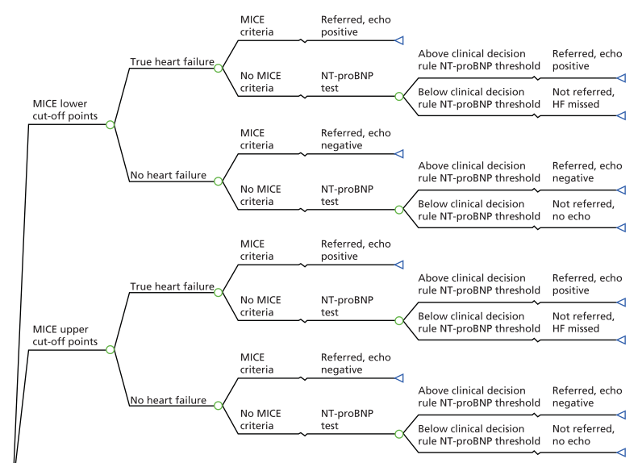

Slide 15
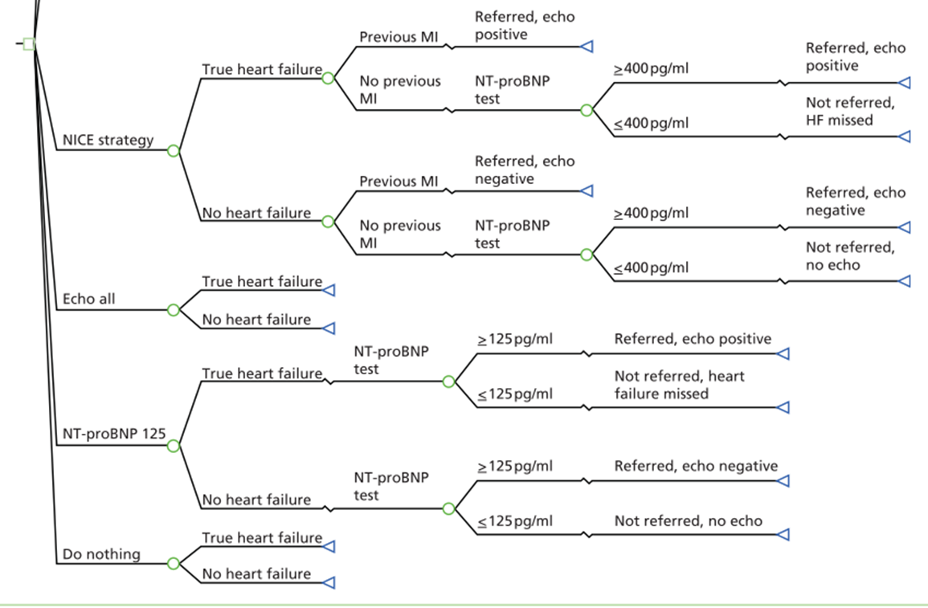

Slide 16
Are there systematic reviews of evidence that estimate the relative impact of management options on relevant outcomes?
Yes
Notes:
Clinical decision rules (CDRs) may help clinicians to assess the probability that a patient has a particular condition.
The ‘MICE’ CDR was developed from an individual patient database meta-analysis of all (n = 11) prospective epidemiological studies of heart failure screening in primary care, which was commissioned as a health technology assessment by the National Institute for Health and Care Excellence (NICE). The CDR comprised four clinical elements – Male, history of myocardial Infarction, Crepitations at the lung bases and oEdema – and was combined with natriuretic peptide levels to identify those likely to have heart failure and who should be referred for further diagnostic testing.

Slide 17
Is there an appropriate specification of values and preferences associated with each of the outcomes?
Effects of early heart failure diagnosis
Effects of delayed heart failure diagnosis
Treatment effects on mortality
Early heart failure treatment effect on hospital admissions
Notes:
Effects of early heart failure diagnosis
The initiation of heart failure treatment after correct early detection was assumed to have a survival benefit for the heart failure patient compared with a missed heart failure diagnosis.
Effects of delayed heart failure diagnosis
We assumed that the delayed diagnosis patients had the same prognosis as untreated patients for the first 6 months. After 6 months, the delayed diagnosis patients were put on treatment and thereafter had the same survival probability as someone who was already on treatment.
Treatment effects on mortality- Next slide has the picture
Early heart failure treatment effect on hospital admissions
The early detection of heart failure also has the benefit of a reduction in hospitalisations. Patients on beta-blockers compared with placebo have a hazard ratio of 0.71 (95% CI 0.65 to 0.77) for first heart failure-related hospital admission. Similarly, treatment with ACE inhibitors reduces the likelihood of a hospital admission, with an odds ratio of 0.67 (95% CI 0.61 to 0.74)

Slide 18
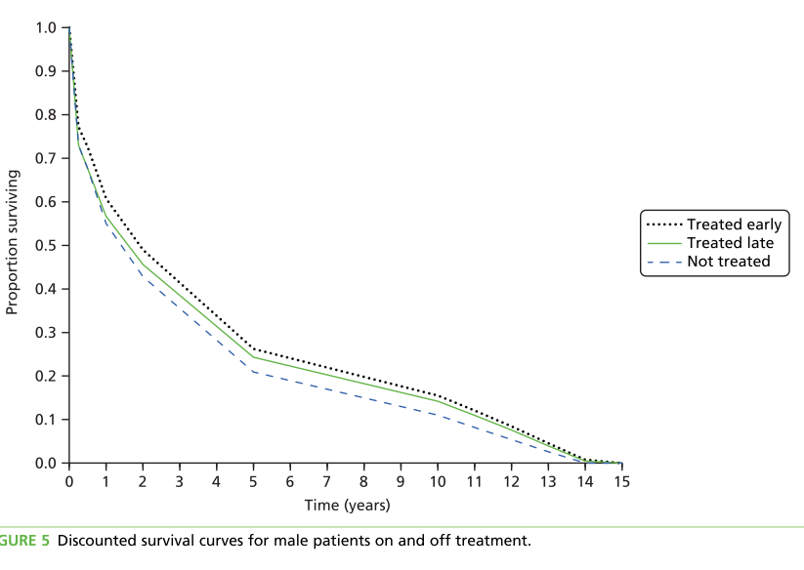
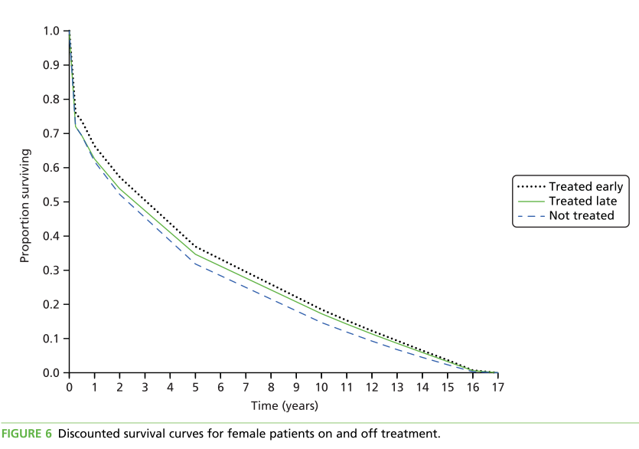

Slide 19
Do the authors indicate the strength of their recommendations?
No

Slide 20
What are the results?
What are the key recommendations?
NICE for the diagnosis of heart failure is appropriate, that is, patients presenting with symptoms suggestive of heart failure should be referred straight for echocardiography if they have a history of myocardial infarction or if their NT-proBNP level is ≥ 400 pg/ml.
Notes:
Overall, this analysis provides evidence based on primary data that the current strategy recommended by NICE for the diagnosis of heart failure is appropriate, that is, patients presenting with symptoms suggestive of heart failure should be referred straight for echocardiography if they have a history of myocardial infarction or if their NT-proBNP level is ≥ 400 pg/ml. However, based on sensitivity analysis, as the proportion of patients with HFREF increases from the 12% seen in the REFER study, it becomes more cost-effective to change the NT-proBNP threshold from 400 pg/ml to 125 pg/ml.

Slide 21
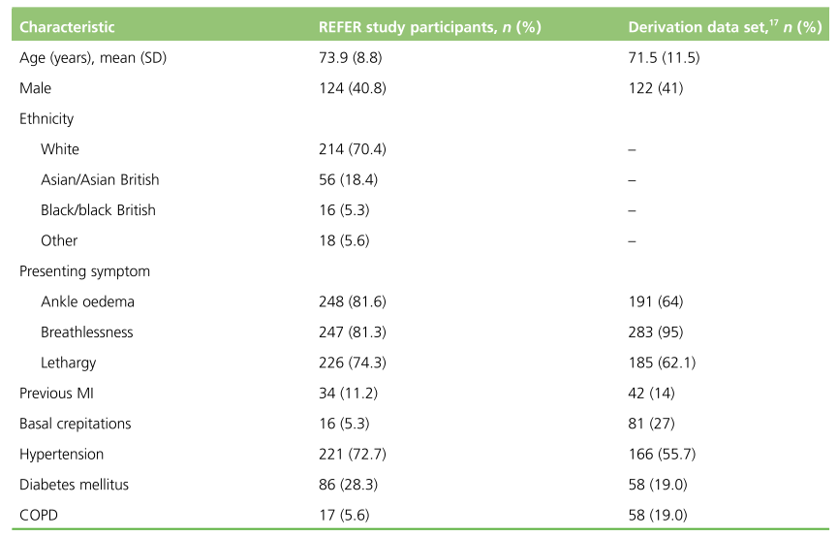
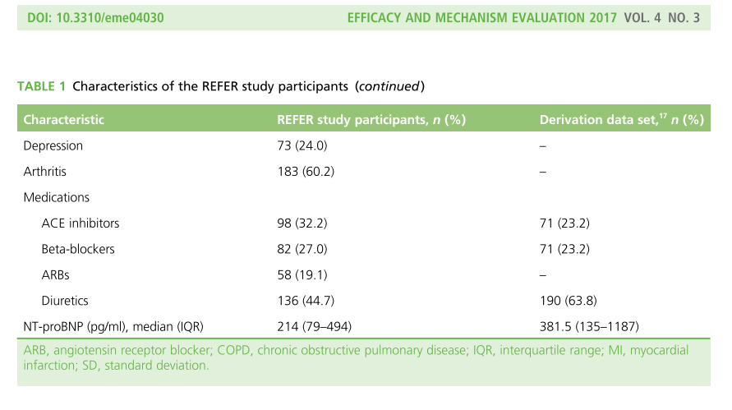
Will the recommendations help you in caring for your patients?
Do the recommendations make sense in your practice setting?
Notes:
Overall, this analysis provides evidence based on primary data that the current strategy recommended by NICE for the diagnosis of heart failure is appropriate, that is, patients presenting with symptoms suggestive of heart failure should be referred straight for echocardiography if they have a history of myocardial infarction or if their NT-proBNP level is ≥ 400 pg/ml. However, based on sensitivity analysis, as the proportion of patients with HFREF increases from the 12% seen in the REFER study, it becomes more cost-effective to change the NT-proBNP threshold from 400 pg/ml to 125 pg/ml.

